Slide 1
5. Tech and infrastructure

Slide 2

Overall tool design: elements underpinning priceAdvisor
5A
Customer Segmentation
& Information
Price Book (List)
Freight Lookups
Package Cost Lookups
Commission Rates
👤
📘
🚚
📦
$
1. Master data
Customer ID
Ship-to
Segment / metadata
Book prices
Target prices
By product/customer
Freight adders
By package type /
distance
Package adders
By package type
Rep commission logic
Quota attainment
mapping
Reference tables
(System of record)
Source: CRM
Source: Existing, Expanded
Source: Existing, Expanded
Source: Existing, Expanded
Source: Existing, Reformat
Similar Deal & Guidance Logic
Deal Score Logic
Approval Thresholds
Approvals Mapping
📊
◉
🛡
👥
Compare to past deals
Peer price benchmarks
Pricing guidance
Scores basket based on
discount % vs. target
and floor prices
Required approval level
by deal score and size
Map approval level to
specific approvers
(roles / people)
2. Decision logic
Business rule engines
Status: New
Status: New
Status: New
Source: CRM
Opportunity / Quote in CRM
Approval Workflow
Approved / Rejected / Revised
📝
⟳
📄
Pulls customer, price, and cost data
Runs guidance and scoring logic
Shows commission impact
Generates recommended quote
Routes using threshold
+ approver mapping
Approvers review and act
Status returned to CRM
Full audit trail on record
3. CRM workflow
(Transactional layer)
User: Sales Rep
Users: Approvers
User: Sales Rep & Approvers
Approved Quote
⛁
Microsoft Dynamics
ERP / F&O
Order Fulfillment
Final approved pricing written to CRM
Sent downstream to ERP / F&O for order and fulfillment
4. Downstream
(Integration layer)
Destination: ERP / F&O

Slide 3
PRICEADVISOR WILL BE BUILT AS A CUSTOM REACT APPLICATION EMBEDDED IN DYNAMICS This approach best supports the required user experience, real-time pricing logic, and long-term extensibility, with higher but manageable delivery and sustainment effort
2026-04-15 09:50 (-4) HW: I consolidated the information from the “A-B-C options” pages to here (but only for the customer web app (C)
5B
Solution Design | Business and Functional Advantages | Resourcing and Sustainment Model
React frontend embedded in Dynamics via iFrame / web resource Backend services call Dataverse and ERP through secured APIs Admin tables and approval queues remain managed in Dynamics Supports modular business logic beyond native CRM limitations | Enables the required user experience and interaction flexibility Supports real-time pricing logic and modular backend services Allows richer workflows and visualizations than native Dynamics Provides the strongest platform for long-term pricing capability build-out | Team / skills Front-end + full-stack development capability React frontend, backend/API development, Dynamics integration DevOps / app support capability needed for deployment and maintenance Indicative sustainment Back-end data engineering / analytics: 1.0 FTE Front-end sustainment: 1.0 FTE Azure / compute cost: ~$20-40K incremental
Key Functionalities Supported
Real-time Pricing Guidance
Live recalculation of peer comparison guidance as prices are adjusted
Dynamic Deal Score Recalculation
Backend services support responsive scoring logic with fewer native CRM constraints
Advanced Visualizations
Rich UI and charting support beyond standard Dynamics components
Modular Margin / Pricing Services
Margin, scoring, and comparison logic can be reused across workflows

Slide 4
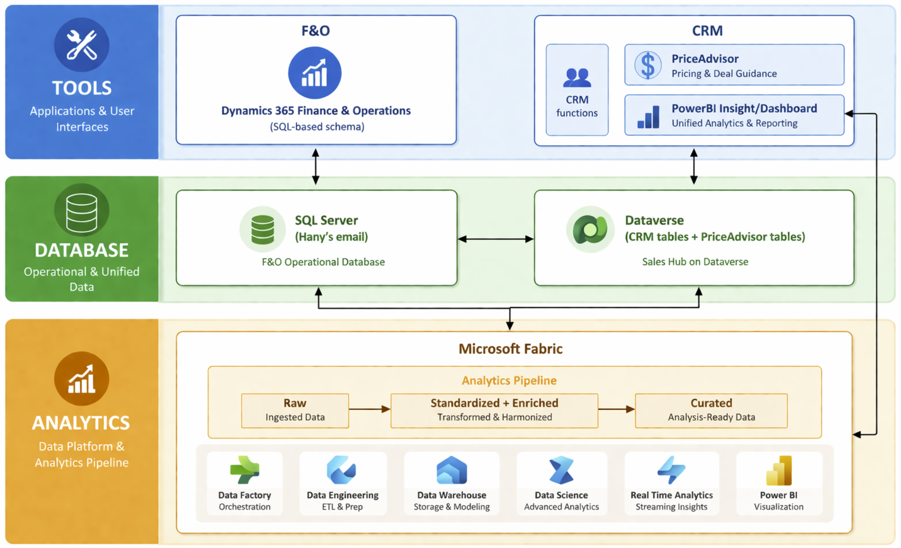
TARGET STATE ARCHITECTURE FOR PRICEADVISOR PriceAdvisor sits natively within CRM, with Dataverse and Microsoft Fabric supporting transaction data, analytics, and secure in-workflow access
5C
PriceAdvisor sits inside CRM, where sales teams already work, which keeps pricing guidance embedded in the quoting process rather than creating a separate tool or offline workflow
CRM Dataverse is extended database to support PriceAdivsor where transaction data and analysis output from the analytics platform are stored
Microsoft Fabric serves as the analytics platform. Allows performing advanced analytics by joining F&O and CRM data in a single "Lakehouse" without duplicating data or any ETL (Extract, Transform, Load) code
Authentication and access will be inherited from Dynamics 365 - when the user logs into Dynamics, their access and role-based permissions are carried through into the PriceAdvisor, React application, ensuring a seamless and secure experience without separate login.

Slide 5
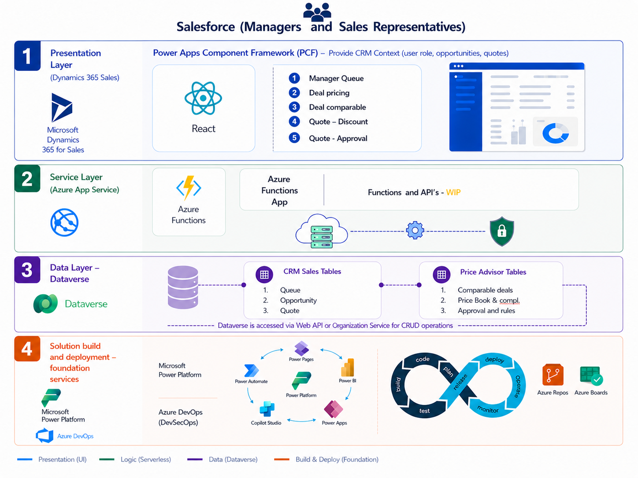



TARGET STATE ARCHITECTURE FOR PRICEADVISOR || deep-dive
5C
Presentation Layer (Dynamics 365 Sales) - React application integrated into the Dynamics 365 Sales interface using Power Apps Component Framework (PCF), a more modern approach:
The React app is packaged as a PCF Control, providing a native-like experience that can be bound to Dataverse fields or datasets.
Fluent UI library is used to ensure React components consistently match the Dynamics 365 Sales design system.
Logic Layer - Azure Functions act as a middle-tier "API Gateway" and serverless backend to handle complex business logic that should not reside in the client:
Authentication: The React app authenticates with the Function App using Microsoft Entra ID
Managed Identity: The Function App uses a Managed Identity to securely connect to Dataverse without storing client secrets.
Server-Side Execution: Logic such as complex calculations, external API calls, or high-volume data processing is offloaded to the Azure Function to prevent browser throttling.
Data Layer – Dataverse serves as the primary data store and the underlying engine for Dynamics 365 Sales:
Web API: The Azure Function interacts with Dataverse via the Dataverse Web API or the Organization Service for CRUD ops.
Tables: Standard Sales tables (e.g., Accounts, Opportunities) and Price Advisor custom tables are used to store the application's data
Build and deployment – Foundation Services
Azure DevOps: Key Services for Project & DevSecOps Management
Power Platform Apps: Packaging CRM integrated solutions and deployment to Dynamics 365 as well as automating approval workflows
Salesforce (Managers and Representatives)

Slide 6
Data tables: storage, Maintenance, and owners Tables will reside in the Dynamics Dataverse, owned by relevant business owners, and updated by IT/product teams.
5D
Table | Description | Current Status | Refresh approach / cadence | Pipeline code complexity | Potential business owner
Price Book (List) | Book and target prices for products in scope New structure vs. current price book | Already exists; will be expanded | Annually | High (direct from price book per product/customer) | Pricing team¹ maintains
Deal score logic | Logic to score baskets based on discount % relative to target and floor prices | Does not currently exist | Infrequent | Low (simple univariate scale) | Pricing team¹ maintains
Approvals thresholds | Map of approvals required by employee level based on deal score and size | Does not currently exist | Infrequent | Med | Pricing team¹ maintains
Approvals mapping | Map of specific employees required to give approval | Already exists in CRM | Manually when CRM approvers change (promotion / exit / etc.) | Low (direct from CRM) | Pricing team¹/HR maintains
Customer Master | Customer metadata on IDs, ship-to locations, segmentation (A-D), etc. | Already exists in CRM; Needs to be accurate to support quoting | Maintained regularly in CRM | Low (direct from CRM) | Pricing team¹ and customer service
Similar deal and guidance logic (multiple tables) | Logic to produce “similar deals” based on comparison of bid baskets Logic to show how prices map vs. peers | Does not currently exist | Runs daily via automated pipeline on ERP + CRM data (most complex | High | Pricing team¹ maintains with IT support
Freight lookups | Freight “adder” based on package type/distance | Already exists (flat rate); will be expanded | Quarterly | Med | Freight working group
Package cost lookups | Package “adder” based on package type/cost | Already exists (flat rate); will be expanded | Quarterly | Med | Packaging working group
1. Roles currently under definition and to be finalized by Week 5 for hiring

Slide 7
Other nonfunctional parameters: Constraints, security, access, maintenance…
5E
Access and usability
Data refresh and latency
Tool will be accessible in CRM and usable on desktop and mobile
Experience will remain simple and responsive for reps and approvers
Data pipelines will run on a scheduled basis, at minimum weekly
Tool will clearly distinguish live workflow data from scheduled analytical outputs
Security and controls
Performance and supportability
Security:
The tool will inherit existing Dynamics / Dataverse role-based permissions
Users will only access records, actions, and approvals within their authorized scope
Control: Pricing and approval changes will maintain an auditable record
Core workflows will use native Dynamics workflows and in line with user expectations for Dynamics-based tools
The Solution avoids impacting source systems
Business rules and reference tables will be maintainable without rebuilding the tool

