Slide 1

ReSwift
Redux style unidirectional data flow
Amresh Kumar
Application Developer @ ThoughtWorks

Slide 2
Outline
Introduction to ReSwift Architecture
Problems with MVC
Different architectures and patterns
State management issues
Code Example
Notes:
Architecture
Step back to understand the problems
Code example

Slide 3
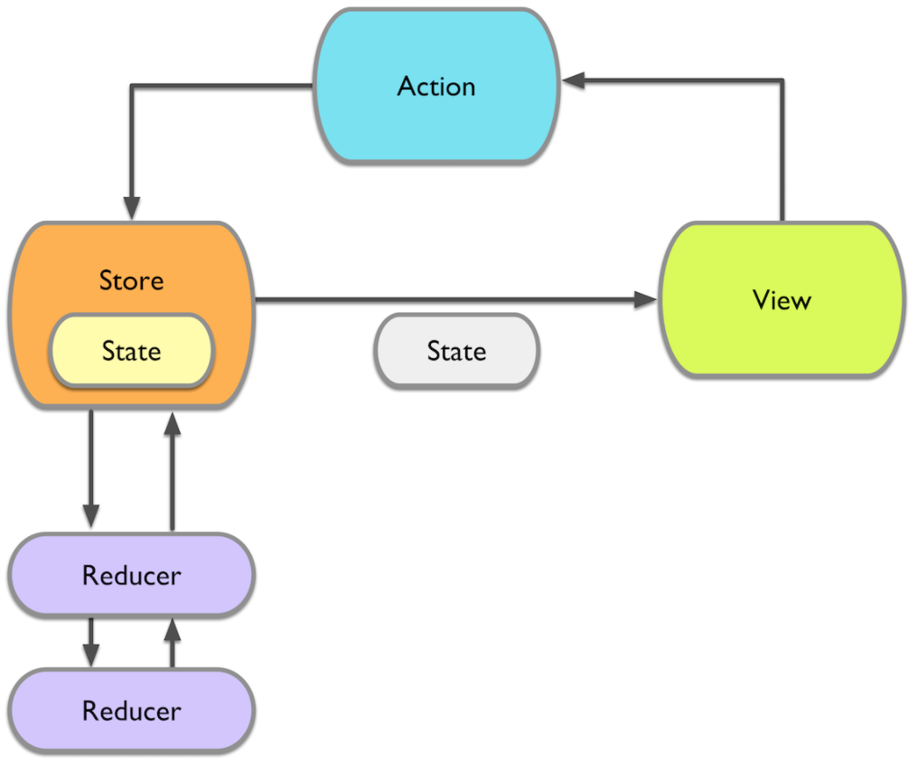
ReSwift Architecture
1
Notes:
Global store – one state, multiple sub-state
Flux had multiple stores, Redux has just one.

Slide 4

ReSwift Architecture
2
Notes:
View is just a skin on top of state
Make state, and actions testable

Slide 5
ReSwift Architecture
3
Notes:
Action is the only way to modify state
Multiple sub states can use - setup, reset actions

Slide 6
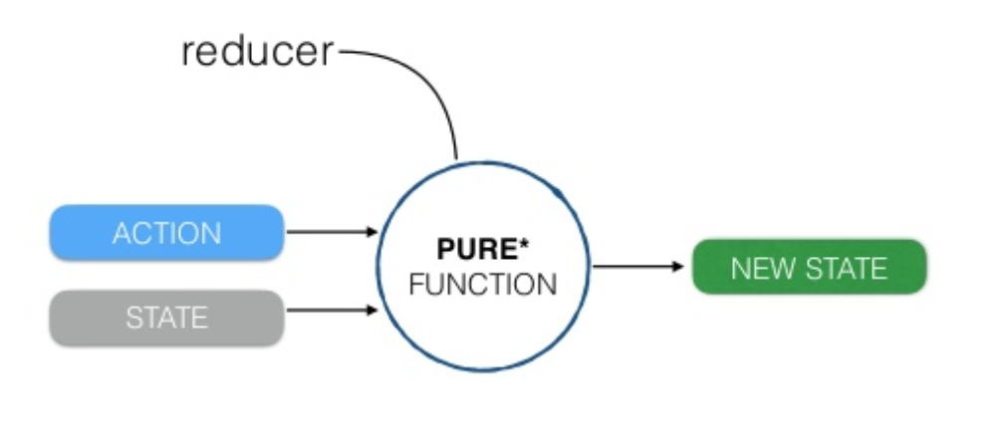
ReSwift Architecture
4
Notes:
Given an action and a state is produces a new state

Slide 7
The problem of
Massive View Controller

Slide 8
Responsibilities of a View Controller
Apple’s Documentation
managing your views
handling events
transitioning from one screen to another

Slide 9
Responsibilities of a View Controller
Interacting with Storyboards and Segues (7)
Managing Child View Controllers in a Custom Container (6)
Responding to View Events (8)
Adapting to Environment Changes (2)
Configuring Tab Bar Items (1)
Managing the View (5)
Coordinating with System Gesture Recognizers (3)
Presenting View Controllers (9)
Extending the View's Safe Area (2)
Configuring the View’s Layout Behavior (5)
Configuring Gestures (3)
Supporting App Extensions (1)
Managing the View's Margins (3)
Managing State Restoration (5)
Adjusting the Interface Style (3)
Configuring the View Rotation Settings (4)
Getting Other Related View Controllers (6)
Accessing the Available Key Commands (2)
Configuring a Navigation Interface (4)
Responding to Containment Events (2)
Managing the Status Bar (7)
Handling Memory Warnings (1)
Adding Editing Behaviors to Your View Controller (3)
Supporting Custom Transitions and Presentations (6)

Slide 10
Responsibilities of a View Controller ??
Flags – Bool/Enum
Properties that do not belong elsewhere
More ??

Slide 11
Recommendation
Clean separation of responsibilities.
Minimize view controller’s role in managing the actual data.
Notes:
Separation of responsibility is achieved by many architectures

Slide 12
Architectures
MVC, MVP, MVVM
VIPER

Slide 13
Architectures
MVC, MVP, MVVM
Generally - tight connection issues makes scalability and testing difficult.
VIPER

Slide 14
Architectures
MVC, MVP, MVVM
VIPER
More SOLID than any other architecture
also - More confusing than any other architecture
Google – “the good the bad and the ugly of viper”

Slide 15
Patterns in iOS
Delegation
Notification Center
KVO
Callback Blocks
Notes:
One to one
One to many
Any to any
Mix and match of everything in a code base

Slide 16
State management
State can be messy - especially when you have lot of user interactions.
Notes:
Let’s see various user interactions

Slide 17
State management
State can be messy - especially when you have lot of user interactions.
Standard Gestures –
Tap, Double Tap, Long press, Pinch, Flick, Swipe, Drag, 3D touch, Touch and hold
Complex screens –
Lots of UIControl = lots of combinations = lots of ways to change state in no fixed order
Chances of state and view getting out of sync is HIGH.

Slide 18
State management
Unpredictable pathways to update view state can cause
Bugs that are hard to reproduce
Code that is impossible to understand and reason
Components that can not be unit tested

Slide 19
Code Example

Slide 20
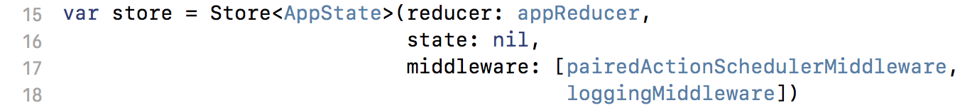
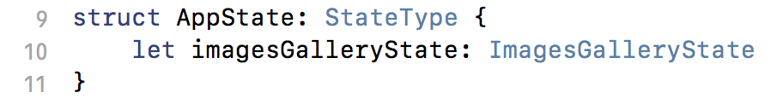
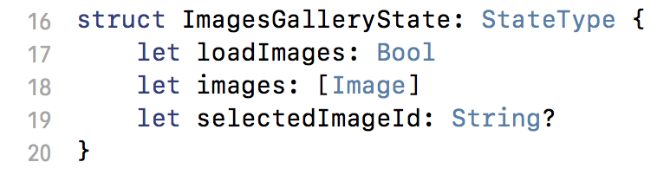
2
1
3
4

Slide 21
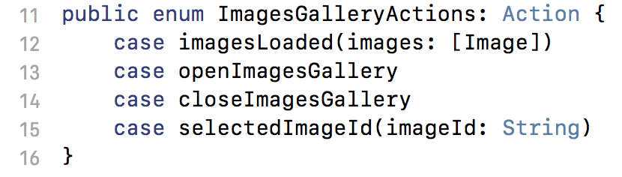
2
1
3

Slide 22
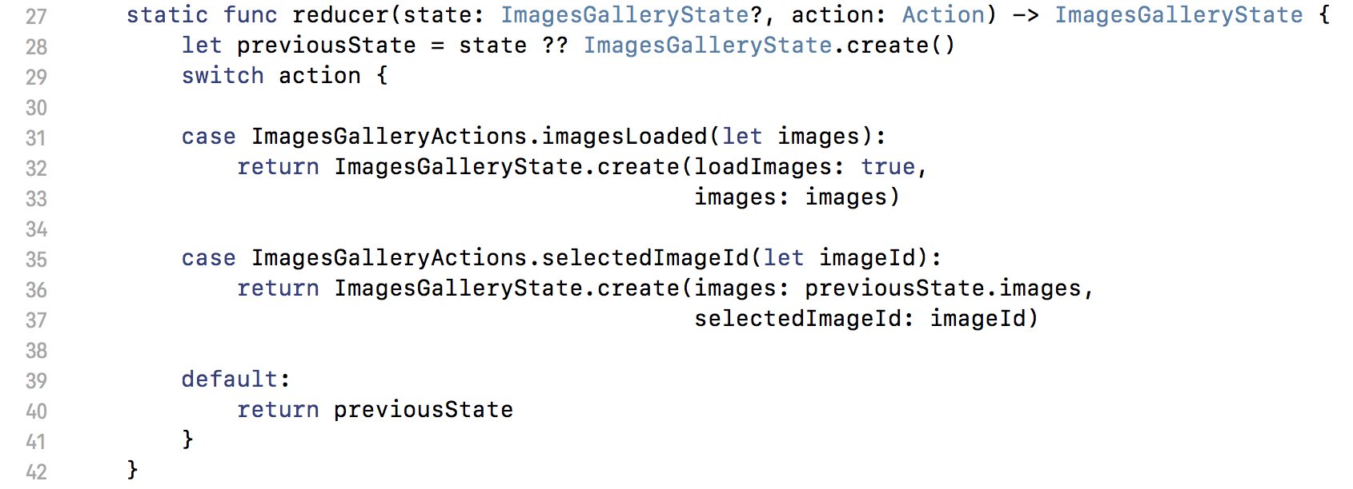
1
2

Slide 23
Basic principles
All view data should be stored in a state.
At any point in time – the entire application (as seen by a user) is a “nice representation” of this state.
State should only be modified by dispatching an action.
For every view controller only one class (usually a presenter) will listen and respond to state changes.

Slide 24
Middleware
Event logging
Action Scheduling

Slide 25
Standard ReSwift
State
Informs of
update
View
Update
Reducer / Middleware
Action

Slide 26
How it fits in iOS ecosystem
View / Application
State
Informs of
update
Update
Reducer / Middleware
Action

Slide 27
How it fits in iOS ecosystem
State
View Controller
Informs of
update
Informs of
update
Presenter
Update
Triggers UI update
Reducer / Middleware
Action
View /
Delegates /
Data Source
Informs of action
Notes:
How MVVM and components from VIPER fits in this picture.

Slide 28
Q/A

