Slide 1

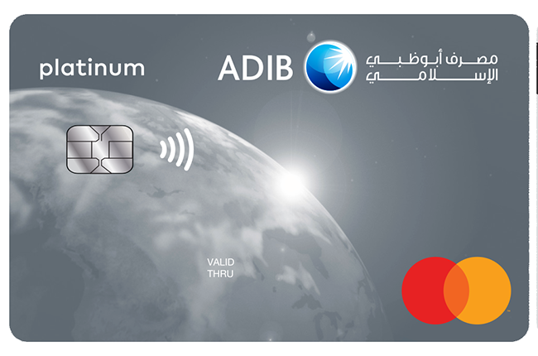
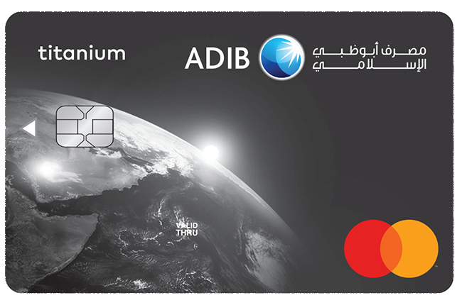
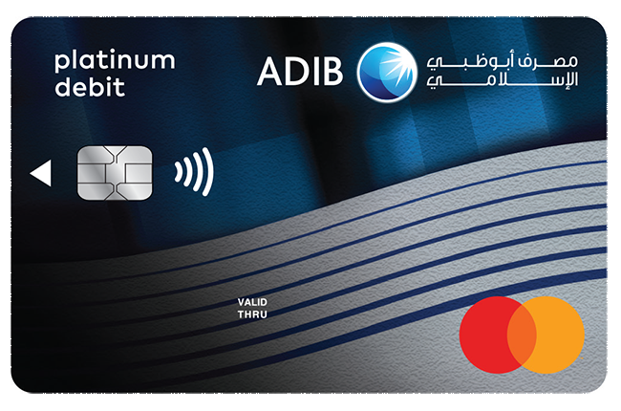
ADIB Cards Presentation
Simple, visual and readable slides designed around the ADIB card collection.
Card portfolio snapshot

Slide 2
Card Portfolio
Three clean product visuals with short labels for fast reading.
Titanium Cash Back
Platinum Cash Back
Platinum Debit
Shari'a-compliant cashback card with a modern silver finish.
Premium cashback option presented with a polished platinum look.
Contactless platinum debit card designed for everyday convenience.

Slide 3
Featured Card Designs
A balanced comparison between the two highlighted variants.
Platinum
Titanium
Premium visual finish with a refined, high-contrast layout.
Soft metallic styling that feels modern, simple and professional.

Slide 4
Brand Snapshot
• Clear bilingual branding • Strong blue identity • Premium card presentation • Simple visual structure
Designed for a clean and readable story.

