Slide 1


ADIB Cards Presentation
Simple, visual and readable overview
Slide 1: Logo on left + card visual on right

Slide 2

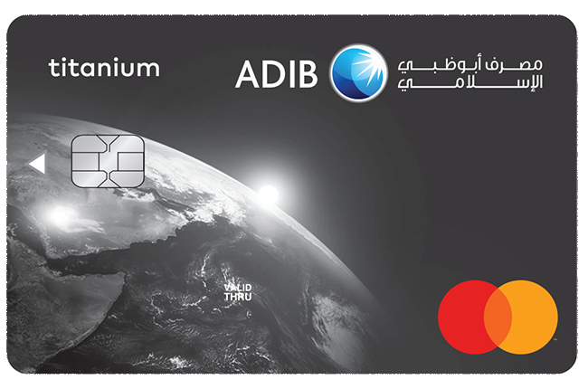
Brand Snapshot
A clean, modern visual identity
Recognizable ADIB brand and premium card style
Consistent blue/grey palette for trust and clarity
Visuals centered on products, not heavy text
Slide 2

Slide 3
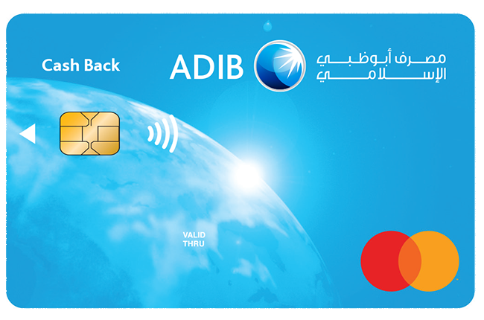
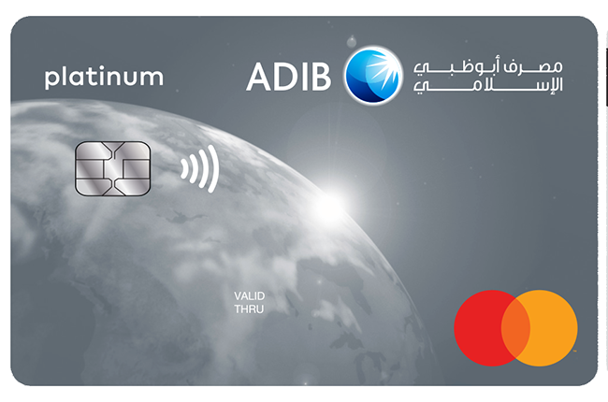
Card Portfolio
Classic, Titanium and Platinum tiers
Classic
Titanium
Platinum
Slide 3

Slide 4
Platinum Card Focus
Featured premium design
High-contrast card face with elegant finish
Simple visual hierarchy keeps content readable
Mastercard mark and contactless icon are clear
Slide 4

Slide 5
Summary
Simple visual design for a professional deck
Simple
Visual
Readable
Minimal text and clean composition
Strong product imagery on every key slide
Large headings with high contrast colors
Slide 5

