Slide 1

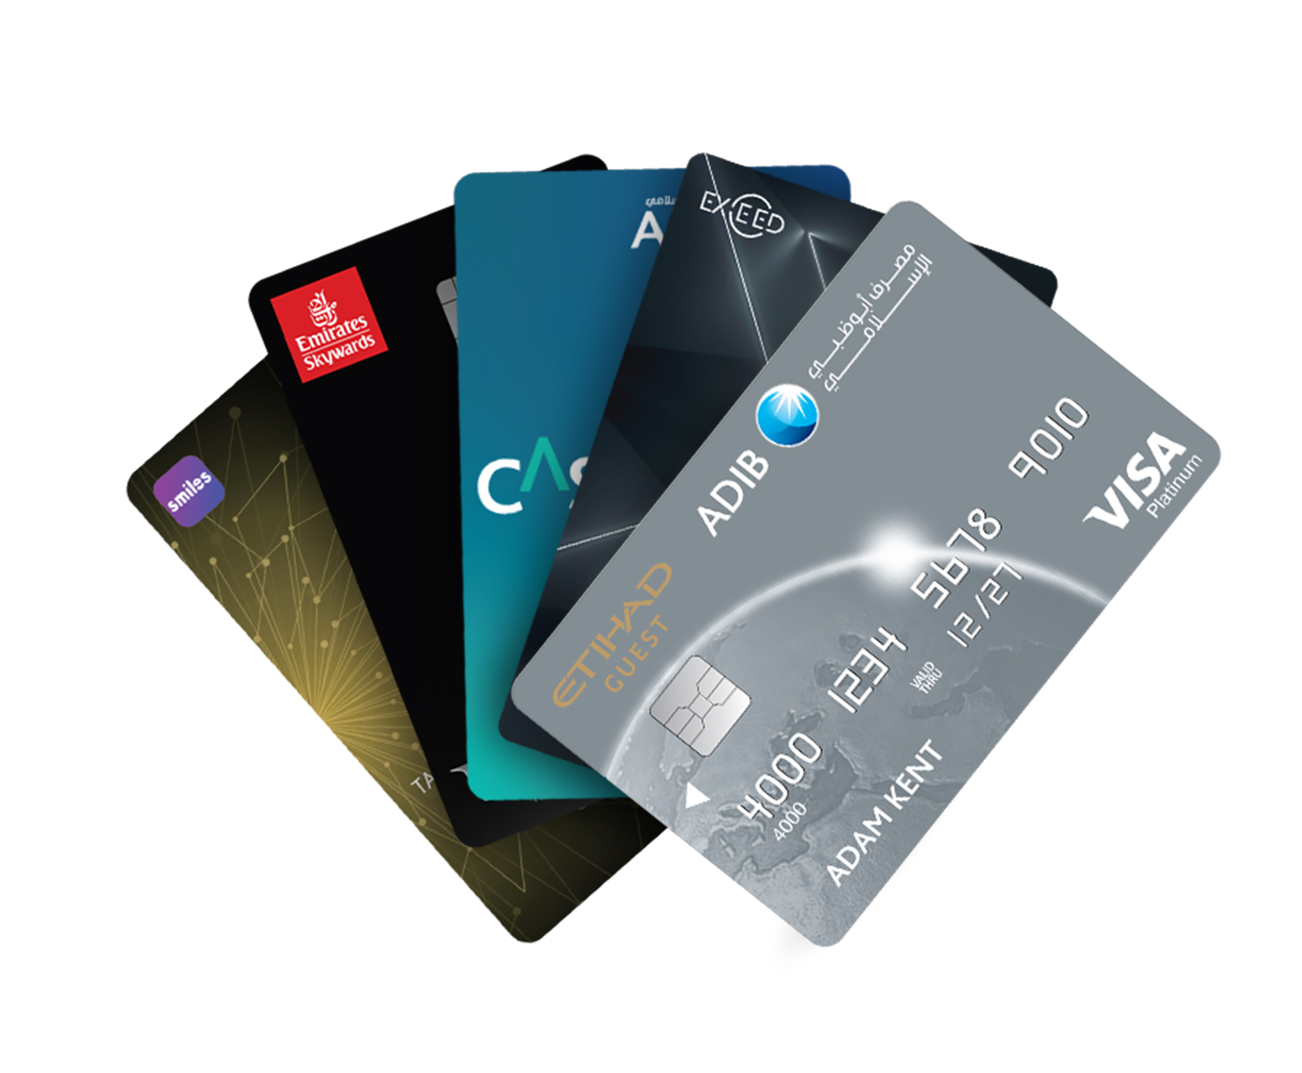

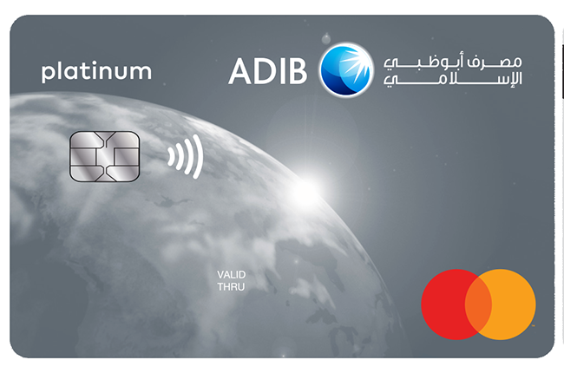
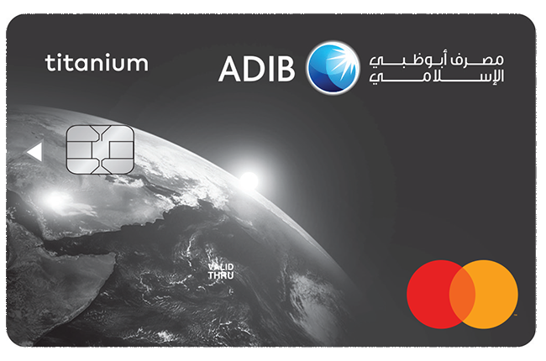
ADIB Card Portfolio
Simple visual overview of ADIB card options and customer value.
Cashback
Lifestyle
Secure Payments
Clean design. Clear message. Easy to read.
Cards at a glance

Slide 2
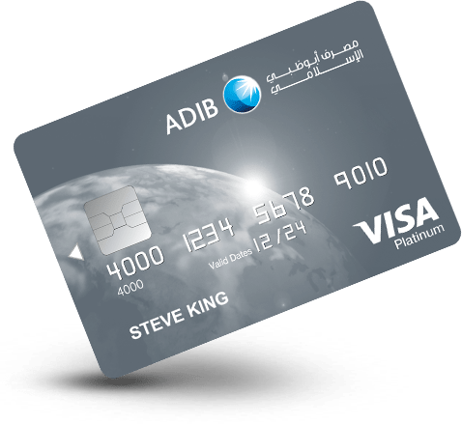
Card portfolio
A simple view of the cards and the lifestyle needs they support.
PLATINUM
TITANIUM
CASHBACK
Premium value and everyday cashback
Accessible rewards with Mastercard acceptance
Straightforward savings on daily spend

Slide 3


Key benefits
Simple, confident everyday payments.
1%
NFC
24/7
PIN
Cashback
Contactless
Digital access
Security
Clear value on everyday purchases
Fast, convenient tap-to-pay use
Manage cards through online channels
Chip, PIN, and transaction alerts

Slide 4
Platinum vs Titanium
Keep the choice simple: match the card tier to the customer need.
PLATINUM
TITANIUM
Premium positioning
Everyday rewards
Strong card presence
Clean Mastercard design
Best for frequent spenders
Best for practical use
Ideal for benefit-led messaging
Ideal for simple value messaging

Slide 5
Simple message
ADIB cards combine recognizable branding, daily value, and secure payment convenience.
+
Recognizable ADIB visual identity
+
Clear card tiers for different needs
+
Benefits shown with minimal text
+
Readable layout for presentation use
Thank you
Prepared as a clean, visual ADIB card presentation.

