Slide 1

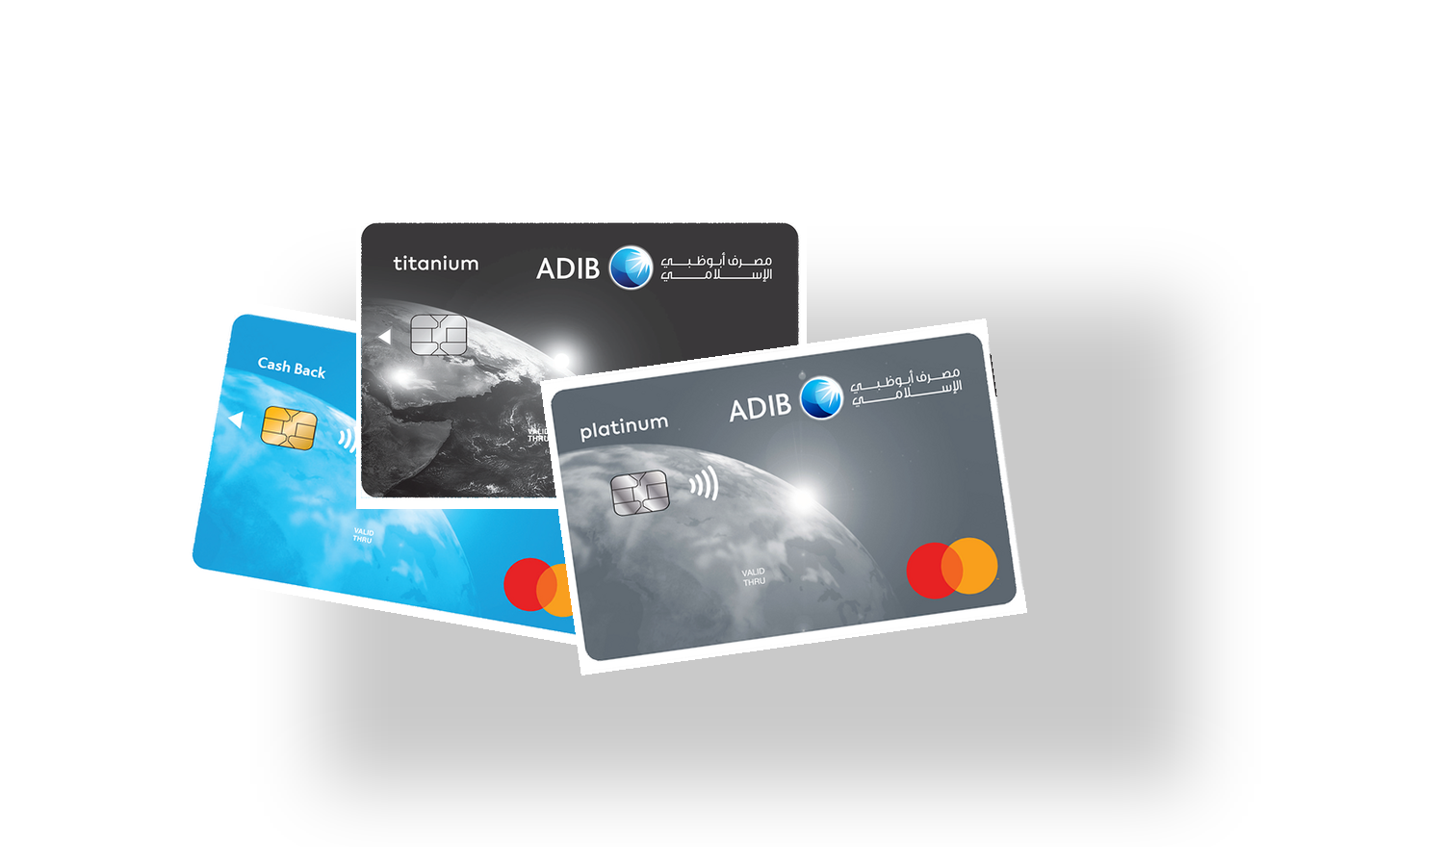
ADIB
Abu Dhabi Islamic Bank
Cards Portfolio
Simple visual overview
A clean introduction to ADIB card products, designed for quick reading and strong visual impact.
Cash Back | Titanium | Platinum
ADIB card products

Slide 2
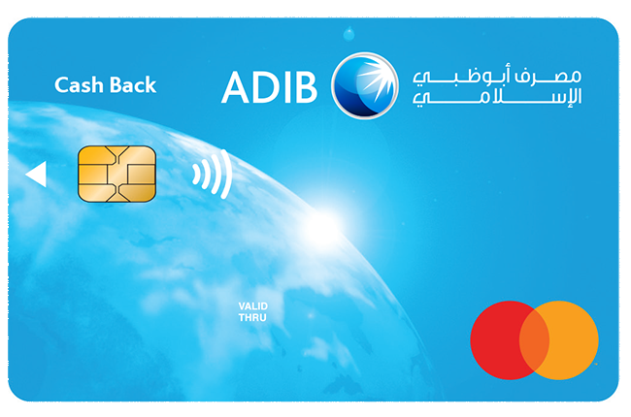
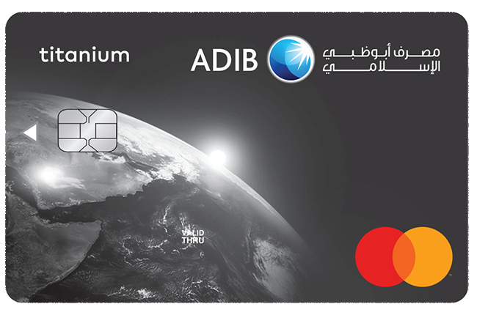
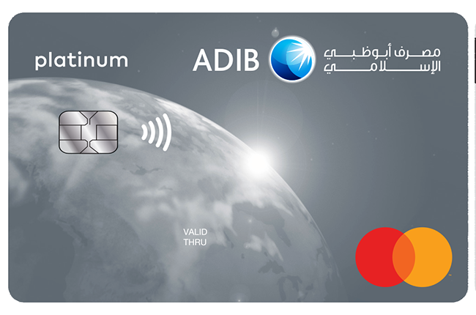
ADIB
Overview
Portfolio at a Glance
Cash Back
Titanium
Platinum
Everyday rewards
Modern daily banking
Premium positioning
ADIB Cards Portfolio
02

Slide 3
ADIB
Platinum
ADIB Platinum Cash Back Card
Key messages
Premium visual card design
Cashback proposition
Contactless Mastercard payments
ADIB Cards Portfolio
03

Slide 4
ADIB
Titanium
ADIB Titanium Cash Back Card
Key messages
Strong everyday card option
Cashback on purchases
Clear global card branding
ADIB Cards Portfolio
04

Slide 5
ADIB
Compare
Simple Product Comparison
Product
Visual tone
Positioning
Design focus
Cash Back
Classic blue
Everyday rewards
Simple card-first layout
Titanium
Dark titanium
Daily premium feel
Simple card-first layout
Platinum
Silver premium
Premium positioning
Simple card-first layout
Recommendation: keep each slide focused on one product, one image, and three short messages.
ADIB Cards Portfolio
05

Slide 6
ADIB
Cards Portfolio
Simple. Professional. Visual.

