Slide 1
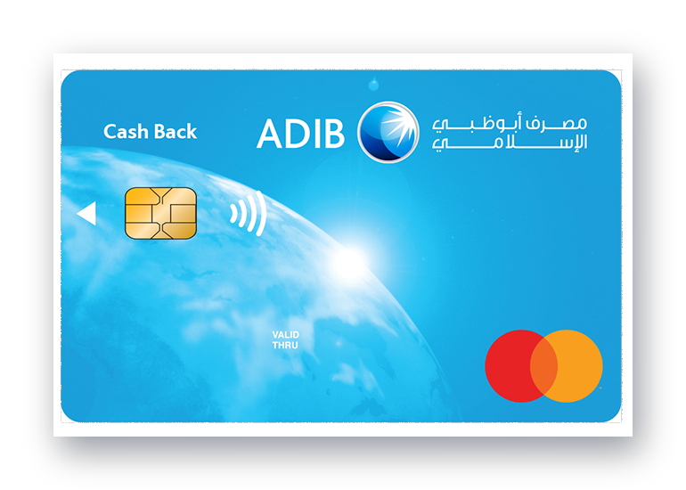

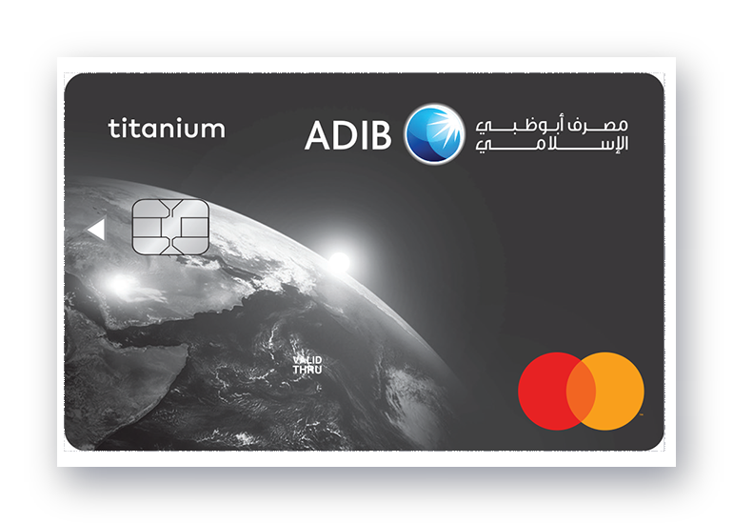
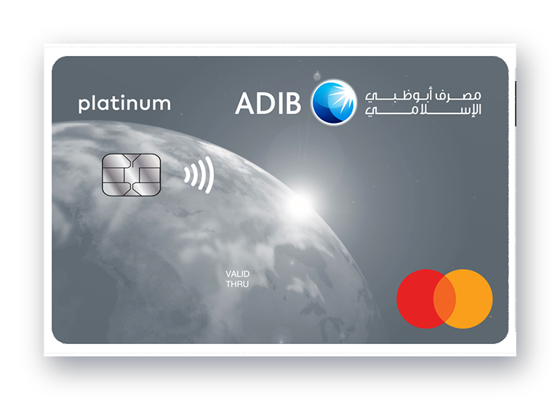
ADIB Covered Cards
A simple look at our Sharia-compliant card family
Abu Dhabi Islamic Bank • Banking as it should be

Slide 2
About ADIB
Abu Dhabi Islamic Bank at a glance
1997
100%
1M+
Founded in Abu Dhabi, United Arab Emirates
Sharia-compliant products and services
Customers served across our markets
ADIB combines modern everyday banking with the principles of Islamic finance —
transparent, fair, and built around our customers.
2

Slide 3
One Family, Three Cards
A card for every lifestyle
Cash Back Card
Titanium Card
Platinum Card
Instant cash back on your everyday purchases
Everyday value with premium convenience
Premium privileges and higher limits
3

Slide 4
Platinum Card
Premium, made simple
■ Premium privileges — exclusive offers and lifestyle benefits
■ Higher finance limits — more room for the things that matter
■ Contactless payments — fast, secure tap-and-go convenience
■ Sharia-compliant — a covered card built on Islamic principles
4

Slide 5
Titanium Card
Everyday strength
■ Everyday value — rewards on your regular spending
■ Worldwide acceptance — use it wherever Mastercard is accepted
■ Smart security — chip protection and instant transaction alerts
■ Sharia-compliant — a covered card built on Islamic principles
5

Slide 6
Cash Back Card
Get rewarded on every purchase
■ Instant cash back — earn on all your local purchases
■ No limits — no minimum or maximum cash back caps
■ Contactless payments — fast, secure tap-and-go convenience
■ Sharia-compliant — a covered card built on Islamic principles
6

Slide 7
Thank you
adib.ae • Banking as it should be

