Slide 1
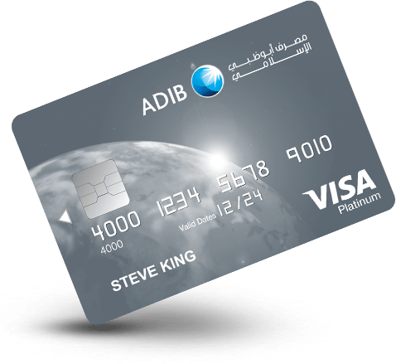
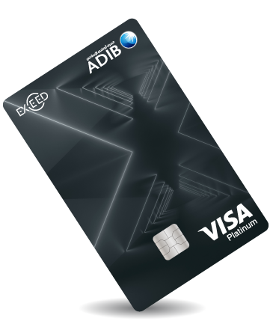

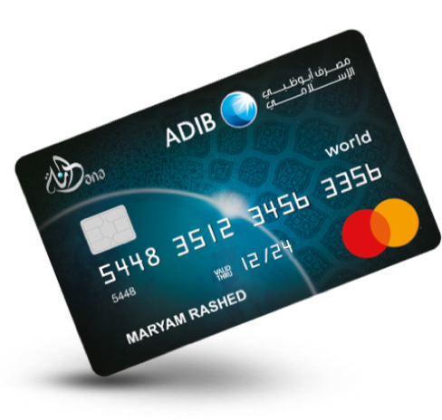
ADIB Card Presentation
Simple | Visual | Readable
Card visuals from ADIB public pages

Slide 2
Card Lineup at a Glance
Cashback Platinum
Exceed Platinum
Dana Master Card

Slide 3
Key Benefits Snapshot
• Simple product tiers for different customer needs
• Clear branding with premium visual identity
• Strong focus on rewards and lifestyle value
• Readable design, easy to compare card options

Slide 4
Simple Design Enhancements
1
Use one core brand color per slide
2
Keep text short: max 4 bullet lines
3
Use one main visual focal point
4
Maintain strong contrast for readability

Slide 5
Thank You
A simple, visual, and readable ADIB presentation template.

