Slide 1

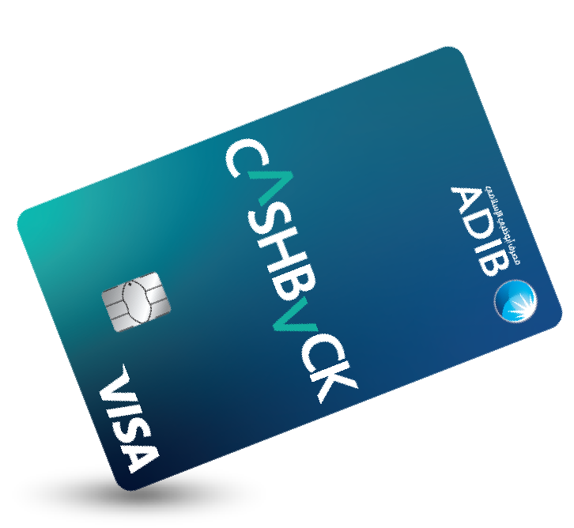
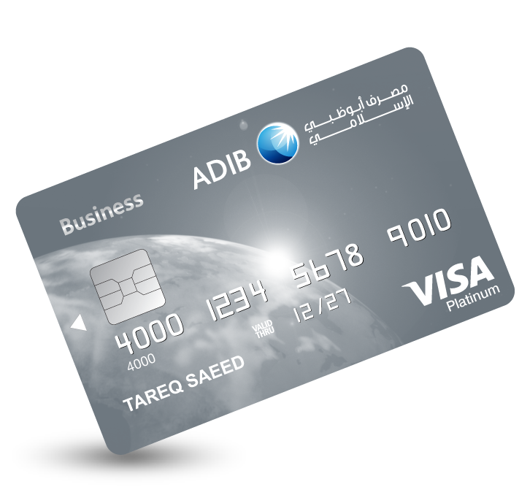
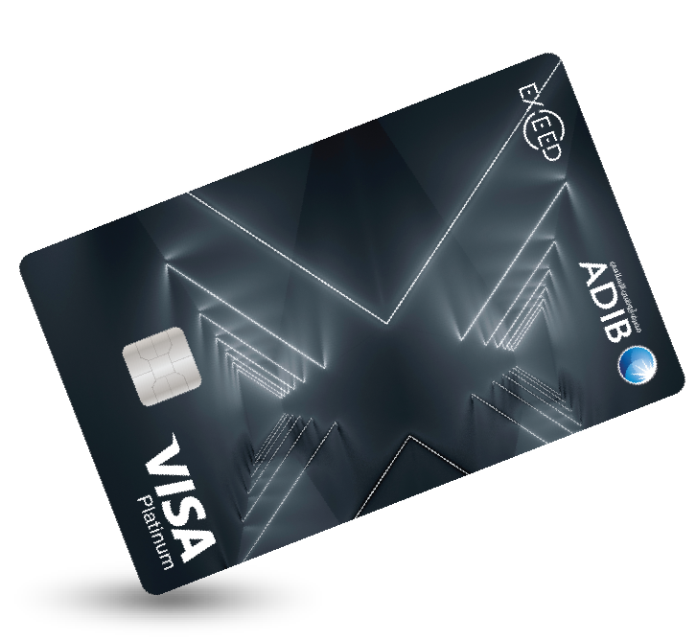
Simple visual presentation
Clean layout, readable text, and a premium card-focused first slide.
Cover concept
ADIB | Simple visual deck

Slide 2
Card gallery
A simple three-card layout that keeps the visuals clear and balanced.
Cashback Visa Covered Card
Exceed Visa Platinum Covered Card
Business Visa Platinum Covered Card
Simple caption area for editing.
Simple caption area for editing.
Simple caption area for editing.
ADIB | Simple visual deck

Slide 3
Design principles
Built to stay visual, readable, and easy to update.
Keep each slide focused
Recommended visual balance
• Use one main message per slide.
• Limit text to short phrases and labels.
• Let the card images carry most of the visual weight.
• Use the blue ADIB palette for a clean, consistent look.
Large image area
Small text block
ADIB | Simple visual deck

Slide 4
Thank you
This deck is set up as a simple visual presentation and can be edited easily in PowerPoint.
ADIB | Simple visual deck

