Slide 1

Exploratory Data Analysis
G2M insight for Cab Investment firm
Name: Amr Elbana
Date: 18/06/2022

Slide 2

Executive Summary
The Client
XYZ is a private firm in the US. Due to remarkable growth in the Cab Industry in the last few years and multiple key players in the market, it is planning for an investment in the Cab industry and as per their Go-to-Market(G2M) strategy they want to understand the market before making the final decision.
Project Objective:
Provide actionable insights to help XYZ firm in identifying the right company for making an investment.
Deliverables:
1) EDA
2) Presentation of the findings
The presentation will be judged based on the visuals provided, the quality of your analysis, and the value of your recommendations and insights.

Slide 3
Problem Statement
The company is planning to invest in any of the fast-growing companies working in the local transportation sector. This industry is growing fast in the last few years. The company provides us with datasets to extract any insights about the key players in the market and to understand the market before taking a final decision.

Slide 4
Approach
Steps:
Data has loaded from the GitHub Repo.
The four tables were merged in an inner join on the common columns between the tables
The columns with invalid entries are cleaned.
Exploration of the big table is done using some of the statistical and visual methods

Slide 5
EDA
The available data was quite clean.
No duplicates were found; only 2 columns required data transformation.
To facilitate analysis, columns of different tables were combined to create more meaningful tables.
The data spans a 3-year period (January 2016 to December 2018)
No outliers in the data
Data is mostly clean

Slide 6
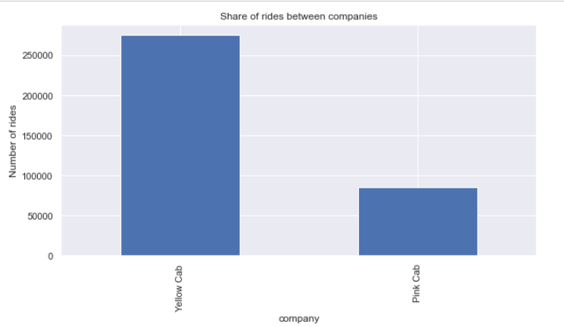
EDA Trips share analysis
This chart shows that Yellow_cab is the most preferable company for transportation

Slide 7
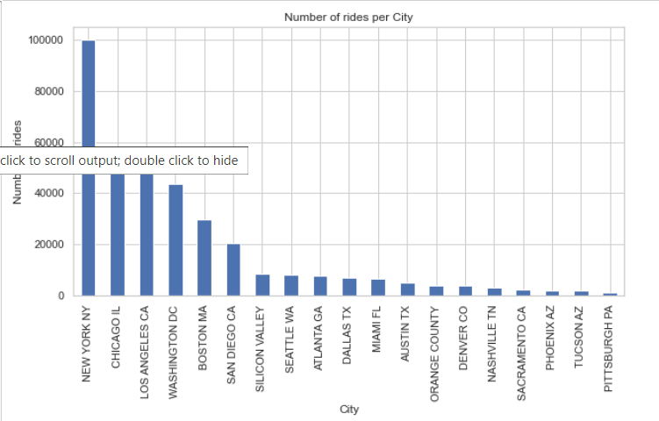
EDA City_Trips share analysis
This chart shows that most of the rides were in NewYork, this was solidified by the fact that New York is the most Populated city that used the both companies and also it contains the most users for both companies.

Slide 8
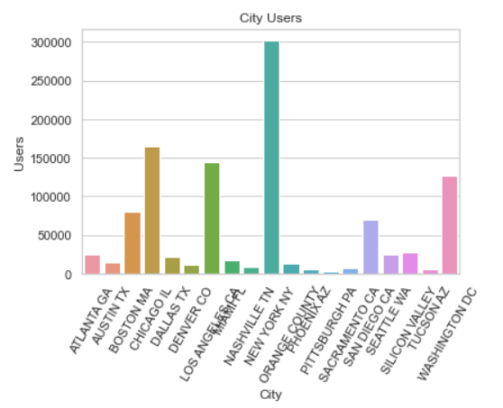
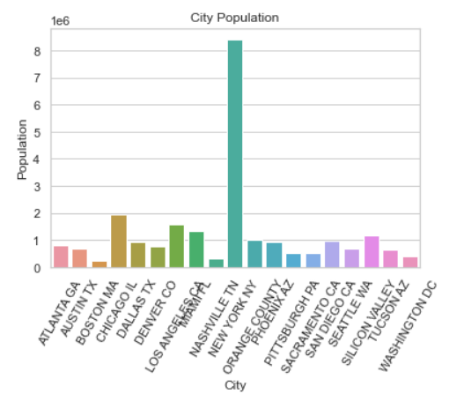
EDA Cities analysis

Slide 9
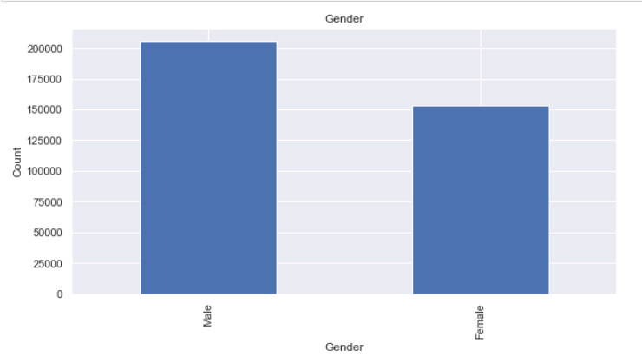
EDA Gender analysis
This chart shows that most of the almost 60% of the users are from the male.

Slide 10
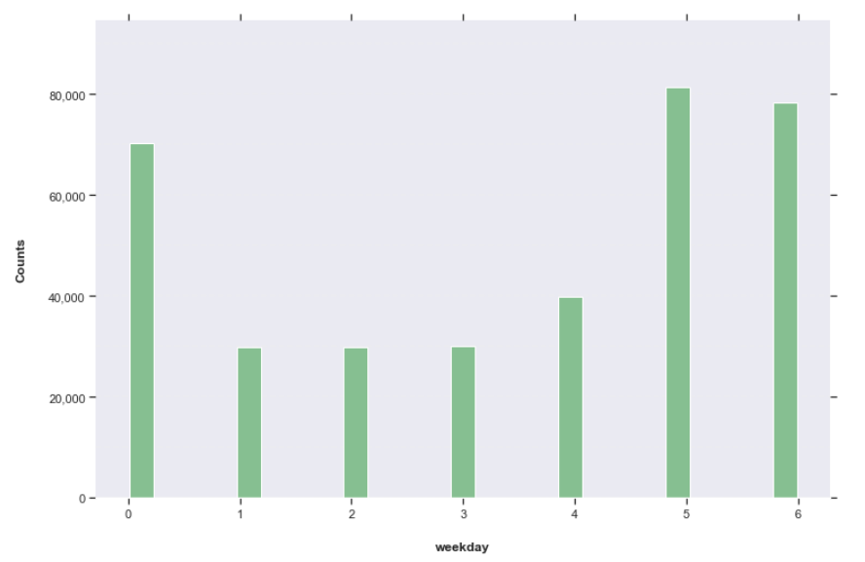
EDA Busiest day analysis
This chart shows that most rides were done on weekends and on Mondays by which most of the people are going out on weekends and maybe miss the time on the first day of the week.

Slide 11
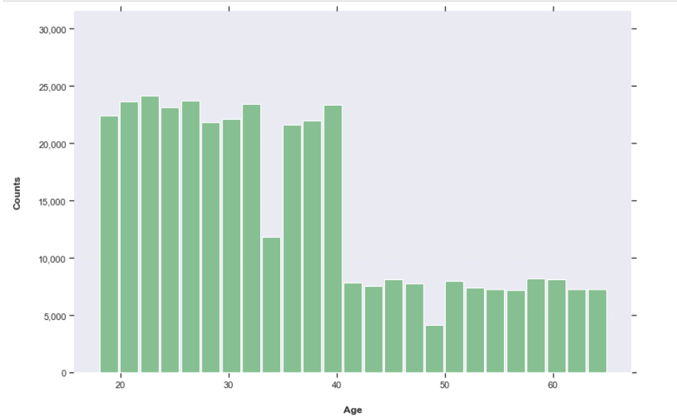
EDA Age analysis
This chart shows that most rides were done by people younger than 40 years old, this may be because the people who are mostly going out and using the apps to order rides are from the young generations.

Slide 12
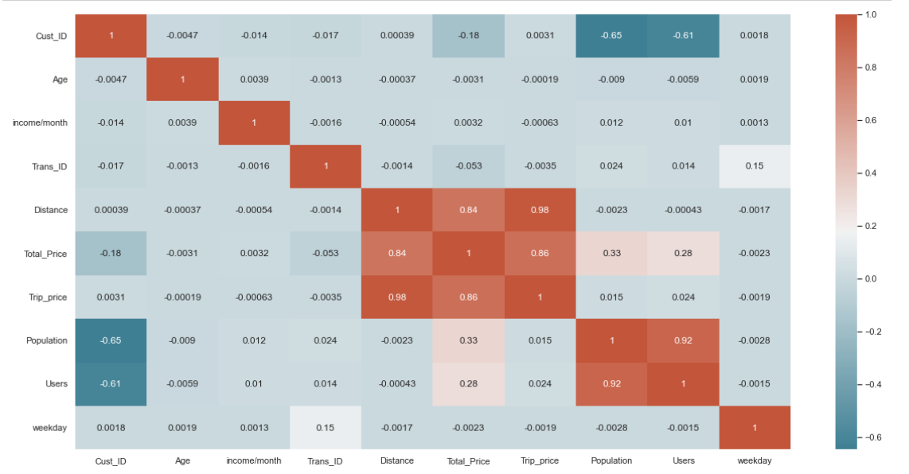
EDA Corr analysis
This Heatmap shows that the ride price is highly correlated with the distance.

Slide 13
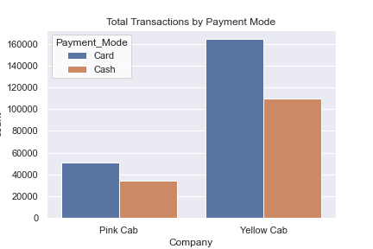
EDA Payment analysis
This chart shows that paying by card is dominating for both companies.

Slide 14
Recommendations
Recommendations
New York is the most crowded city, but the marketing teams of the companies should make a campaign to attract users from other cities.
Your main target is the elderly people, try to attract them by making offers for
Make offers for people who pay by card to make most of them pay by card.
Try to check why most of the users are from the male side and make a marketing plan to attract females by for example offering rides by female drivers or with discounts.
Yellow_cab is better than Pink_Cab and preferred by a wide sector of the people, so it is a better choice to invest in it.

Slide 15
Thank You

