Slide 1
CARL-5
Group #12

Slide 2
Team Members
Amr Gawish
Suhaib haboush
Osama Rashid
Nolan Dickson
Supervisor: Professor Ana-Maria

Slide 3
Table of content
Over view & Goals
Phases:
  Phase 1 (follow the line)
    Hardware
    Implementations
    Acheivments
  Phase 2 & 3 (solve the maze / innovations)
    Hardware
    Implementations
    Acheivments
Conclusion

Slide 4
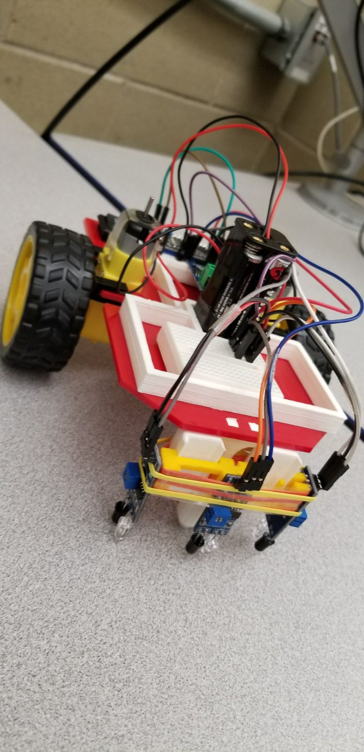
Overview & goals
Carl-5
The purpose of this project is to make a fully functioning robot that will finish the three phases of the course.
  Ability to walk over a line drawn on the ground until the end of that line
  Ability to finish a maze knowing all the direction required to finish the maze.
  Ability to finish a maze not knowing the direction to the end of the maze, as well avoiding any excitant optical while going through its path.
Develop code that will program the Arduino to read data from the sensors and adjust the direction of the robot accordingly

Slide 5
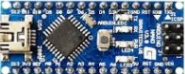

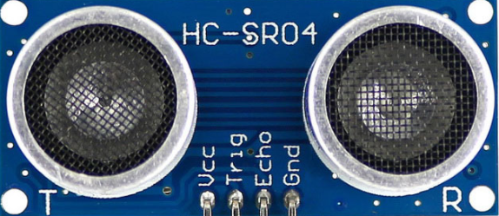
hardware
Plastic board that simulate the car body
Arduino Nano that is the brain of the car
2 motors that are attached to the Arduino to control the wheels
Sensors:
  3 IR sensors to sense the line and send the data to the Arduino
  Or
  3 distance sensor that gets data about the walls of the maze or any other object
Arduino Nano
IR Sensor
Distance Sensor

Slide 6
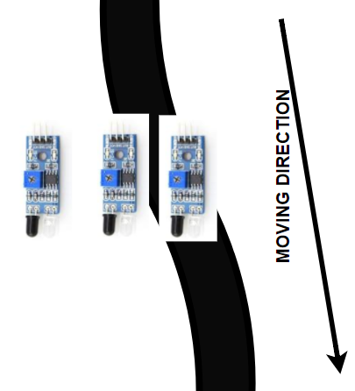
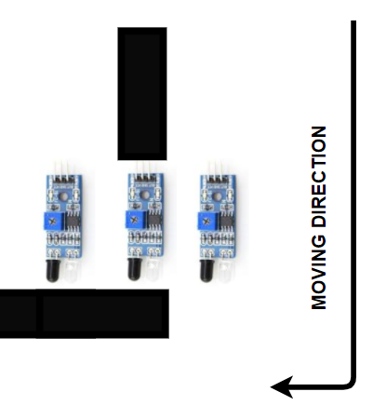
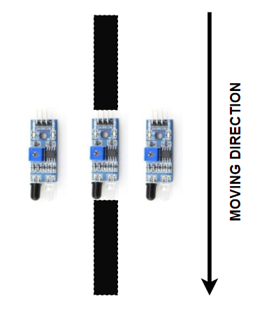
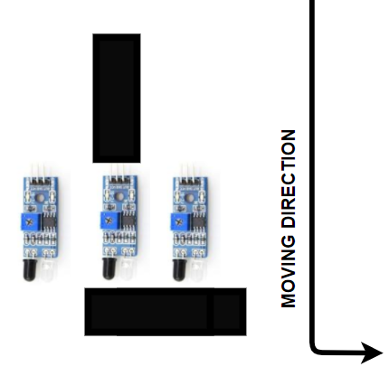
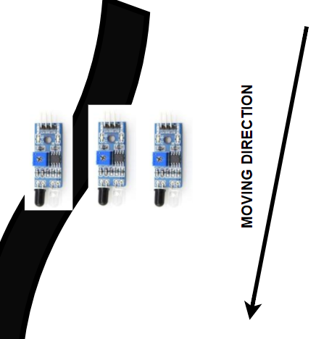
implementations
Slight Right
Right
Straight
Right
Slight Right

Slide 7
Achievements
Construction of the Carl-5 car in the right manner.
Successfully connecting all the electrical components (Battery, Sensors, Arduino)
Successfully developing the code that gets the data from the IR sensors and adjust the direction of the car until reaching to the end of the line
Replacing the IR sensors to distance sensors to fit the new objective; phase two

Slide 8
conclusion
The Robot was able to follow the line perfectly without the need for any external assistance, therefor phase one was completed

