Slide 1
VOIP Project
SIP.JS API
Amr Hoballah 46-13257
Abdelrahman Sherif 46-4048
Abdelrahman Ahmed 46-11334
Supervised by Dr. Hisham Othman

Slide 2
Project Outline
Forked from and based on sip.js from OnSIP.
Creates a SimpleUser using the simple user interface.
User is then registered to OnSIP’s own domain.
The demo has a fixed call target which is an account we setup on OnSIP's own app.
Successfully initiates and holds a video call to an OnSIP account.

Slide 3
Webpage elements
Call initiation and termination firing
Connect button: Activates a listener which initiates a connection to the SIP server using the API call .connect().
Register User: Activates a listener which calls .register() so the user is now registered on the SIP server. If registration is denied for any reason an alert is displayed indicating an error has occurred.
Initiate Video Session: Sends an SIP INVITE using .call(). If the invite is denied for any reason an alert is displayed indicating an error has occurred.
End Video Session: Calls .hangup() to end the running session.
Unregister: Calls .unregister() to unregister the created temporary user from the SIP server.
Disconnect: Calls .disconnect() to disconnect from the demo server.

Slide 4
Webpage elements
Mid-call interaction
Mute checkbox: Mutes and unmutes the audio of the call by using the .mute() API call.
Hold checkbox: pauses and resumes the call by using the .hold() API call.

Slide 5
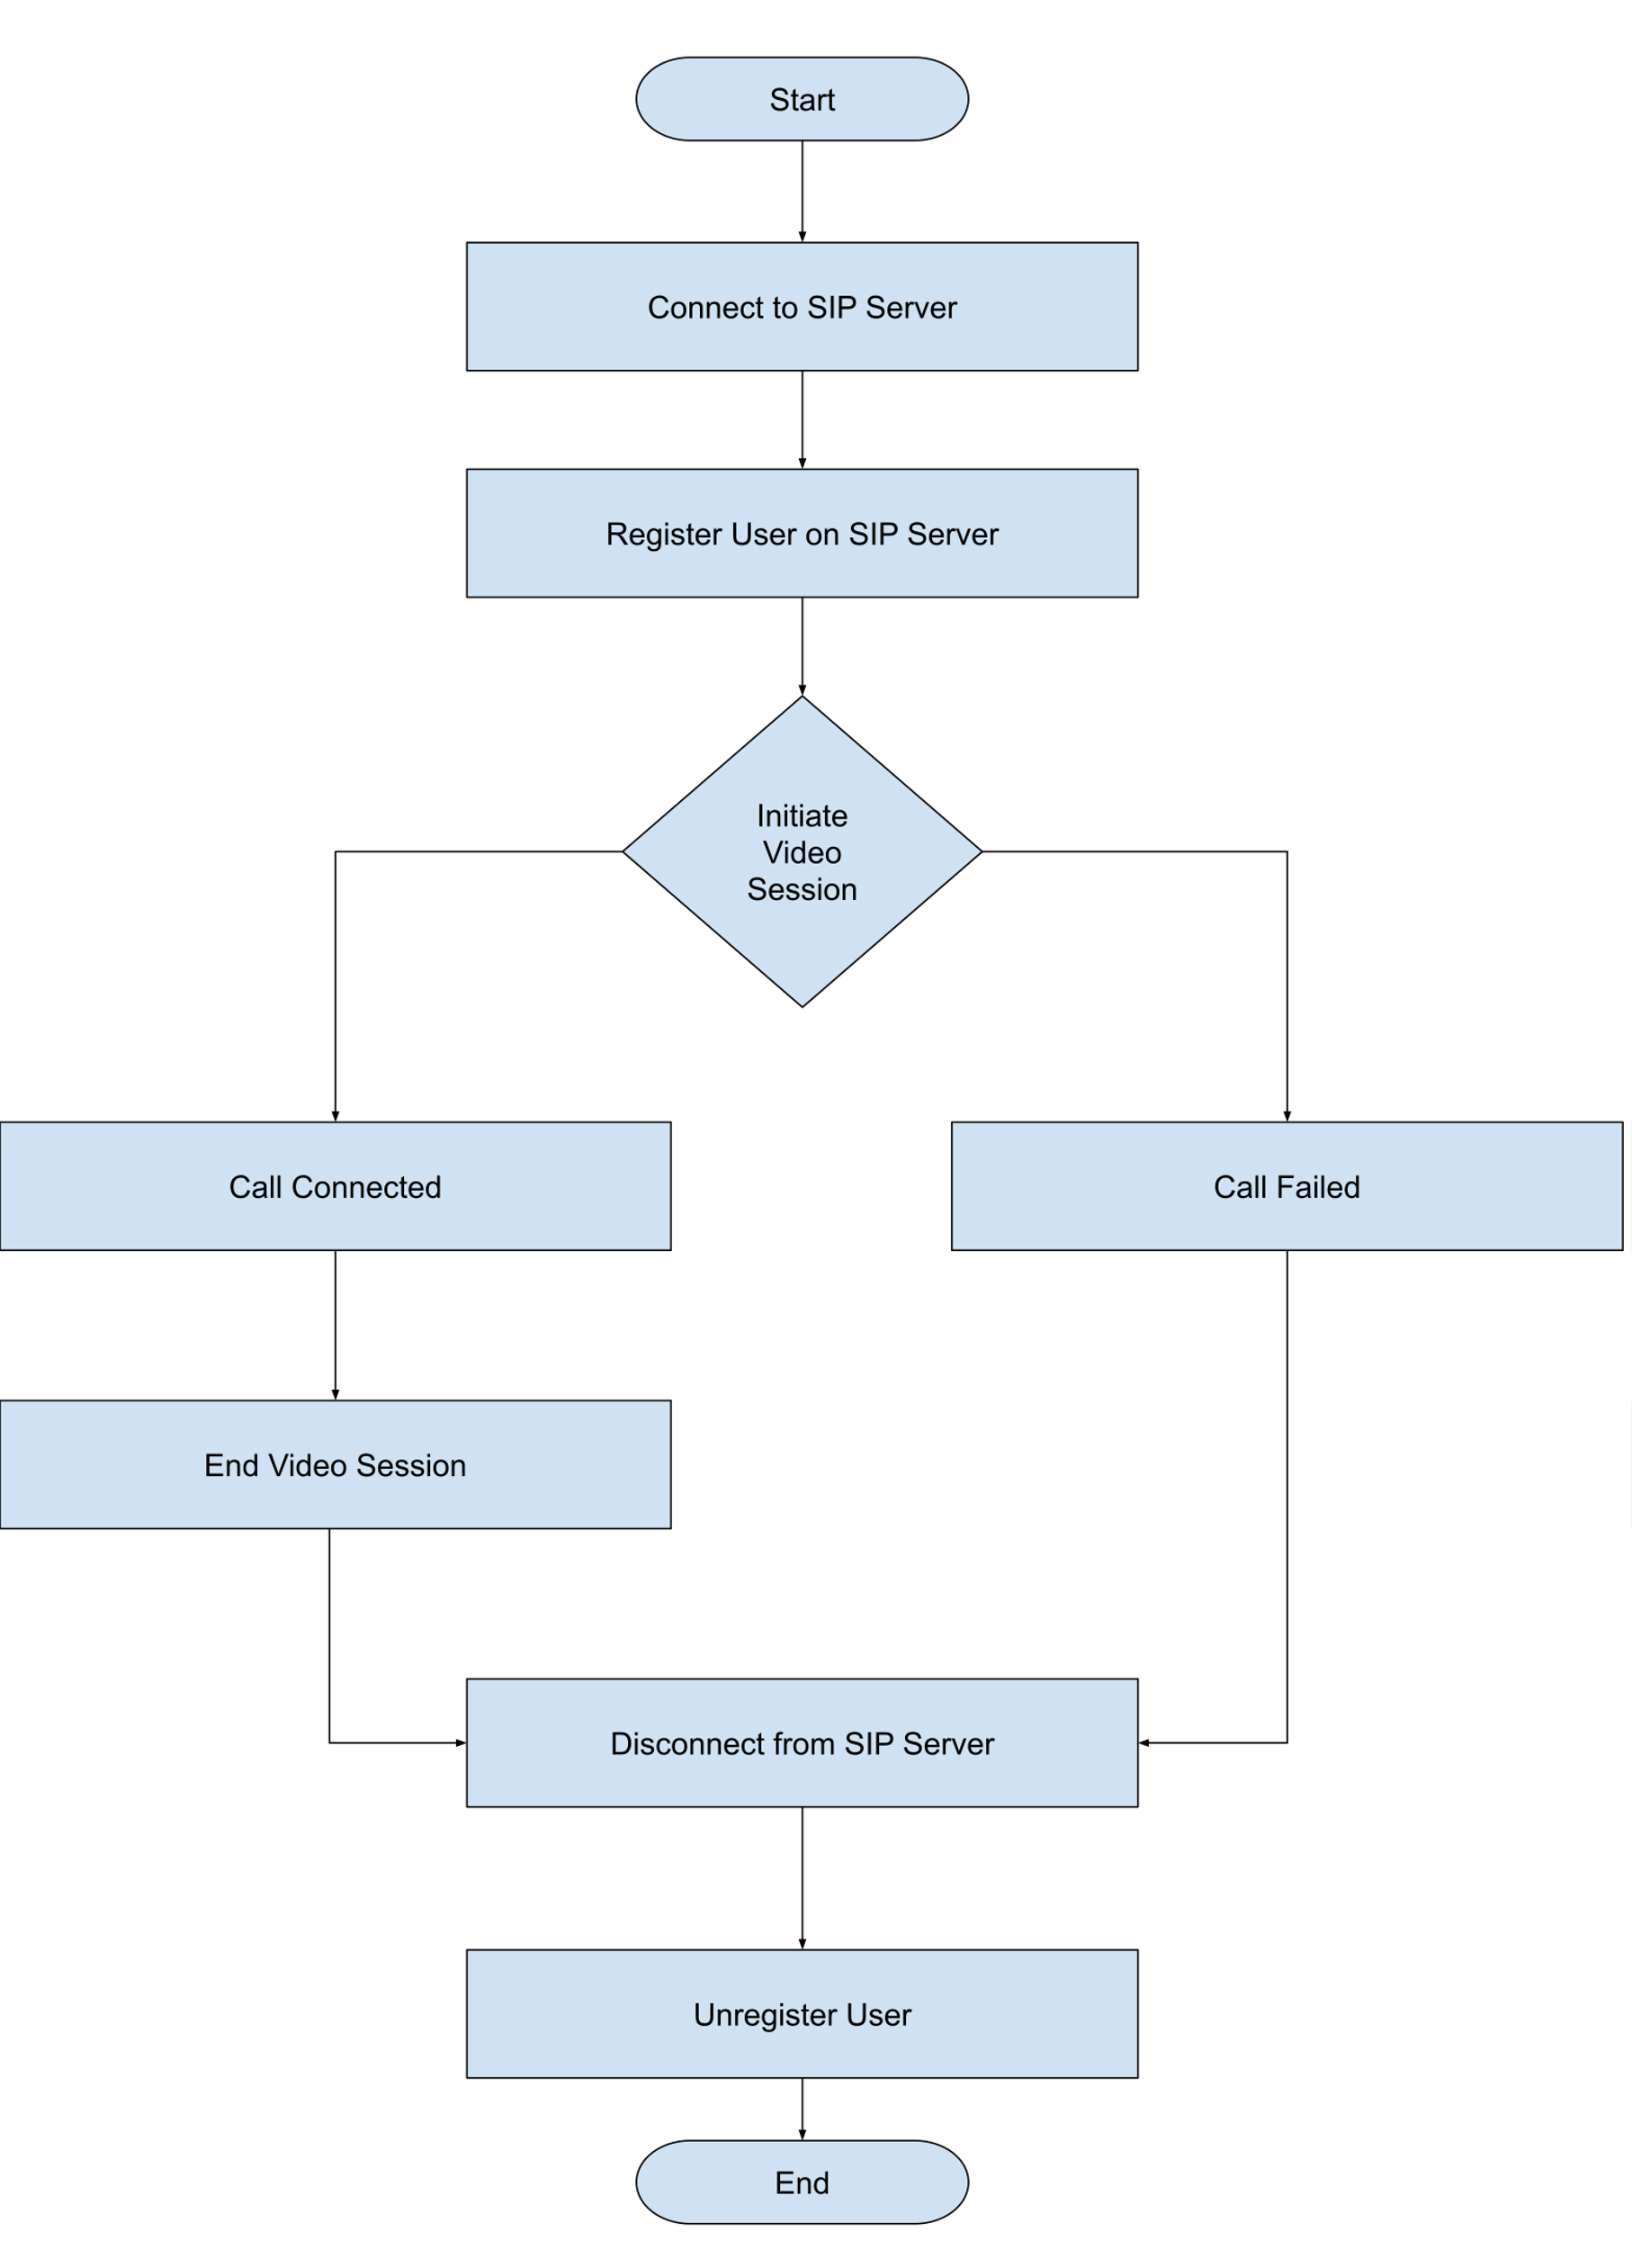
Flowchart
SIP video-call process using SIP.js API

Slide 6
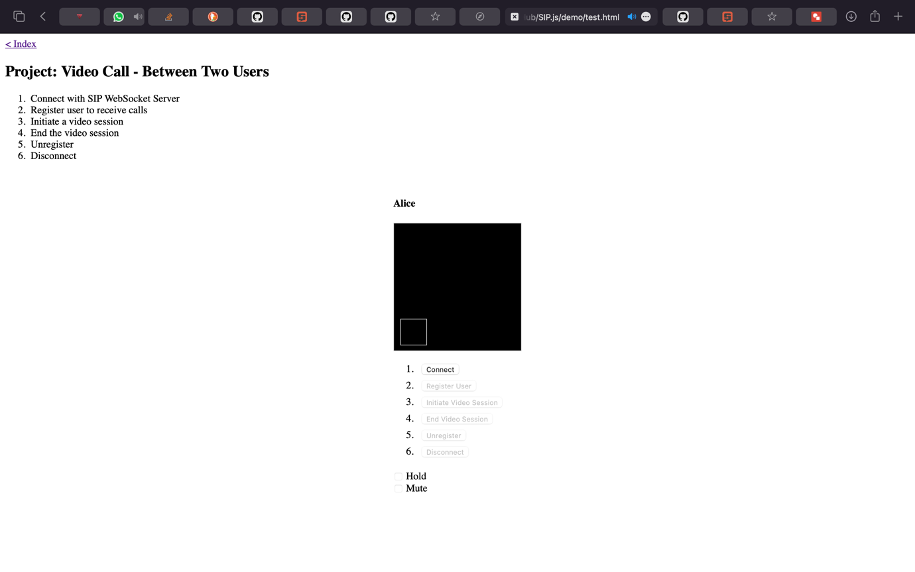
Webpage

Slide 7
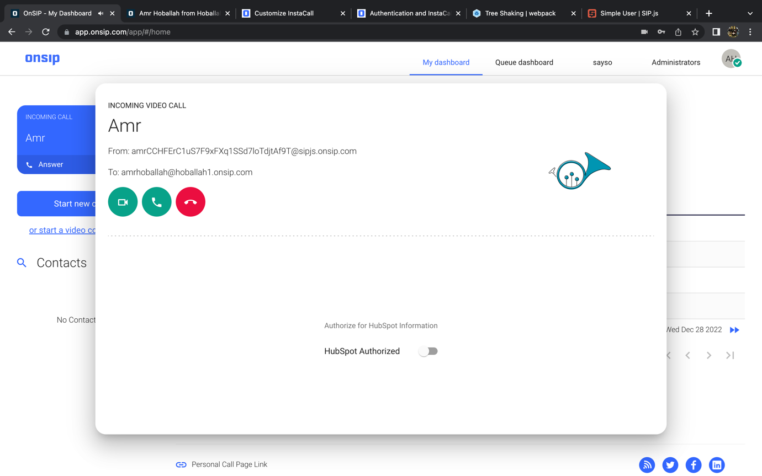
Incoming call

Slide 8
Thank you
Any questions?

