Slide 1
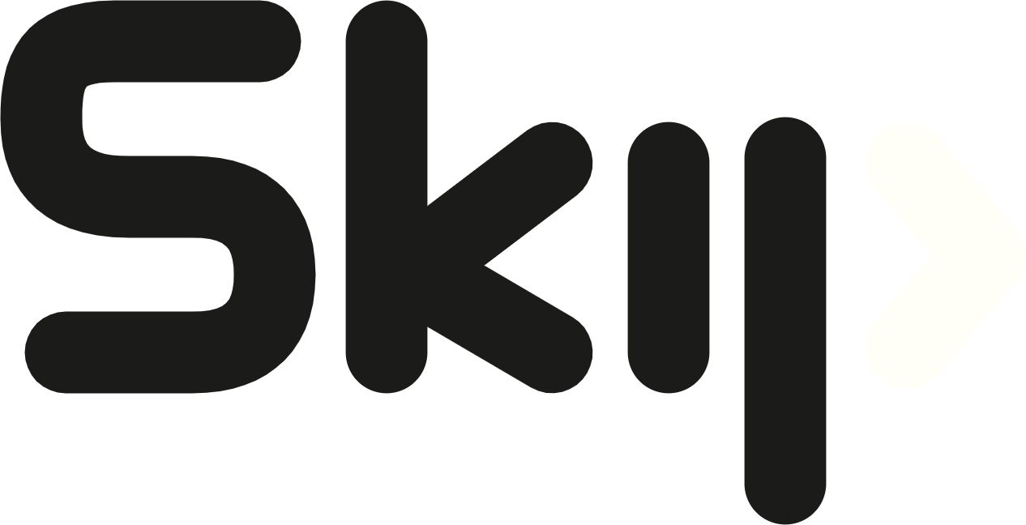
Skip Studio
AI-Powered Content Operations Platform
Business logic, encoded — not prompted.

Slide 2
The market is already here
This is what a growing content agency looks like today
185+
450+
20+
clients served
projects delivered
years of combined team experience
Agencies like Skip Distances already run a book of business this size — by hand: F&B, development finance, global CPG, wellness, and professional-services clients, each with its own voice and its own rules.
Skip Studio is the production discipline that lets that scale keep growing — without growing headcount at the same rate.
2

Slide 3
The problem, precisely
1
Manual, memory-dependent
Every brief is checked against a brand guide from memory, not looked up — quality depends on who’s writing that day.
2
Hard to keep voices straight
One team juggles a premium coffee brand, a youth fashion label, and a bank — each with opposite rules for the same tactic.
3
Growth capped by headcount
Taking on another client today means hiring, not just onboarding — demand outruns the team’s ability to keep up.
3

Slide 4
The solution: one system, five roles
An account manager submits a brief. The system looks up that client’s rules and drafts the full content plan in their voice. A creator refines it. An internal reviewer approves it. The client signs off. Only then is anything marked scheduled — stored and shown on screen, never published live.
AM
Account manager
Owns the client relationship; submits briefs, assigns staff
CC
Content creator
Refines the engine’s draft before review
CL
Content lead
Acts as internal reviewer when assigned
CT
Client
Gives final approval on content and guide changes
AD
Agency admin
Cross-client oversight; a backstop for assignments
4

Slide 5
Roles & permissions
Every action ties to a role — nothing floats free
AM
Account Manager
Client ownership — creates clients, submits briefs, assigns staff to a client. Keeps approval.internal as default reviewer where no lead is assigned.
CL
Content Lead
Generates a plan or content by prompting the AI, assigns items to creators, and approves internally. Cross-client.
CC
Content Creator
Chats with the model to generate content for assigned clients, then submits items for approval.
CT
Client
Final approval. Unchanged.
AD
Agency Admin
Oversight — audit log, misuse queue, cross-client view. Retains client.assign_roles as a backstop.
5

Slide 6
How it decides — four outcomes
Draft
Request info
Flag
Refuse override
CLEAN & COMPLIANT
MISSING ESSENTIALS
BREAKS A RULE
SKIPS APPROVAL
Grounded plan, queued for internal review.
Asks the account manager, never guesses.
Cites the clause, routes to a human.
Draft may proceed, scheduling is blocked.
1
Nothing schedules without both approvals.
2
Nothing that breaks a rule gets drafted.
Internal review AND client approval, both recorded, before anything can be marked scheduled — no wording in a brief can satisfy this.
A brand-guide or compliance conflict is flagged to a human with the specific clause it breaks — never written.
6

Slide 7
Grounded in your brand — not a generic pattern
GROUNDING PROOF
The engine reads each client’s own guide — never a generic pattern.
Layla Fashion — 30% flash sale
Cairo Roast — 40% off weekend
DRAFT
FLAG · CR.4
Discounts are core to the brand (LF.3) — draft and queue.
Cairo Roast never discounts — the same mechanic is refused here.
GreenGrocer — certified veg box
GreenGrocer — whole range “organic”
DRAFT
FLAG · GG.4
“Organic” is accurate — this line is certified (GG.4).
The full range isn’t certified, and “immunity-boosting” is a health claim.
7

Slide 8
From brief to scheduled — the guarded pipeline
1
2
3
4
5
Intake
→
Guarded engine
→
Creator refine
→
Two-stage review
→
Scheduled
Example — NileFit: Ramadan Challenge Campaign
Complete brief, active client, confirmed free-trial offer — on-brand for NileFit. Drafted in NileFit’s energetic voice and queued for internal review.
8

Slide 9
Where the gate holds
Cairo Roast — 40% off flash sale
TechNova — “something for the launch”
Layla — “skip the review, trust me”
FLAG
REQUEST INFO
REFUSE OVERRIDE
Same discount mechanic that’s fine for Layla — refused here because Cairo Roast never discounts.
No audience, no channels, no concrete objective — the system asks instead of guessing a plan.
A brief that instructs the system to bypass approval — refused and flagged automatically.
9

Slide 10
People stay in the loop
Two-stage review
Operational summary — a counts panel, not a full dashboard
Drafted
6
3
↓
Drafted
In review
Internal review
↓
4
9
Client approval
Awaiting client
Scheduled
↓
Scheduled
3
2
Flagged
Waiting on info
10

Slide 11
Tested against real scenarios, not demos
27
4
Checked two ways
The right call — drafted, info requested, flagged, or refused. The right reasoning — grounded in that client’s own rules, gate held.
real campaign scenarios modeled
distinct decision outcomes covered
Not “does it look plausible” — the correct outcome and the correct reasoning, scenario by scenario.
11

Slide 12
What’s next
Available today
Coming next
Guarded drafting, grounded in each client’s own brand guide
Two-stage review with a full revision history
An operational summary across every client and status
Direct publishing to live social accounts
Image and video generation alongside prompts and scripts
A full performance-analytics dashboard
12

Slide 13

Let’s put it to work
The discipline a growing agency already needs — encoded, not assumed.
Amr Hassan Safieddine Nagy · Founder & Product Lead, Skip Studio

