Slide 1


Self-Improving Agents with Google ADK
Google Agent Development Kit (ADK) creates intelligent agents that learn from interactions. These systems evolve through feedback loops for continuous improvement.
by Amrita Bhattacharjee

Slide 2








Continuous Improvement Cycle
Capture Interactions
Evaluate Performance
Log agent actions, thoughts, and user feedback in Episodic Memory.
Analyze conversations against defined goals using Vertex AI.
Deploy & Monitor
Suggest Improvements
Implement changes and observe real-world performance.
Generate prompt refinements and configuration changes.

Slide 3
Interaction Capture System
Agent Actions
User Feedback
Storage System
Internal reasoning
Explicit ratings
Google Cloud Logging
Tool calls
Comments
Episodic Memory
Responses
Query rephrasing
Interaction history

Slide 4

Performance Evaluation
Identify Improvement Areas
Analyze Conversation Context
Pinpoint response inaccuracies, inefficient tool usage, and delegation issues.
Define Success Criteria
Review complete interaction histories with full contextual understanding.
Establish clear goals and golden examples for agent performance.

Slide 5




Memory Systems
Episodic Memory
Procedural Memory
Stores detailed interaction histories and experiences in Cloud Logging.
Contains core instructions and tool definitions for agent operations.
Semantic Memory
Maintains facts and examples in Vertex AI Example Store.

Slide 6






Multi-Prompt Optimization
Enhanced Performance
Optimized agent responses and efficiency
Targeted Improvements
Specific refinements to different system components
Data-Driven Analysis
Evaluation based on real interaction patterns

Slide 7



Agent Hierarchy
Root Agent
Orchestrates tasks and manages worker coordination
Worker Sub-Agents or Agent-as-Tools
Handle specialized tasks with domain expertise
Tool Integration
Access to external services and capabilities

Slide 8
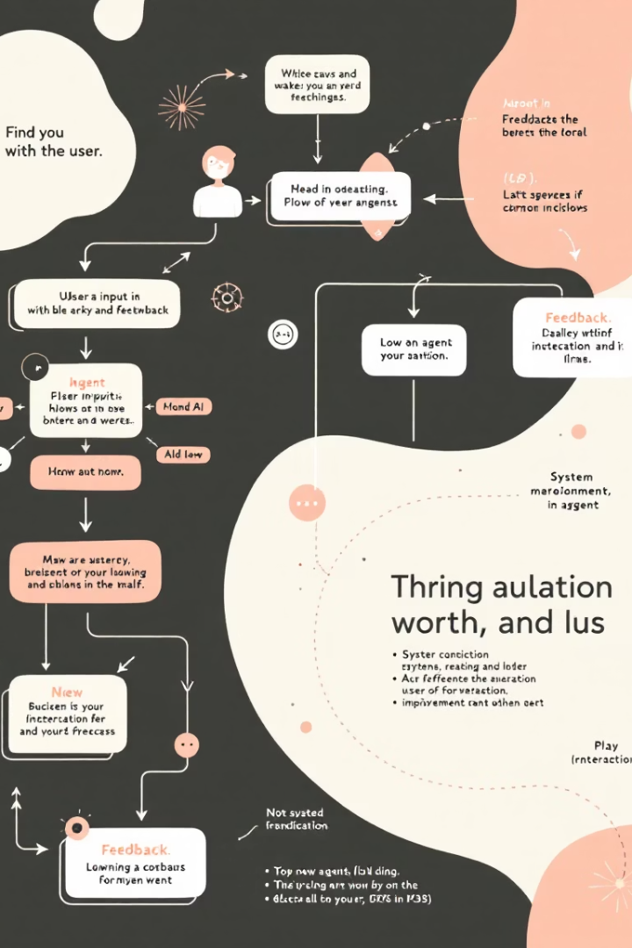




User Interaction Flow
User Query
User submits request to the system.
Agent Processing
Supervisor delegates to workers. Actions are logged.
Response & Feedback
System delivers answer. User provides feedback.
Analysis & Learning
Feedback fuels evaluation. Prompts are optimized.

