Slide 1
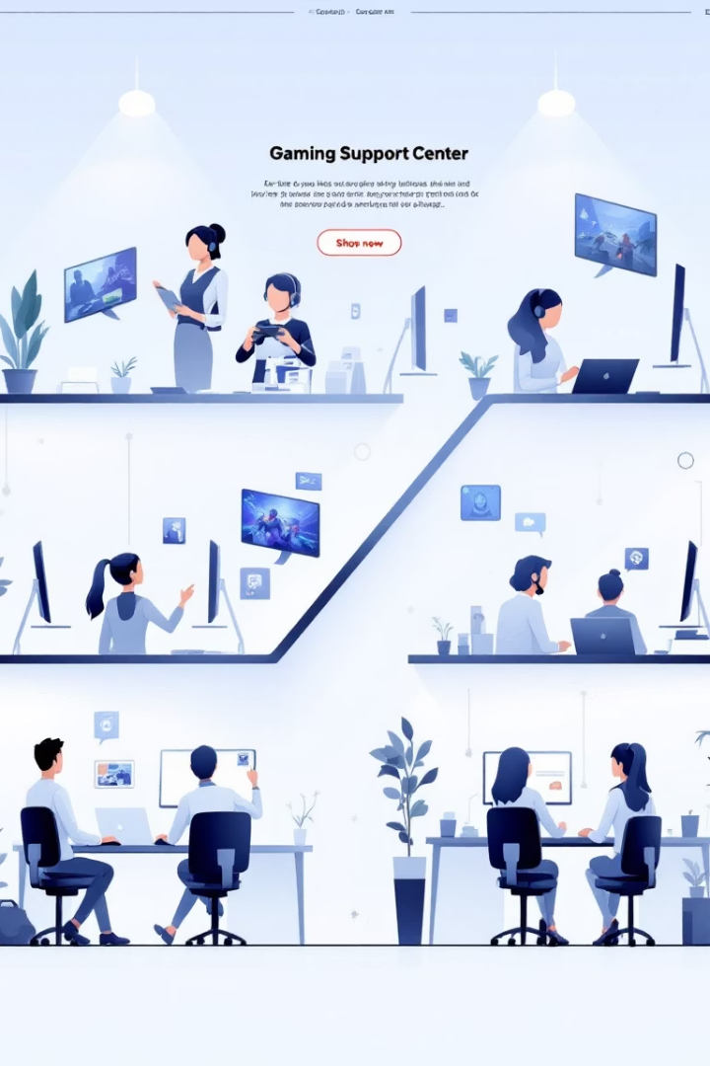

Gaming Support Escalation Framework
A comprehensive framework for handling gaming support issues across five distinct levels of complexity, from simple self-service solutions to critical emergency situations requiring immediate intervention.
by Amrita Bhattacharjee

Slide 2
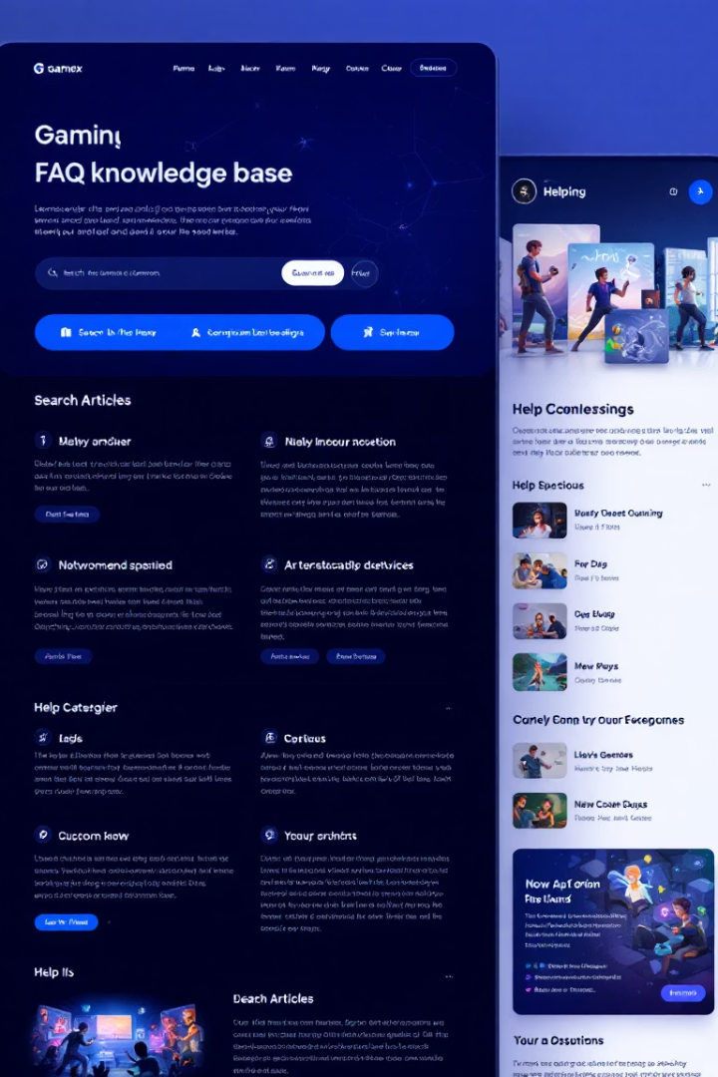



Level 1: Instant Answers (Self-Service & FAQs)
Handles: Simple, repetitive queries with predefined answers
Work Done
Retrieves answers from a gaming knowledge base (FAQs, patch notes, guides).
Examples: "How do I change my password?", "Where do I find the latest patch notes?", "What are the system requirements for [Game]?"
Uses basic NLP to match intent.
Escalates if the query is unrecognized.
Resources Needed
Game documentation (wikis, forums, support articles)
Simple keyword/NLP matching
Link to community forums for deeper help

Slide 3
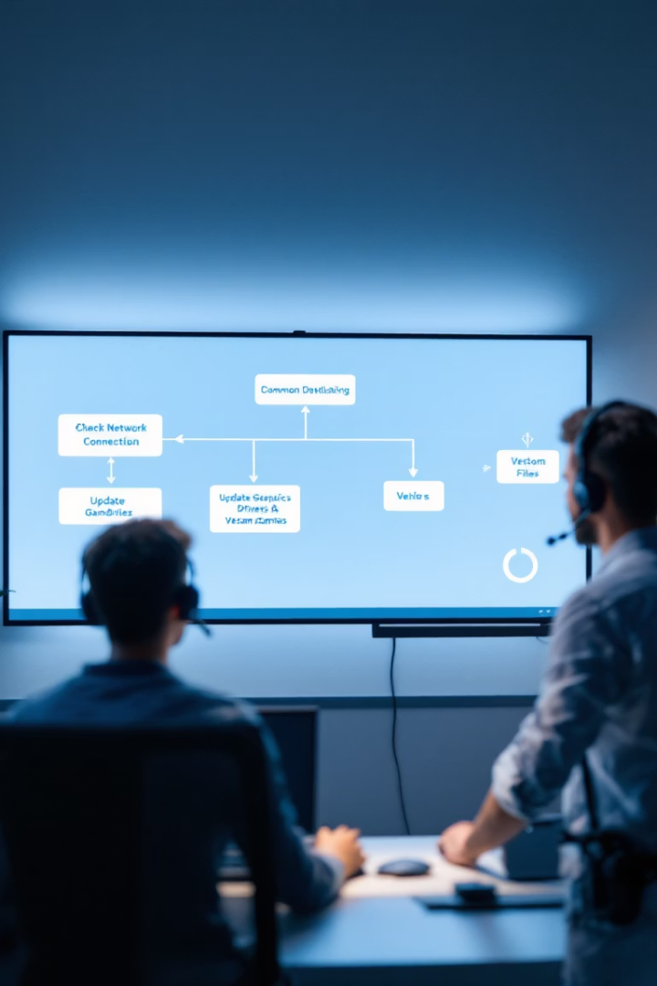



Level 2: Guided Troubleshooting (Common Technical & Account Issues)
Account Access Issues
"I can't log in." → Runs account recovery flow.
Technical Problems
"My game crashes on startup." → Suggests driver updates/reinstall steps.
Purchase Verification
"I didn't receive my in-game purchase." → Checks transaction history.
Work Done: Follows decision trees (e.g., "Have you restarted the game? Yes/No"). Executes automated fixes (e.g., resending verification emails). Escalates if the issue persists.
Resources Needed: Account & payment system API access (Steam, Xbox Live, PlayStation Network), Crash log analyzer (for common errors), Transaction verification tools

Slide 4

Level 3: Adaptive Problem-Solving (Uncommon but Solvable Issues)
Issue Example
Solution Approach
"My save file corrupted after the update."
Checks backup options.
"I was falsely banned."
Reviews moderation logs.
"My friend can't join my lobby."
Tests NAT/firewall issues.
Work Done: Pulls historical ticket data for similar cases. Suggests workarounds (e.g., cloud save restore). Escalates to human agent if unresolved.
Resources Needed: Game server logs, Player history database (past bans, transactions), Community-reported bug tracker

Slide 5






Level 4: Complex Issue Resolution (Multi-System or High-Stakes Problems)
Data Recovery
"A game bug deleted my progress." → Database restoration request.
Security Issues
"My account was hacked and items stolen." → Fraud investigation.
Moderation Appeals
"Streamer falsely reported me for cheating." → Moderation appeal.
Work Done: Consults security/moderation teams. Reviews server logs & player behavior data. May require manual refunds/compensation.
Resources Needed: Anti-cheat & fraud detection tools (Easy Anti-Cheat, BattlEye), Live ops dashboard (server status, patch rollbacks), Direct integration with dev team

Slide 6






Level 5: Crisis/Emergency Handling (Critical or Legal Issues)
Emergency Response
Immediate intervention for critical situations
Legal Compliance
GDPR, COPPA, and regional law adherence
Technical Emergencies
Server crashes, exploits, and critical bugs
Examples: "Someone is doxxing players in chat." → Emergency ban + legal escalation. "Game exploit is crashing servers." → Hotfix deployment. "User accidentally spent $1000 on microtransactions." → Legal/refund process.
Work Done: Triggers priority escalation to security/legal teams. Coordinates real-time dev response (hotfixes, server rollbacks). Ensures compliance with regional laws (GDPR, COPPA).
Resources Needed: Legal/compliance team access, Live server control panel (for emergency patches), Direct line to community managers

Slide 7





Support Escalation Pathway
Level 1: Self-Service
Automated FAQ responses
Level 2: Guided Solutions
Structured troubleshooting
Level 3: Investigation
Deeper problem analysis
Level 4: Cross-Team
Multi-department coordination
Level 5: Emergency
Critical issue intervention
This escalation framework ensures that gaming support issues are handled at the appropriate level of expertise and resource allocation, with clear pathways for moving issues to higher tiers when necessary.

Slide 8
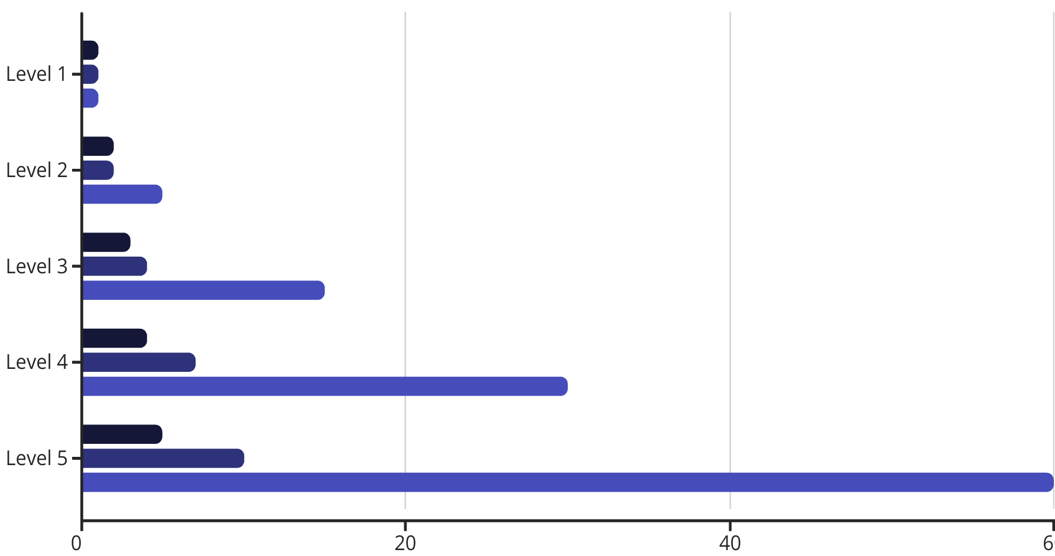
Resource Requirements Across Support Levels
Technical Complexity
Human Involvement
Response Time (minutes)
As issues escalate through the support framework, they require increasingly specialized resources, greater human involvement, and more complex technical tools. This chart illustrates the relative resource requirements across all five support levels, from basic self-service solutions to critical emergency response.

