Slide 1

DevOps Architecture
Made by Amr Ibrahim

Slide 2
Table of contents
Tools used
AWS Architecture
CI/CD Architecture

Slide 3
Tools used
Terraform for provisioning
AWS Cloud provider
Docker and Kubernetes
Jenkins for CI/CD

Slide 4
Tools used
Terraform for provisioning
AWS Cloud provider
Docker and Kubernetes
Jenkins for CI/CD
Loki logging

Slide 5
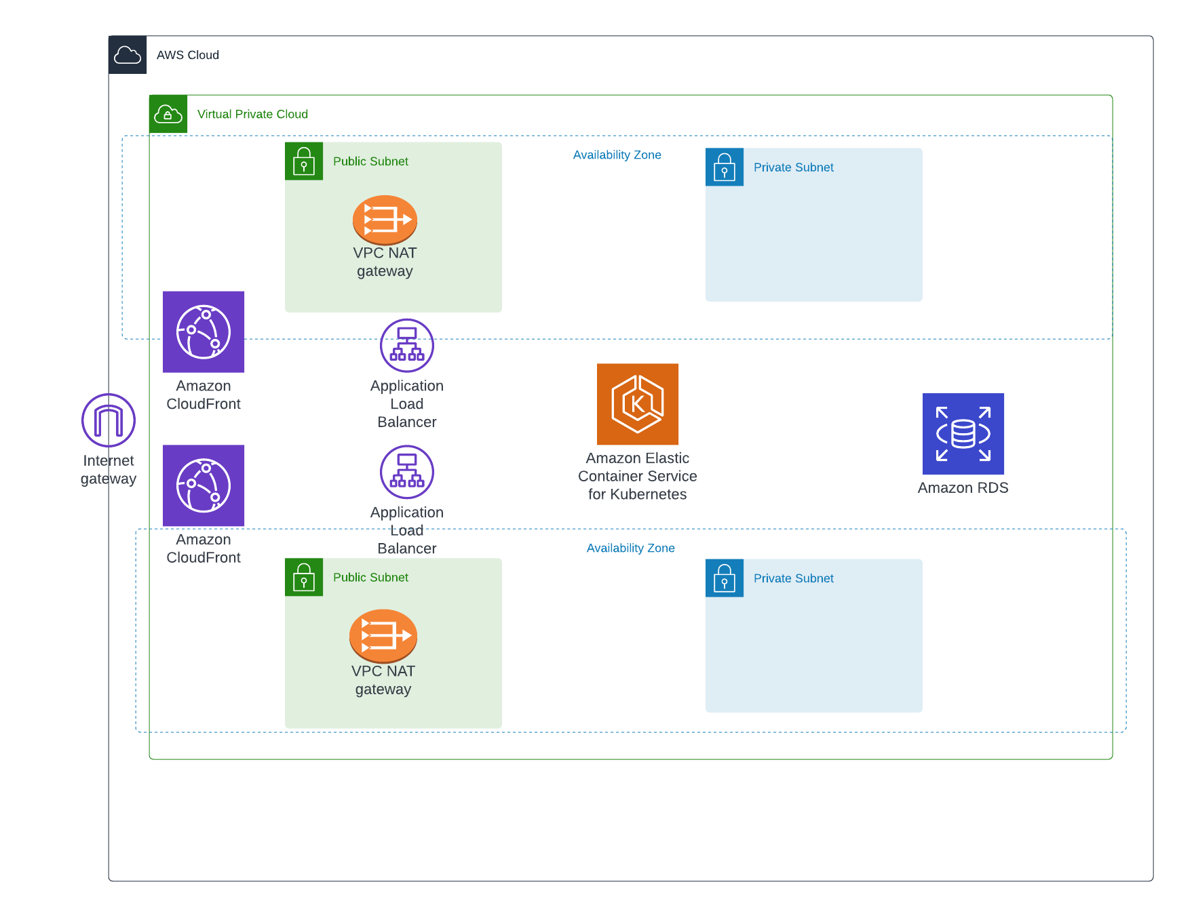
AWS Architecture

Slide 6


CI/CD
Developer
Jenkins trigger a job to agent
Push or make merge request to main branch
Clone new code
Run terraform code
Install loki using helm
Apply Kubernetes files
Update .kube config file

Slide 7
Thanks

