Slide 1

F A S H I O N W A V E
Retail Sales Performance
Analysis
FY 2023–2024 | Business Intelligence Case Study
50 stores across India • 100K transactions • 3 product categories
Prepared from the completed Power BI analysis

Slide 2
Project Objectives & Analytical Approach
Business goals, data scope and preparation used for the case study
OBJECTIVE 01
OBJECTIVE 02
OBJECTIVE 03
Increase weekend sales
Improve profitability
Optimize discounting
Target: +15% next quarter
Identify weak categories and stores
Protect margin while driving demand
DATA SCOPE
DATA PREPARATION
Jan 2023 – Dec 2024
Cleaning before analysis
100,000 transactions across 50 stores and 3 categories: Clothing, Accessories and Shoes.
11 required fields were analyzed, including price, cost, discount, customer type and payment mode.
• Missing Discount values → 0% (no discount)
• Missing CustomerType values → Unknown
• Net Sales = Quantity × Unit Price × (1 − Discount)
• Profit = Net Sales − Quantity × CostPerUnit
Source: FashionWave sales dataset | Power BI analysis | Values rounded for presentation
FashionWave | Retail Sales Performance Analysis | 02

Slide 3
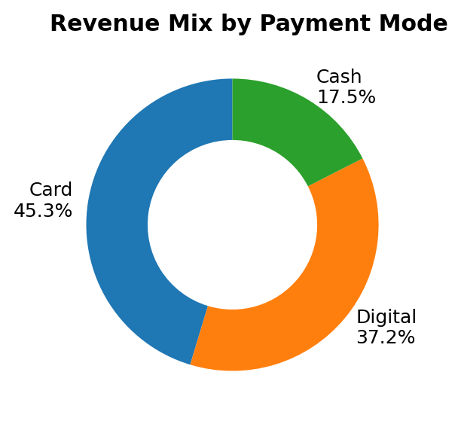
Executive Dashboard — Two-Year Performance
A high-level view of revenue, profitability, customer activity and payment behavior
TOTAL SALES
TOTAL PROFIT
PROFIT MARGIN
AOV
UNITS SOLD
₹24.35 Cr
₹8.06 Cr
33.1%
₹2,435
203.6K
Net of discounts
Profit after product cost
Profit / Net Sales
Revenue per transaction
Across all categories
BUSINESS READ
PAYMENT MIX
Sales are concentrated in core drivers
Card 45.3% | Digital 37.2%
Returning customers contribute 57.0% of revenue.
Shoes contribute 53.9% of revenue, making category mix a major profitability lever.
Cash contributes 17.5% of revenue. Digital already represents 37.2%, creating a strong base for targeted digital offers.
Source: FashionWave sales dataset | Power BI analysis | Values rounded for presentation
FashionWave | Retail Sales Performance Analysis | 03

Slide 4
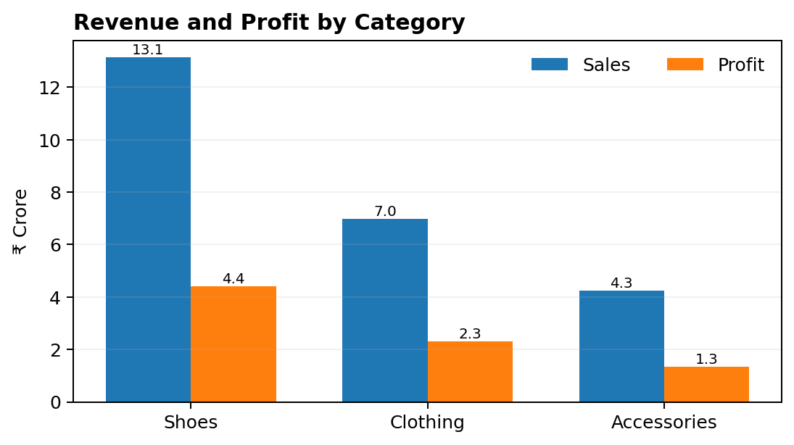
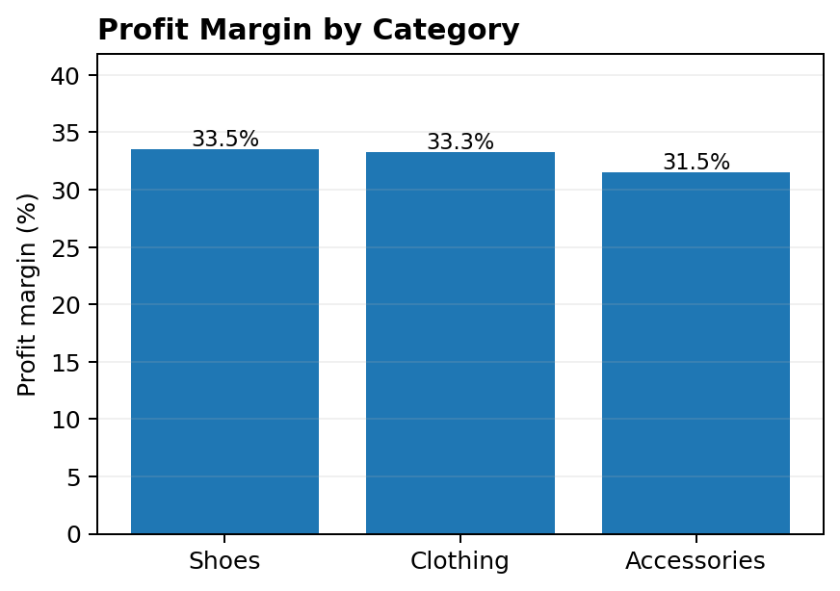
Q1 — Product Category Performance
Which categories generate the highest revenue and profit?
FINDING
FINDING
ACTION
Shoes lead revenue at ₹13.13 Cr
Clothing leads volume at 73.3K units
Accessories margin: 31.5%
53.9% of total sales and ₹4.40 Cr profit.
High unit volume makes availability and assortment important.
Improve pricing, mix and bundles rather than relying on deep discounts.
Source: FashionWave sales dataset | Power BI analysis | Values rounded for presentation
FashionWave | Retail Sales Performance Analysis | 04

Slide 5
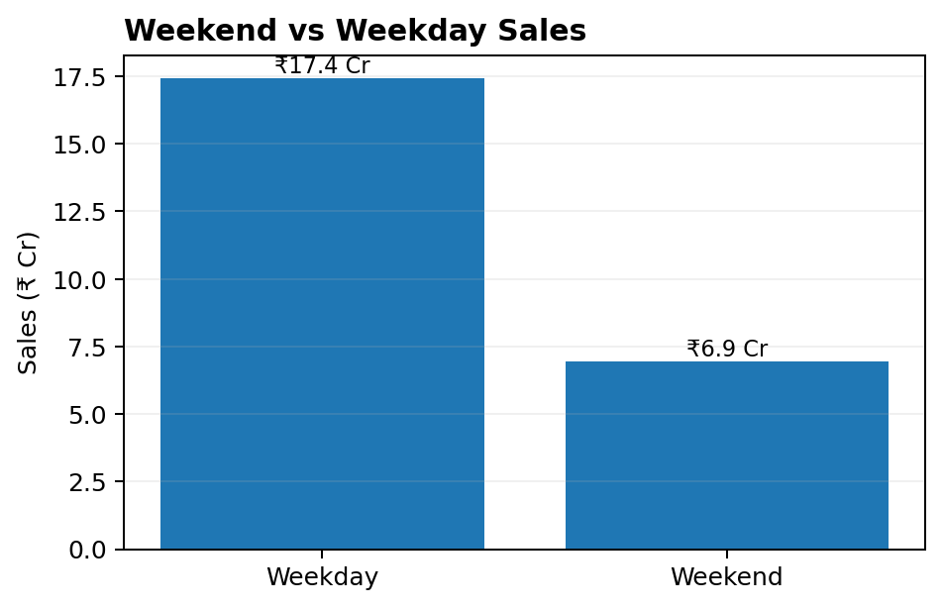
Q2 — Weekend vs Weekday Sales
How do weekend sales compare, and where is the opportunity?
WEEKEND SALES
WEEKEND / WEEKDAY
₹6.93 Cr
0.40×
28.5% of total
Sales ratio
KEY FINDING
Weekend is not materially weaker on a per-day basis
Weekend revenue share is 28.5% versus ~28.6% of calendar days. Average sales/day are ₹3.3L on weekends vs ₹3.3L on weekdays — only about 0.6% lower.
Business implication
The +15% objective should be treated as a growth opportunity, not a recovery from a large per-day sales gap.
Source: FashionWave sales dataset | Power BI analysis | Values rounded for presentation
FashionWave | Retail Sales Performance Analysis | 05

Slide 6
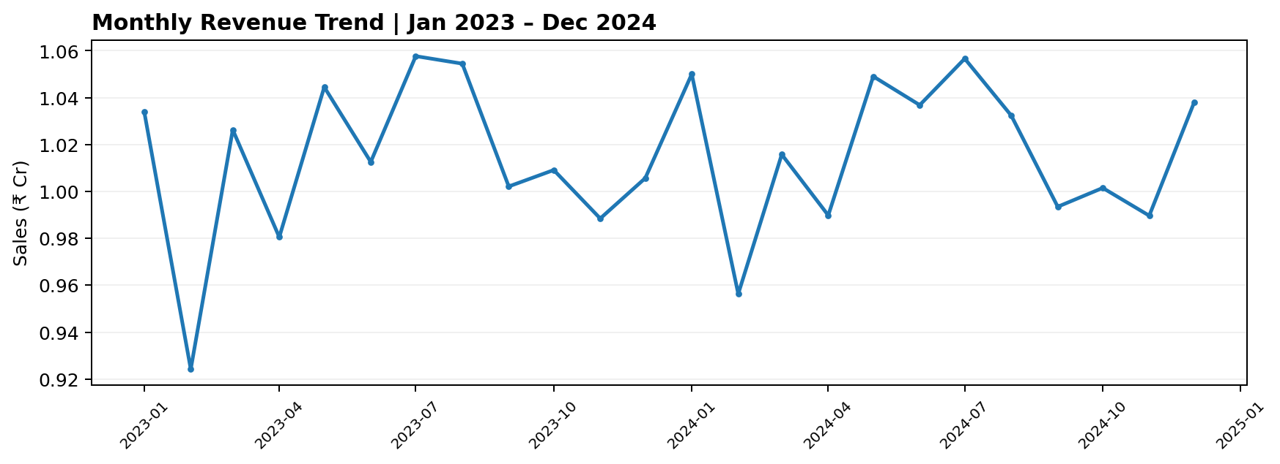
Sales Trend & Seasonality
Monthly performance reveals recurring peaks and softer periods
PEAK PERIOD
PLANNING
ANALYST NOTE
Jul 2023 leads at ₹1.06 Cr
Feb 2023 is the softest month
Seasonality is visible, but external drivers are not in the dataset
Use recurring high-demand periods for inventory and campaign planning.
Use softer periods for targeted clearance, bundles and customer reactivation.
Use the trend for planning; validate festival/event effects with business data before attributing causality.
Source: FashionWave sales dataset | Power BI analysis | Values rounded for presentation
FashionWave | Retail Sales Performance Analysis | 06

Slide 7
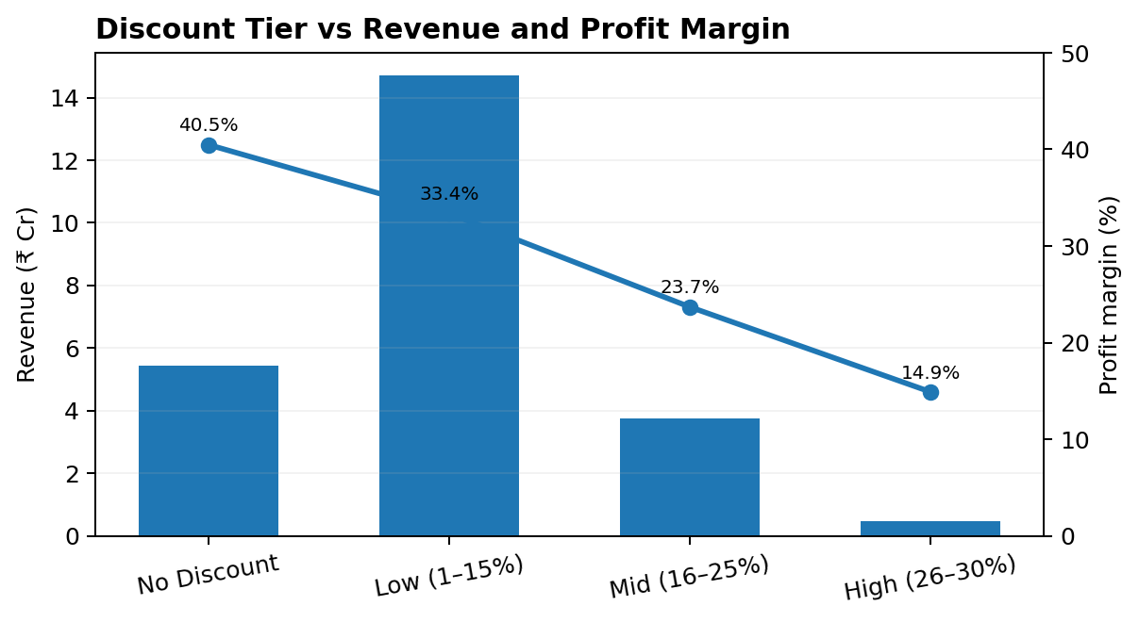
Q3 — Impact of Discounting on Profit Margins
How does discount depth affect profitability?
MARGIN EROSION
40.5% → 14.9%
Profit margin falls sharply from no-discount transactions to the 26–30% discount tier.
WHERE THE VOLUME SITS
60.1% of transactions use 1–15% discount
The low-discount tier is the dominant promotional band, with a 33.4% margin.
RECOMMENDATION
Make deeper discounts targeted, not routine
Keep standard promotions around ≤15%; use 16–20% selectively and reserve 26–30% for controlled clearance or strategic cases.
Source: FashionWave sales dataset | Power BI analysis | Values rounded for presentation
FashionWave | Retail Sales Performance Analysis | 07

Slide 8
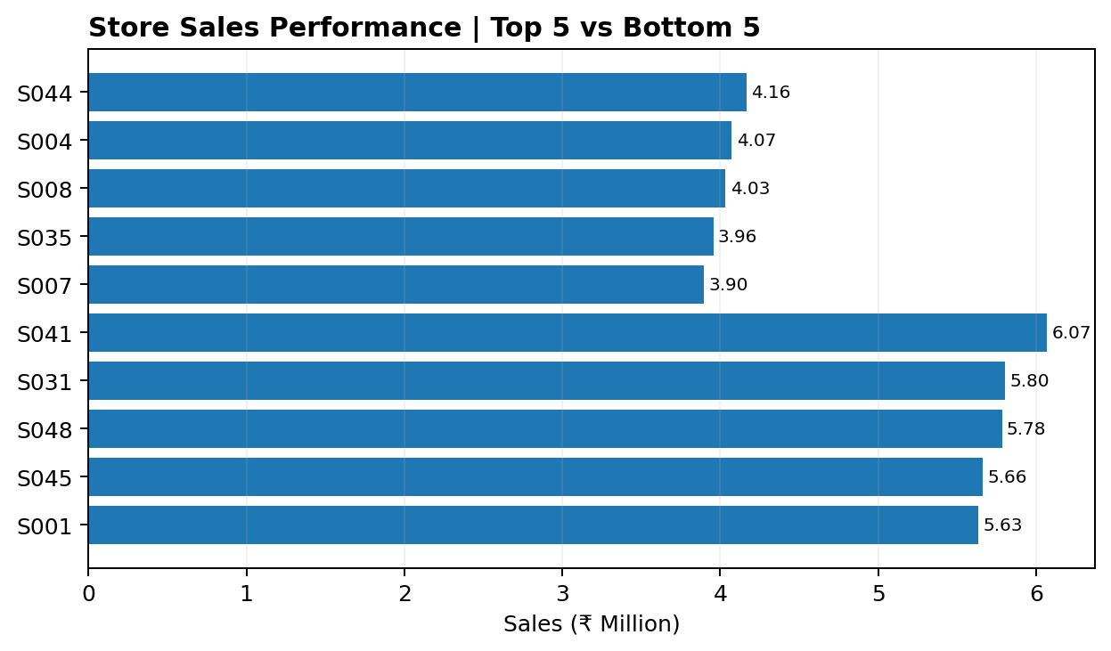
Q4 — Store Performance: Top vs Bottom
Which stores are underperforming, and what does the data suggest?
TOP-5 AVG SALES
BOTTOM-5 AVG
₹5.79M
₹4.02M
per store
per store
PERFORMANCE GAP
43.8% higher sales in the top 5
The gap is primarily a sales-volume issue. Store margins remain relatively close to the overall margin.
POSSIBLE CAUSES TO VALIDATE
Transaction volume, assortment and local demand
The dataset does not contain footfall, staffing, local marketing or inventory depth, so these are hypotheses—not proven causes.
Source: FashionWave sales dataset | Power BI analysis | Values rounded for presentation
FashionWave | Retail Sales Performance Analysis | 08

Slide 9
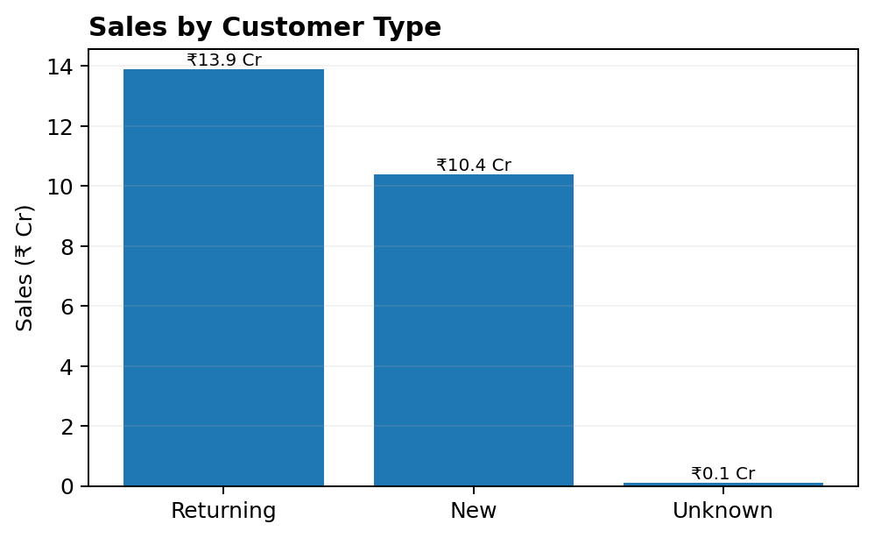
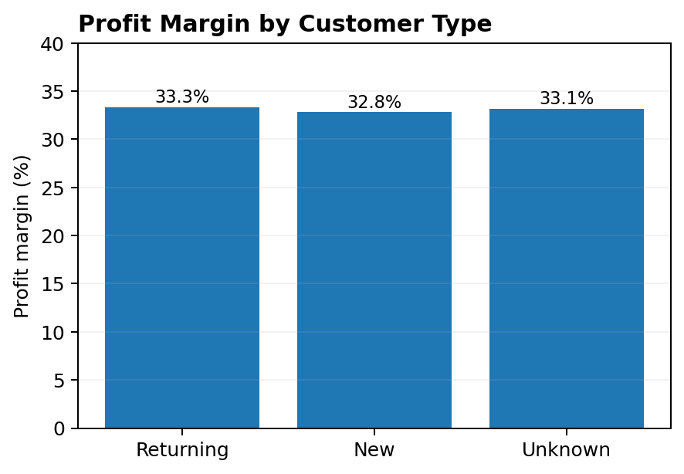
Q5 — Customer Segmentation & Targeted Strategies
Segment customers using purchase behavior available in the dataset
RETURNING CUSTOMERS
NEW CUSTOMERS
57.0% of revenue | AOV ₹2,451
42.6% of revenue | AOV ₹2,413
Priority: loyalty, repeat-purchase journeys, early access and category cross-sell. Margin is slightly above New customers.
Priority: post-purchase re-engagement, first-to-second purchase conversion and targeted category recommendations.
Source: FashionWave sales dataset | Power BI analysis | Values rounded for presentation
FashionWave | Retail Sales Performance Analysis | 09

Slide 10
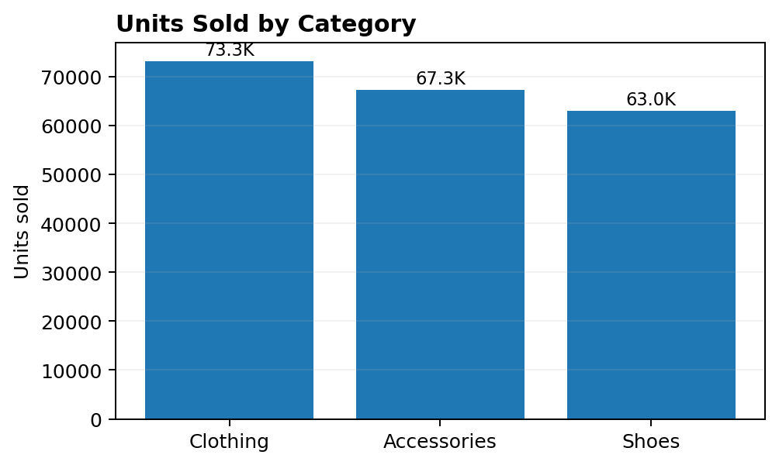
EDA Deep Dive — Payment Mix & Product Volume
Supporting signals for campaign, assortment and checkout strategy
PAYMENT BEHAVIOR
VOLUME LEADER
REVENUE LEADER
Card leads at 45.3%
Clothing: 73.3K units
Shoes: ₹13.13 Cr
Digital is already 37.2% of revenue — useful for targeted digital offers.
Maintain size availability and breadth in the highest-volume category.
Use pricing and promotion discipline because Shoes carry the largest revenue pool.
Source: FashionWave sales dataset | Power BI analysis | Values rounded for presentation
FashionWave | Retail Sales Performance Analysis | 10

Slide 11
Strategic Recommendations
Prioritized actions directly linked to the analysis
QUICK WINS | 0–3 MONTHS
LONGER-TERM | 3–12 MONTHS
ACTION 1
ACTION 1
Pilot weekend-only offers on selected high-demand SKUs; measure incremental sales rather than blanket discounting.
Build a store/category KPI scorecard with Sales, AOV, Margin, Units and Discount Impact.
ACTION 2
ACTION 2
Keep routine discounts around ≤15%; approve deeper offers only for targeted campaigns or clearance.
Use customer purchase history to move beyond New/Returning into richer behavioral segments when more data becomes available.
ACTION 3
ACTION 3
Launch returning-customer loyalty rewards and first-to-second-purchase journeys for New customers.
Strengthen Shoes pricing and supplier-cost review because Shoes drive the largest revenue and profit pool.
ACTION 4
ACTION 4
Create a bottom-store action list using transactions, sales and margin; test local campaigns before scaling.
Use monthly seasonality to plan inventory, campaigns and clearance windows ahead of demand changes.
Source: FashionWave sales dataset | Power BI analysis | Values rounded for presentation
FashionWave | Retail Sales Performance Analysis | 11

Slide 12
F A S H I O N W A V E
From descriptive analysis to action
The analysis points to three priorities: protect margin, grow high-value customer relationships, and use store/category insights to target growth rather than applying broad discounts.
01 | PROFITABILITY
02 | GROWTH
03 | FOCUS
33.1% overall margin
57.0% revenue from Returning
53.9% from Shoes
Discount depth is the clearest margin lever.
Retention and repeat purchase are key growth levers.
Prioritize the largest revenue pool while protecting margin.
Thank you • Questions & Discussion

