Slide 1
TB
TASTYBITES
TB
PRODUCT PRICING &
PROFITABILITY ANALYSIS
Business Intelligence Case Study
3,000 orders • 20 products • 4 categories
October 2024 – September 2026

Slide 2
PROJECT OBJECTIVES
Revenue & Profitability
Discount Optimization
Pricing Opportunities
Promotion & Bundling
Identify products and categories that drive the highest revenue and profit, using net revenue after discount.
Measure the monetary impact of discounts and assess how discount levels relate to product and category profitability.
Identify high-volume, healthy-margin products that are candidates for controlled price-adjustment tests.
Recommend targeted promotions and bundle structures that increase value per order without unnecessary margin erosion.
KPIs: Revenue per Product • Profit Margin % • Units Sold • Discount Impact • Contribution to Total Profit • AOV
TastyBites • Product Pricing & Profitability Analysis

Slide 3
EXECUTIVE DASHBOARD — OVERALL PERFORMANCE
TOTAL REVENUE
TOTAL PROFIT
PROFIT MARGIN
₹10.8L
₹4.8L
45.0%
Net of discounts
Revenue less product cost
Profit ÷ Revenue
AVERAGE ORDER VALUE
TOTAL ORDERS
UNITS SOLD
₹359
3,000
6,885
Revenue ÷ unique orders
Unique OrderIDs
Total quantity
Executive readout
Meals generate 59.2% of revenue and 50.7% of total profit. Beverages deliver the strongest category margin at 58.8%. Total discount impact is ₹1.0L, equivalent to 8.7% of gross sales before discount.
TastyBites • Product Pricing & Profitability Analysis

Slide 4
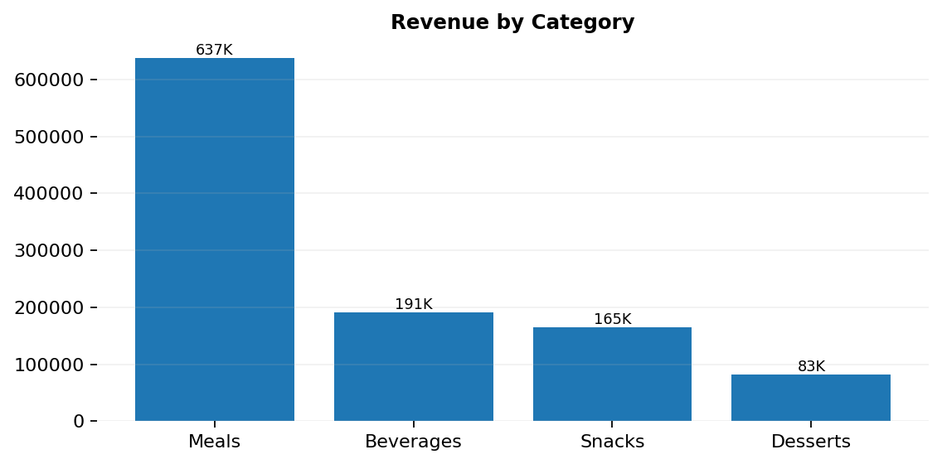
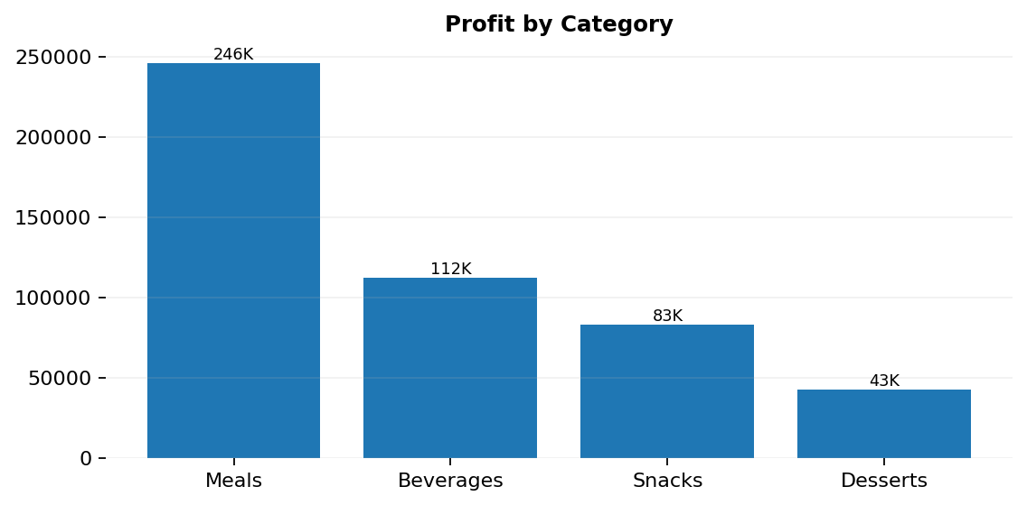
Q1: PRODUCTS & CATEGORIES GENERATING THE HIGHEST REVENUE AND PROFIT
Revenue leaders
Profit leaders
Top product: Chicken Biryani at ₹0.9L. Meals lead category revenue at ₹6.4L.
Top product: Chicken Biryani at ₹0.3L. Beverages have the highest category margin at 58.8%, making them strong profit-supporting products.
TastyBites • Product Pricing & Profitability Analysis

Slide 5
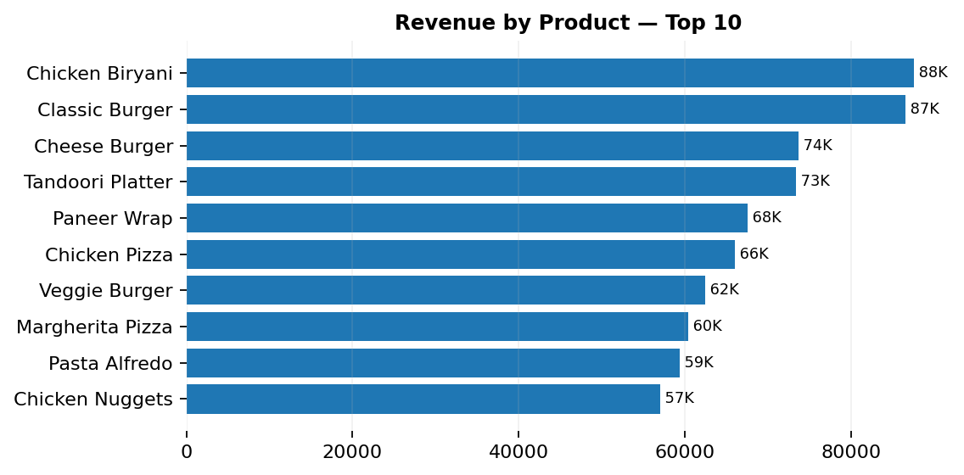
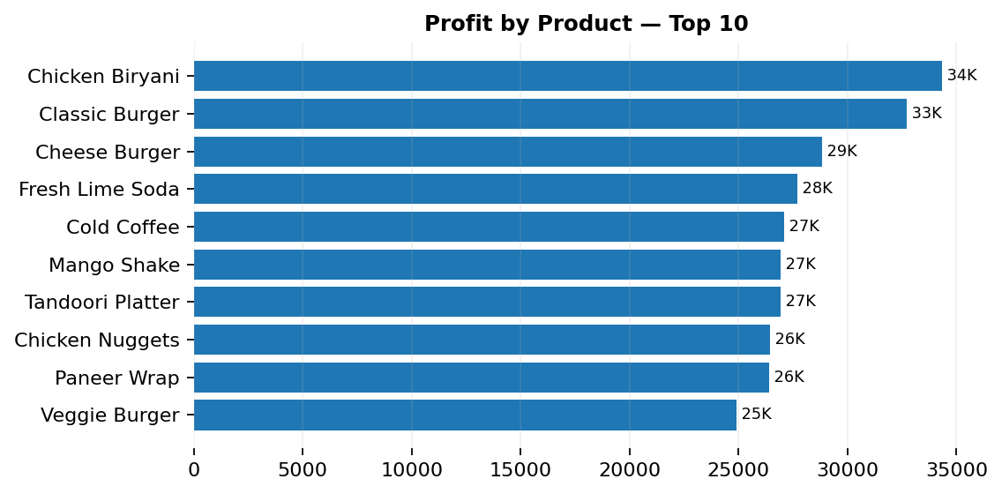
Q1: PRODUCT-LEVEL PERFORMANCE — REVENUE, PROFIT & MARGIN
Top revenue products
Top profit products
1. Chicken Biryani — ₹87.6K
2. Classic Burger — ₹86.6K
3. Cheese Burger — ₹73.7K
1. Chicken Biryani — ₹34.4K
2. Classic Burger — ₹32.7K
3. Cheese Burger — ₹28.8K
TastyBites • Product Pricing & Profitability Analysis

Slide 6
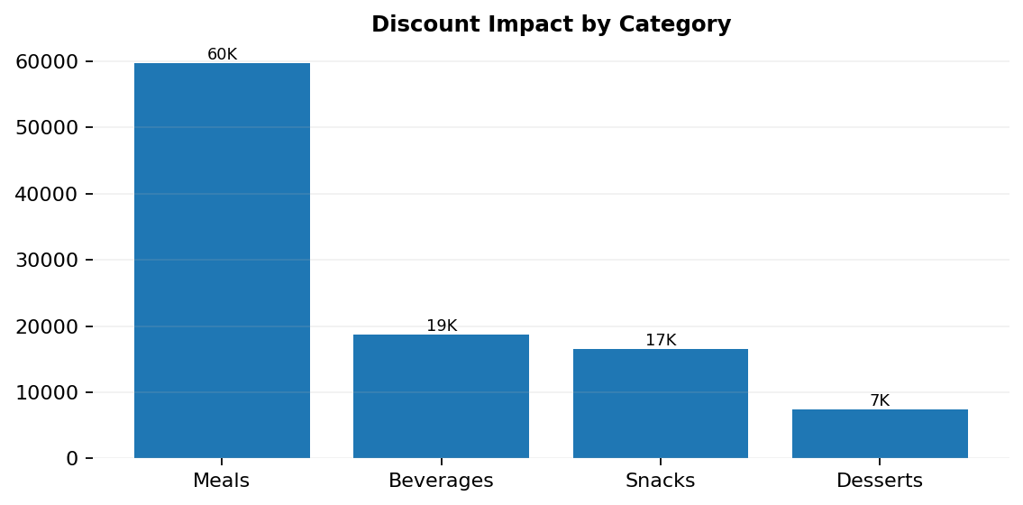
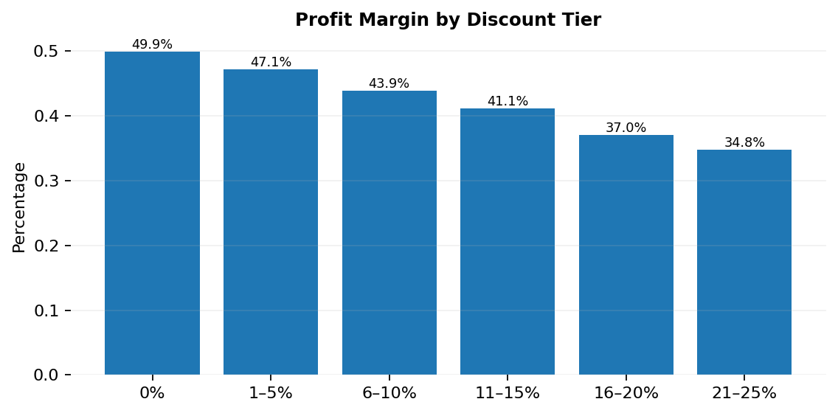
Q2: HOW DISCOUNTS AFFECT PROFITABILITY
Largest discount impact
Margin trend
Chicken Biryani has the highest product-level discount impact at ₹0.1L, followed by Classic Burger (₹0.1L) and Paneer Wrap (₹0.1L).
Margin falls from 49.9% at 0% discount to 34.8% in the 21–25% tier. No transactions exceed 25% in this dataset.
TastyBites • Product Pricing & Profitability Analysis

Slide 7
Q2: PRODUCT & CATEGORY PROFITABILITY COMPARISON
CATEGORY-LEVEL ANALYSIS
PRODUCT-LEVEL HIGHLIGHTS
Category
Revenue
Profit
Margin
Disc. Impact
Product
Profit
Margin
Units
Avg Disc.
Meals
₹637K
₹246K
38.6%
₹60K
Chicken Biryani
₹34K
39.2%
344
8.4%
Beverages
₹191K
₹112K
58.8%
₹19K
Classic Burger
₹33K
37.8%
430
8.3%
Snacks
₹165K
₹83K
50.4%
₹17K
Cheese Burger
₹29K
39.1%
321
8.1%
Desserts
₹83K
₹43K
52.0%
₹7K
Fresh Lime Soda
₹28K
61.6%
494
8.8%
Cold Coffee
₹27K
54.7%
363
8.8%
Mango Shake
₹27K
53.5%
326
9.4%
Tandoori Platter
₹27K
36.7%
190
7.8%
Business interpretation
Discounts are not equally harmful across the portfolio. Meals absorb the largest absolute discount impact because of their sales scale, while beverages retain the strongest margins. Promotion design should therefore protect high-volume meal margins and use high-margin beverages/desserts as value-adding components.
TastyBites • Product Pricing & Profitability Analysis

Slide 8
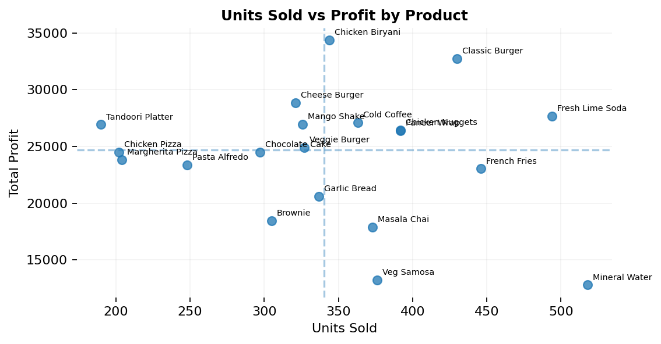
Q3: PRODUCTS THAT SELL A LOT BUT CONTRIBUTE RELATIVELY LITTLE TO PROFIT
KEY READOUT
• Mineral Water: 518 units but only ₹0.1L profit.
• Fresh Lime Soda: 494 units and 61.6% margin.
• French Fries: 446 units and 51.9% margin.
The clearest high-volume / lower-margin pressure sits in the Meals category, where several best-selling products operate around 37–40% margins.
Action
Avoid broad discounts on these volume drivers. Test bundle pricing, supplier-cost improvements, and small price changes before adding further promotions.
TastyBites • Product Pricing & Profitability Analysis

Slide 9
Q4: CANDIDATE PRODUCTS FOR CONTROLLED PRICE ADJUSTMENTS
Product
Units Sold
Profit Margin
Avg Discount
Discount Impact
Mineral Water
518
67.3%
8.2%
₹2K
How to interpret the candidates
Recommended test design
These products combine strong current volume with healthy margins and moderate discount dependence. They are candidates for controlled pricing tests — not proof that volume will remain unchanged after a price increase.
Use a small A/B or store-level pilot, monitor units sold, revenue, margin and repeat purchase rate, and compare against a control group before making a permanent price change.
TastyBites • Product Pricing & Profitability Analysis

Slide 10
Q5: PROMOTIONS & BUNDLING STRATEGIES TO IMPROVE PROFITABILITY
1
Meal + Beverage Bundles
2
Add-On Dessert Strategy
Use high-volume meal anchors with high-margin beverages such as Fresh Lime Soda or Cold Coffee. Offer a small bundle saving rather than a deep discount.
Attach Chocolate Cake or Brownie to popular meal orders as a low-friction add-on. The objective is to lift order value while protecting margin.
3
Targeted Promotions
4
Buy-More, Save-More
Use promotions selectively on lower-margin or slower products. Avoid blanket discounts on products already generating strong demand and profit.
For high-volume products, use controlled quantity thresholds rather than large single-item discounts to encourage incremental units.
Important data limitation
The dataset does not contain basket-level co-purchase information, so these are performance-based bundle recommendations, not observed customer purchase combinations.
TastyBites • Product Pricing & Profitability Analysis

Slide 11
STRATEGIC RECOMMENDATIONS
QUICK WINS (0–3 MONTHS)
LONG-TERM (3–12 MONTHS)
Quick win 1
Long-term 1
Prioritize meal + beverage bundles to raise AOV without deep discounting.
Build basket-level data collection to validate true product affinities and bundle combinations.
Quick win 2
Long-term 2
Review discount-heavy meal products, especially Chicken Biryani and Classic Burger.
Introduce price elasticity experiments with control groups before permanent price changes.
Quick win 3
Long-term 3
Use targeted promotions instead of portfolio-wide percentage discounts.
Develop a discount governance framework by product margin and customer type.
Quick win 4
Long-term 4
Pilot controlled price tests on high-volume, healthy-margin products.
Track Revenue, Profit, Margin, AOV, Units Sold and Discount Impact in a recurring Power BI review.
TastyBites • Product Pricing & Profitability Analysis

Slide 12
TB
TASTYBITES
Thank You
Product Pricing & Profitability Analysis

