Slide 1
MUNICIPAL POLICY & ATMOSPHERIC ML ENGINE
AQI Prediction & Urban Policy Impact Simulator
A machine learning engine designed to quantify urban air quality dynamics and simulate municipal policy interventions prior to public enforcement.
Core Technology Stack: Python • Scikit-Learn • FastAPI • Streamlit • Joblib

Slide 2
ENVIRONMENTAL ML
The Governance Gap: Reactive Warnings vs. Proactive Modeling
1. Complex Environmental Interdependence
Urban AQI fluctuates non-linearly across multiple variables. Emission baselines from traffic and factory output interact dynamically with wind speed, temperature, and humidity dispersion rates.
Traditional linear models fail to capture these tipping points, leading to high estimation error during peak smog months.
2. Unquantified Policy Interventions
Municipalities traditionally react to severe pollution spikes after hazardous thresholds are crossed. Drastic policies like vehicle bans or factory closures are implemented without quantitative pre-evaluation.
This creates public economic disruption without guaranteeing whether the intervention will successfully reduce local AQI to safe levels.

Slide 3
ENVIRONMENTAL ML
Engineered Solution: Predictive ML & Policy Simulation
01 / PREDICTION ENGINE
Deterministic ML Core
A Random Forest model trained on multi-source weather, traffic, and industrial spatial metrics.
It captures complex non-linear atmospheric interactions to deliver accurate hourly AQI forecasts, outperforming mean baselines by over 75%.
02 / SIMULATION ENGINE
Policy Delta Simulator
A dedicated scenario simulation backend enabling urban planners to adjust policy deltas (e.g., -30% traffic, -20% factory emissions).
It re-calculates predicted AQI gains instantly, providing actionable quantitative yield data before enforcement.

Slide 4
ENVIRONMENTAL ML
System Architecture: End-to-End Pipeline Infrastructure
System Layer | Technologies | Core Operational Responsibilities
Data Pipeline | Open-Meteo, OSM API | Ingests atmospheric weather, factory spatial density, and diurnal rush-hour traffic proxies. Applies IQR outlier capping.
ML Engine Core | Scikit-Learn, Joblib | Random Forest Regressor (100 trees, max depth 12). Evaluated via 5-Fold Cross-Validation and serialized as a lightweight artifact.
Backend API | FastAPI, Pydantic | Asynchronous HTTP engine providing POST /predict for inference and POST /simulate for real-time scenario delta processing.
Control Dashboard | Streamlit | Interactive decision interface with policy sliders, live AQI risk indicators, and side-by-side scenario comparison charts.

Slide 5
ENVIRONMENTAL ML
Actionable Municipal Applications & Simulations
-30%
Traffic Restrictions
Simulating 'Odd-Even' vehicle bans during stagnant, low-wind winter days to test if traffic cuts alone drop AQI below severe thresholds.
-50%
Industrial Curtailment
Modeling an operational cap on factories within a 25km radius during inversion events, balancing air safety against industrial downtime.
Long-Term
Urban Planning
Evaluating high-capital infrastructure changes like low-emission zones or bus fleet electrification to forecast long-term AQI returns.

Slide 6
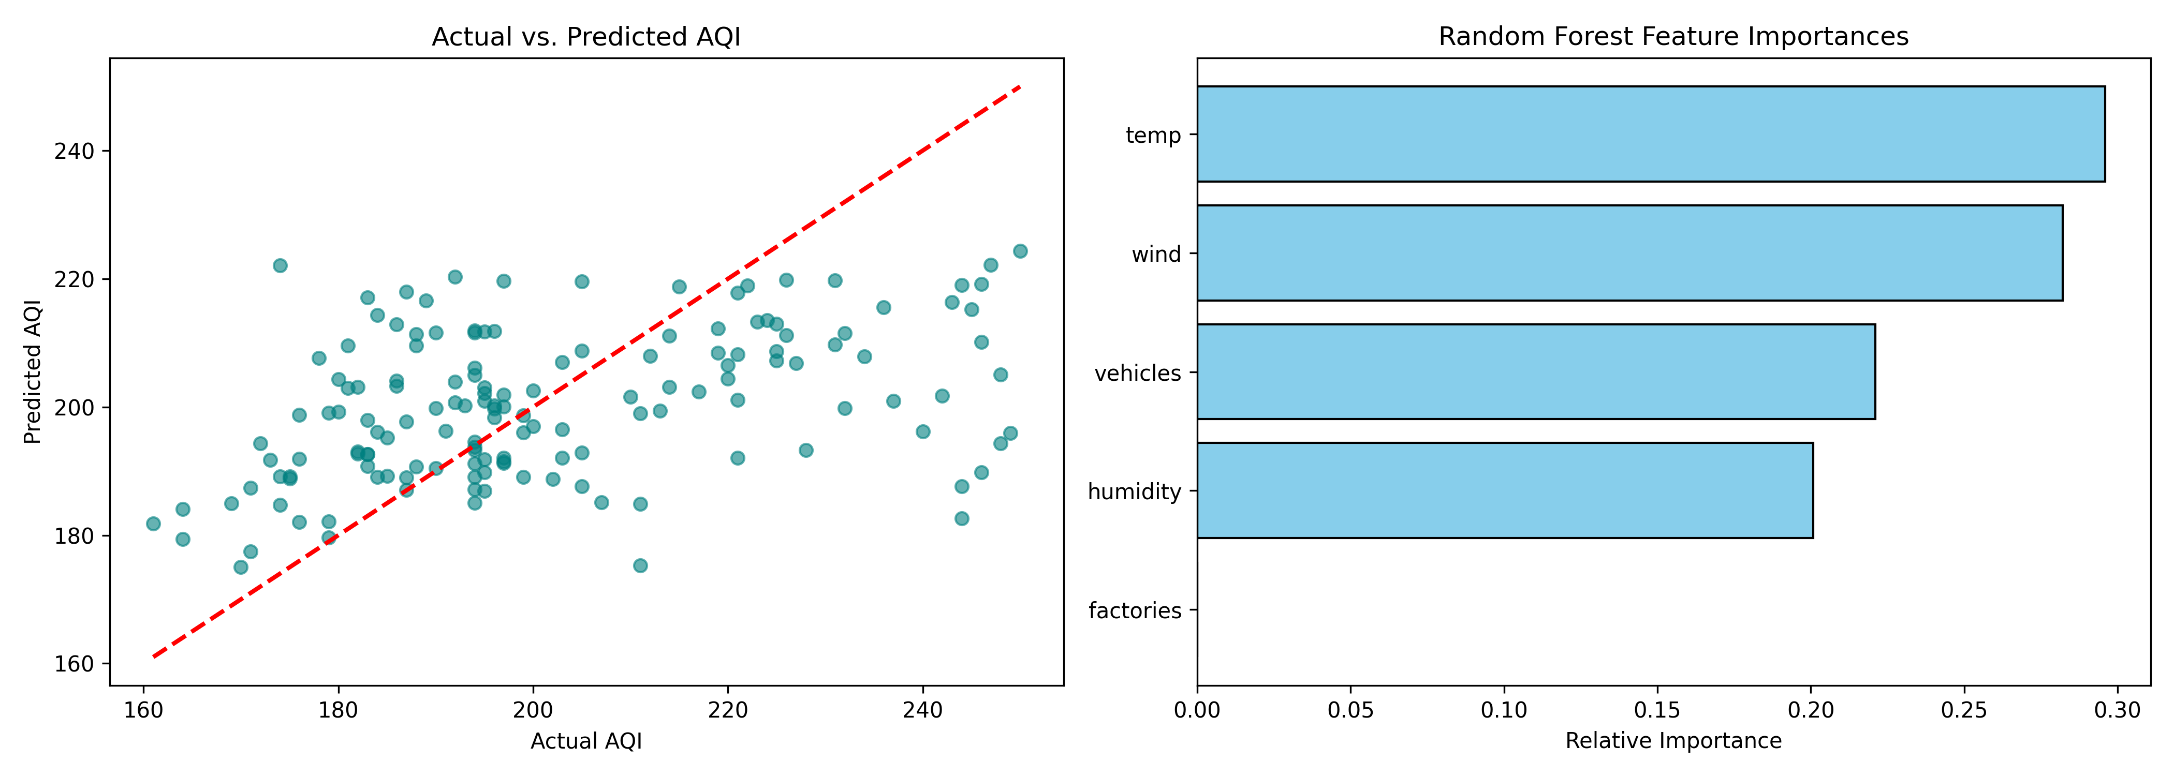
ENVIRONMENTAL ML
Model Performance & Diagnostic Validation
< 8.5 MAE
Target Accuracy Level
Outperforms the ~38.4 baseline mean estimation error by over 75%.
Diagnostic Key Insights
• Cross-Validation: Verified consistency across 5 distinct data folds with zero temporal overfitting.
• Primary Feature Drivers: Traffic density and factory counts dictate baseline emissions, while wind speed acts as the primary natural dispersion mechanism.

Slide 7
Development Roadmap & Future Expansion
PHASE 01
ML Core Engine
COMPLETED
Data pipeline built with weather and spatial APIs. Outliers capped via IQR. Random Forest model trained, cross-validated, and serialized as joblib artifact.
PHASE 02
Full-Stack Integration
IN PROGRESS
FastAPI backend implementation with asynchronous POST /predict and POST /simulate endpoints. Interactive Streamlit dashboard with policy sliders.
PHASE 03
Spatial Expansion
FUTURE SCOPE
Ingestion of Sentinel-5P satellite aerosol data. Expansion from single-city predictions to multi-zone spatial grid heatmaps and LSTM time-series forecasts.

