Slide 1
MINI PROJECT
FACE DETECTION
&
RECOGNITION

Slide 2
FACE DETECTION AND RECOGNITION
Arif Alam Ansari
CSDS A
4th sem
Amritanshu Sharma
CSDS A
4th sem
Aditya Raj
CSDS A
4th sem
Adiba
CSDS A
4th sem

Slide 3
Problem Statement
Identify or varify one or more persons in the scene using a stored database of faces.
Identify person face from a traffic video.
To control the devices using face expression and eye movement.

Slide 4
Introduction
Face detection and recognition are two related technologies that have become increasingly prevalent in recent years, thanks to advances in computer vision, artificial intelligence, and machine learning. In this article, we will explore the basics of face detection and recognition, their underlying technologies, their applications, and their potential risks and ethical considerations.
Face Detection
Face detection is the process of locating human faces in digital images or videos. This is typically done using a combination of image processing techniques, machine learning algorithms, and statistical models. The goal of face detection is to identify the presence and location of a face in an image or video frame, regardless of the position, orientation, or size of the face.

Slide 5
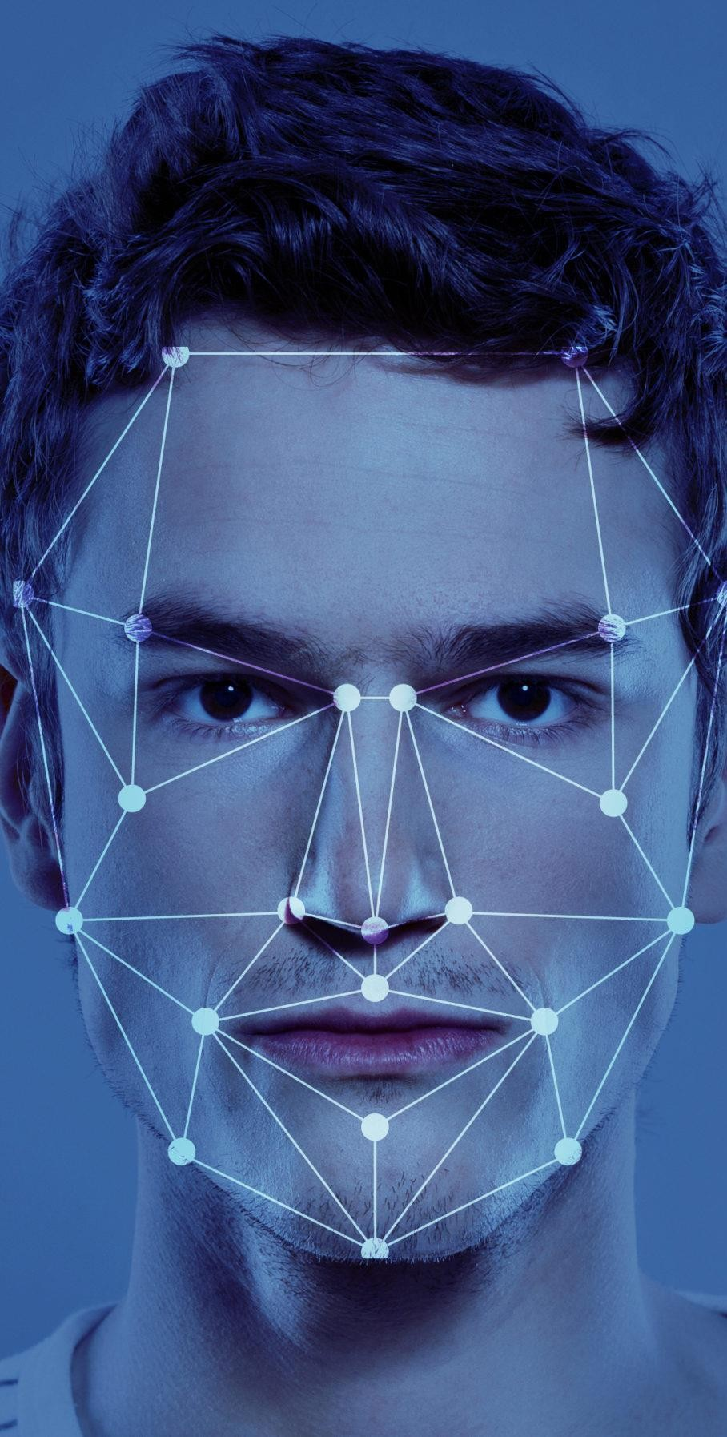
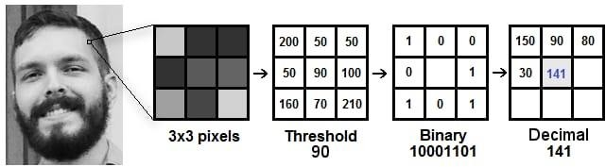

Slide 6
Face Recognition
Face recognition is the process of identifying a person by comparing their facial features with a pre-existing database of faces. This is done by analyzing the unique features of a person's face, such as the shape of their eyes, the size of their nose, and the contours of their cheeks.
Applications of Face Detection and Recognition
Face detection and recognition have many practical applications in various fields, including security and surveillance, biometric identification, marketing and advertising, and entertainment

Slide 7
Feasibility Study
OpenCV provides several face detection algorithms, and the selection of a suitable algorithm depends on the lighting conditions, the size of the face, and the speed required for the application.
The system should be designed to maintain privacy and security, including protecting the facial data of individuals.
A feasibility study assessing the hardware requirements, data requirements, face detection, and recognition algorithms, privacy, security and maintenance considerations, and scalability must be undertaken before embarking on a project.

Slide 8

Open Source Computer Vision Library

Slide 9
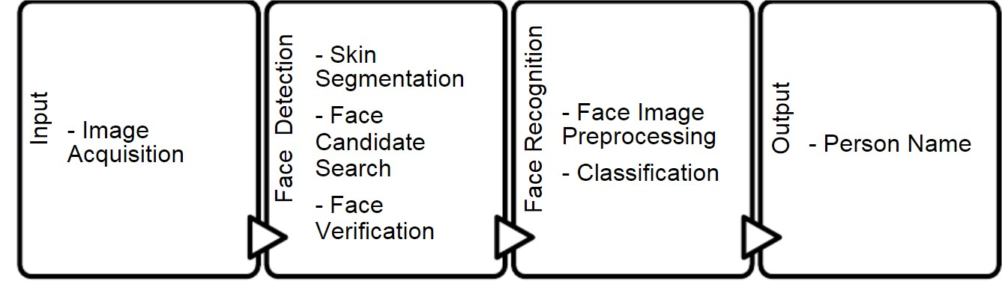
Methodology
Gary Bradski proposed the idea of OpenCV, which could operate on a multi-level architecture. OpenCV contains a number of noteworthy features and conveniences that are immediately apparent. The OpenCV assists in identifying a person's frontal face and also generates XML documents for various places, such as body parts
A face recognition system requires the input component. The picture acquisition process is completed in this section. Live pictures are transformed to digital data so that image-processing operations may be carried out on them. A face detection algorithm receives these collected photos. For the face recognition system, face detection handles face picture extraction and
location tasks.

Slide 10

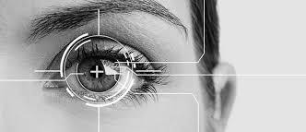


Retina scan for removing duplication.
Python library for retina scan G6-iris-recognition

Slide 11
Facilities required for proposed work
Software Requirements
Operating system: OpenCV is compatible with Windows, Linux, macOS, and other platforms.
Python: OpenCV can be used with Python, so a compatible version of Python will be required.
OpenCV library: The OpenCV library will need to be installed on your system. You can install it using package managers such as pip or conda, or by building it from source code.
Integrated Development Environment (IDE): You can use any text editor or IDE that supports Python, such as PyCharm, Spyder, or Visual Studio Code.

Slide 12

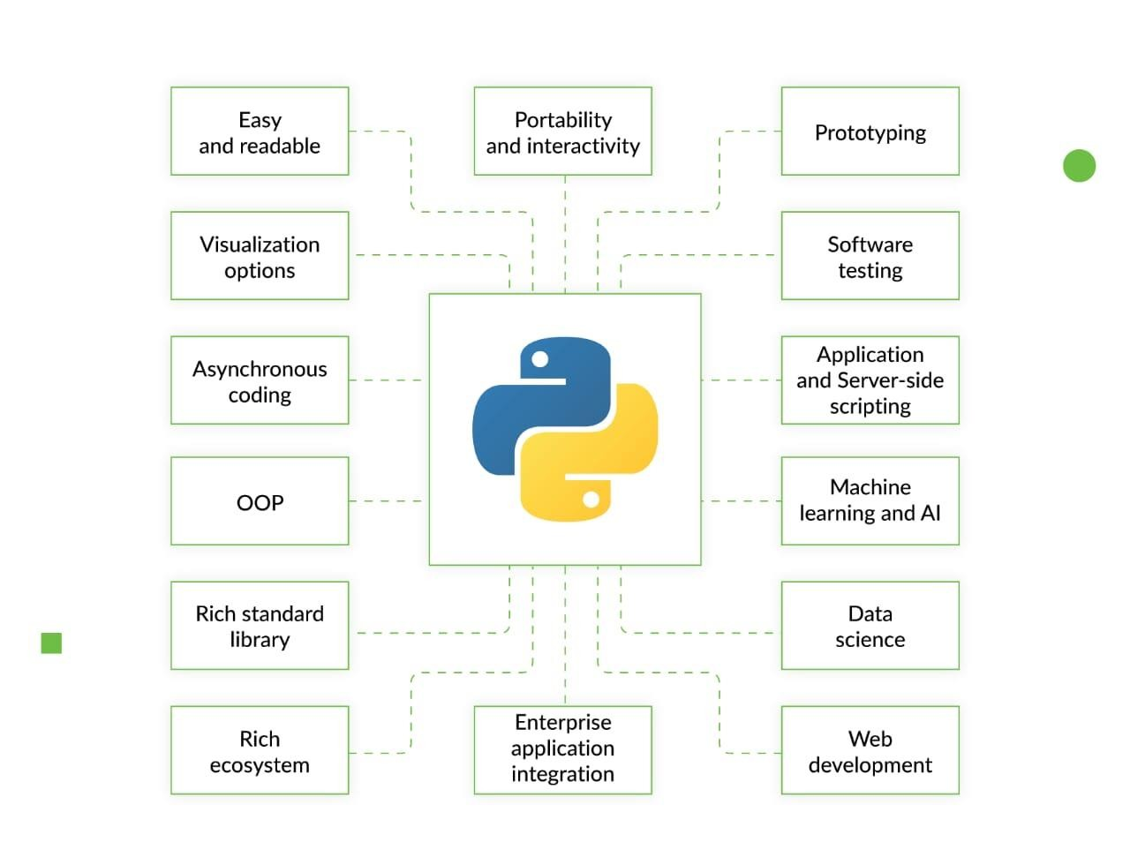
Back end technology

Slide 13
Hardware Requirements
Camera: A high-resolution camera with good image quality and adequate lightening is required in a face recognition system.
Processor: A multi-core processor is recommended for faster processing.
Memory: Sufficient memory to store and manipulate large amount of data is required.
GPU: A dedicated graphics processing unit (GPU) can improve the speed and accuracy of face recognition algorithms.
Storage: Adequate storage capacity is necessary to store large database of faces for recognition.
Network connectivity: A high-speed network connection is essential for remote access and sharing of face recognition data.
Power supply: The system should have a reliable and uninterrupted power supply to ensure continuous operation.
RAM: A minimum of 4 GB of RAM is recommended, but higher RAM capacity will be better for larger datasets or more complex algorithms.
Display: A display to monitor the system’s performance and output during operation.

Slide 14
thank you

