Slide 1
SENTIMENT ANALYSIS
Amazon Reviews for Mobiles
INFO6105 FINAL PROJECT
AMRITA DUBEY; NUID - 002760658 SACHI KOTHARI; NUID - 002925276

Slide 2
CONTENT
Introduction – Problem Background
Data – Reference, Files & Data Dictionary
Data Analysis
Model Used for Prediction
Findings & Accuracy
Key Insights & Recommendations
Suggestions for performance improvement

Slide 3
INTRODUCTION– PROBLEM BACKGROUND
The customer is a mobile manufacturer based in the US. As they are a new entrant in the sector, they want to understand their competitors and preferences of their users so that they can design their strategies accordingly. They want to tweak the marketing strategies to add more value to their brand, provide features to customers that add the most value, and close the demand-supply gap. Their objective is to increase the market share as well as the brand value.
Their objective is to develop a new product optimally and create some marketing strategies. Some major insights into the mobile phone industry would help them achieve their objective.

Slide 4
DATA
Reference, Files & Data Dictionary

Slide 5
REFERENCES
We have used Amazon review data for different cell phones and accessories that were purchased between the years 1996 and 2018. The data set used in this project has been taken from this link :
http://jmcauley.ucsd.edu/data/amazon/index_2014.html
FILES & DATA DICTIONARY
FILE: stop_words_long.txt
List of stop words to use for the analysis.
FILE: Remove_Keywords.txt
List of Keywords like Mobile names and some other random keywords

Slide 6
FILE: Cell_Phones_and_Accessories.csv
Contains the consumer activity information
overall: Overall rating for the particular product given by the user
verified: Whether the user is a verified reviewer or not
reviewerID: ID of the reviewer, e.g. A2SUAM1J3GNN3B
asin: ID of the product, e.g. 0000013714. ASIN stands for Amazon Standard Identification Number. It is a 10-character alphanumeric unique identifier that is assigned by Amazon.com and its partners. It is primarily used for product-identification within their product catalogue
style: Information about physical features like colour
reviewerName: Name of the reviewer
reviewText: Review provided by the reviewer
summary: Summary of the review
unixReviewTime: Time of the review (Unix time)
vote: Upvotes or Downvotes of the review. A review with more upvotes can hold a higher significance
image: Image of type .png or .jpg, etc provided by the reviewer
review_sentiment: Pre-labelled sentiment of the review which can be either positive or negative.

Slide 7
FILE: meta_Cell_Phones_and_Accessories.json
This data contains the product information and is independent of the consumer/reviewer activity and includes description, price, sales-rank, brand info, and co-purchasing links etc.
Category: List of categories the product belongs to, e.g., ['Cell Phones & Accessories', 'Cell Phones']
tech1: The specifications and technology of the product, e.g., Phablet ( a hybrid of phone and a tablet)
tech2: Contains data similar to that of tech1
description: A short description of the product
fit: A column which has no values for a mobile phone dataset
title: Name of the product
also_buy: Product IDs of the products that are generally bought along with the particular product
image: Image of the product by the supplier
brand: Brand of the product
feature: Features of the product including specifications such as the 4G/3G, language, apps supported etc.
rank: Ranking of the product as given by Amazon based on various parameters in different segments. It is a metric that explains the relationship among products within a category based on their sales performance. Sales rank is updated hourly, it can range from 1 to over 1 million, and is influenced by seasonality, and its algorithm remains unrevealed.
also_view: Products which are also viewed while searching for this product.
details: Contains details from a delivery point of view such as product dimension, shipping weight etc.
main_cat: The main category to which the product belongs, e.g., “All Electronics”
similar_item: Related products.
price: Price of the product.
asin: ID of the product, e.g., 0000031852

Slide 8
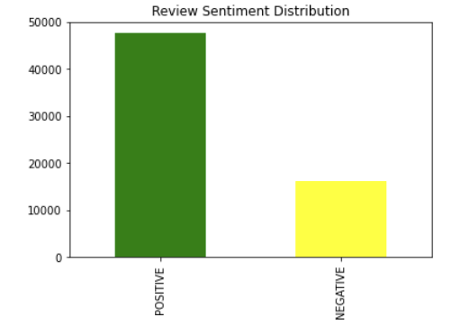
STEP 1: DATA PRE-PROCESSING
Exploratory Data Analysis
Cleaning the data by handling the missing values, removing duplicates, etc.
Asins are a unique identification number for each product in Amazon. Metadata contains duplicate Asins, so we must remove duplicates, review text columns that cannot have blank entries, etc.
'Category' column of the metadata contains a list for each entry. The second element of the list tells you whether the entry is a Cell Phone or an accessory. So, we need to extract only the entries for the Cell Phones and work with it
Using column 'also viewed' to extract some features and get an idea of the competitor brands for each of the mobile phone brands.
Converting the unixReview time to normal time stamp is another example.
Choosing the columns that can be useful to the analysis from phone data and metadata, and merging them together based on some primary key value will open up more possibilities for the insights.
STEP 2: TEXT ANALYTICS
Cleaning the review text using the lexical processing methods and creating some useful word corpus that will be useful for the analysis.
Using stemming/lemmatization from nklt library for text pre-processing. It will improve model performance in the latter part of the solution.
Converting the cleaned text into a numeric format (bag-of-words or tf-idf) so that it can be fed into the machine learning models.
Using of the positive and negative words corpuses provided to extract some features out of the review text and use it for visualisation.

Slide 9
Model Used For Prediction:
Naïve Bayes

Slide 10
Naive Bayes Multinomial algorithm is a variant of the Naive Bayes algorithm that is used for text classification tasks, such as sentiment analysis
In the multinomial Naive Bayes algorithm, the frequency of each word is used as a feature. The algorithm assumes that the frequency of each word is independent of the frequency of other words in the document, which is a reasonable assumption for text classification tasks.
Transform the text data into numerical data by using TF-IDF vectorizer.
TF-IDF vectorizer is a feature extraction technique that converts text data into a numerical vector representation using the TF-IDF method.
Split data into training and testing then fit the model with training data and test it with testing data.
Once the model is trained we can use it to predict the sentiment of amazon reviews.
Compare the predicted sentiment with the actual sentiment of the testing data
Notes:
TF-IDF (Term Frequency - Inverse Document Frequency) is an algorithm that uses the frequency of words to determine how relevant those words are to a given document.

Slide 11
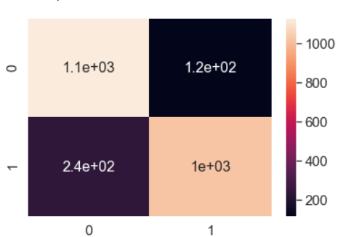
Accuracy
Findings
To measure the performance of model, we can use metrics like accuracy, precision, recall, and F1-score. These metrics provide a quantitative measure of the performance of the model.
Below are the metrics of our model:
Precision: 0.8987676056338029
Precision Score: 0.8987676056338029
Recall Score: 0.8103174603174603
F1 Score: 0.8522537562604342
Confusion Matrix:
Precision refers to the proportion of correctly predicted positive instances out of all positive predictions. the Precision score is 0.898, which means that out of all the positive predictions made by the model, 89.88% were correct.
Recall, on the other hand, measures the proportion of correctly predicted positive instances out of all actual positive instances. The Recall score for this model is 0.8103, indicating that the model was able to identify 81.03% of all actual positive instances.
The F1 score is the harmonic mean of Precision and Recall and provides a more balanced measure of the model's performance. The F1 score is 0.852, which suggests that the model is reasonably accurate in predicting positive instances.
Overall, these evaluation metrics indicate that the model performs reasonably well in predicting positive instances, with high precision and reasonable recall.

Slide 12
KEY INSIGHTS & RECOMMENDATIONS

Slide 13
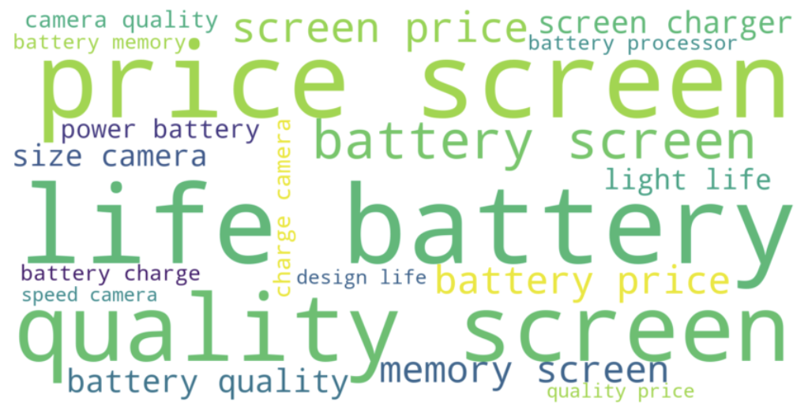
Important phone characteristics Vs review sentiment
Word cloud enables identification of frequently occurring words or phrases. Let’s analyze the attached word cloud snapshot:
Screen, Battery, Life, Quality Are the most common keywords in review sentiment followed by features like processor, charger and design.
While price is mentioned several times, keywords like speed, size and memory were also cited.
Notes:
A word cloud is a popular visualization technique in data science that represents text data in a visual format. In a word cloud, the size of each word is proportional to its frequency in the text. The most frequent words appear larger and are typically displayed in the center of the cloud, while less frequent words appear smaller and are placed towards the edges of the cloud.

Slide 14
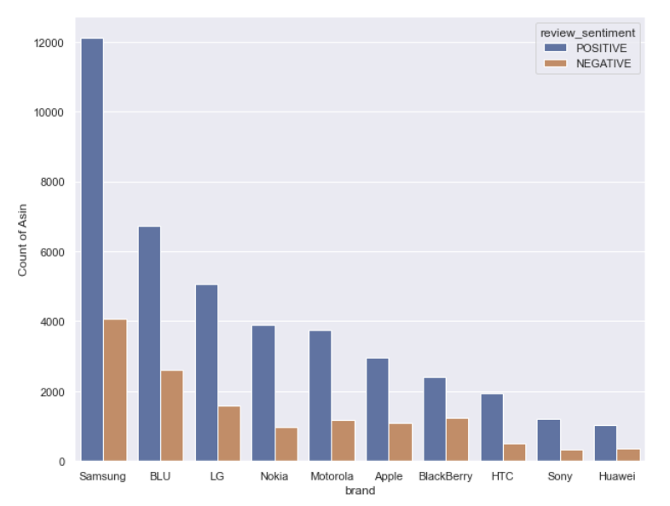
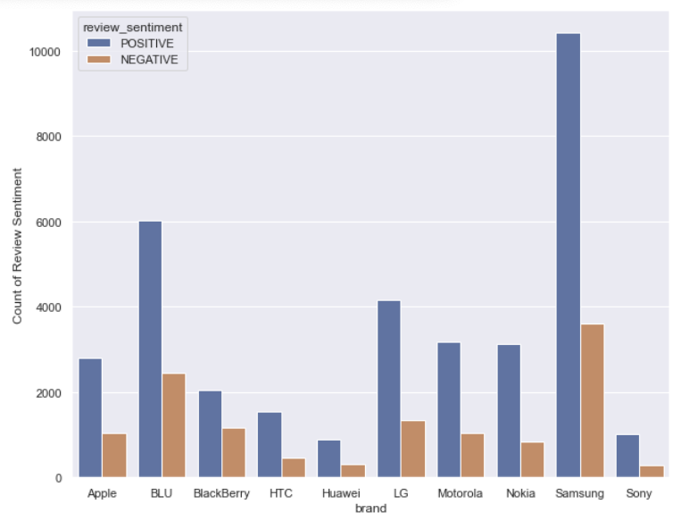
Review Sentiment
Reviews with Votes
Brand Vs Review Sentiment
Samsung leads in having the most favorable sentiments among verified users.
Reviews with upvotes also highlight Samsung on the top.
Surprisingly, Samsung has garnered more upvotes for Negative reviews as well.

Slide 15
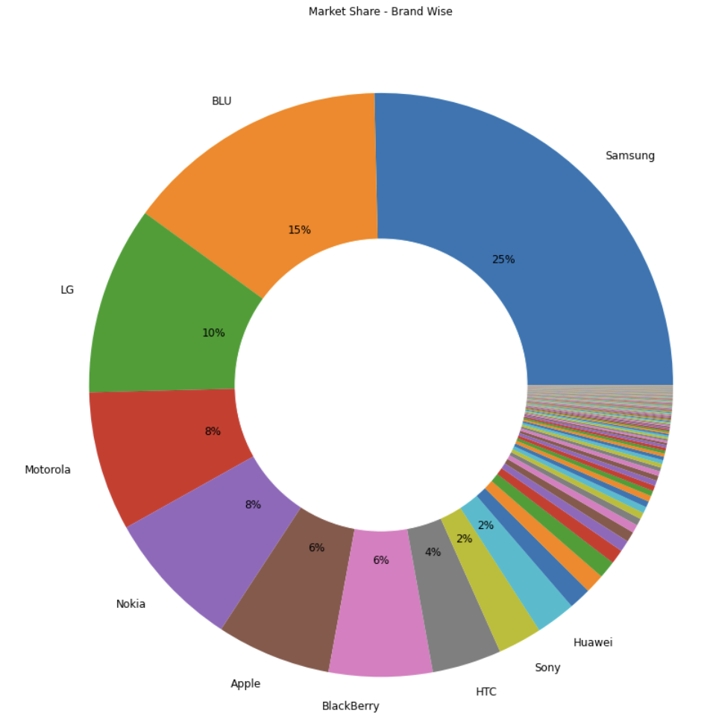
Top 10 brands with the highest market share
‘Samsung’ is the mobile phone market leader with ~ 25% of the share.
‘BLU’ & ‘LG’ are the second and third leads with ~ 15% and 10% respectively
Remaining is distributed majorly among the remaining brands – Motorola, Nokia, Apple, Blackberry, HTC, Sony & Huawei.
Notes:
A donut chart is a type of data visualization that displays data in a circular shape, similar to a pie chart.In a donut chart, the data is divided into segments, where each segment represents a proportion of the whole. The size of each segment is proportional to the value it represents.

Slide 16
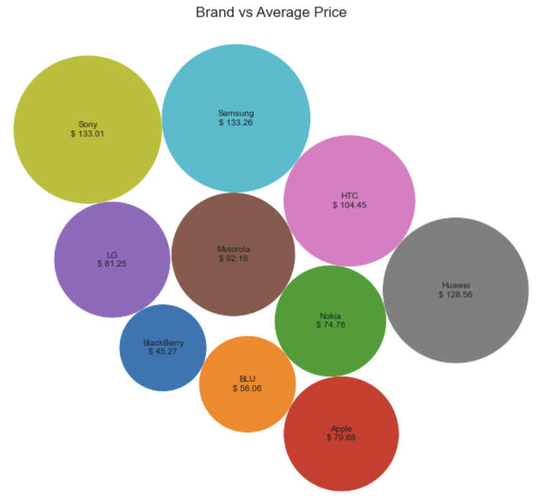
Average Price for the Brands
Samsung & Sony have the most expensive mobile phones followed by Huawei & HTC while Blackberry and BLU are the cheapest brands.
HTC, Sony & Huawei have higher average price of mobiles with respect to their market share.
BLU has cheaper phones and the second largest market share
Notes:
Used packed bubble chart to visualize the average price of mobile brands.

Slide 17
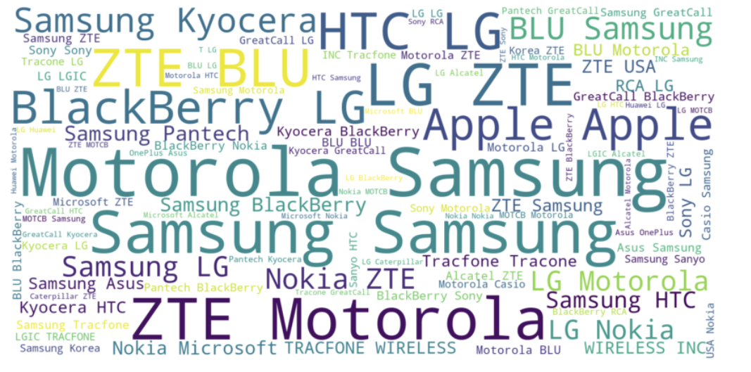
Brand Loyalty
Customer preference in the brand remains same in both - alternate brand viewed and the brand purchased.
Samsung is once again the highest viewed alternate brand when a mobile is purchased.
ZTE is a new entrant in the top listers, followed by LG, Motorola & BLU.
Notes:
Overall, sentiment analysis of Amazon reviews can provide valuable insights that can help businesses improve their products and services, better understand their customers, and ultimately drive growth and profitability.

Slide 18
Suggestions to improve performance of model
Use Ensemble Techniques: Ensemble techniques can help to improve the model's performance by combining multiple models into a single prediction. We can consider using techniques such as bagging or boosting to improve the model's performance.
Continuously evaluate and fine-tune the model: The performance of the model should be continuously evaluated and fine-tuned as new data becomes available. This will ensure that the model stays up-to-date and continues to provide accurate predictions.
Use a pre-trained model: Using a pre-trained model, such as BERT or GPT-3, can save time and improve performance. These models are trained on massive amounts of data and can provide a good starting point for fine-tuning on the specific dataset.
Improve data preprocessing: Proper data preprocessing can have a significant impact on the performance of the model.Consider experimenting with different preprocessing techniques to see what works best for the data.

Slide 19
REFERENCES
Julian, M.(2014). Amazon product data.University of california, San Diego.
Retrieved April 13, 2023 from http://jmcauley.ucsd.edu/data/amazon/index_2014.html
WordNet A Lexical Database for English, Princeton University
Retrieved April 14, 2023 from https://wordnet.princeton.edu/
Prakhar, Python – Lemmatization Approaches with Examples. Geeksforgeeks.
Retrieved April 14, 2023 from https://www.geeksforgeeks.org/python-lemmatization-approaches-with-examples/
Sumedh, K. Generating Word Cloud in Python. Geeksforgeeks.
Retrieved April 14, 2023 from https://www.geeksforgeeks.org/generating-word-cloud-python/
Packed Bubble Data Visualisation
Retrieved April 20, 2023 from https://matplotlib.org/stable/gallery/misc/packed_bubbles.html
Brand Watch, Case Study - oneplus
Retrieved April 20, 2023 from https://www.brandwatch.com/case-studies/oneplus/view/

Slide 20
THANK YOU

