Slide 1

PRE-IDEATHON TEMPLATE
GENESIS
IDEATHON
TEAM & DOMAIN
Introduce your team and the domain you have chosen
Team Flux
Team Name –
Team Members –
Selected Domain –
Problem Statement –
Gokul Santhosh V , Harini ,Sarvajit N , Shahana
Digital Technologies , AI and Cyber Security
Question papers for important exams, such as entrance tests, board exams, and recruitment exams, pass through a long, mostly manual chain of setting, printing, packing, transport, storage, and distribution to many centres. Because there is no end-to-end tracking, tamper detection, or accountability at each handover, a single compromised person or location can leak the paper before the exam. Leaks damage fairness, force exams to be cancelled or repeated, and destroy the trust of lakhs of students. There is a need for a secure, traceable, tamper-proof system that protects any high-stakes question paper at every stage and detects unauthorized access in real time.

Slide 2


DOMAIN PROBLEM IN OUR WORDS
TEAM
Your Team Name
Explain the problem in your domain simply, in your own words
What exactly needs to be solved?
Why is it important right now?
What exactly needs to be solved?
Important question papers get leaked because they are handled through a long, manual chain .
(setting → printing → packing → transport → storage →exam centre) with no end-to-end tracking or tamper detection.
We need to solve:
1.How to keep the paper unreadable to anyone before the exam.
2.How to trace who handled it at every step
3.How to leaks or tampering quickly and act before the exam
Why is it important right now?
Leaks keep happening across entrance, board, and recruitment exams, leading to cancelled exams, re-tests, and court cases.
Lakhs of students lose time, money, and trust, and honest students suffer the most.
Exams are growing in scale, with more centres and more people involved, so the risk of a weak link is higher.
Leaked papers now spread within minutes through messaging apps and social media.
Tools like encryption, digital audit trails, and AI monitoring are now affordable and ready to use.

Slide 3
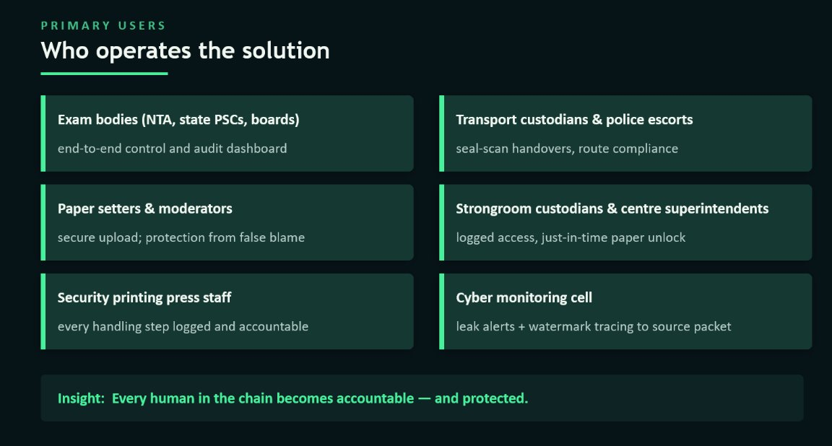
WHO IS AFFECTED?
TEAM
Flux

Slide 4
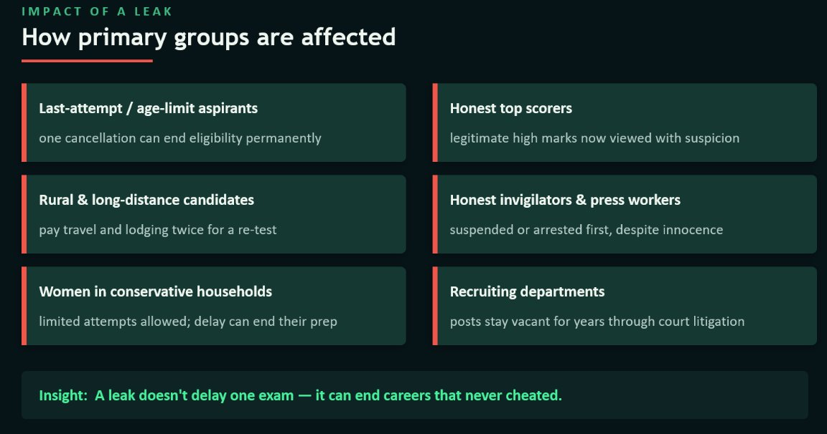
CURRENT SITUATION & CONTEXT
TEAM
Flux

Slide 5
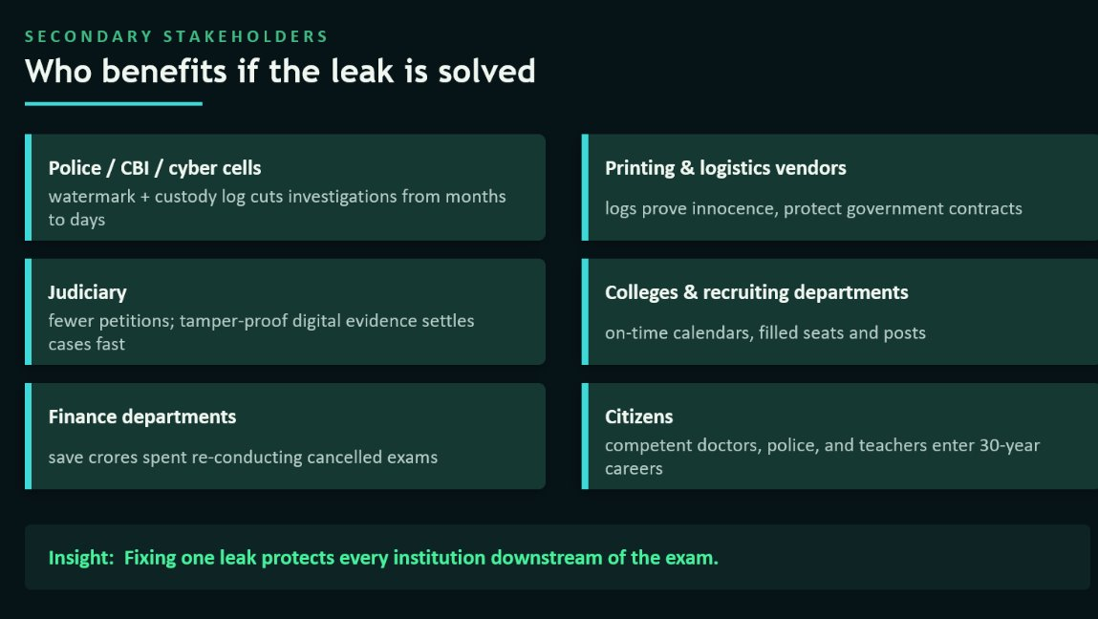
CURRENT SITUATION & CONTEXT
TEAM
Flux

Slide 6
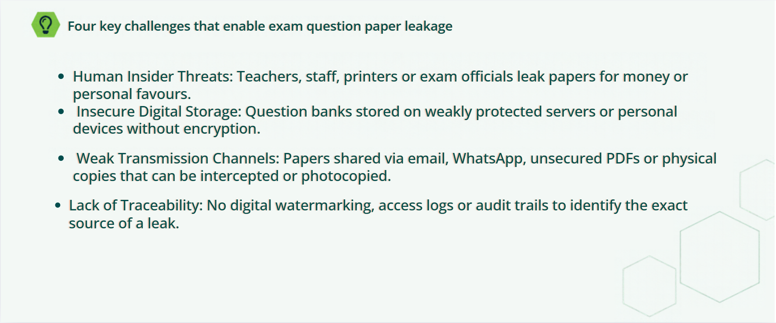
KEY CHALLENGES
TEAM
Flux

Slide 7
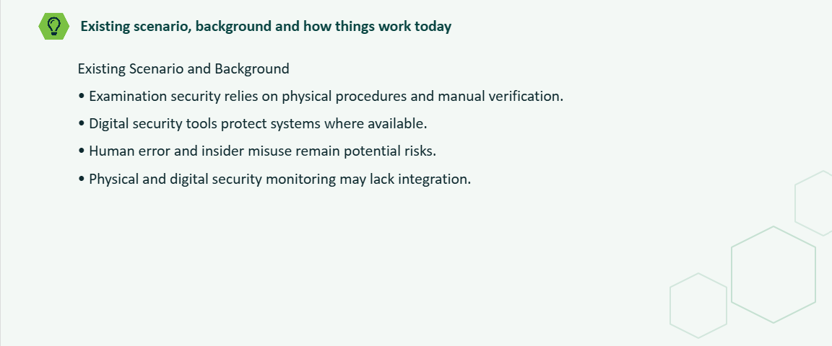
EXISTING SOLUTIONS / APPROACHES
TEAM
Flux

Slide 8
PROBLEM INSIGHTS & OPPORTUNITY AREAS
TEAM
Flux
EXISTING TECHNOLOGIES/APPROACHES​
​
• MFA (Multi-Factor Authentication): Verifies user identity using multiple factors.​
​
• RBAC (Role-Based Access Control): Restricts access based on user roles.​
​
• End-to-End Encryption (E2EE):Protects data during transmission.​
​
• AES-256 Encryption: Secures stored data.​
​
• TLS Encryption: Secures data exchanged over networks.​
​
• SIEM Monitoring: Collects and analyses security logs.​
​
• AI-Based Threat Detection: Identifies suspicious activities using machinelearning.​
​
• Zero Trust Architecture:Verifies every access request.
Decision Tree Models: Classify activities based on predefined conditions.​

Slide 9
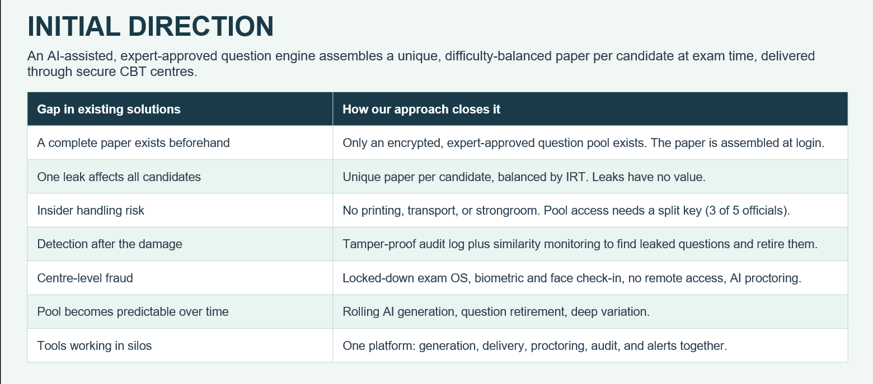
INITIAL DIRECTION
TEAM
Flux

Slide 10
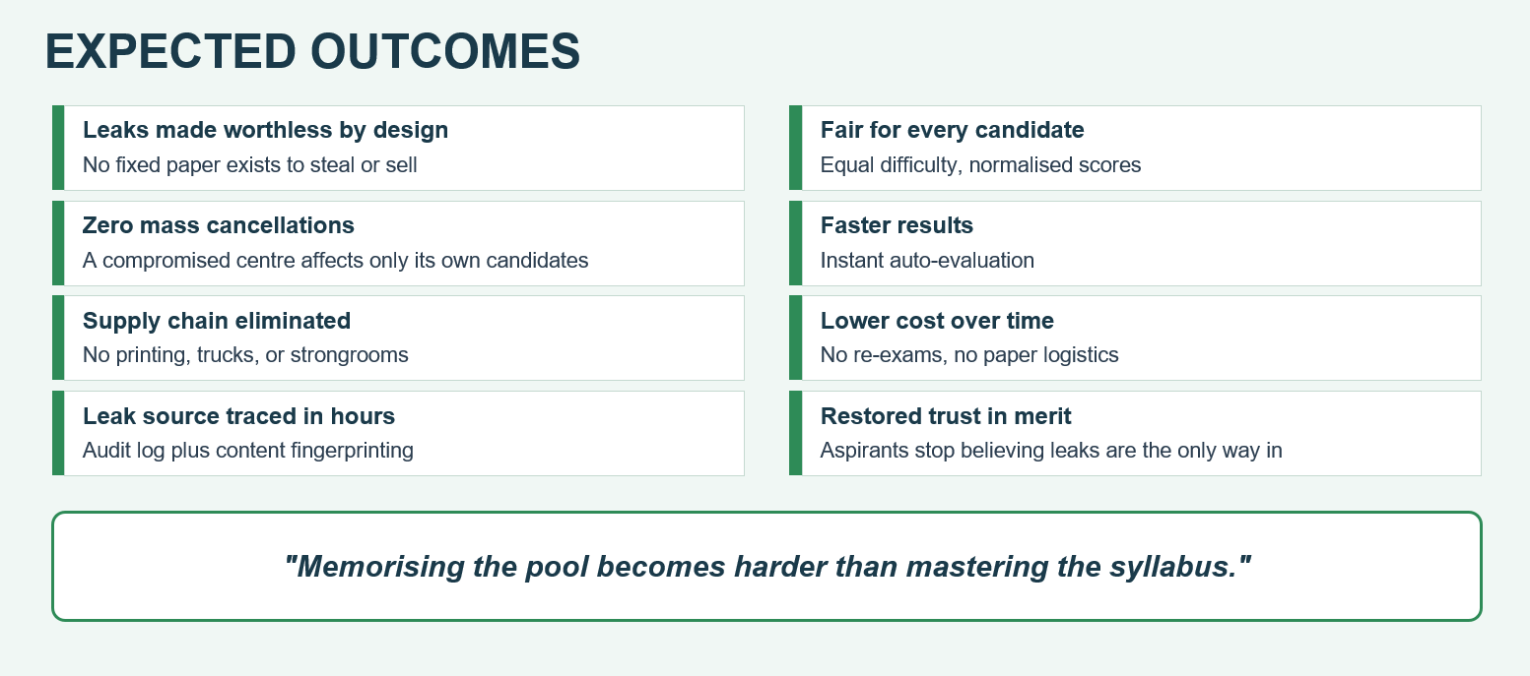
Expected Outcomes
TEAM
Flux

Slide 11
TEAM CONTRIBUTION
TEAM
Your Team Name
Who will hanle which part of the execution
Team Member | Role | Responsibility in Execution
Member 1 name | Role | What they will handle
Member 2 name | Role | What they will handle
Member 3 name | Role | What they will handle
Member 4 name | Role | What they will handle

