Slide 1
Machine learning: Explainable ML-Based Threat Detection using RAG and System Behavior Analytics
VAAGAIARASU – 25026
SUBASH CHANDRA BOSE - 25015

Slide 2
CONTENTS
Traditional security systems rely on signature-based detection
Cannot detect zero-day attacks
Lack of explainability in ML-based detection
Non-security professionals struggle to interpret alerts
Build a system that:
Detects anomalies using ML
Explains them using AI (RAG)
Makes insights understandable
GOALS

Slide 3
Objectives
Detect anomalous system behavior using unsupervised learning
Provide human-readable explanations
Map anomalies to MITRE ATT&CK techniques
Build an interactive dashboard
Enable user interaction via Q&A

Slide 4
Technologies used
PythonScikit-learn (Isolation Forest)
Streamlit (Dashboard)
Plotly (Visualization)
LangChain (RAG)
FAISS (Vector DB)
Sentence Transformers (Embeddings)
Groq API (LLM)

Slide 5





System Overview
Step 1
Step 2
Step 3
Step 4
Step 5
Synthetic System logs generation
Ml Model & Anomaly Detection
Retrieval Augmented Generation
Dashboard
Explanation of Anomalies

Slide 6
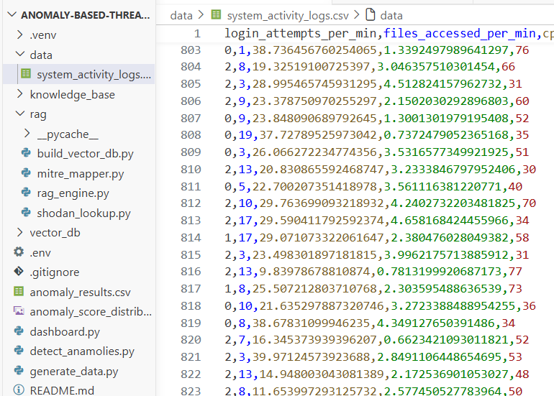
Data generation
Synthetic system logs were created with features:
CPU usage
Network traffic
Login attempts
Process count
File access
Purpose:
Simulate real-world behavior
Create normal + anomalous patterns

Slide 7
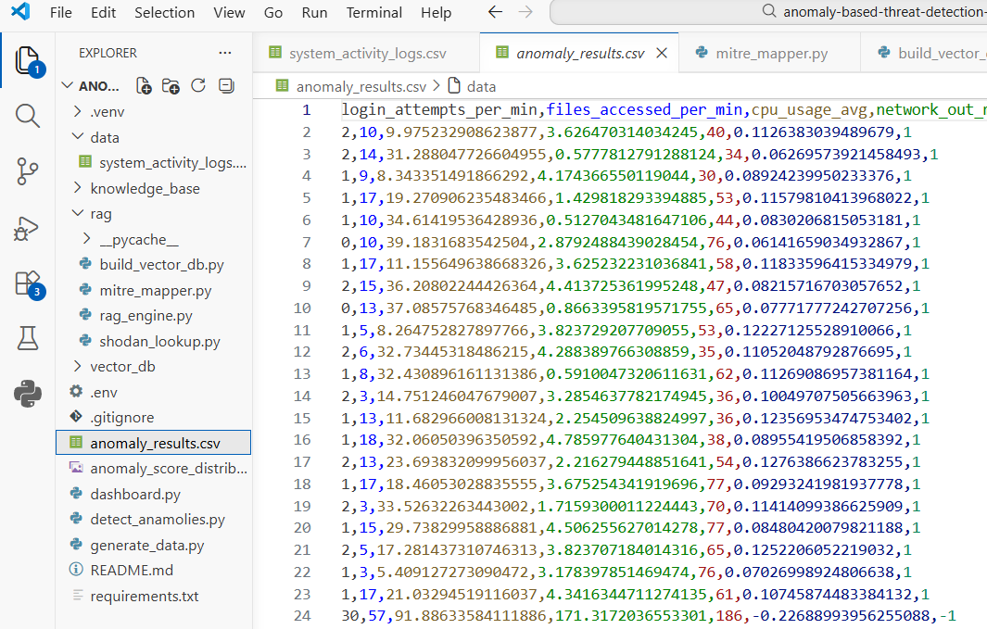
Anomaly detection
Isolation Forest:
Unsupervised learning algorithm
Detects anomalies without labeled data
Based on isolation of outliers
Steps:
Train on normal behavior
Assign anomaly score
Classify as normal or anomaly

Slide 8
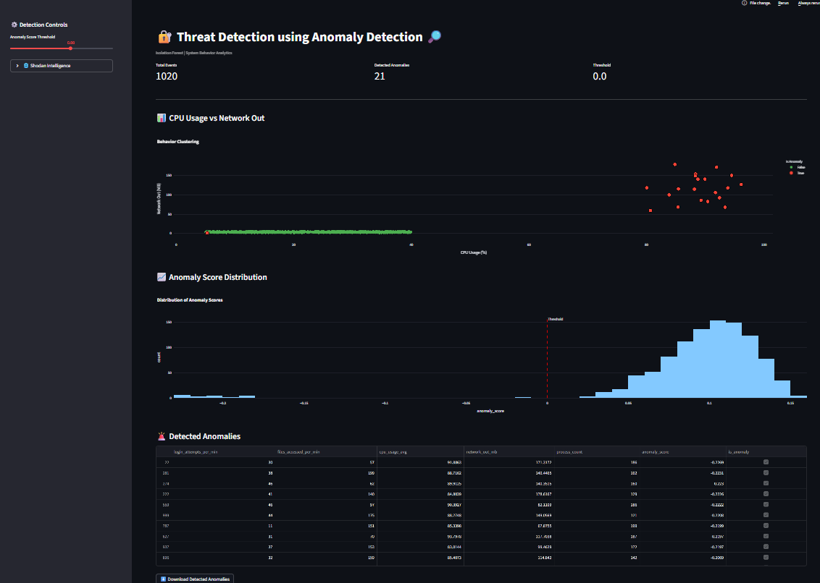
Visualization Dashboard
Components:
Interactive Streamlit dashboard
Real-time threshold control
Visual analytics
Features:
CPU vs Network scatter plot
Anomaly score distribution
Anomaly table

Slide 9
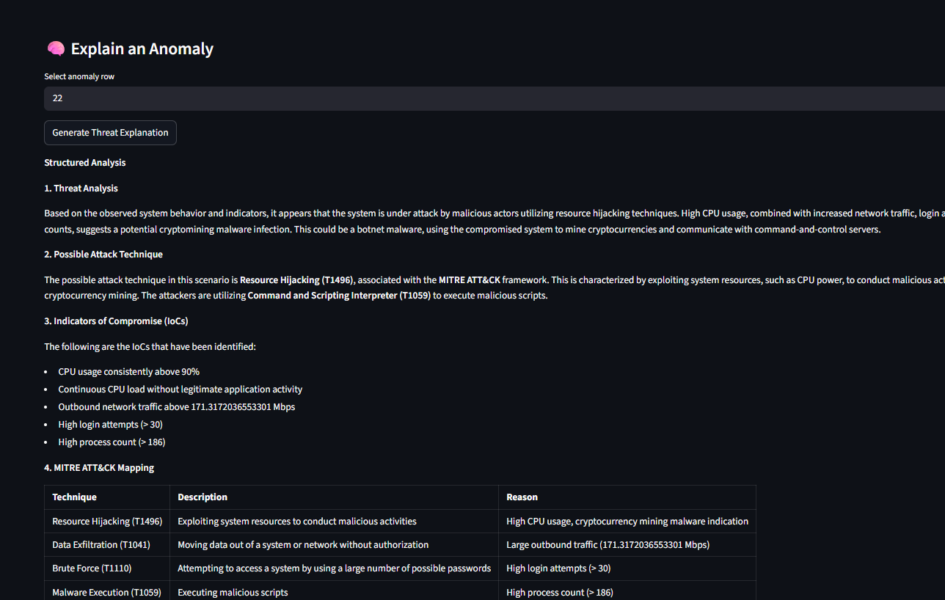
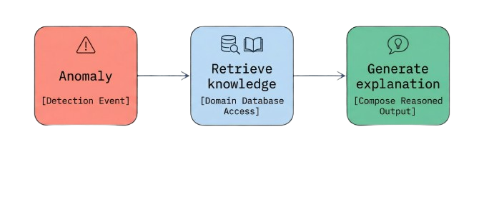
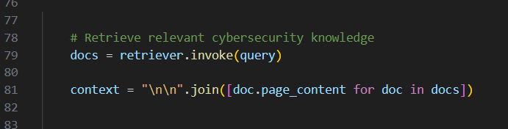
Retrieval Augmented Generation
RAG:
Combines:
Knowledge base (cybersecurity docs)
LLM (Groq)
Retrieves relevant info
Generates explanation

Slide 10
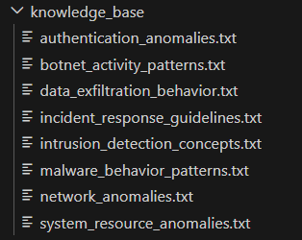
Knowledge Base
Domain-specific documents used:
MITRE ATT&CK
OWASP Top 10
Malware behavior
Network anomalies
Purpose:
Provide context-aware explanations

Slide 11
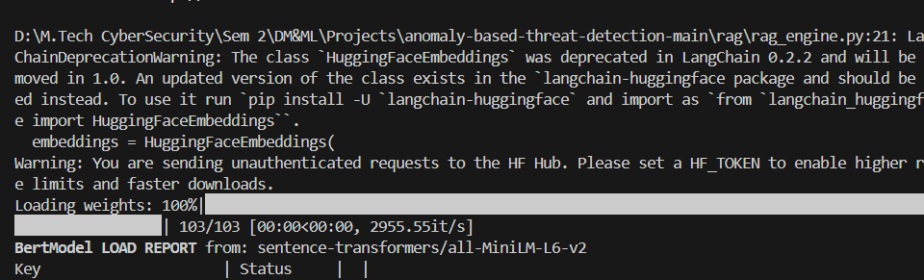
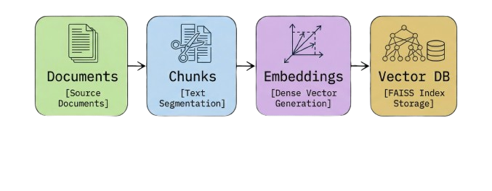
Vector Database
FAISS:
Converts text → embeddings
Stores in FAISS
Enables fast retrieval

Slide 12
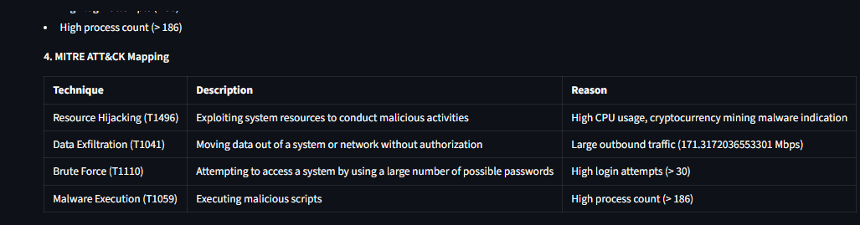
MITRE ATT&CK Mapping
Maps anomalies to attack techniques
Examples:
High CPU → Resource Hijacking (T1496)
High login attempts → Brute Force (T1110)
High network → Data Exfiltration (T1041)

Slide 13
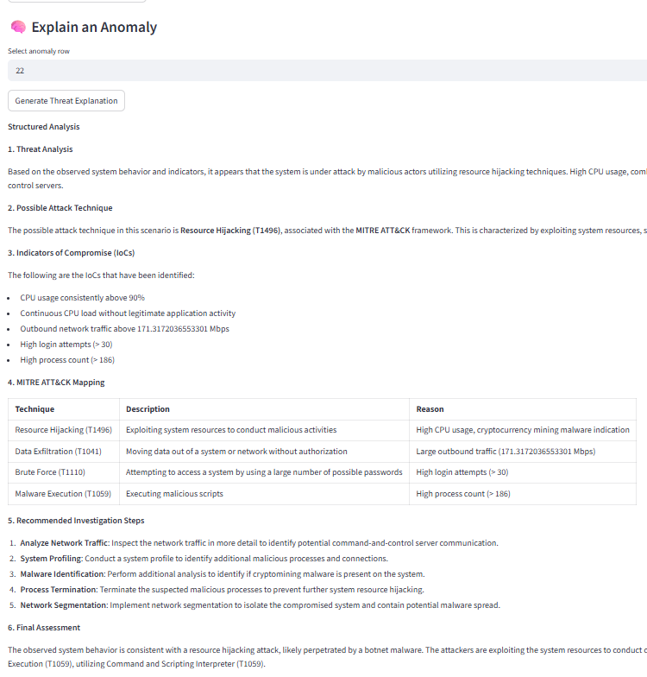
Explainable AI Output
System generates:
Threat analysis
Attack technique
Indicators of compromise
Investigation steps
Final assessment

Slide 14
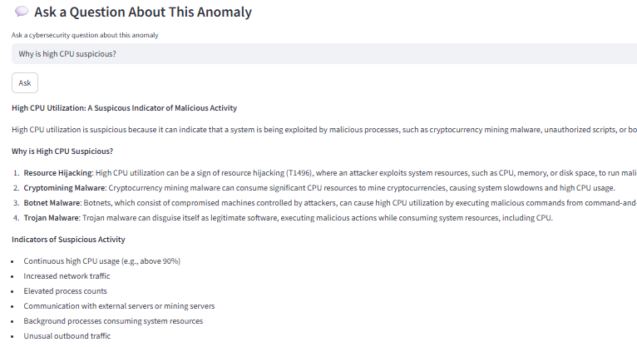
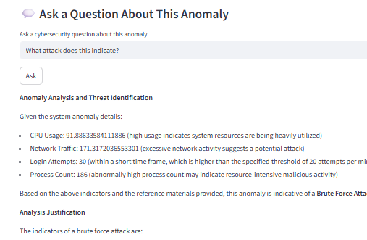
Interactive Q&A
User can ask questions about anomalies
System provides contextual answers
Examples:
“Why is high CPU suspicious?”
“What attack does this indicate?”

Slide 15
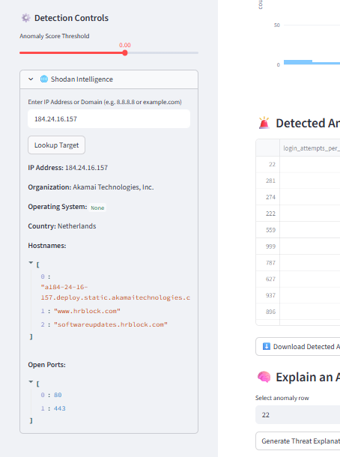
Future Work
Threat intelligence integration
Integrate Shodan API
Future Enhancements
Analyze:
IP addresses
Domains
Identify:
Open ports
Exposed services
Vulnerabilities
Real – time log monitoring
SIEM integration
Automated threat scoring
Multi-model anomaly detection
Advanced visualization

Slide 16
SUMMARY
This project presents an anomaly-based threat detection system that uses unsupervised machine learning (Isolation Forest) to identify abnormal system behavior such as unusual CPU usage, network activity, and login patterns. To improve interpretability, it integrates Retrieval-Augmented Generation (RAG), which retrieves relevant cybersecurity knowledge (e.g., MITRE ATT&CK, OWASP) and generates human-readable explanations for detected anomalies. The system is deployed as an interactive Streamlit dashboard, enabling users—especially L1 IT professionals—to understand potential threats, investigate anomalies, and take informed actions without requiring deep cybersecurity expertise.

Slide 17
THANK YOU
Vaagaiarasu - 25026
Subash Chandra Bose - 25015

