Slide 1
Model Predictive Control Based Jumping of Robotic Leg on a Particular height using Reinforcement Learning
Presented by :
Amrita Rai
1

Slide 2
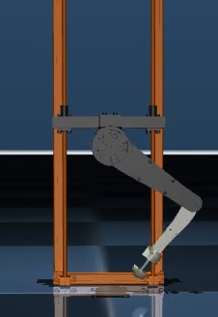
Content
Introduction
Objective
Motivation
Theoretical Background
Methodology
Result
Conclusion
Future Scope
Reference
2

Slide 3
Introduction
Robots:
A Robots are machines that can be programmed by computers and are capable of per- forming a complex series of tasks on their own.
Robots’ ability to perform simple tasks in a manner similar to that of humans makes their work simple, quick, and easy.
Robots are more adept at the following tasks than humans are:
1.In business or industrial settings, automate manual or repetitive processes.
2.Perform dangerous or unpredictable tasks in order to find dangers like gas leaks.
3.Deliver and process reports on corporate security.
4.Deliver internet orders, room service, and even food packages in an emergency.
5.Help patients throughout operations.
Robotic hands and legs are only two examples of the many robots utilized in the medical field.
3

Slide 4
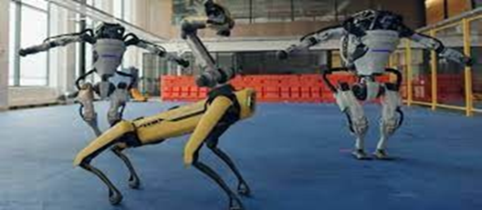
Introduction
Robots are essential to the study of physics because they can perform tasks that humans are unable to.
We are specifically referring to space robots, which have the ability to live in space, transport supplies for space missions, monitor space stations, or just stroll on the earth so that people may view these locations from a distance.
An industrial robot is a versatile manipulator that can be autonomously controlled, reprogrammed, and programmed in three or more axes.
Figure 1: Boston Robots
4

Slide 5
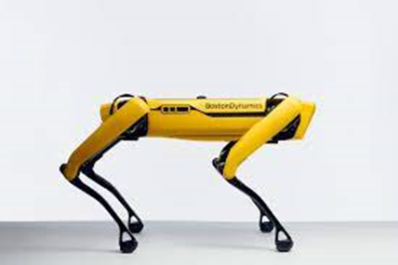
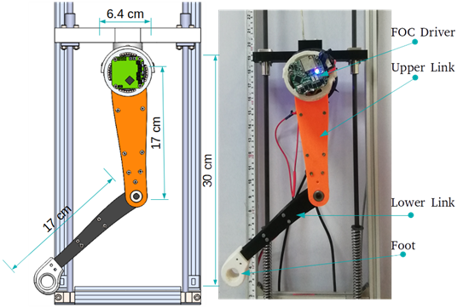
Introduction
Robotics:
Robotics is the science and technology of robots, their design, manufacturing and application.
Robotics develops machines that can substitute for humans and replicate human actions.
Figure 2: Spot Figure 3: Bob(Car)
5
[1] https://robots.ieee.org/robots/minicheetah/
[2] https://www.giantfreakinrobot.com/sci/robot-cheetah.html

Slide 6
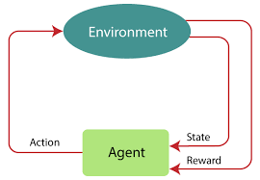
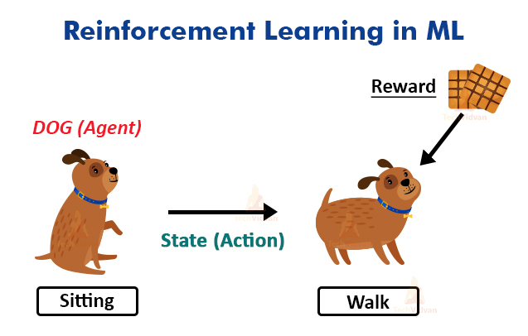
Introduction
Reinforcement Learning : An agent in environment who learn from there action and try to get cumulative rewards.
Figure4: Reinforcement Learning
Figure5: A sitting dog (agent) want to walk ,
for this he will get biscuits as a reward.
6

Slide 7
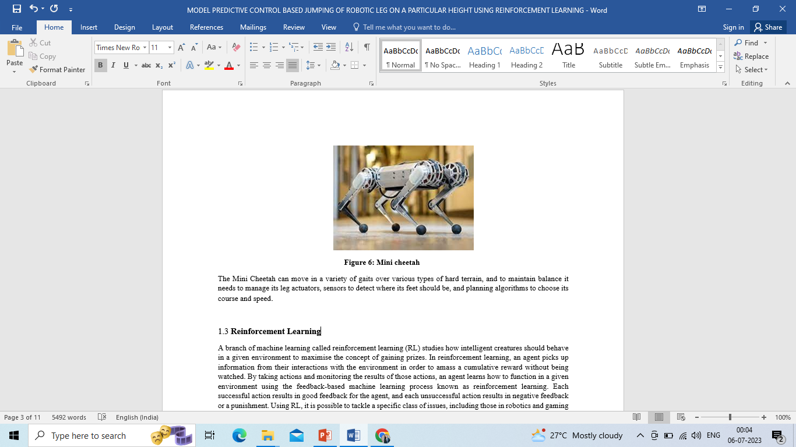
Introduction
Legged robot :
Legged robots are a subset of mobile robots that move by using movable limbs, such as leg mechanics.
One-legged, two-legged, four-legged, six-legged, eight-legged, and hybrid robots are just a few of the numerous varieties of legs that exist today.
7

Slide 8
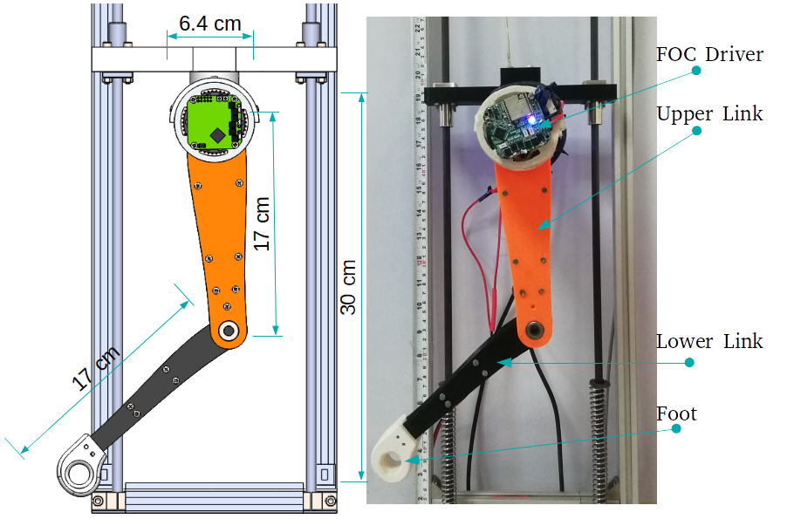
Objective
Required torque generation in order to jump on different heights using
proprioceptive data using reinforcement learning.
Robotic leg control by pd controller.
Reinforcement learning for jumping behavior of a robotic leg.
Applying reinforcement learning algorithm on a robotic leg for training to learn jumping.
Figure 7: Bob image
**Bhashkar, A., Sharma, A.K. (2023). Experimental Analysis on Different Terrains Using Proprioceptive Information of One Leg of Quadruped Robot. In: Yadav, S., Jain, P.K., Kankar, P.K., Shrivastava, Y. (eds) Advances in Mechanical and Energy Technology. Lecture Notes in Mechanical Engineering. Springer, Singapore. https://doi.org/10.1007/978-981-19-1618-2_12 8

Slide 9
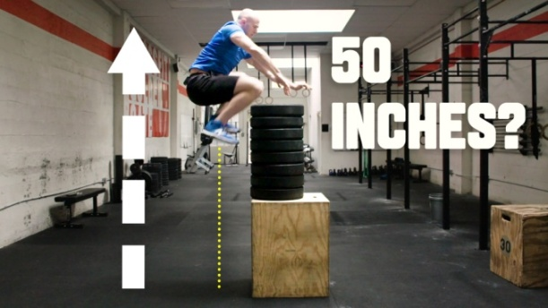
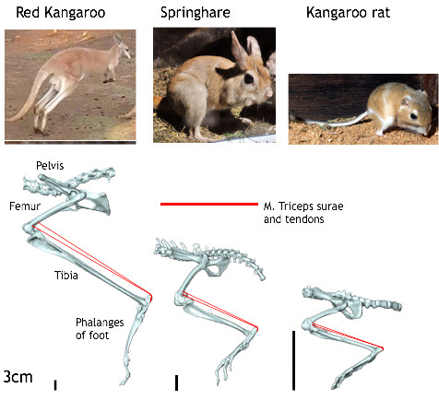
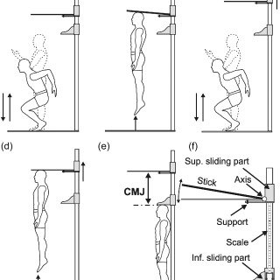
Motivation
Athleticism in Nature
Agility
Hopping behavior in Nature
How animals and humans learn
or train to do such dynamic maneuver?
How to apply that experiences of
dynamics maneuver in robots?
Figure8: A man trying to jump on a given height.
[1] https://www.istockphoto.com/photo/low-section-of-fit-male-athlete-box-jumping-in-gym-gm588385480-101049223
[2] https://www.istockphoto.com/photos/animal-behavior
*[3] https://www.pngitem.com/middle/iJhTTib_human-behavior-performing-arts-silhouette-silhouette-jumping-for/
Figure9: Animals leg structure
Figure10: human jumping Behavior
9

Slide 10
Theoretical Background
Dynamics:
The two types of dynamics are linear dynamics and rotational dynamics.
Linear dynamics takes into account variables like force, mass/inertia displacement, velocity, acceleration , and momentum when it comes to moving objects in a straight line.
Torque, moment of inertia/rotational inertia, angular displacement, angular velocity, angular acceleration, and angular momentum are certain aspects of rotational dynamics.
Dynamics are really play a vital role to move any body and we are working on a leg so here dynamics are so much important.
10

Slide 11
Theoretical Background
Kinematics:
An engine, a robotic arm, or the human skeleton are examples of multi-link systems, and the motion of these systems is referred to as kinematics.
It is utilized in biomechanics, robotics, and mechanical engineering. To describe the spatial positions of bodies or systems of material particles, as well as their speeds and velocities, is the aim of kinematics (acceleration).
There are two types of Kinematics are use in this project –
Forward Kinematics
Inverse Kinematics
11

Slide 12
Theoretical Background
Forward Kinematics :
Forward kinematics is the process of using a robot’s kinematic equations to ascertain the joint parameters that must match the end-position effector’s prescribed values.
Forward kinematics describes the location and orientation of the end effector in relation to the joint variables.
A proper kinematics model should be used in order to have forward kinematics for a robot mechanism in a systematic method.
The D-H parameter, which contains four parameters, is utilized. And describe the link length, twist, offset, and joint angle.
12

Slide 13
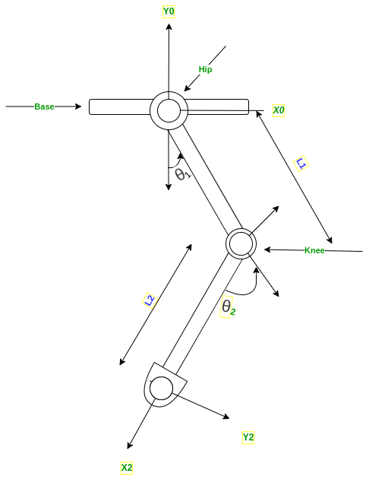

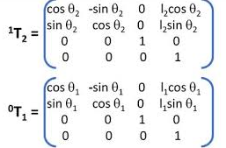

Theoretical Background
Kinematics: Forward Kinematics:
We have 2 joint leg and for position of toe
there are D-H parameter and matrix .
13

Slide 14
Theoretical Background
Inverse Kinematics:
The end of a kinematic chain, such as the skeleton of an animated character or a robot manipulator, needs to be placed in a specific position and orientation with respect to the start of the chain. Inverse kinematics is a mathematical technique that establishes the variable joint parameters required for this.
Inverse kinematics is used to determine the necessary location for a leg to jump or slip.
Inverse kinematics refers to the difficulty of translating the location and orientation of a manipulator end effector from Cartesian space to joint space.
To determine the analytical inverse kinematics solution, two techniques are used: geometric and algebraic.
14

Slide 15
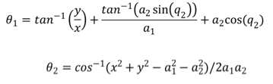
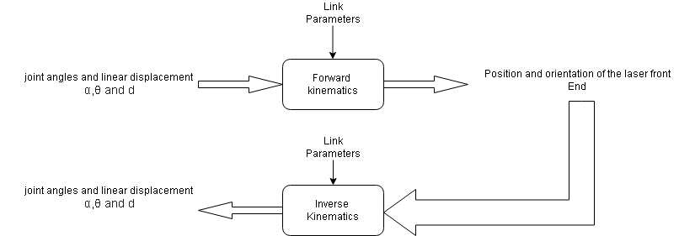
Theoretical Background
Inverse Kinematics: Inverse kinematics is the use of kinematic equations to determine the motion of a robot to reach a desired position.
We have relation between Forward kinematics
and Inverse kinematics as follows:
15

Slide 16
Theoretical Background
Deep reinforcement learning:
A branch of machine learning called deep reinforcement learning (deep RL) combines deep learning and reinforcement learning (RL).
Deep RL algorithms can decide what actions to take to achieve an objective by analyzing very massive inputs, such as every pixel presented to the screen in a video game (maximizing the game score).
Robotics, video games, natural language processing, computer vision education, transportation, finance, and healthcare are just a few of the diverse fields in which deep reinforcement learning has been applied.
16

Slide 17


Methods
Control and Learning of the Robots:
Dynamics:
We had used two degree of freedom planer robotic leg for analysis
purpose shown in figure-
The equation of dynamics of the Two-link Robotic leg:
Where ,
ɽ = Appropriate Torque,
\Theta = angle of joints
\Theta_dot = angular velocity
I = inertia
M = mass
l = length of leg
ӫ = angular acceleration
I1
m1
m2
I2
17

Slide 18
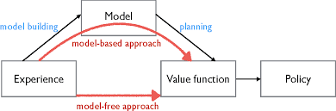
Methods
Model based Approach:
Model-based Reinforcement Learning refers to learning optimal behavior indirectly by
learning a model of the environment by taking actions and observing the outcomes that
include the next state and the immediate reward.
https://medium.com/analytics-vidhya/model-based-offline-
reinforcement-learning-morel-f5cd991d9fd5
Figure11- Model based approach
18

Slide 19
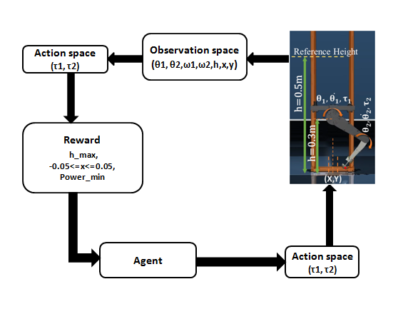
CLOSED LOOP PROCESS Of REINFORCEMENT LEARNING:
Process of training robotic leg is performed
on Mujoco Simulator with a closed loop
Architecture.
Figure12 : Control framework using Reinforcement leaning
19

Slide 20
Methods
Reinforcement Learning Algorithm:
PPO Algorithm:
Proximal policy gradient is a policy gradient method for reinforcement learning. It works like a neural network a lot of actions as input and best action will be result for an action. The most common implementation of PPO is via the Actor-critic model which uses 2 deep neural network , one is Actor and another is Critic.
Here are the equation for PPO :
E_t = empirical expectation over time-steps.
r_t = ratio of the probabilities under the new and old policy.()Importance sampling ratio).
A_t = estimate advantage at time t.\
epsilon = hyper-parameter , usually 0.1 or 0.2 .
20

Slide 21
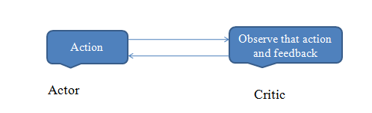
Reinforcement Algorithm Used for Project
A2C
Advantage Actor-critic Algorithm , it is a policy based algorithm. The actor critic algorithm consist of two network (the actor and critic) working together to solve a particular problem.
Here are the equation for A2C algorithm that shows how this algorithm works:
Where ,
a_t = action taken as per time
S_t = State of an action\\
21

Slide 22
Reward Function
Max reward = base height + foot position + power consumption.
Power consumption = torque * velocity
if (horizontal)Foot position < 0.05 , reward will be +100
else foot position < 0.01, reward will be +20
if (pos – 0.1) > 0.03 , reward will be -10 (penalty)
22

Slide 23
Conclusion
After conducting experiments in order to accomplish the goal and analyzed the findings to reach the following conclusions:
By employing reinforcement learning, a model-based strategy, and no control system, model will be train to jump beyond a specified height.
Reinforcement learning lead us to explore feasible implementation of highly dynamic movements without any equation of motion.
Using reinforcement learning we can achieve higher height .
23

Slide 24
Future Scope
In the future, there will be wide research on robotic legs using reinforcement learning and there is scope to learn these models using algorithms. After this project, these are the main scopes to do some progressive work:
PPO algorithm are used in this project to train a robotic limb using several reinforcement learning techniques.
Reinforcement learning techniques are capable of training quadruped models.
24

Slide 25
references
1. D. Rodriguez and S. Behnke, “Deepwalk: Omnidirectional bipedal gait by deep reinforcement learning,” in 2021 IEEE International Confer- ence on Robotics and Automation (ICRA) (IEEE, 2021) pp. 3033–3039.
2. G. Bellegarda and Q. Nguyen, “Robust quadruped jumping via deep reinforcement learning,” arXiv preprint arXiv:2011.07089 (2020).
3. J. Ibarz, J. Tan, C. Finn, M. Kalakrishnan, P. Pastor, and S. Levine, “How to train your robot with deep reinforcement learning: lessons we have learned,” The International Journal of Robotics Research 40, 698 – 721 (2021).
4. T. Haarnoja, A. Zhou, S. Ha, J. Tan, G. Tucker, and S. Levine, “Learning to walk via deep reinforcement learning,” ArXiv abs/1812.11103 (2019).
5. T. P. Lillicrap, J. J. Hunt, A. Pritzel, N. M. O. Heess, T. Erez, Y. Tassa, D. Silver, and D. Wierstra, “Continuous control with deep reinforcement learning,” CoRR abs/1509.02971 (2016).
6. S. Fujimoto, D. Meger, and D. Precup, “Off-policy deep reinforcement learning without exploration,” in ICML (2019).
7. T. Haarnoja, H. Tang, P. Abbeel, and S. Levine, “Reinforcement learning with deep energy-based policies,” in ICML (2017). M. Hutter, “Learning agile and dynamic motor skills for legged robots,” Science Robotics 4 (2019). 25

Slide 26
References
8. Q. Nguyen, M. J. Powell, B. Katz, J. D. Carlo, and S. Kim, “Optimized jumping on the mit cheetah 3 robot,” 2019 International Conference on Robotics and Automation (ICRA) , 7448–7454 (2019).
9. V. Tsounis, M. Alge, J. Lee, F. Farshidian, and M. Hutter, “Deepgait: Planning and control of quadrupedal gaits using deep reinforcement learning,” IEEE Robotics and Automation Letters 5, 3699–3706 (2020).
10. S. Ha, J. Kim, and K. Yamane, “Automated deep reinforcement learning environment for hardware of a modular legged robot,” in 2018 15th international conference on ubiquitous robots (UR) (IEEE, 2018) pp. 348–354.
11. J. Fu, J. D. Co-Reyes, and S. Levine, “Ex2: Exploration with exemplar models for deep reinforcement learning,” in NIPS (2017).
12. T. Xiao, E. Jang, D. Kalashnikov, S. Levine, J. Ibarz, K. Hausman, and A. Herzog, “Thinking while moving: Deep reinforcement learning with concurrent control,” ArXiv abs/2004.06089 (2020).
13. Z. Xie, P. Clary, J. Dao, P. Morais, J. Hurst, and M. van de Panne, “Learning locomotion skills for cassie: Iterative design and sim-to-real,” in CoRL (2019).
14. J. Hwangbo, J. Lee, A. Dosovitskiy, D. Bellicoso, V. Tsounis, V. Koltun, and M. Hutter, “Learning agile and dynamic motor skills for legged robots,” Science Robotics 4 (2019). 26

Slide 27
References
15. P. F. Christiano, J. Leike, T. B. Brown, M. Martic, S. Legg, and D. Amodei, “Deep reinforcement learning from human preferences,” in NIPS (2017).
16. X. B. Peng, G. Berseth, K. Yin, and M. Van De Panne, “Deeploco: Dynamic locomotion skills using hierarchical deep reinforcement learning,” ACM Trans. Graph. 36, 41:1–41:13 (2017).
17. J. Hwangbo, J. Lee, A. Dosovitskiy, D. Bellicoso, V. Tsounis, V. Koltun, and M. Hutter, “Learning agile and dynamic motor skills for legged robots,” Science Robotics 4 (2019).
18. S. Fujimoto, D. Meger, and D. Precup, “Off-policy deep reinforcement learning without exploration,” in International Conference on Machine Learning (PMLR, 2019) pp. 2052–2062.
19. A. Hill, A. Raffin, M. Ernestus, A. Gleave, A. Kanervisto, R. Traore, P. Dhariwal, C. Hesse, O. Klimov, A. Nichol, M. Plappert, A. Radford, J. Schulman, S. Sidor, and Y. Wu, “Stable baselines,” https://github.com/hill-a/stable-baselines (2018)
27

Slide 28


