Slide 1

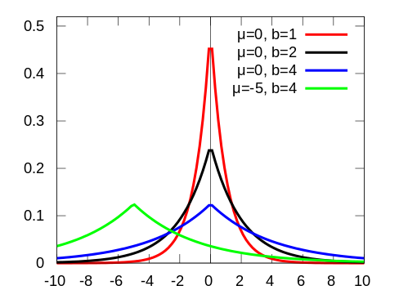
Analytics Server
Client
1 hot encoded vector e_1
Aggregator
Program P
Client
1 hot encoded vector e_2
Encrypted x
Client
1 hot encoded vector e_3
Program Executor
…
…
Client
1 hot encoded vector e_{n-1}
Client
1 hot encoded vector e_n
Measurement Library
Transformation Library
Privacy Engine
Crypto Service Provider

Slide 2
Input has to be in natural attribute form
D attributes – can be real or categorical
Each attribute is encrypted individually
Real – convert to integer or fixed point and encrypt
Categorical – one-hot
Transformations:
Discretization (Real to categorical)
Multi-D histogram (product of domains)
Projection
Filtering (SELECT …)
Idea: Involve the client on any sequence of linear transformations on original input
Requires client to be online.

Slide 3
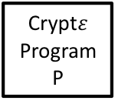
Analytics Server
Data Owner 1
Enc(D_1)
Data Owner 2
Enc(D_2)
Aggregator
Crypt$ε$
Program P
…
Enc(D_3)
Program Executor
Data Owner m-1
…
Transformation Library
Measurement Library
Data Owner m
Enc(D_{m-1})
Enc(D_m)
Privacy Engine
Crypto Service Provider

Slide 4
Input d
NO
IsReal(d)?
YES
Discretize
Aggregator
Output Encrypted x
Preprocessing

Slide 5





Data Owners
Analytics Server
Crypt$ε$
Program
.
.
.
Crypt$ε$
Program
Data Analyst
.
.
.
Aggregator
Program Executor
Differentially Private Output
Program Execution Phase
Data Collection Phase
Cryptographic Service Provider
.
.
.
Crypt$ε$
Program
Crypt$ε$
Program
Key Manager
Data Decryption
Privacy Engine

Slide 6





Data Owners
Crypt$ε$
Data Analyst
$${\tilde{D}}_{1}$$
Analytics Server
.
.
.
Crypt$ε$
Program
.
.
.
Crypt$ε$
Program
.
.
.
Data
Aggregator
Program
Executor
$${\tilde{D}}_{m}$$
Cryptographic Service Provider
Noisy outputs
pk
Key Manager (pk, sk)
Data Decryption
Privacy Engine (B)
Data Collection
Phase
Program Execution
Phase

Slide 8









$$m_{1}×m_{2}$$
$$m_{3}×m_{4}$$
…
…
$$m_{n−3}×m_{n−2}$$
$$m_{n−1}×m_{n}$$
$$×$$
$$×$$
$$⌈\log{n }⌉$$
…
$$×$$
$$m_{1}×m_{2}×… ×m_{n−1}×m_{n}$$

