Slide 1



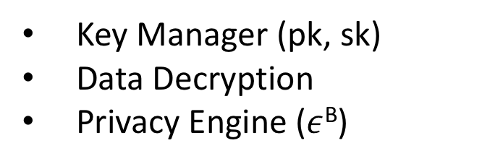


Data Owners
Crypt$ε$
Data Analyst
$${\tilde{D}}_{1}$$
Analytics Server
.
.
.
Crypt$ε$
Program
.
.
.
Crypt$ε$
Program
.
.
.
Data Aggregator
Program Executor
$${\tilde{D}}_{m}$$
Cryptographic Service Provider
Noisy Output
pk
Key Manager (pk, sk)
Data Decryption
Privacy Engine ($ε$^{B})
Data Collection
Phase
Program Execution
Phase

