Slide 1


A Noise-Immune Sub-threshold Circuit Design based on Selective Use of Schmitt-Trigger Logic
M. Donato,
F. Cremona, W. Jin, R. I. Bahar, W. R. Patterson, A. Zaslavsky, J. Mundy
Brown University
This work was supported by DTRA

Slide 2
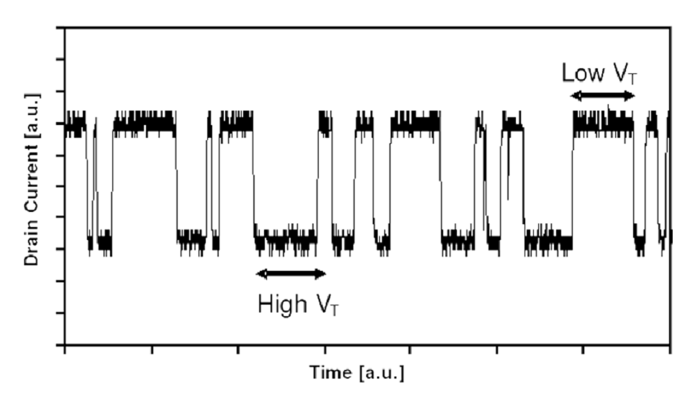
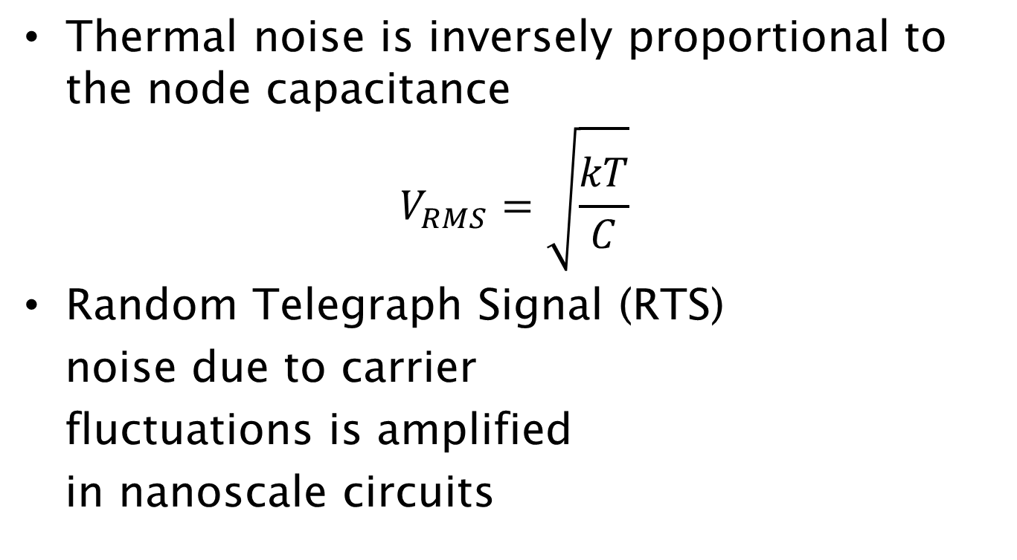
Noise Sources
Thermal noise is inversely proportional to the node capacitance
$$V_{RMS}=\sqrt{\frac{kT}{C}}$$
Random Telegraph Signal (RTS)
noise due to carrier
fluctuations is amplified
in nanoscale circuits
Notes:
Spend some more time explaining noise and add some figures and how they become relevant in subthreshold operation

Slide 3
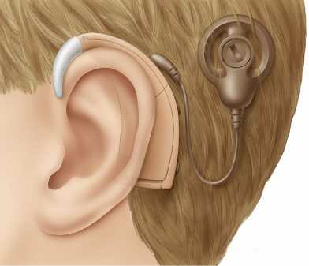

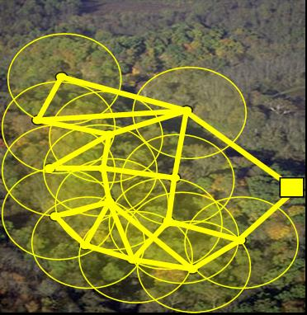
Motivation
Technology and supply voltage scaling bring new reliability challenges
Ultra-Low Power applications
and subthreshold operation
Manufacturing defects and
shrinking noise margins lead to
higher soft-error rates
Notes:
Add images or graphs about subthreshold and ULP circuits. Main point rather than long sentences

Slide 4
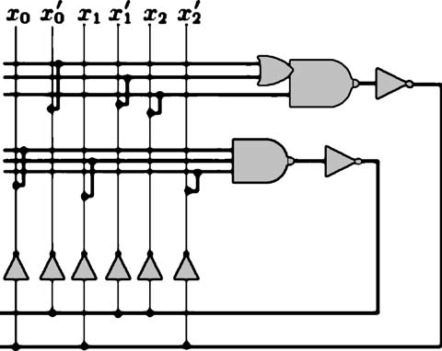
Motivation
Exisiting noise-tolerant design approaches often based on reduntant logic
Trade-off between area overhead and improved noise-robustness
MRF NAND
Notes:
Explain previous work

Slide 5
Outline
Implication
What are they?
How can they be used to improve noise immunity
Schmitt Trigger gates
Basic operation
Embedding implications into Schmitt gate
Simulation results
Automated design flow
How do you select which implications to insert in the circuit?

Slide 6
Outline
Implication
What are they?
How can they be used to improve noise immunity
Schmitt Trigger gates
Basic operation
Embedding implications into Schmitt gate
Simulation results
Automated design flow
How do you select which implications to insert in the circuit?

Slide 7
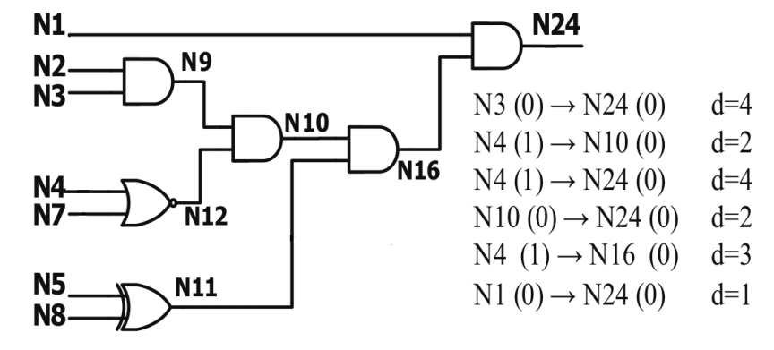
Implications
Implications (or invariant relationships) are logic relations between nodes in the circuit that hold for any input vector
0
0
0
0
1
0
Notes:
Get rid of d column

Slide 8



Implications
If we know the implications in a circuit we can use these relations for reinforcing correct logic behavior
0
0 → 1
0

Slide 9
Outline
Implication
What are they?
How can they be used to improve noise immunity
Schmitt Trigger gates
Basic operation
Embedding implications into Schmitt gate
Simulation results
Automated design flow
How do you select which implications to insert in the circuit?

Slide 10
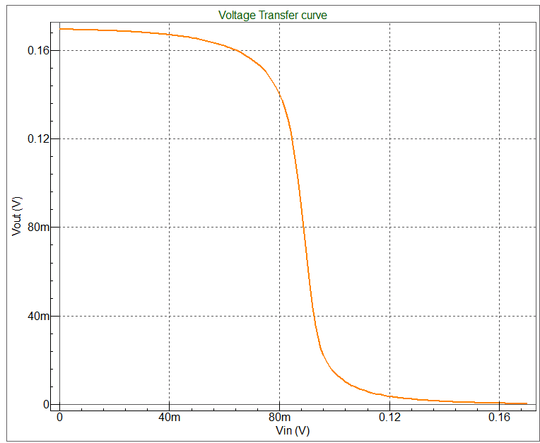
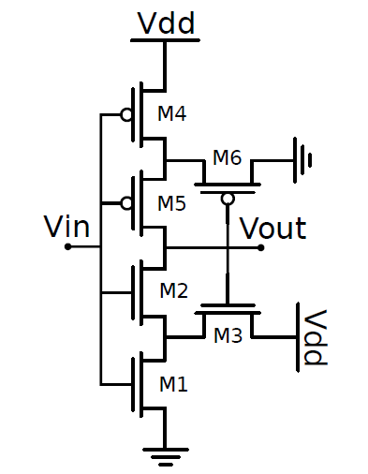
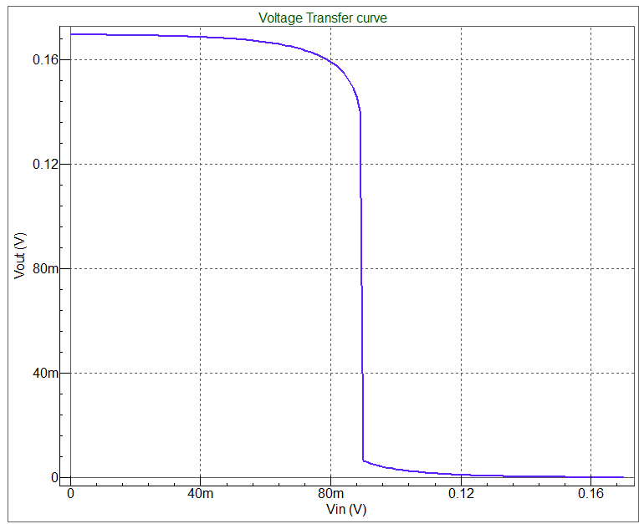
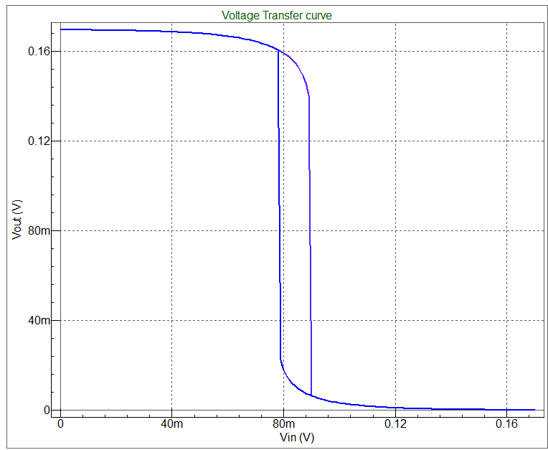
Circuit implementation Schmitt Gates
Schmitt Trigger
Improved noise
margin
Notes:
Compare with an inverter and explain the circuit in detail

Slide 11
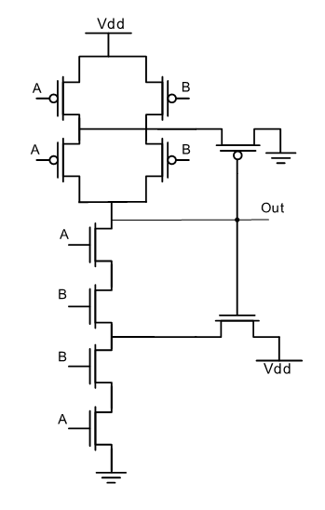
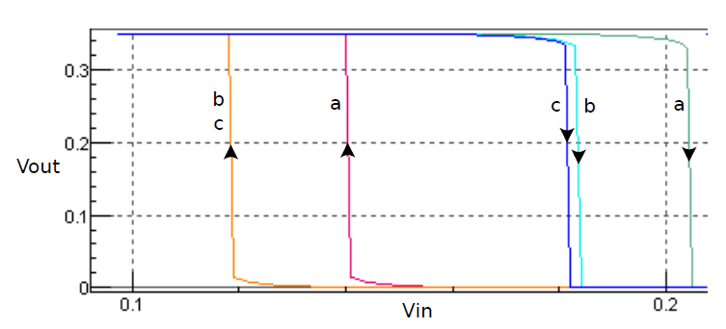
Circuit implementation Schmitt Gates
NAND Schmitt gate
Hysteresis Characteristic of a
NAND Schmitt gate
[Dokic ‘96]

Slide 12
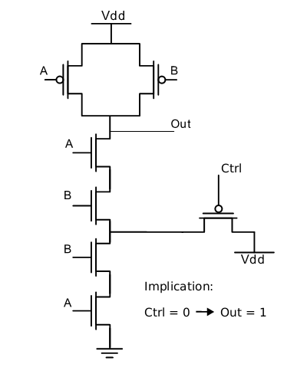
Circuit implementation Schmitt Gates
Including Implications into the Gate
Standard CMOS
pull-up network
Modified Schmitt NAND pull-down

Slide 13
Circuit implementation Schmitt Gates
4 kind of implications
A(0) → B(0) PMOS/Pull-up
A(0) → B(1) PMOS/Pull-down
A(1) → B(0) NMOS/Pull-up
A(1) → B(1) NMOS/Pull-down

Slide 14
Outline
Implication
What are they?
How can they be used to improve noise immunity
Schmitt Trigger gates
Basic operation
Embedding implications into Schmitt gate
Simulation results
Automated design flow
How do you select which implications to insert in the circuit?

Slide 15
Simulation Setup
22nm PTM (BSIM4)
Additive White Gaussian Noise with 0 μ and 10 mV σ
RTS noise with 50 mV amplitude
Sub-threshold operation V_{DD} = 170 mV
Fast-Slow corner libraries

Slide 16
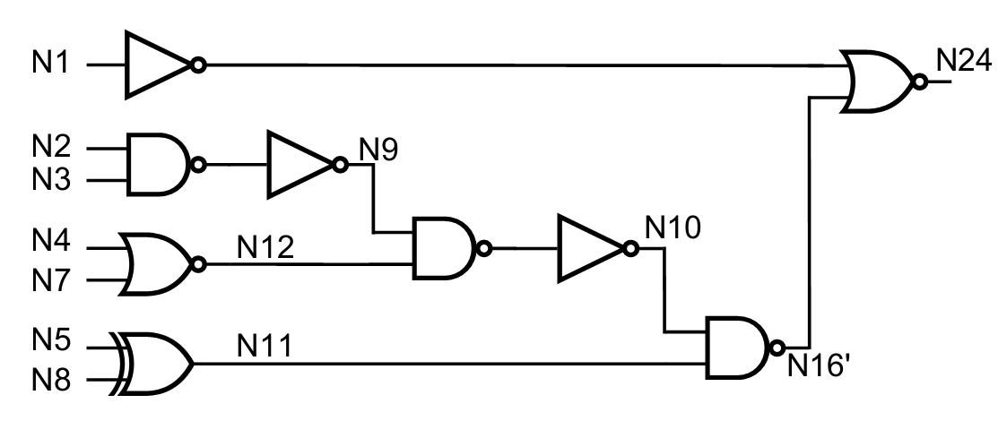
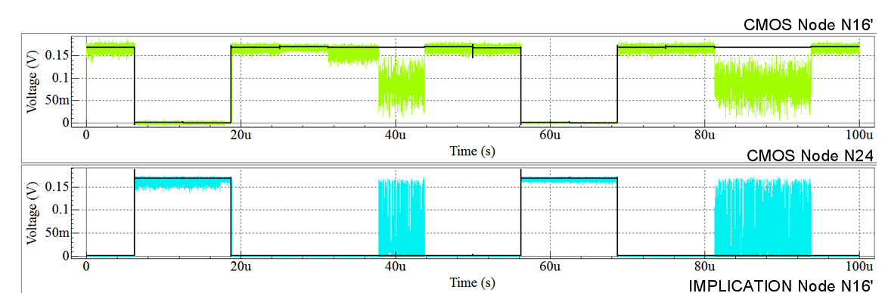
Simulation Results

Slide 17
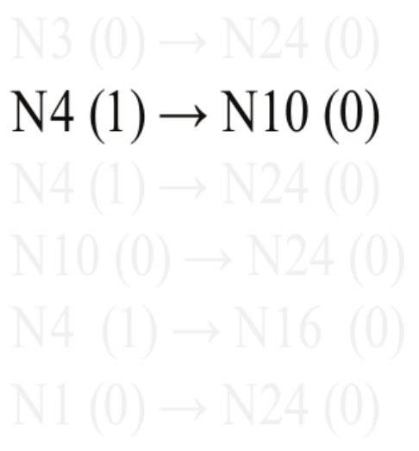
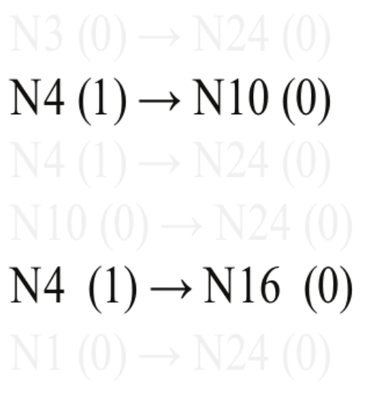
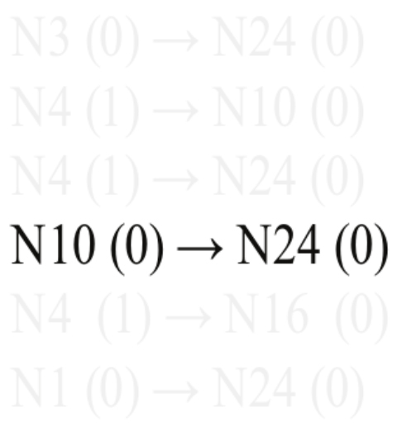
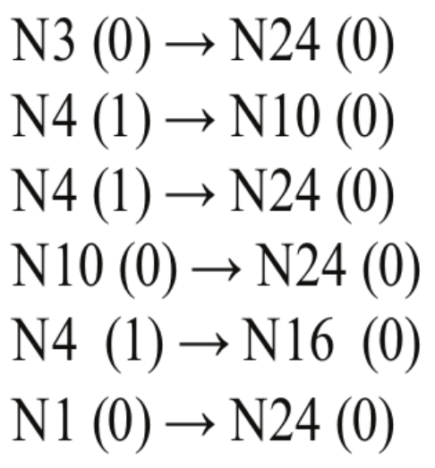
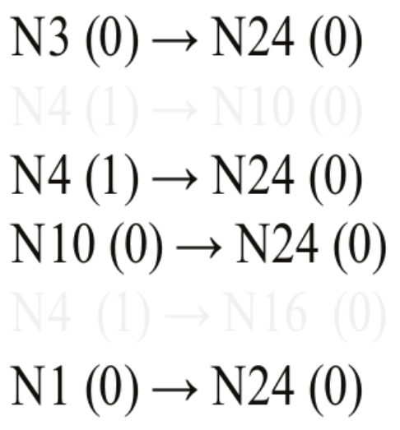
Simulation Results
Implication Selection
Primary Output (N24) is the main target
Subset of implications that have N24 as implicand
Build a chain of implications back to the primary inputs

Slide 18
Simulation Results
Implication Reinforcement
The gates that produce N10’ and N24 are replaced with modified Schmitt gates

Slide 19
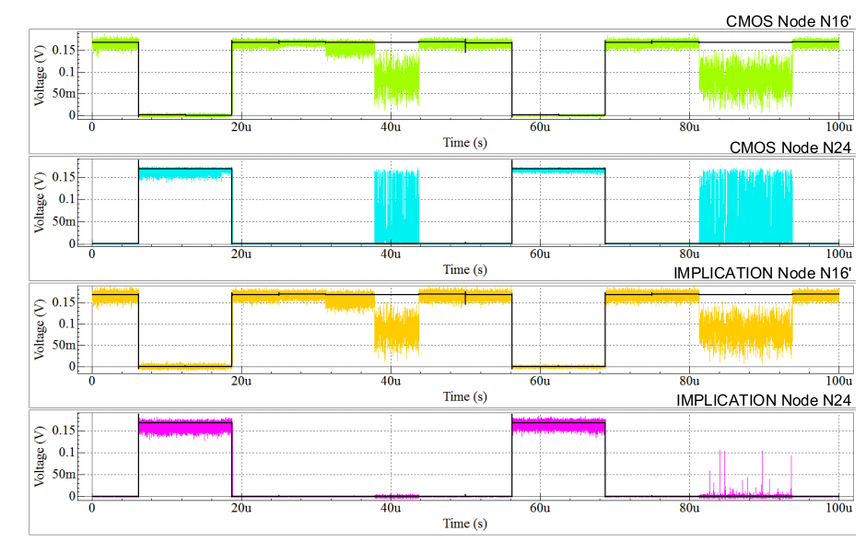
Simulation Results
Implication Reinforcement

Slide 20
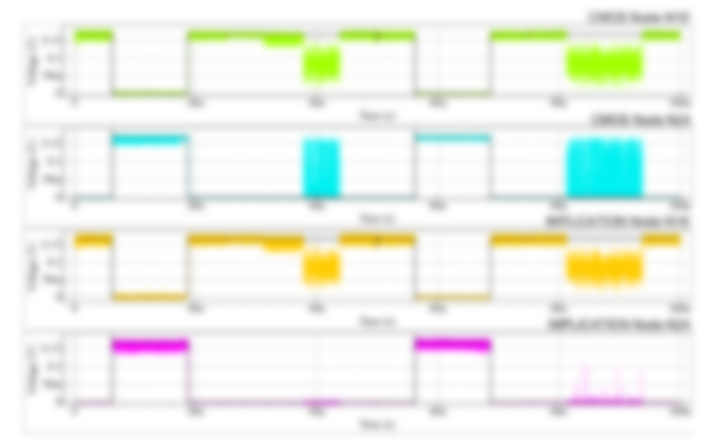
Simulation Results
Implication Reinforcement
Set of 100 simulations with different noise samples
2 Implications (18.75 % area overhead)
Failure rate reduced from 6.5% to 0%

Slide 21
Outline
Implication
What are they?
How can they be used to improve noise immunity
Schmitt Trigger gates
Basic operation
Embedding implications into Schmitt gate
Simulation results
Automated design flow
How do you select which implications to insert in the circuit?

Slide 22
Design Flow
Thousands of implications exist in any circuit
We want to use a limited number of implications
How can we easily select these implications?
Notes:
Why do we need an automated design flow

Slide 23
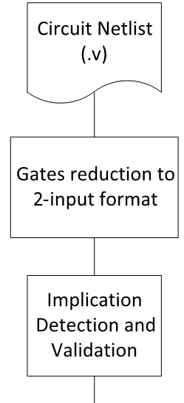
Design Flow
Implication Discovery
and Verification

Slide 24
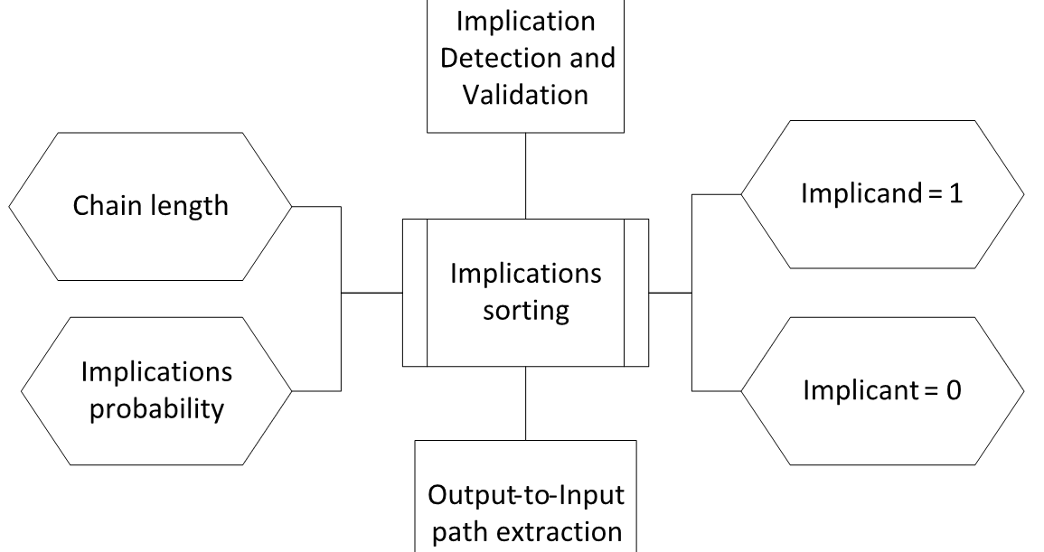
Design Flow
Implication
sorting

Slide 25
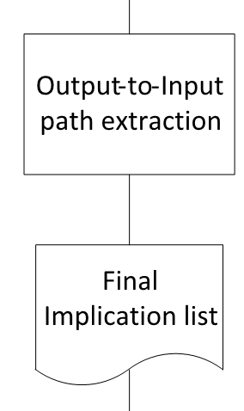
Design Flow
Implications chain
extraction

Slide 26
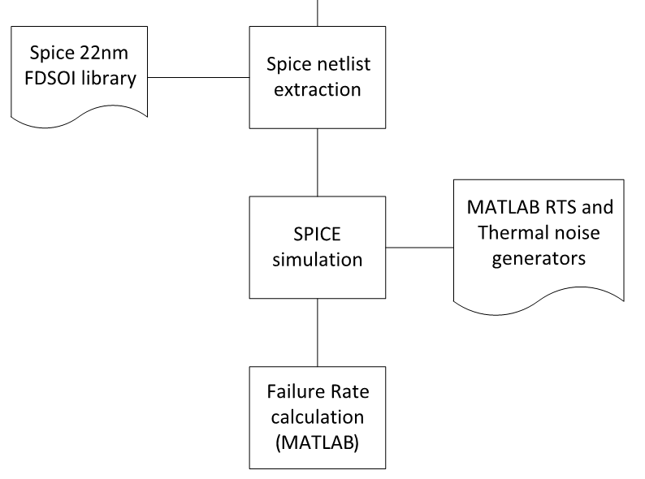
Design Flow
SPICE netlist
extraction
and simulation

Slide 27
Conclusions
We have proposed a cost-effective solution for improving the reliability of sub-threshold nanoscale circuits
Implication relationships are embedded into Schmitt trigger gates to reinforce correct behavior
We plan to expand and improve the design flow with particular emphasis on the “value” of the implication
Future work will focus on considering more advanced technologies and analyzing other noise sources

