Slide 1

Astrazeneca Identifying Gene Markers and Designing Transgenes in CHO Cells
Amrita Moyade (tq24748)

Slide 2
Introduction
CHO Cells: Industry standard for biologics production
Problem: Slow clone selection and inefficient transgene design
Our Goals:
Identify gene markers predictive of PRODUCT-TG expression
Characterize constitutive genes for synthetic transgene design

Slide 3
Data Preparation
Dataset:
Expression matrix (25,594 genes, 108 samples)
Metadata (12 batches)
FASTA sequences (5'UTR, CDS, 3'UTR)
Preprocessing:
Log2(Expression+1) transformation
Filtering low-expression genes
Batch correction: ComBat

Slide 4
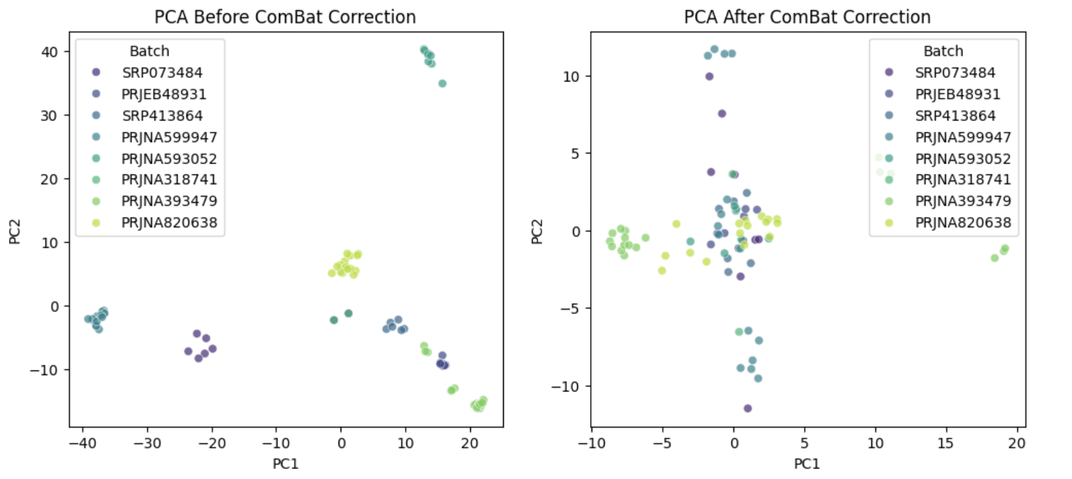

Slide 5
Marker Gene Identification
Spearman Correlation with PRODUCT-TG
Random Forest Regressor for feature importance
Random Forest Classifier for discrete PRODUCT-TG bands
Composite Scoring combining all rankings

Slide 6
Results: Marker Genes
Top overlapping genes: Glul, Actb, GAPDH, RPS13, NSF
Functions: Growth, translation, secretion support
Conclusion: Robust predictors of high PRODUCT-TG expression

Slide 7
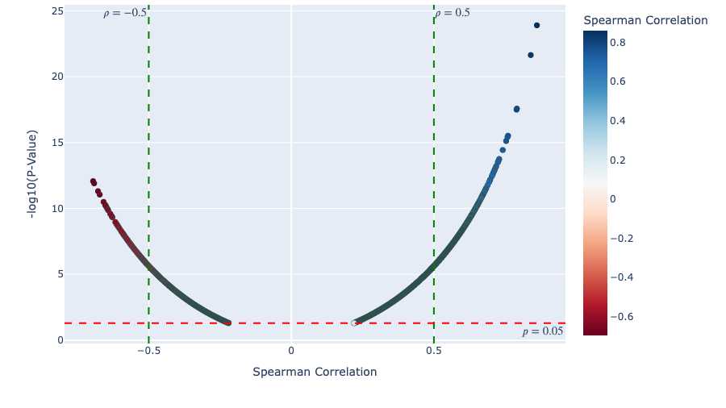
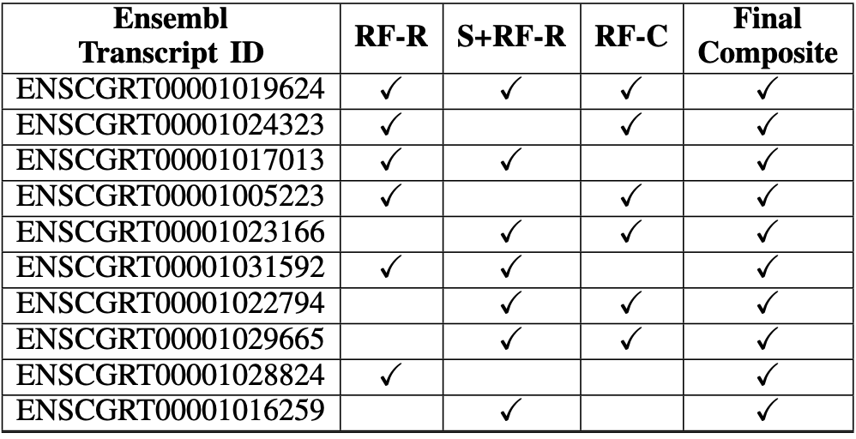
Spearman Correlation with PRODUCT-TG

Slide 8
Constitutive Gene Analysis
Stable genes: Expression Level > 1 and CV < 10%
Feature Extraction:
GC content
DNABERT embeddings
Motif discovery (MEME/FIMO)

Slide 9
Results: Constitutive Genes and Motifs
GC Content: Higher in stable genes
Upregulating Motifs: TTTGGCTTCT, ACCACACCCG
Downregulating Motifs: GAAAAAAAGA, TCCCCTCTCG
Application: Rational UTR design for expression control

Slide 10
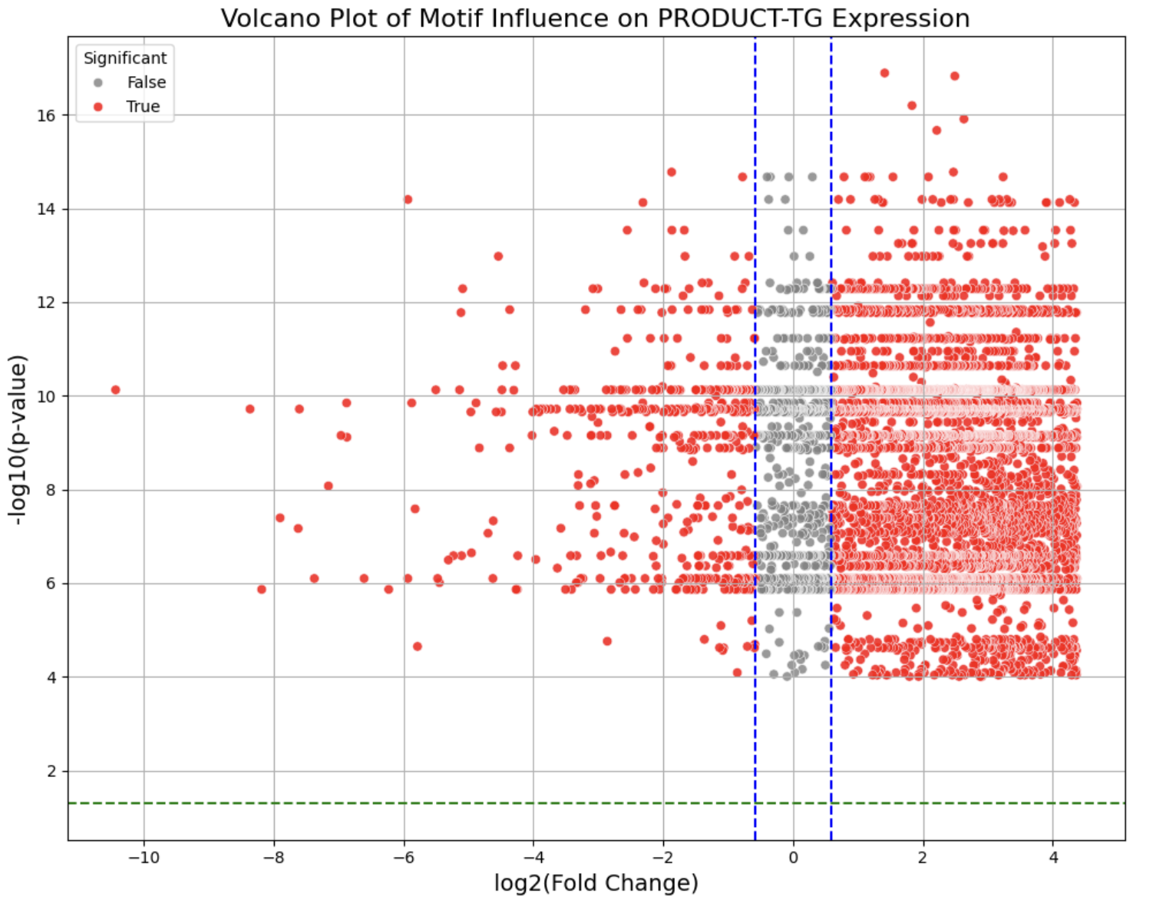

Slide 11
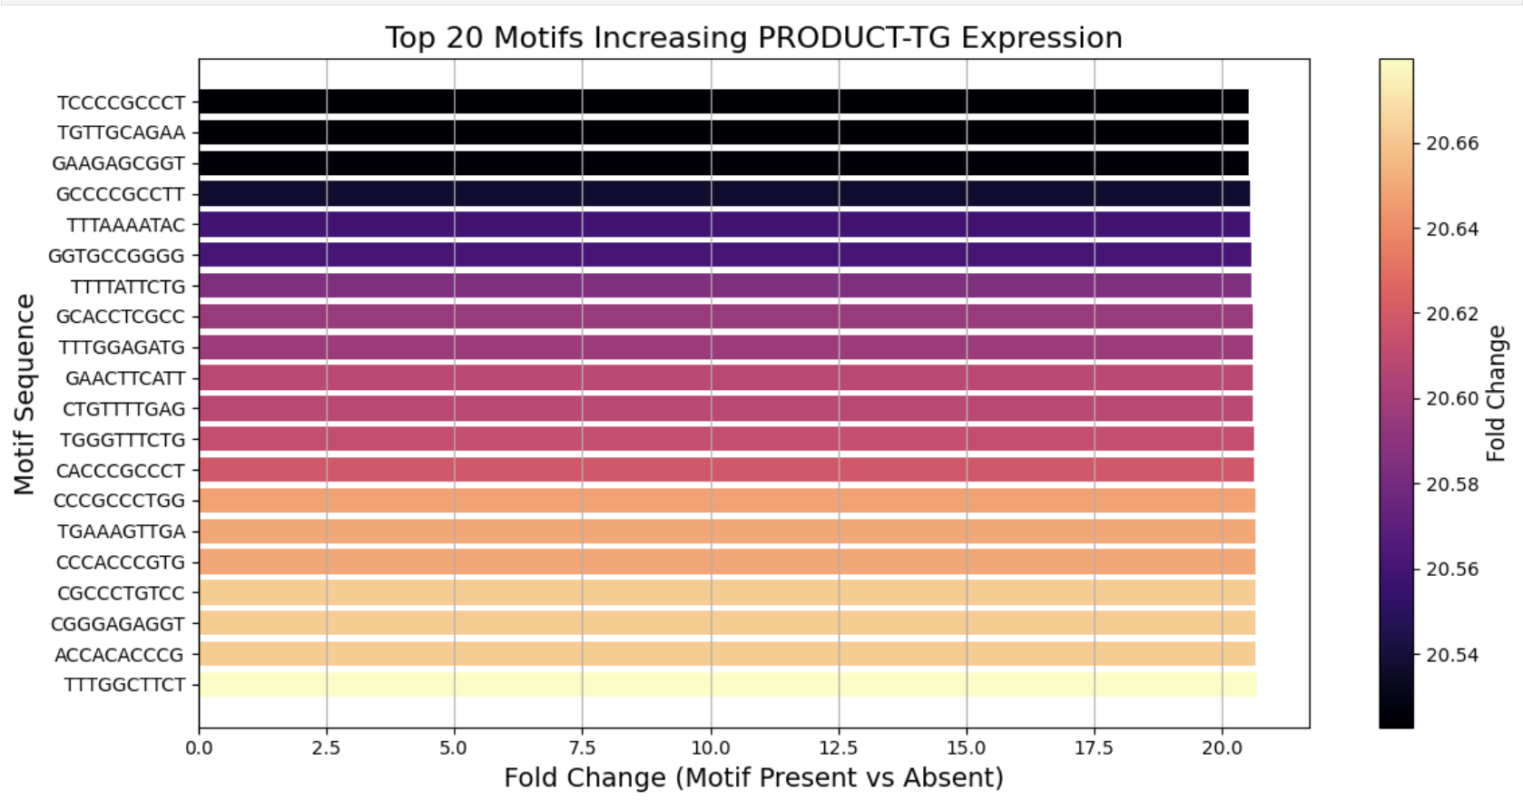
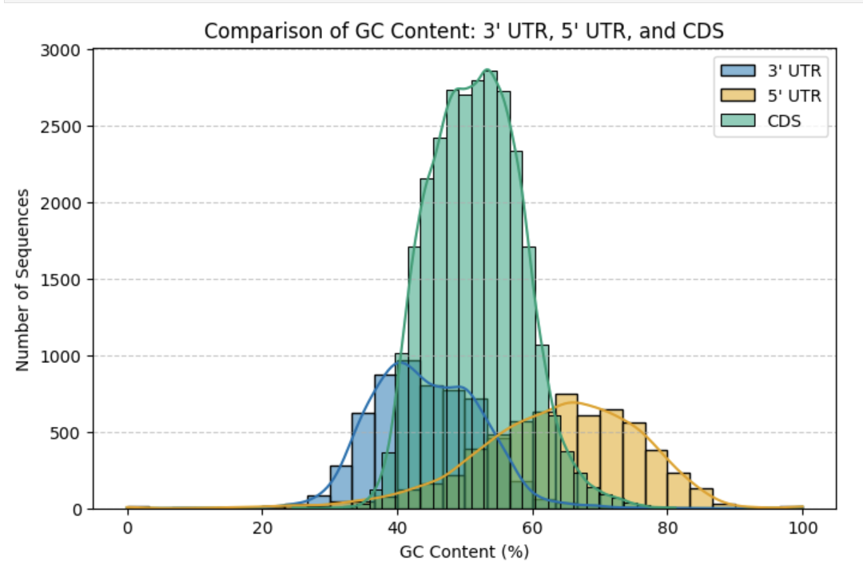
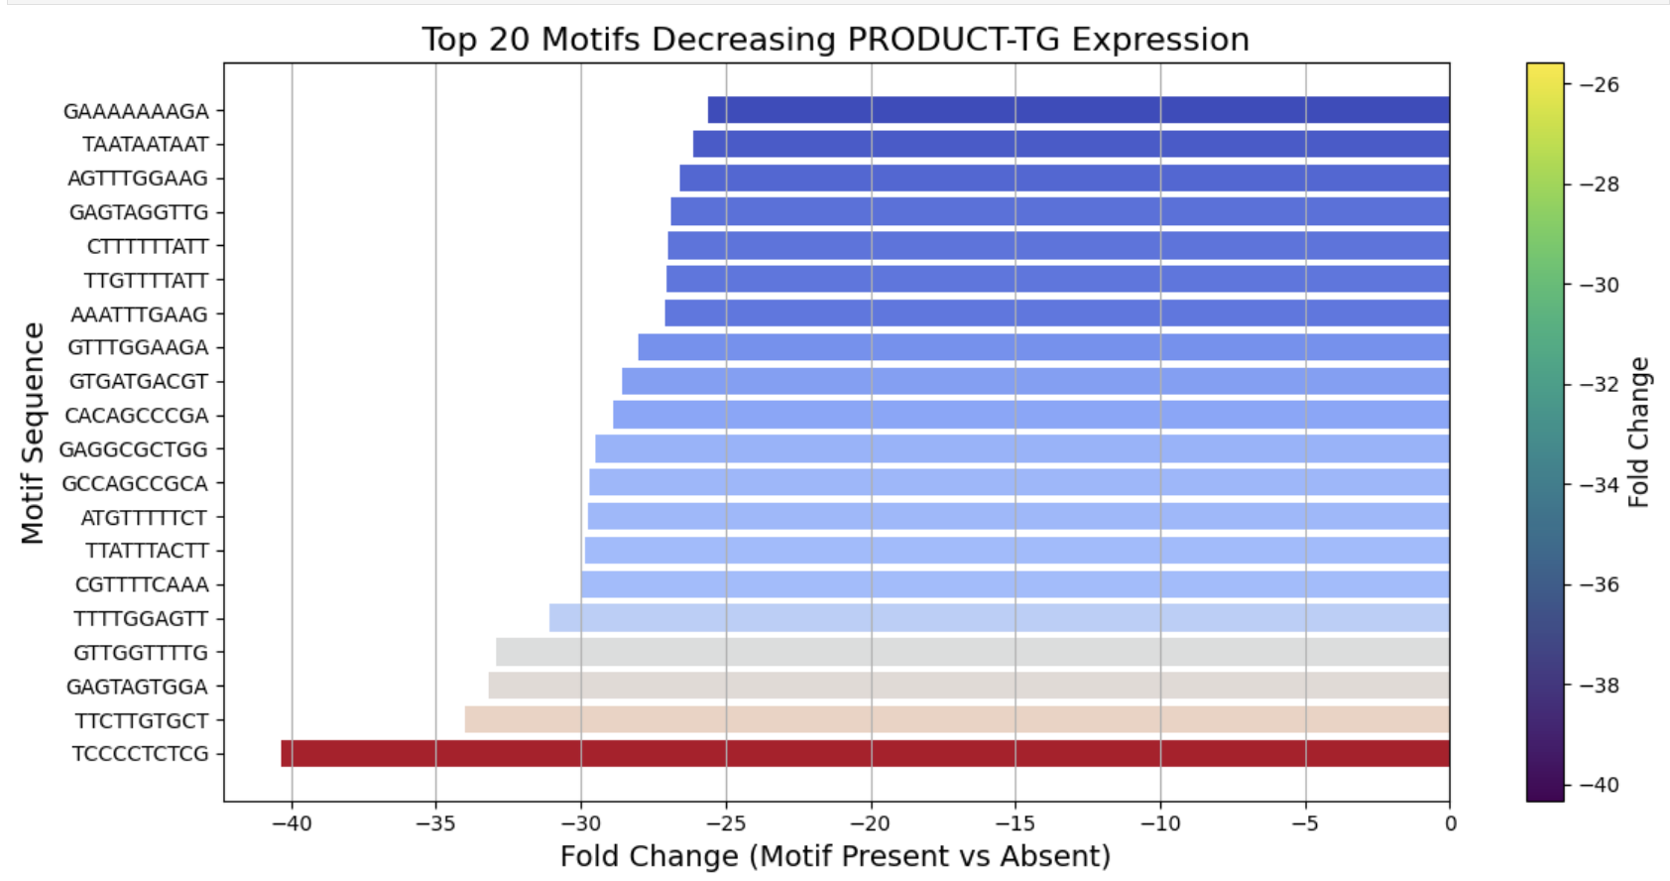

Slide 12
Challenges and Future Work
Challenges:
Batch variability
Skewed PRODUCT-TG distribution
MEME Suite setup
Future Work:
Experimental validation (e.g., qPCR)
Structure-based motif analysis
Expand to proteomics

Slide 13
Conclusion
Identified key marker genes for clone selection
Characterized stable gene features for synthetic design
Supports AstraZeneca's biomanufacturing strategies

