Slide 1




CSE 3021 - Social and Information Networks
Fake Profile Detection System
PRESENTATION
Faculty:
Dr.A.Bhuvaneswari,
Assistant Professor Senior, SCOPE, VIT, Chennai

Slide 2


The Team
Fake Profile Detection System
Amritansh Anand
Kunal Gupta
20BCE1650
20BCE1560

Slide 3
Learning Agenda
Abstract
What we'll discuss this afternoon
Introduction
Dataset & tools to be used
Proposed Framework
Attributes Considered
Random Forest

Slide 4

ABSTRACT
In the present generation, the social life of everyone has become associated with online social networks. These sites have made a drastic change in the way we pursue our social life. Making friends and keeping in contact with them and their updates has become easier. But with their rapid growth, many problems like fake profiles, online impersonation have also grown. There are no feasible solutions exist to control these problems. In this report, we came up with a framework with which the automatic identification of fake profiles is possible and is efficient. This framework uses classification techniques like Random Forest Classifier to classify the profiles into fake or genuine classes. As this is an automatic detection method, it can be applied easily by online social networks that have millions of profiles whose profiles cannot be examined manually. Also, we will be comparing the result with the another method of implementation that is already existing, i.e., SVM (Support Vector Machine).

Slide 5




Introduction
Social networking site is a website where each user has a profile and can keep in contact with friends, share their updates, meet new people who have the same interests. These Online Social Networks (OSN) use web2.0 technology, which allows users to interact with each other. Social networking sites are growing rapidly and changing the way people keep in contact with each other. The online communities bring people with the same interests together which makes users easier to make new friends.
In today’s online social networks there have been a lot of problems like fake profiles, online impersonation, etc. To date, no one has come up with a feasible solution to these problems. In this project, I intend to give a framework with which the automatic detection of fake profiles can be done so that the social life of people become secured and by using this automatic detection technique we can make it easier for the sites to manage the huge number of profiles, which can’t be done manually.

Slide 6


DATASET & TOOLS TO BE USED
We needed a dataset of fake and genuine profiles. Various attributes included in the dataset are a number of friends, followers, status count. Dataset is divided into training and testing data. Classification algorithms are trained using a training dataset and the testing dataset is used to determine the efficiency of the algorithm. From the dataset used, 80% of both profiles (genuine and fake) are used to prepare a training dataset and 20% of both profiles are used to prepare a testing dataset.
LINK TO DATASET:
https://www.kaggle.com/datasets/joewilson02/social-media-fake-account

Slide 7


PROPOSED FRAMEWORK

Slide 8
The proposed framework is the sequence of processes that need to be followed for continues detection of fake profiles with active learning from the feedback of the result given by the classification algorithm. This framework can easily be implemented by social networking companies.
The detection process starts with the selection of the profile that needs to be tested.
After the selection of the profile, the suitable attributes (i.e. features) are selected on which the classification algorithm is implemented.
The attributes extracted is passed to the trained classifier. The classifier gets trained regularly as new training data is feed into the classifier.
The classifier determines whether the profile is fake or genuine.
The classifier may not be 100% accurate in classifying the profile so; the feedback of the result is given back to the classifier.
This process repeats and as the time proceeds, the no. of training data increases and the classifier becomes more and more accurate in predicting the fake profiles.

Slide 9


ATTRIBUTES CONSIDERED FOR FAKE PROFILE IDENTIFICATION

Slide 10
S. No | Attribute | Description
1 | Profile ID | The Profile ID of account holder
2 | Profile Name | The name of the account bolder
3 | Status Count | The number of tweets made by the account
4 | Followers Count | The number of followers for the account
5 | Friends Count | The number of friends for the account
6 | Location | The location of the account holder
7 | Created Date | The date the account was created
8 | Share count | The number of shares done by account holder
9 | Gender | The Gender of the account holder
10 | Language Code | The language of account bolder

Slide 11
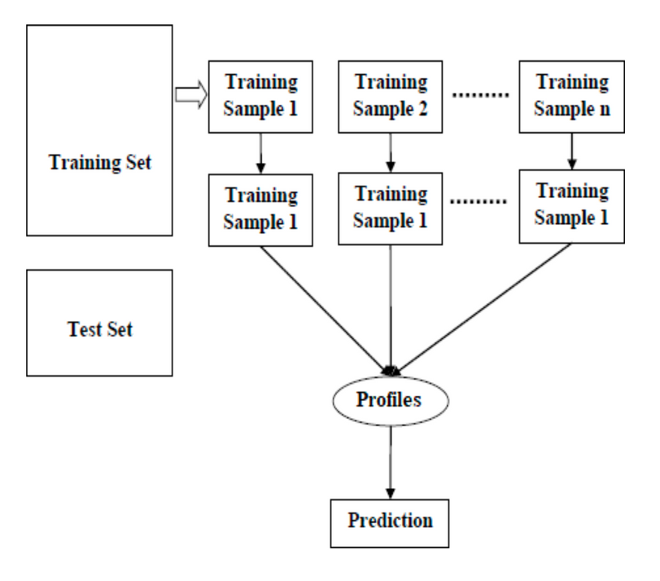
RANDOM FOREST
Random forest is a supervised learning algorithm that is used for both classifications as well as regression. But however, it is mainly used for classification problems. As we know that a forest is made up of trees and more trees mean more robust forests. Similarly, the random forest algorithm creates decision trees on data samples and then gets the prediction from each of them and finally selects the best solution by means of voting. It is an ensemble method that is better than a single decision tree because it reduces the over-fitting by averaging the result.
We can understand the working of the Random Forest algorithm with the help of following steps:
Step 1 − First, start with the selection of random samples from a given dataset.
Step 2 − Next, this algorithm will construct a decision tree for every sample. Then it will get the prediction result from every decision tree.
Step 3 − In this step, voting will be performed for every predicted result.
Step 4 − At last, select the most voted prediction result as the final prediction result.

Slide 12

Support Vector Machine
Support Vector Machine or SVM is one of the most popular Supervised Learning algorithms, which is used for Classification as well as Regression problems. However, primarily, it is used for Classification problems in Machine Learning.
The goal of the SVM algorithm is to create the best line or decision boundary that can segregate n-dimensional space into classes so that we can easily put the new data point in the correct category in the future. This best decision boundary is called a hyperplane.
SVM chooses the extreme points/vectors that help in creating the hyperplane. These extreme cases are called as support vectors, and hence algorithm is termed as Support Vector Machine.
SVM can be of two types:
Linear SVM: Linear SVM is used for linearly separable data, which means if a dataset can be classified into two classes by using a single straight line, then such data is termed as linearly separable data, and classifier is used called as Linear SVM classifier.
Non-linear SVM: Non-Linear SVM is used for non-linearly separated data, which means if a dataset cannot be classified by using a straight line, then such data is termed as non-linear data and classifier used is called as Non-linear SVM classifier.

Slide 13
CONCLUSION
We have given a framework using which we can identify fake profiles in any online social network by using Random Forest Classifier with a very high efficiency as high as around 95% and with a comparative analysis through SVM with a efficiency of around 88%. Fake profile Identification can be improved by applying NLP techniques and Neural Networks to process the posts and the profiles. In the future, we wish to classify profiles by taking profile pictures as one of the features.

Slide 14
Thank you!
Send us a message at amritansh.anand2020@vitstudent.ac.in
kunal.gupta2020@vitstudent.ac.in
if you have any questions.

