Slide 1



ಚಿಲ್ಡ್ರನ್ಸ್ ಎಜುಕ'ೇಶನ್ಸ ಸ'ೊಸ'ೈಟಿ
Children’s Education Society
ದ ಆಕ್ಸ್ಫರ್ಡ್ ಕಾಲ'ೇಜ್ ಆಫ್ ಇಂಜಿನಿಯರಂಗ್
The Oxford College of Engineering
STARTUP BATTLEFRONT
Team Name – Quantum Warrior
Idea Title – Intelligent Water Security for a Thirsty Planet
Amritanshu Kishore & 1OX24CS010
Goutam Parashuram Gotur & 1OX24CS042

Slide 2
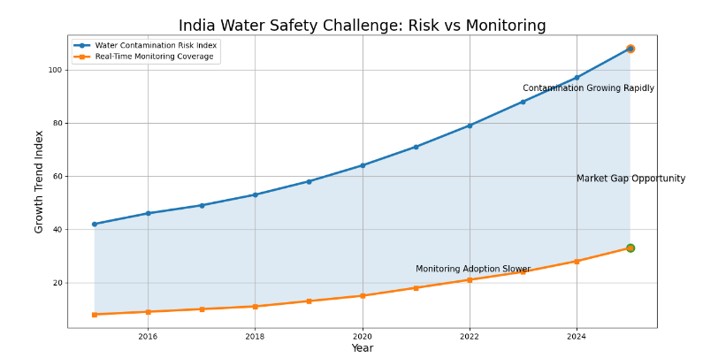
Smart Detection for Unsafe Water
1. Problem Statement: Unsafe & Poor-Quality Drinking Water. Over 2 billion people lack access to safe water. Contamination, slow testing, and zero real-time monitoring put millions at daily risk.
Bacteria, heavy metals, chemical contamination
No instant purity or mineral-level detection
Traditional testing: slow and expensive
2. PROPOSED SOLUTION
Water Safety Detection
Refractive Index Analysis
Nutritional Mineral Detection
Water Level Monitoring
Real-Time IoT Alerts
3. ADDRESSES THE PROBLEM
Real-Time Water Quality Detection
Refractive Index (RI) Monitoring
Nutritional Mineral Analysis
Water Level & Scarcity Monitoring
Smart AI & IoT Alerts
4. INNOVATION & UNIQUENESS OF THE SOLUTION
6-Sensor Fusion: Biosensor, RI, pH, TDS, Turbidity, Level all in one device
RI Optical Sensing
Fast, accurate impurity identification via refractive index

Slide 3
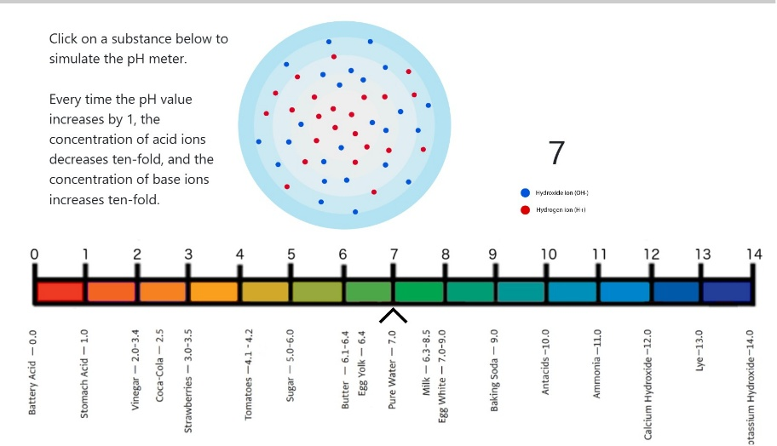
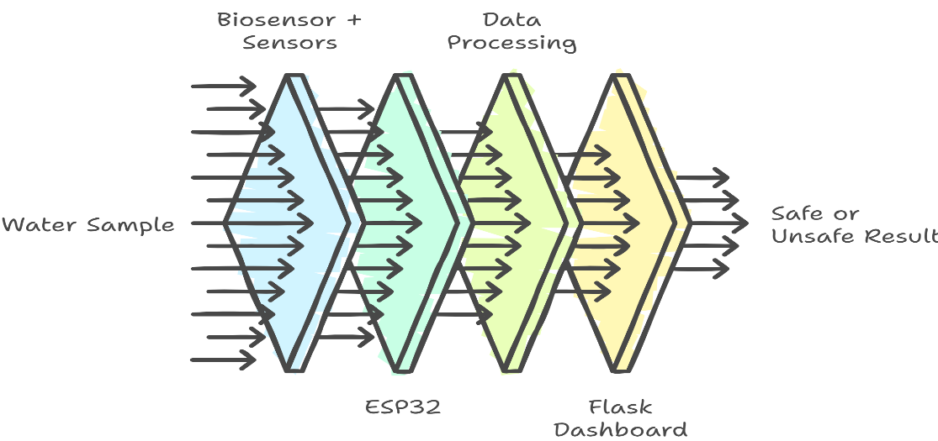
TECHNICAL APPROACH
1. Hardware Technologies
EPS32
Biosensor (Combined)
2. Software Technologies
Arduino IDE
Embedded C/C++
Python
Flask Framework
Dashboard
pH sensor used for water acidity and purity detection.
Methodology & Process
1. Water sample enters sensing chamber
2. Sensors analyze:
pH, RI, TDS, Turbidity, Water Level
3. ESP32 collects sensor data
4. Flask dashboard processes results
5. Final output:
Safe Water / Unsafe Water
Workflow of smart biosensor-based water monitoring system.

Slide 4
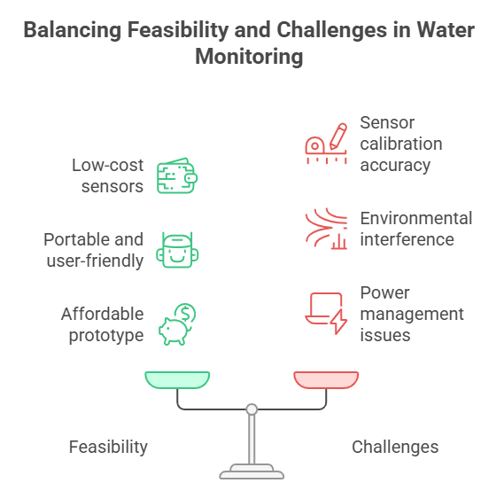
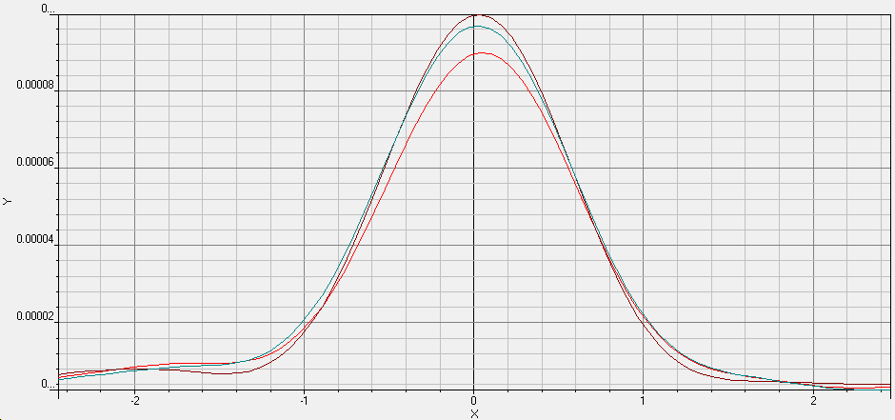

FEASIBILITY AND VIABILITY
Smart Data Processing
Real-time sensor data collection
Water quality analysis using graphs
Detection of contamination patterns
AI-based decision making
Continuous monitoring system
Graph analysis of water quality sensor readings.

Slide 5
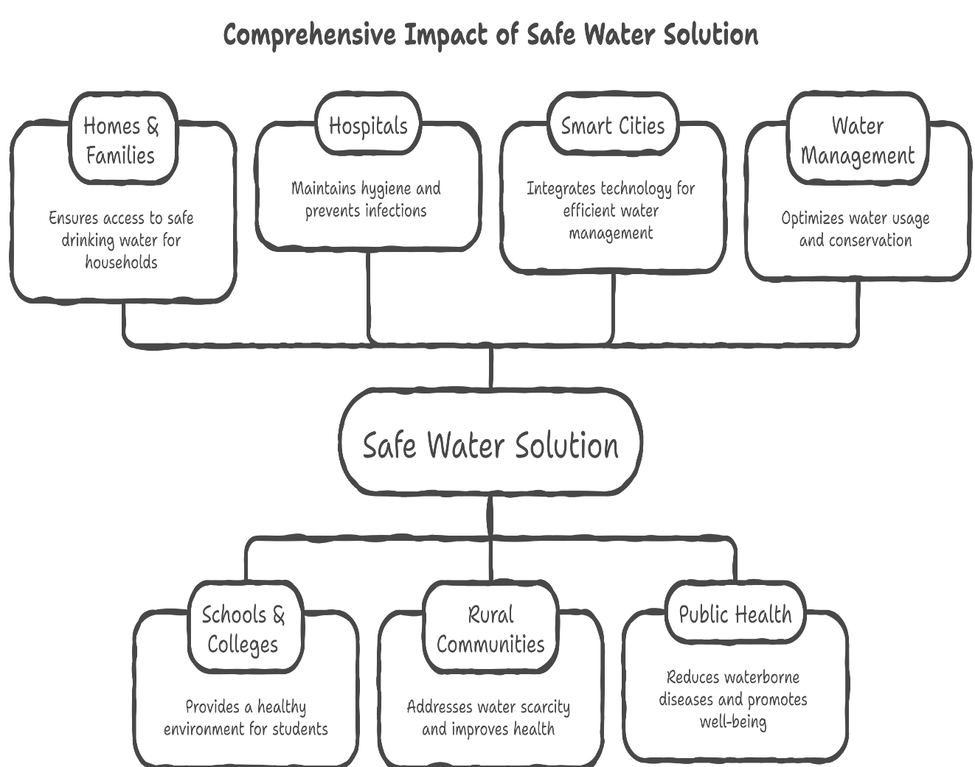
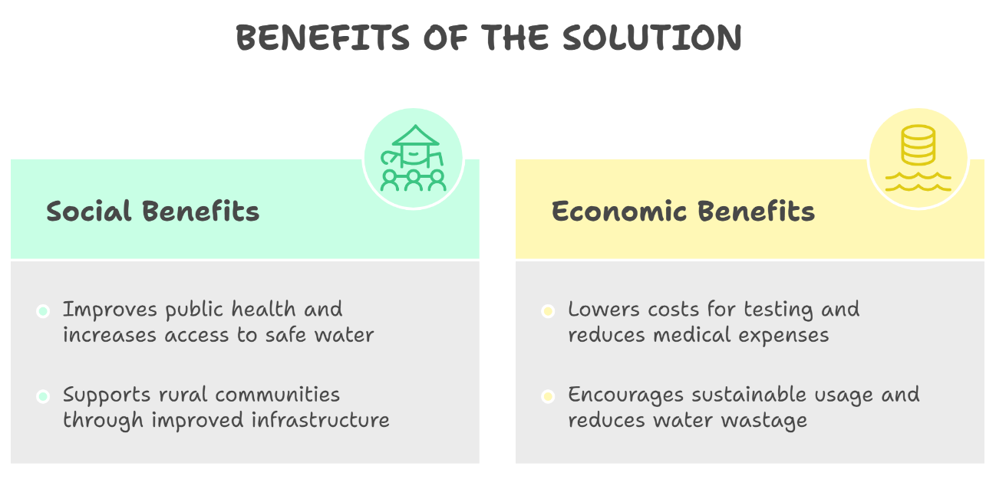

IMPACT AND BENEFITS
POTENTIAL IMPACT ON TARGET AUDIENCE
Sensor Diagram

Slide 6
RESEARCH AND REFERENCES
Kumar, N., Hu, Y., Singh, S., & Mizaikoff, B. (2018). Emerging biosensor platforms for the assessment of water-borne pathogens. Analyst, 143(2), 359-373.
Hesari, N., Alum, A., Elzein, M., & Abbaszadegan, M. (2016). A biosensor platform for rapid detection of E. coli in drinking water. Enzyme and Microbial Technology, 83, 22-28.
Fdez-Sanromán, A., Bernárdez-Rodas, N., Rosales, E., Pazos, M., González-Romero, E., & Sanromán, M. Á. (2025). Biosensor technologies for water quality: detection of emerging contaminants and pathogens. Biosensors, 15(3), 189.
Knollenberg, R. (1987). The importance of media refractive index in evaluating liquid and surface microcontamination measurements. The Journal of Environmental Sciences, 30(2), 50-58.
Sharma, S., & Bhattacharya, A. J. A. W. S. (2017). Drinking water contamination and treatment techniques. Applied water science, 7(3), 1043-1067.
pH Simulator | CSDT
Best TDS Levels for Drinking Water in India (2026) | RO Care India

