Slide 1

Predicting Bankruptcy with Machine Learning
UW FinTech – Nov 2022
Amrita Prithiani
Yu Takahashi
Jeremy Vargas

Slide 2


Bankruptcy
What is?
When a business is unable to repay its debts or obligations. It follows a legal process handled by the U.S. Federal Court and ruled by U.S. Bankruptcy Code.
How is it measured?
Financial ratios are used to measure a business financial fitness and can be used to provide some foresight on a business stability.
Ratios:
Current Ratio
Operating Cash Flow to Sales
Debt / Equity Ratio
Cash Flow to Debt Ratio
Project Scope
Our team presents a series of applications that aim to predict business bankruptcy by using data analysis techniques and machine learning algorithms.
These models and approaches are presented and differentiated as part of this effort.
Notes:
Current Ratio = Current Assets / Total Current Liabilities
Debt / Equity = Total Debt / Shareholders Equity

Slide 3
Generalized approach
Obtain Data set
Prepare Data for learning
Choose Algorithm
Fit and Train
Predict
Calculate relevant financial ratios
Append to original data
Study data set, shape, information, description, etc.
Standardize data
Determine Target (x) and Features (y) variables for training.
Split data for training
Decide classification method

Slide 4
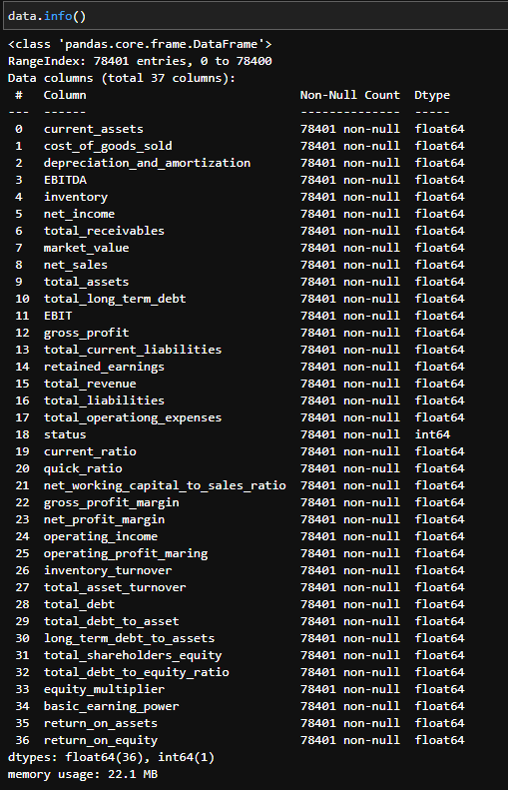
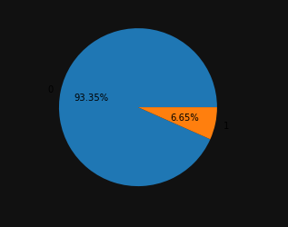
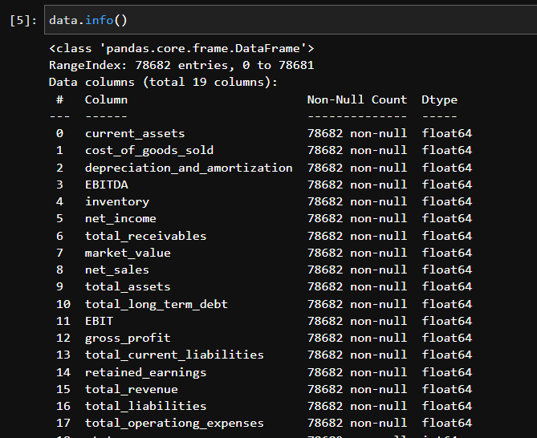
Original vs. Expanded with financial ratios.
What we know:
Labeled: Classified
Bankruptcy “Status”
0 = No
1 = Yes
Imbalanced:
73,191 companies
5210 bankrupt (6.65%)
Non-linear
Financial ratios give us more features learn from
Notes:
Logistic Regression: 93.48%
K-Nearest Neighbors: 93.18%
Decision Tree: 88.03%
Support Vector Machine (Linear Kernel): 27.12%
Support Vector Machine (RBF Kernel): 93.48%

Slide 5
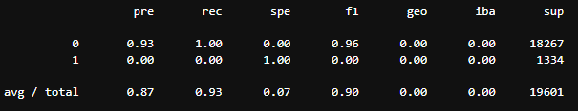
Approach # 1 ADA BOOST
Data set + Financial Ratios (18 vs. 38 features)
ADABOOST requires the selection of a “stump tree” (estimator)
Used ADABOOST Regression to obtain the optimum number of trees (estimator)
Trained model with 1 and 20 trees (0.93 accuracy score - R score)
GridSearchCV function to obtain ideal estimator
Classification report: Imbalanced. ⇒ Results: NOT IDEAL
Notes:
fit a sequence of weak learners on repeatedly modified versions of the data
ADA Boost is better used for “weak learners” Which is determined by the parameter (n_estimators)
different weak learners can be specified through a base estimator.
Ideally the base estimator needs to be discovered. Thus using the regression method.

Slide 6
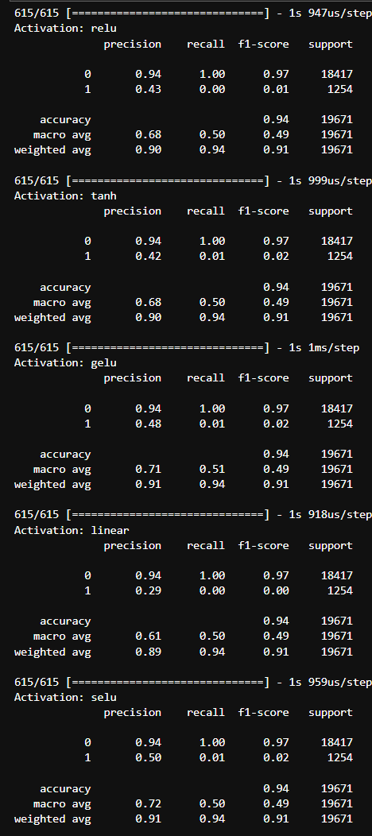
Approach # 2 Neural Network
Data set
Original Dataset
Model
SVC kernel = rbf
MLP Classifier
IMBLearn models
Tensorflow Keras
Nodes: 8 nodes to 120 nodes [96]
activation_list = ['relu', 'tanh', 'gelu', 'linear', 'selu']
output_list = ['sigmoid', 'softmax', 'softplus', 'softsign', 'swish']
optimizer_list = ['adadelta', 'adagrad', 'adam', 'adamax', 'nadam', 'ftrl', 'rmsprop', 'sgd']
Notes:
MLP Classifier
# first hidden layer = 100
# activation = 'relu'
# optimizer = 'adam'
# epochs = 200
IMBLearn
Easy Ensemble Classifier
RUS Boost classifier
Balanced random forest classifier

Slide 7
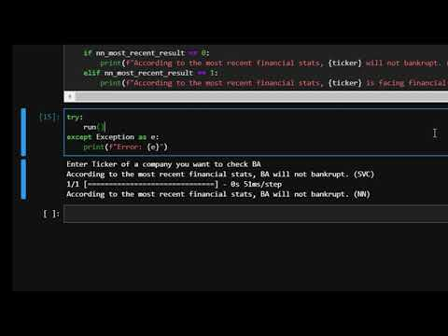
User Interface (see video demo)
Save and load fitted models
Joblib
Fitted scaler model
Fitted ML model
Tensorflow
Fitted Neural Network
Notes:
If there was more time I wanted to try to create Amazon Lex Bot based on this code.
Also, if my PC was powerful enough, I would try k Fold validation method for some of the machine learning parameters that I tried.

Slide 8
Approach # 3 - Iterating Models
Bankruptcy Dataset -
Financial statement data of American companies in the stock market (1999 -2018) - Github
8262 companies
Did not use Financial Ratios
Preparing Process
Cleaned and prepared data.
Standard Scaler to scale variances
Created X and Y split for training.
Applied Smote Oversampling for Imbalanced data
Used KFOLD variation for splitting and testing data and training.
Training Process:
K-Folds cross-validator: Provides train/test indices to split data in train/test sets.
Split dataset into k consecutive folds (without shuffling by default).
Each fold is then used once as a validation while the k - 1 remaining folds form the training set. Definition by scikit-learn.org

Slide 9
Approach # 3 - Iterating Models (cont.)
Focused on models optimized for Imbalanced Data
Random Forest Classifier
Set of decision trees (DT) from a randomly selected subset of the training set and then It collects the votes from different decision trees to decide the final prediction.
XgBoost classifier
In XGBoost, weights are assigned to all the independent variables which are then fed into the decision tree which predicts results. Individual classifiers/predictors adjusted by the weights give a strong and more precise model.
Decision tree classifier
Follows a flowchart-like tree structure, where each internal node denotes a test on an attribute, each branch represents an outcome of the test, and each leaf node (terminal node) holds a class label.

Slide 10
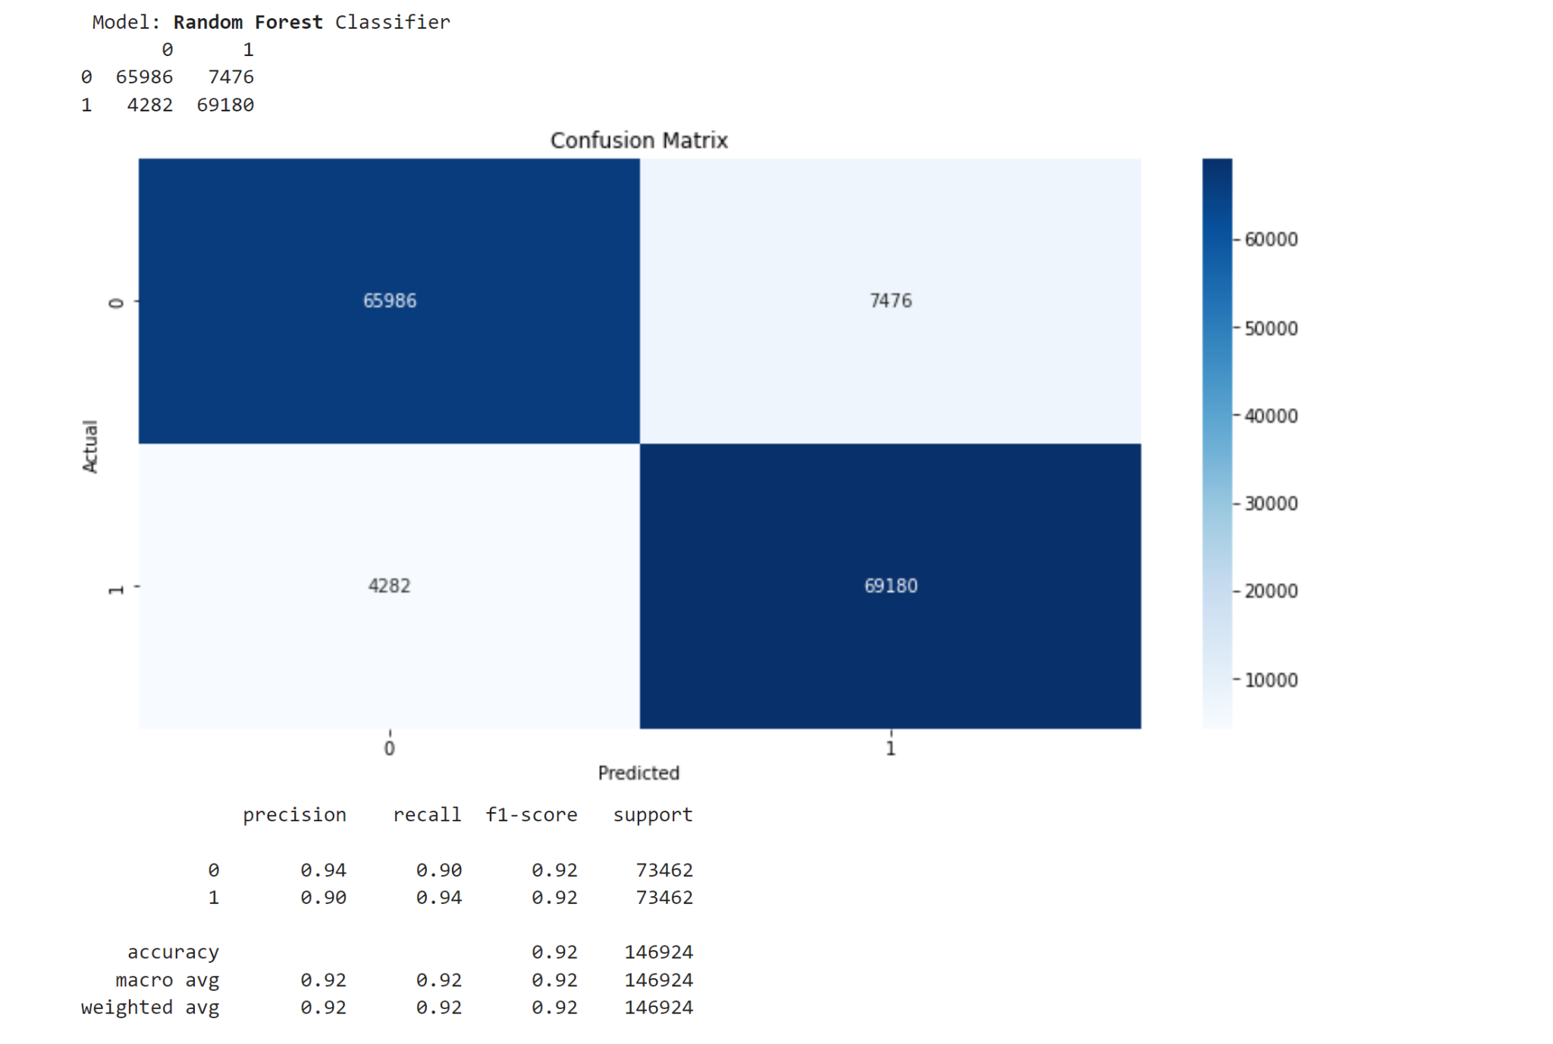

Slide 11
Next steps
Test the model on more recent data
Ideally Post pandemic.
Include visual comparisons for all models applied.
Continue exploring other techniques to classify unbalanced data

Slide 12
Resources
Machine Learning for Bankruptcy Prediction in the American Stock Market: Dataset and Benchmarks
Bankruptcy prediction dataset for american companies in the stock market
Bankruptcy Prediction
How to Plot a Confusion Matrix from a K-Fold Cross-Validation

Slide 13
Q&A

