Slide 1

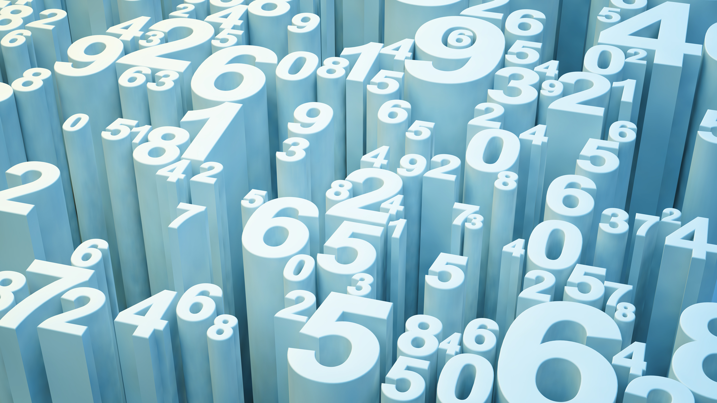
Company Bankruptcy using machine learning
Amrita Prithiani

Slide 2
Overview
Our project is about predicting the company bankruptcy by utilizing the accounting data and ratios with help machine learning. Bankruptcy prediction is the art of predicting bankruptcy and various measures of financial distress of public firms. It is a vast area of finance and accounting research. The importance of the area is due in part to the relevance for creditors and investors in evaluating the likelihood that a firm may go bankrupt.
How it relates to fintech and machine learning:
Predicting bankruptcy is one of the fundamental task of credit risk assessment. All business small or large face the challenge of managing risk. In order to be prepared in the event of a potential loss become actual loss, fintech plays a crucial role in managing such risk. Fintech make risk management easier not just for business but for all participants in the financial eco-system. Fintech enable data-driven predictions to help in making business or investment decision. Using machine learning as tool

Slide 3
Models
Since the data being imbalance, categorical and non-liner, we picked models which can go well with imbalance data.
Random Forest Classifier: Random forest classifier creates a set of decision trees from a randomly selected subset of the training set. It is basically a set of decision trees (DT) from a randomly selected subset of the training set and then It collects the votes from different decision trees to decide the final prediction.
XgBoost classifier algorithm, decision trees are created in sequential form. Weights play an important role in XGBoost. Weights are assigned to all the independent variables which are then fed into the decision tree which predicts results. The weight of variables predicted wrong by the tree is increased and these variables are then fed to the second decision tree. These individual classifiers/predictors then ensemble to give a strong and more precise model. It can work on regression, classification, ranking, and user-defined prediction problems.
Decision tree classifier- Decision tree is a flowchart-like tree structure, where each internal node denotes a test on an attribute, each branch represents an outcome of the test, and each leaf node (terminal node) holds a class label.

Slide 4
Data Source
We found a bankruptcy prediction dataset related to the American companies in the stock market (1999-2018) on Github.
This data has accounting data from different 8262 different companies in the period between 1999 to 2018
The data provided on GitHub claims to provide enough features to predict Bankruptcy.
sowide/bankruptcy_dataset: Bankruptcy prediction dataset related to the american companies in the stock market (1999-2018) (github.com)

Slide 5
Data Preparation process
The data was fairly clean but we retitle the columns, checked for any missing information and confirm the dtype of columns, Scaled the data using StandardScaler and finally, splitting the data into X features and y labels.
Training process involves dealing with imbalance data by applying smote oversampling then iterating the models by using kfold validation for splitting the data in to test and training.

Slide 6
Project Approach
Step 1 – clean and scale data
Sklearn standardscaler- Centering and scaling happen independently on each feature by computing the relevant statistics on the samples in the training set. Mean and standard deviation are then stored to be used on later data using transform.
Step 2 – oversample with smote- (synthetic minority oversampling technique) is one of the most commonly used oversampling methods to solve the imbalance problem. It aims to balance class distribution by randomly increasing minority class examples by replicating them.- definition by geeksforgeeks.com
Step 3 – Iterating models with kfold validation
K-Folds cross-validator
Provides train/test indices to split data in train/test sets. Split dataset into k consecutive folds (without shuffling by default).
Each fold is then used once as a validation while the k - 1 remaining folds form the training set. Definition by scikit-learn.org

Slide 7
Unanticipated Insight
We face the problem that are we having proper data for prediction?
Do we need to calculate ratio? (Financial ratios are indicators of company’s health)
As per the research article provided with data source, the data does include enough information to predict the bankruptcy.
To address this issue we tried models with and without ratios

Slide 8
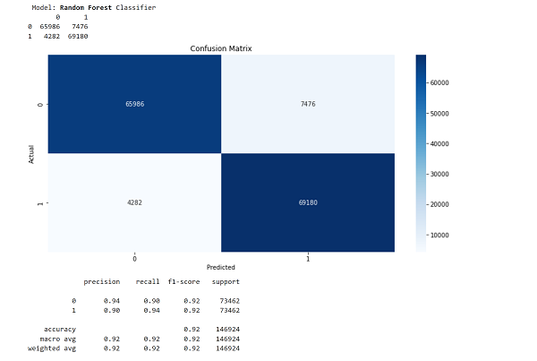
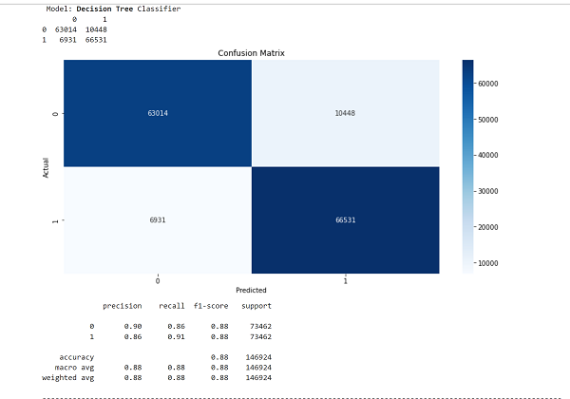
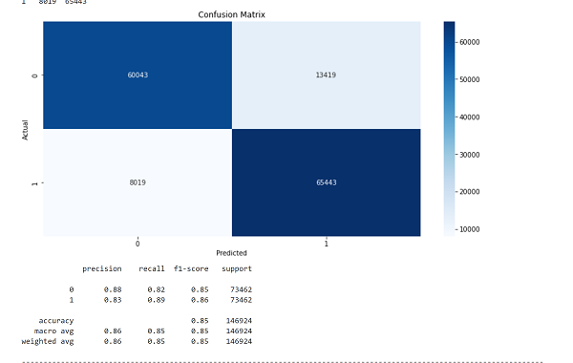
Conclusions
As per the Classification report and confusion matrix, Radom Forest Classifier performed best with a precision 90% for Bankruptcy class. The model was able to predict 94% of bankruptcy cases with 90% precision. Though Decision tree classifier and XGBoost classifier were close too.

Slide 9
Next Step
We would like to see how our model perform on unseen data. Potentially, would like to analysis how model works on post covid data.
Customizing the data window- let say the model can predict bankruptcy for last five year of information or may be less like 2 years
Research more different techniques which can work on such imbalance data.
Discover more tools available for evaluating model performance.

