Slide 1
Durable Goods
Team: 5
Amrita
Austin
Preethi
Swaroop

Slide 2
Background
Transaction data for a major U.S. consumer electronics retailer
Panel data which contains the transactions of 19,936 households
6 years of data spanning between December 1998 to November 2004
Information including:
Product Categories and Subcategories
Extended prices
Quantity purchased
Return or Purchase
Customer Demographics

Slide 3
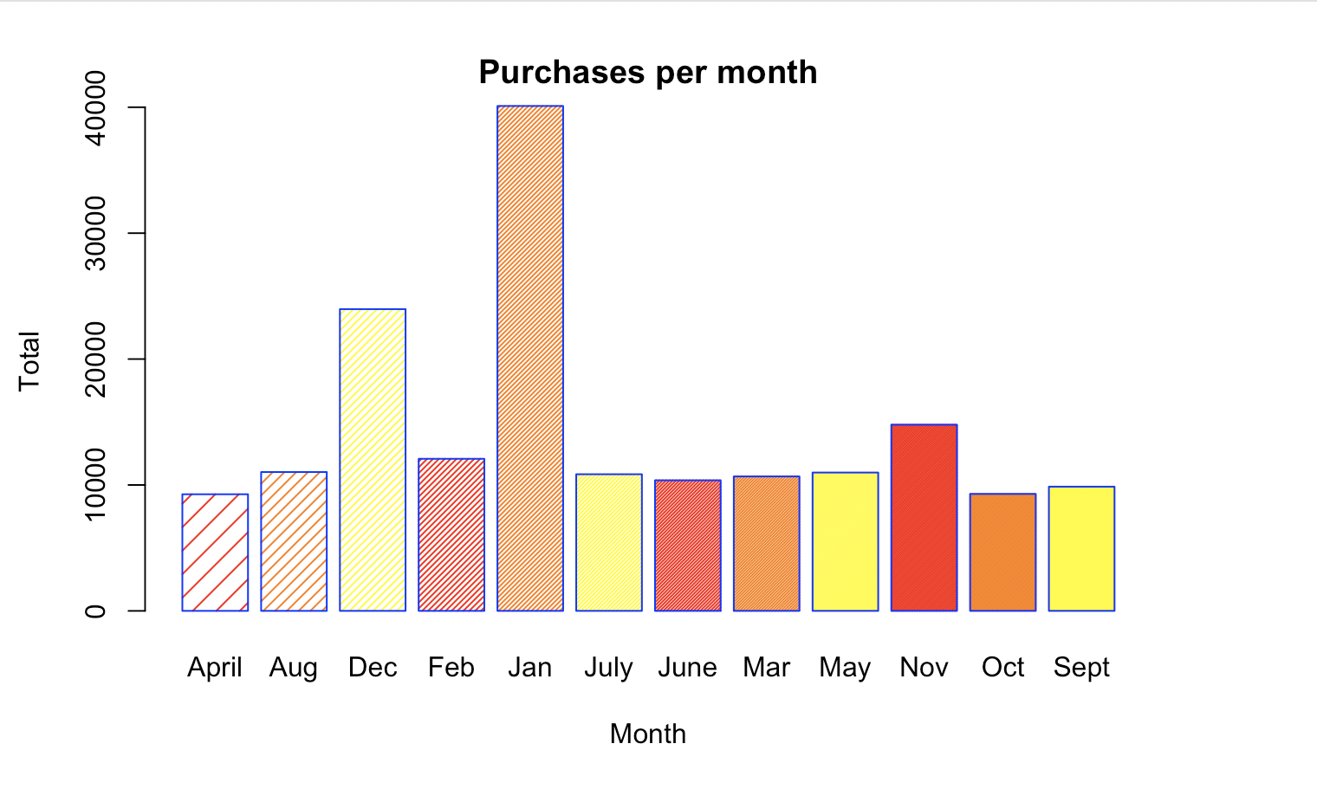
Data Visualization - Purchases per Month

Slide 4
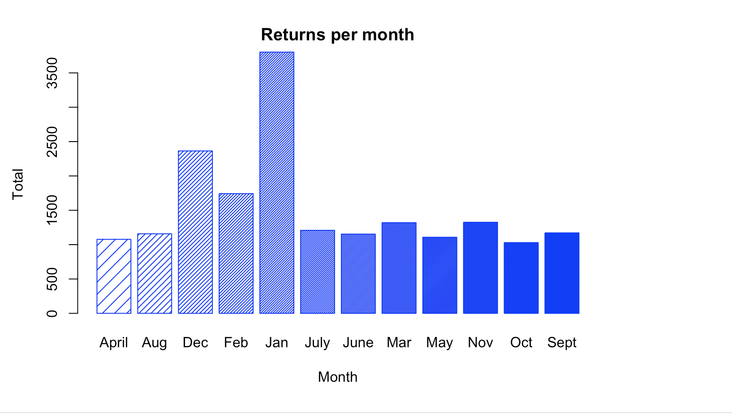
Data Visualization - Returns per Month

Slide 5
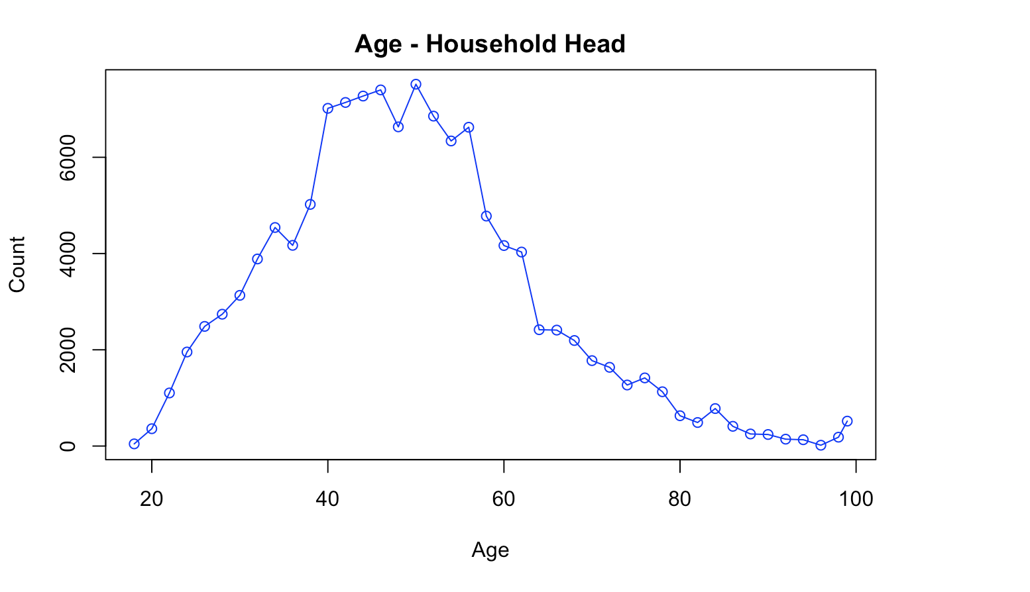
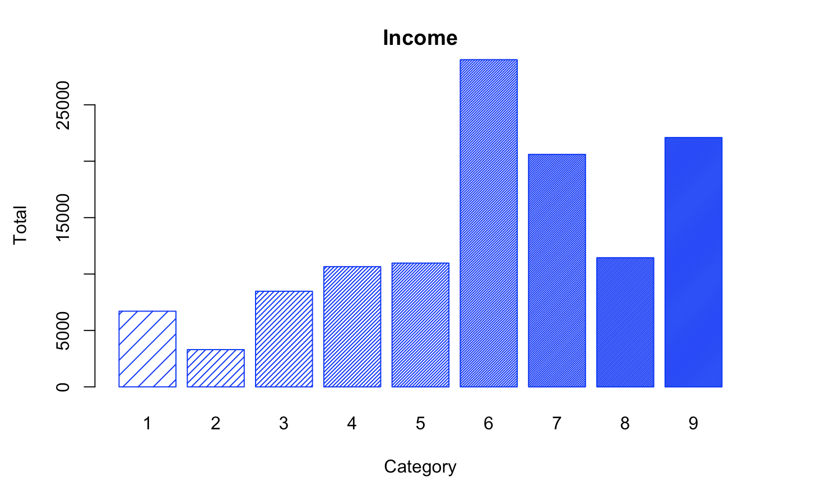
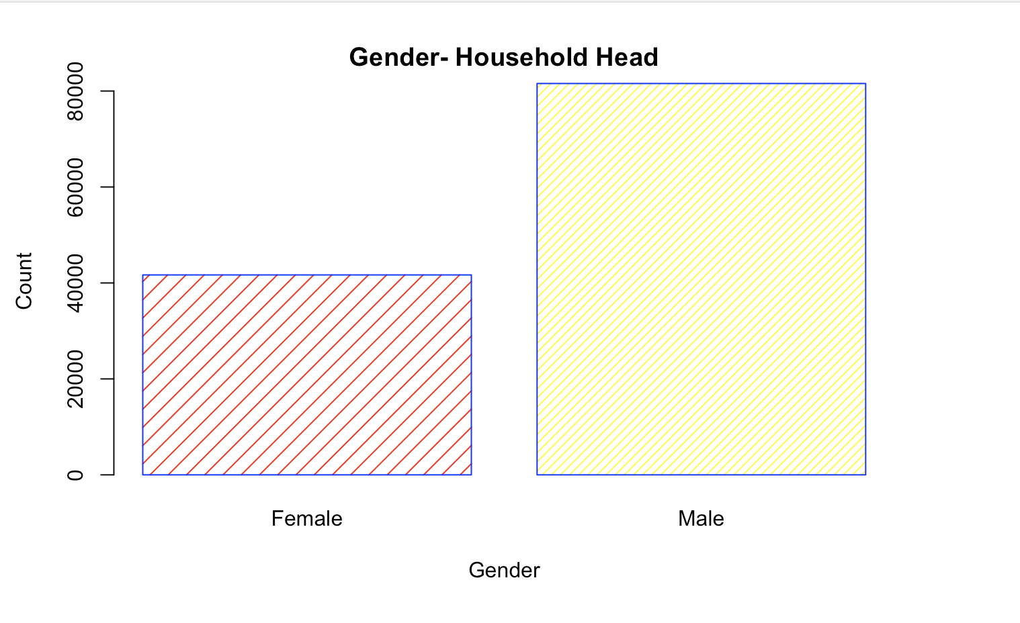
Data Visualization - Customer Demographics

Slide 6
Adjustments Made Before Analysis
‘Express’ Category
only had one data point, so it will be excluded
‘Gift Cards’ Category
quite infrequently purchased, so it will be excluded for product related analysis
Unnamed Category
excluded for product related analysis since the ambiguity makes meaningful insights difficult
Customer demographics with values of NA or Unknown
Any transaction that had an unknown value or NA in any demographic column was excluded for customer based analysis
Customers who purchased less than 3 times
These customers will be excluded from our segmentation analysis
Difficult to establish behavior patterns from 1 or 2 actions

Slide 7
Question 1: Segmentation and Targeting
Through our analysis we hope to identify several customer segments by clustering those with similar purchasing behaviors. Once, we have established segments we will attempt to understand who these customers are by looking at their demographics. This profiling technique will allow us to better target the company’s customers, which can result in increased sales

Slide 8
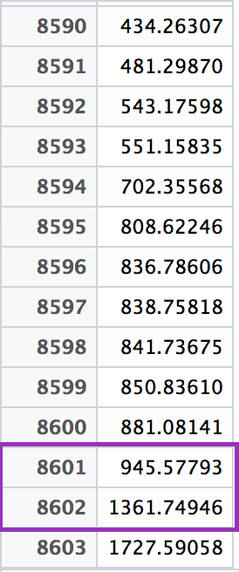
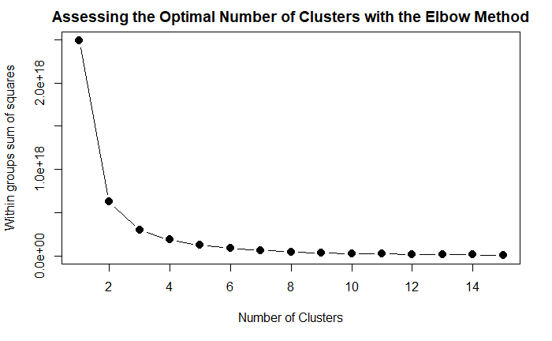
Hierarchical Clustering & Elbow Method

Slide 9
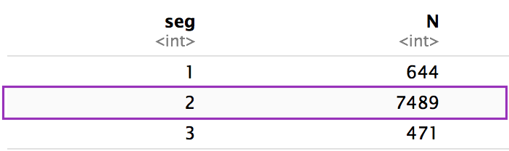
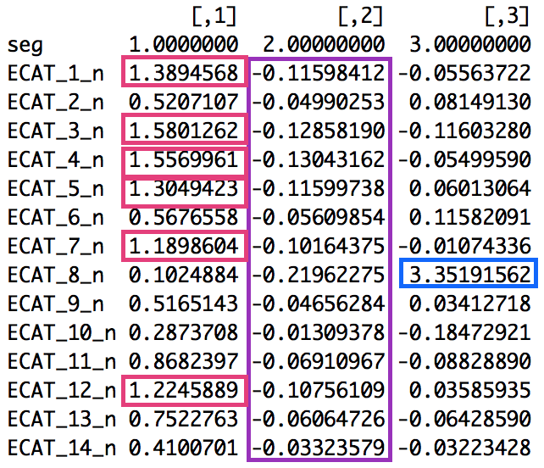
K - Means Clustering
Group 1
Purchases from many categories
TV, Audio, Video Hardware, P*S*T, Imaging, Music
Group 2
Does not seem to purchase, regardless of category
Group 3
Purchases from the Wireless Category

Slide 10
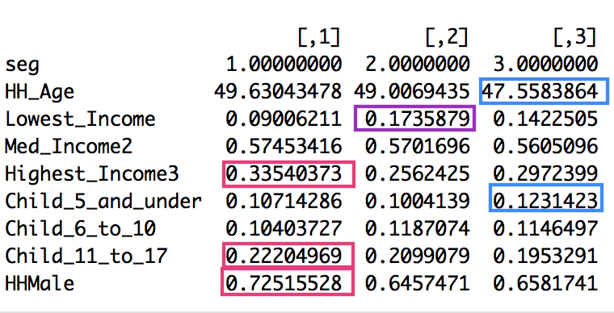
Targeting Based on Demographics
Group 1
Highest Income
Older Children
Male Heads of Household
Group 2
Lowest Income
Group 3
Younger Individuals
Young Children
Ideally, we would have liked the differences across segments to be a bit more extreme

Slide 11
Insights
High Income
Families With Older Children
These individuals will purchase TV, Audio, Video Hardware, P*S*T, Imaging and Music. We may consider running adds on television channels that teenagers enjoy as well as place adds in business magazines.
Newly Weds and New Parents
These individuals purchase from the wireless category which includes items such as phones, internet, etc. One way we might try to attract these individuals is through Wedding and Parenting magazines.
Low Income Customers
These customers typically only purchase necessities. If we are interested in increasing their number of transactions, we may consider sending them coupons or special offers.

Slide 12
Question 2
How do past product returns affect future customer purchases?

Slide 13
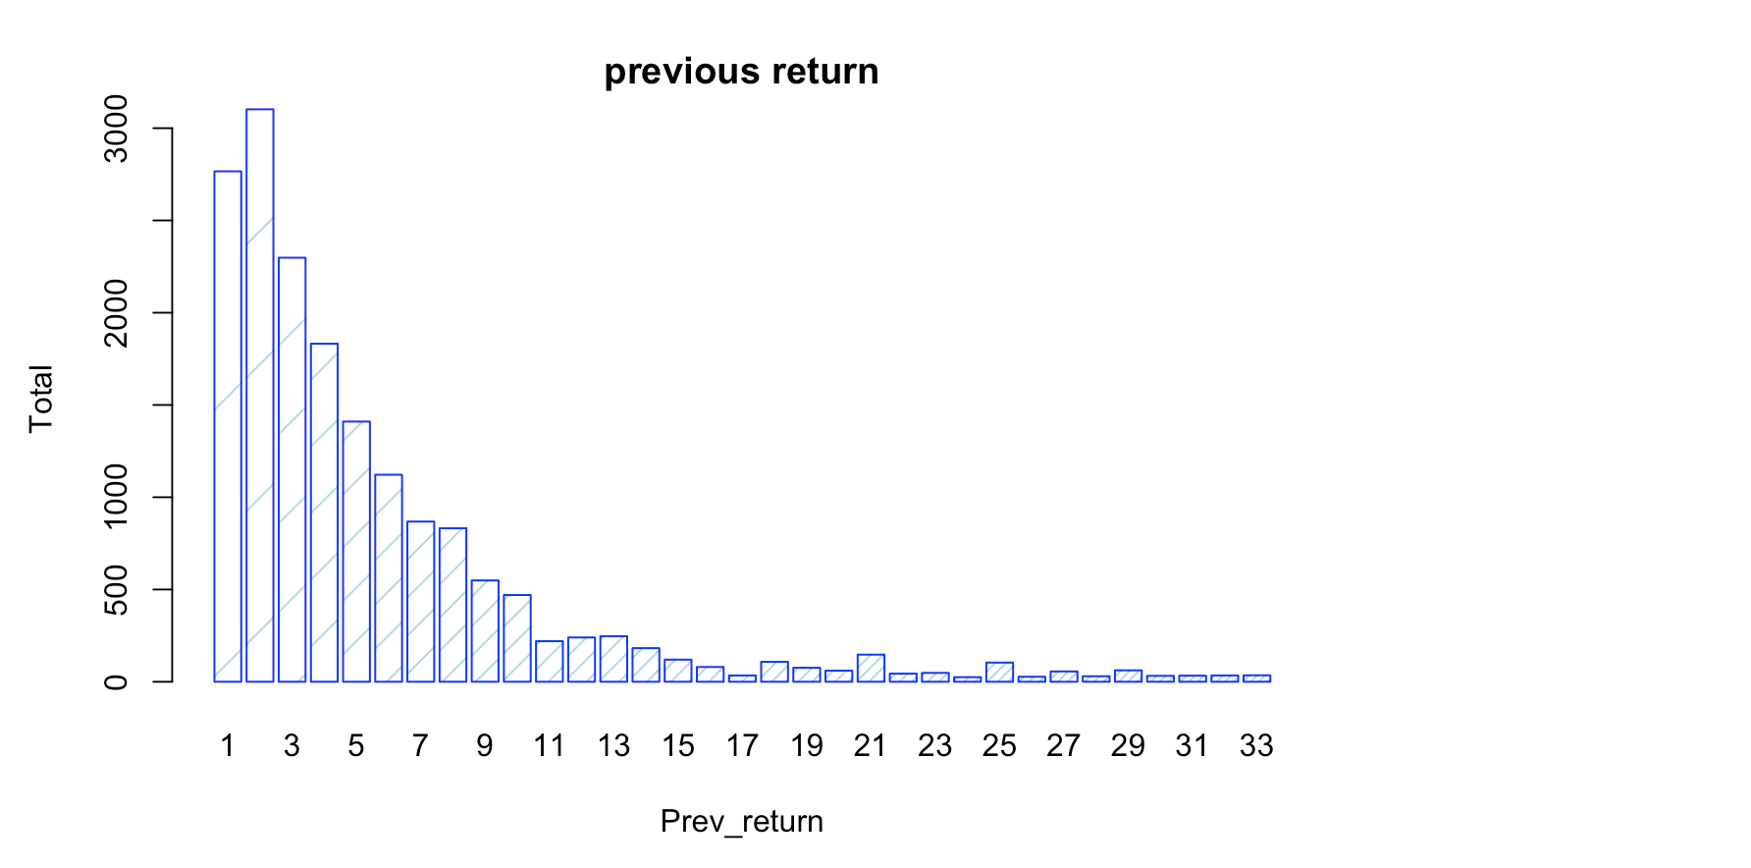
Quick Look At Previous Returns

Slide 14
Theoretical Model:
Logit Model:
Purchase ~ β₀+β₁Previous Returns*Category₁ +
β₂Previous Returns*Category₂ + … +
β₁₄PreviousReturns*Category₁₄ + β₁₅HH Gender +
+ β₁₆HH Age + β₁₇HH Income +
β₁₈Online Transaction + Error

Slide 15
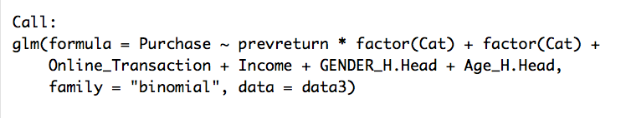
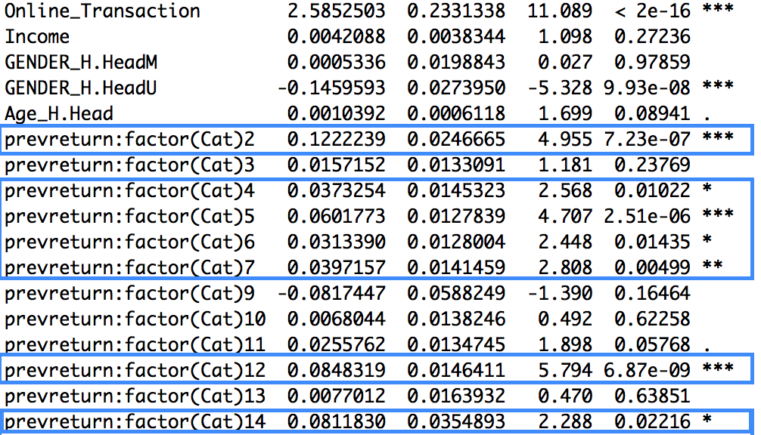
Regression Results
Cat 2 - Majors
Cat 4 - Video Hardware
Cat 5 - P*S*T
Cat 6 - Mobile
Cat 7 - Imaging
Cat 12 - Music
Cat 14 - Intangible

Slide 16
Insights
In general, previous returns do not affect whether or not customer decide to purchase from this business again in the future!
For some categories, each additional past return a customer has made actually increases his or her likelihood to purchase from the business again
This can likely be attributed to customer loyalty
Instead of focusing on preventing customers from returning items, the business should focus on establishing a strong customer brand to maintain customer loyalty

Slide 17
Question 3
Examine which products are most likely to be returned, to help the business improve purchasing decisions.

Slide 18
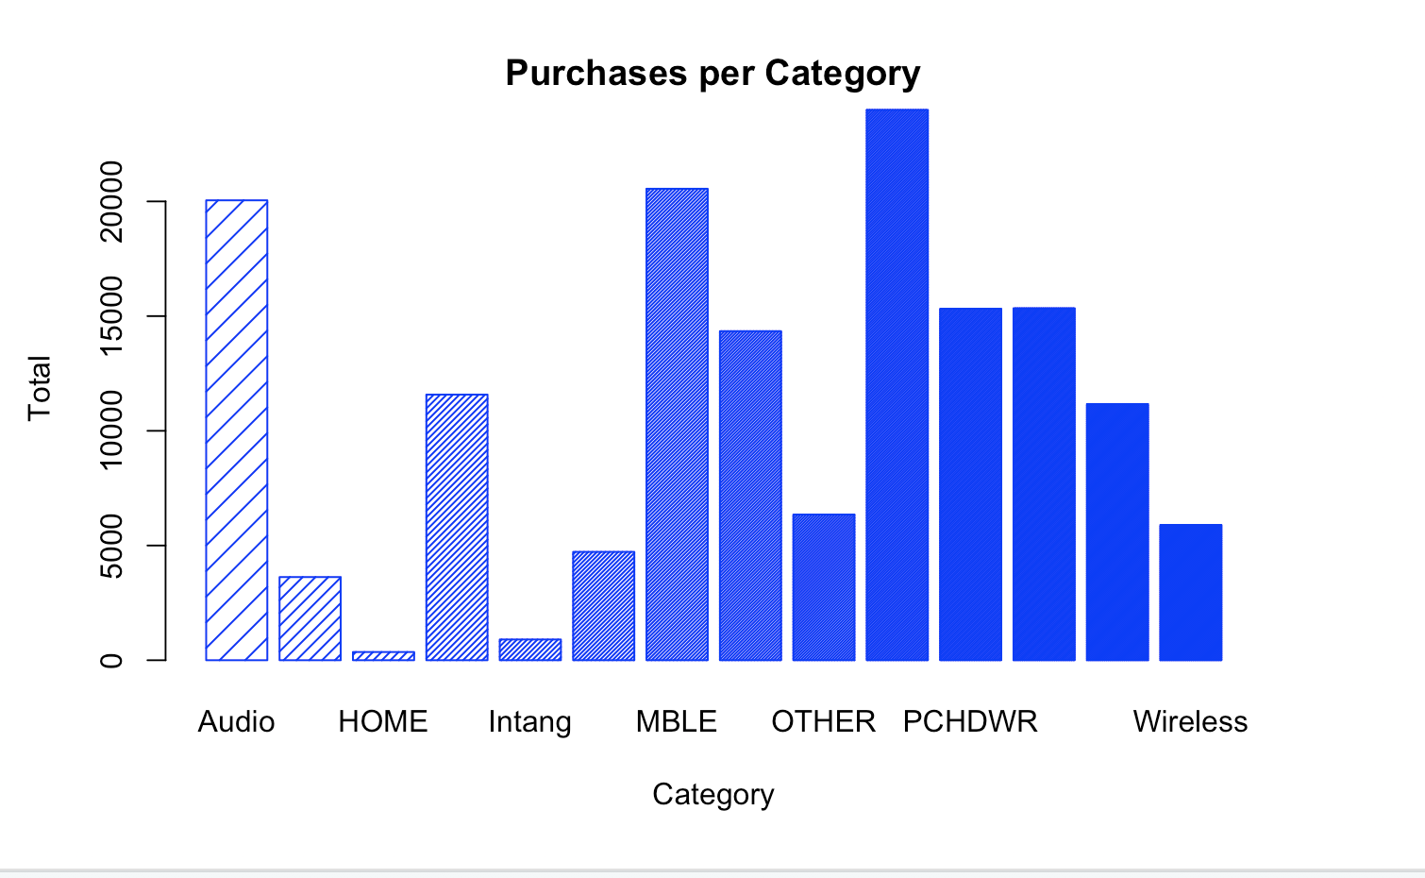
Which Categories are Returned Most?

Slide 19
General Theoretical Model :
Negative Binomial Model:
Total Returned ~ β₀+β₁Sub_Category₁ + β₂Sub_Category₂ + … +
β_{k}Sub_Category_{k} + β_{k+1}Total_Quantity +
β_{k+2}Seasonality + Error

Slide 20
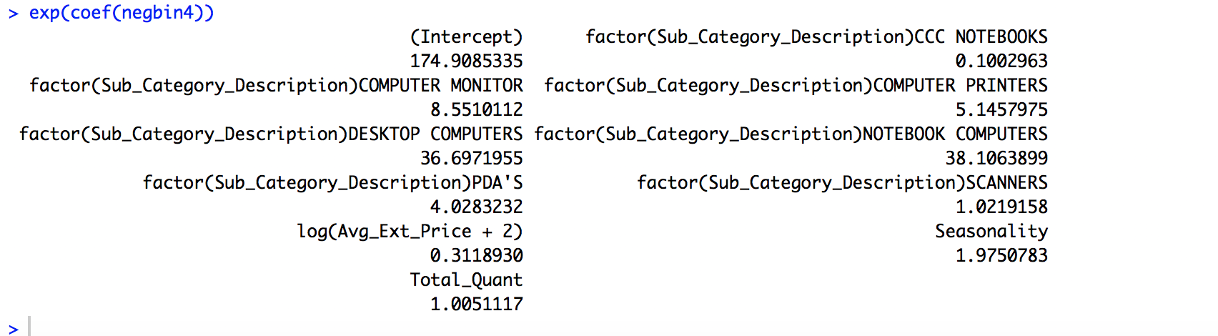
PC Hardware
The number of returns are likely to be higher for Sub categories Desktop Computers and Notebook Computers as compared to others

Slide 21
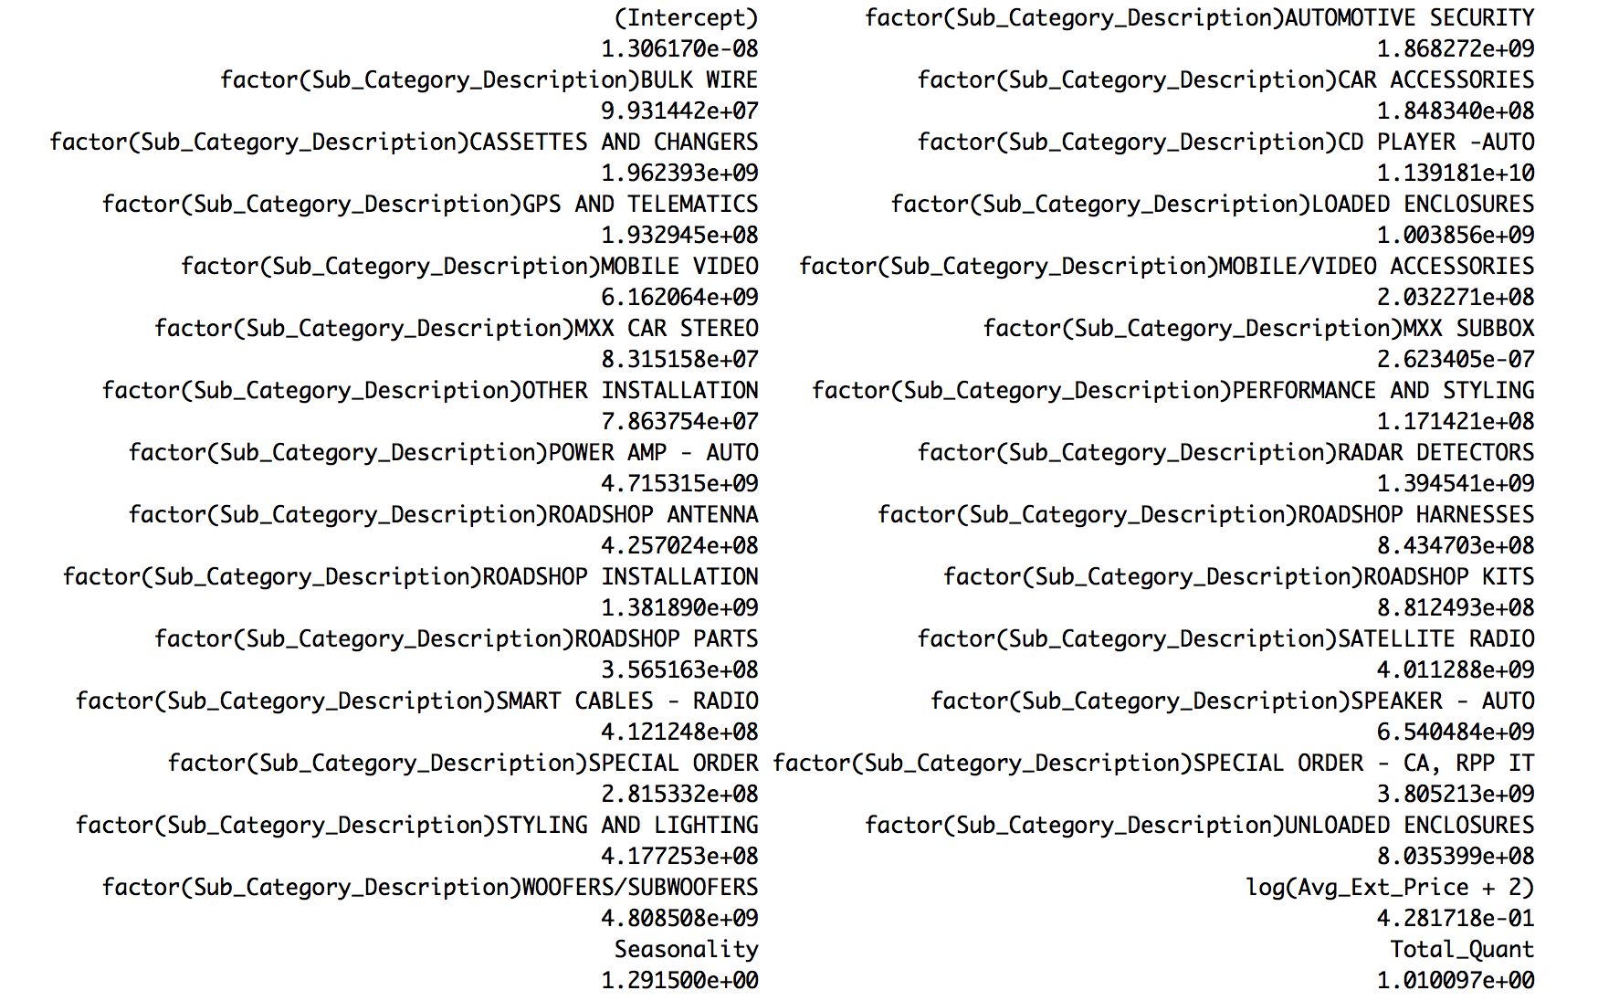
Mobile
The number of returns are likely to be higher for the sub category Auto CD Player as compared to others

Slide 22
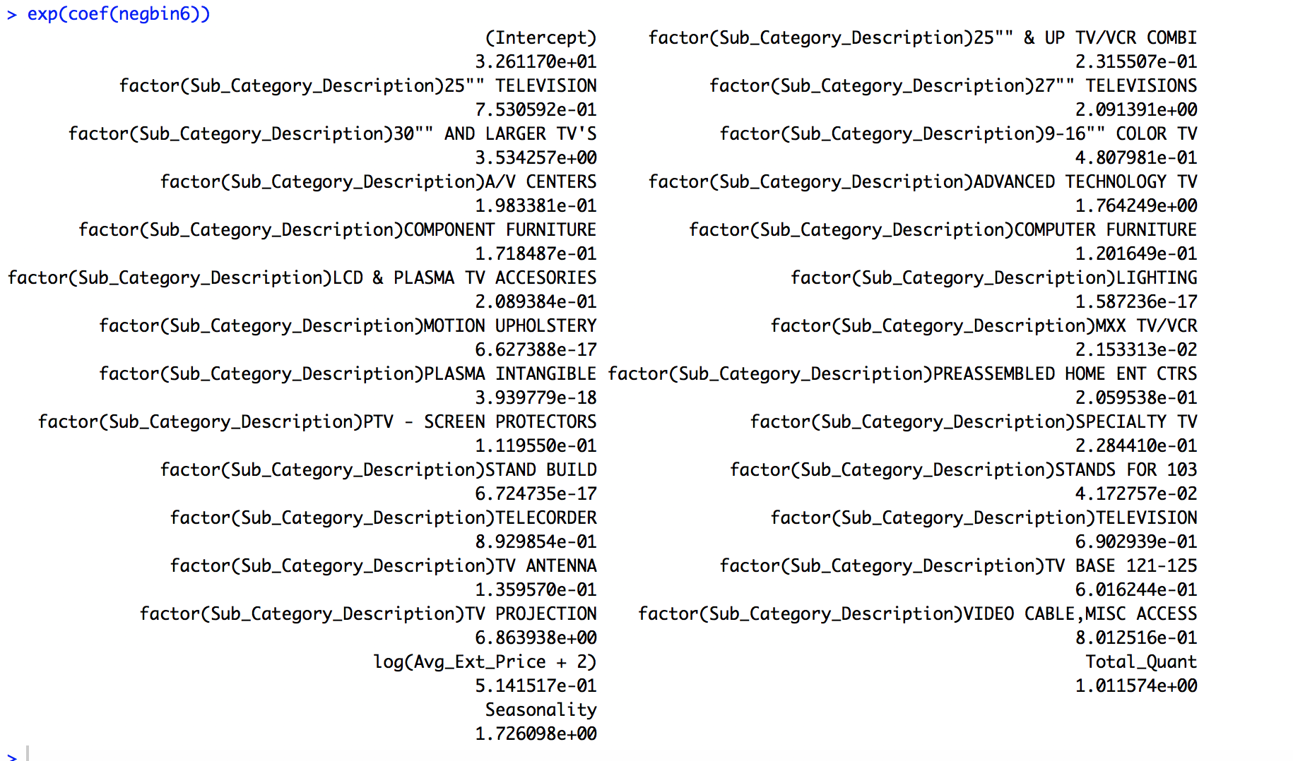
Television
The number of returns are likely to be higher for Sub categories 30” and Larger TV’s & TV Projections as compared to others

Slide 23
Insights
A business will never be able to prevent all returns, however, we believe that deeper analysis should take place on all of the products that belong to the subcategories which we just identified
With additional information (for example such as brand and sku numbers) the business can check if there are any particular items that customers are dissatisfied with.
Through this deeper analysis, the company can re-evaluate if there are any brands or items they should purchase less or discontinue
This can help decrease future returns thus increasing revenue

Slide 24
Thank You

