Slide 1
QUB GIFT CITY | DATATHON 2026 | DATA FOR GOOD
Where Should
Gujarat's Rs 6,500 Crore
Actually Go?
A data-driven investment framework for inclusive, sustainable tourism growth
2,364
hotels analysed
24
destinations
6
region types
14
investment metrics

Slide 2
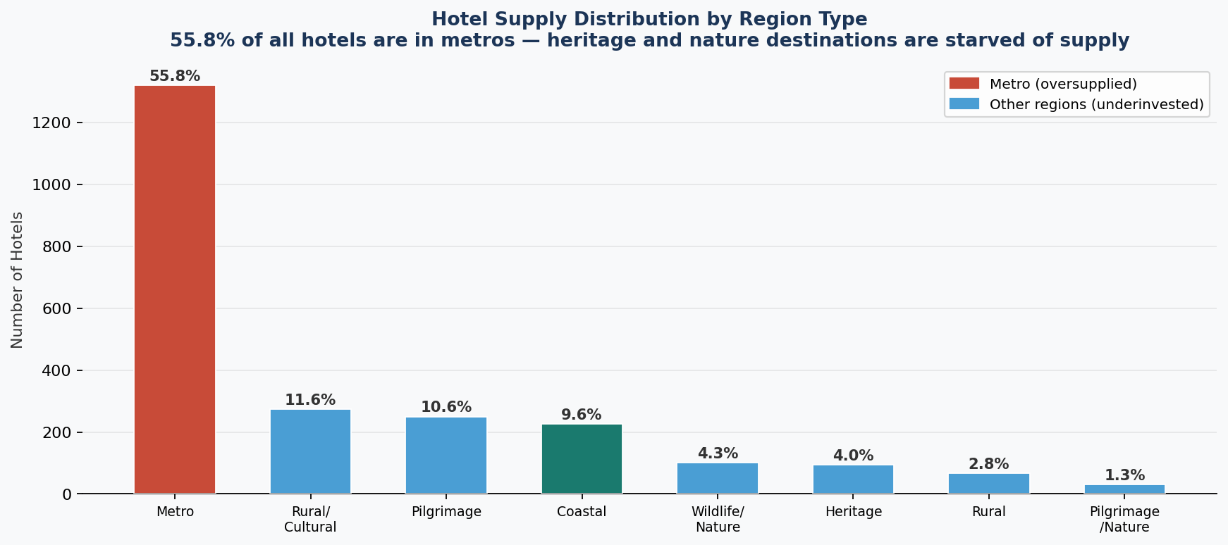
THE PROBLEM
Investment is Chasing Footfall, Not Potential
55.8%
22.8%
26.3%
of all hotels in just 3 metros
leaving heritage zones starved of supply
budget hotel share in heritage and
pilgrimage zones — locking out domestic tourists
avg distress discount at Somnath
hotels cutting prices just to survive
Hotel supply by region type:
2 / 14

Slide 3
METHODOLOGY
How We Built the Framework
01
Data Enrichment
02
Supply-Quality Mismatch Index
Added 21 derived columns — price tiers, value score, facility tier, 6 region classifications, distance parsing and data quality flags across 2,364 hotels.
SQI = avg rating divided by log10 of hotel count. Captures destinations where quality is strong but supply is critically thin. Validated across all 24 destinations.
03
Regional Equity Lens
04
Data-Driven Budget Allocation
Classified all 24 destinations into 6 region types. Measured budget hotel share per region. Mapped to Census 2011 literacy and population data.
Ranked all 24 destinations into 3 tiers using SQI quartile thresholds. Budget split derived from destination count times supply gap severity.
3 / 14

Slide 4
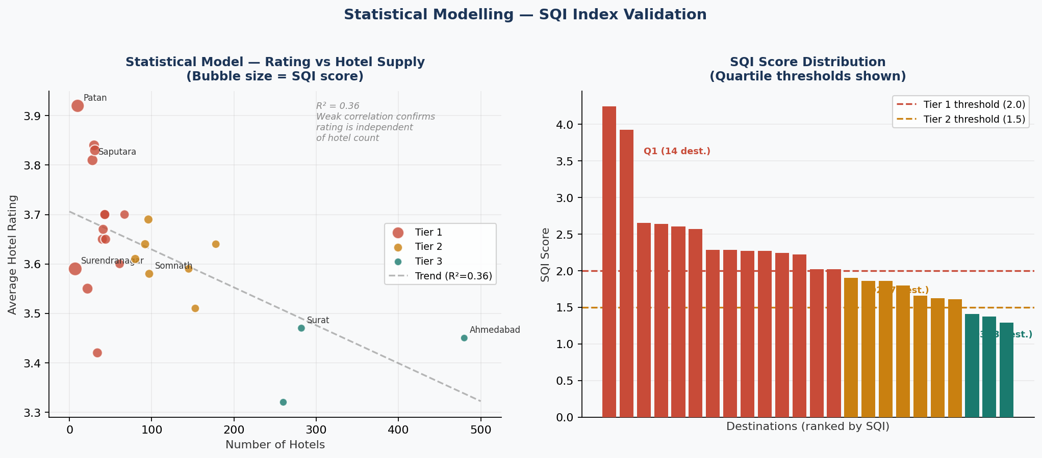
STATISTICAL MODELLING — SQI INDEX VALIDATION
How the Supply-Quality Mismatch Index Was Validated
STATISTICAL MODELLING — SQI composite index | Quartile analysis | Regression validation | Distribution analysis
T
4 / 14

Slide 5
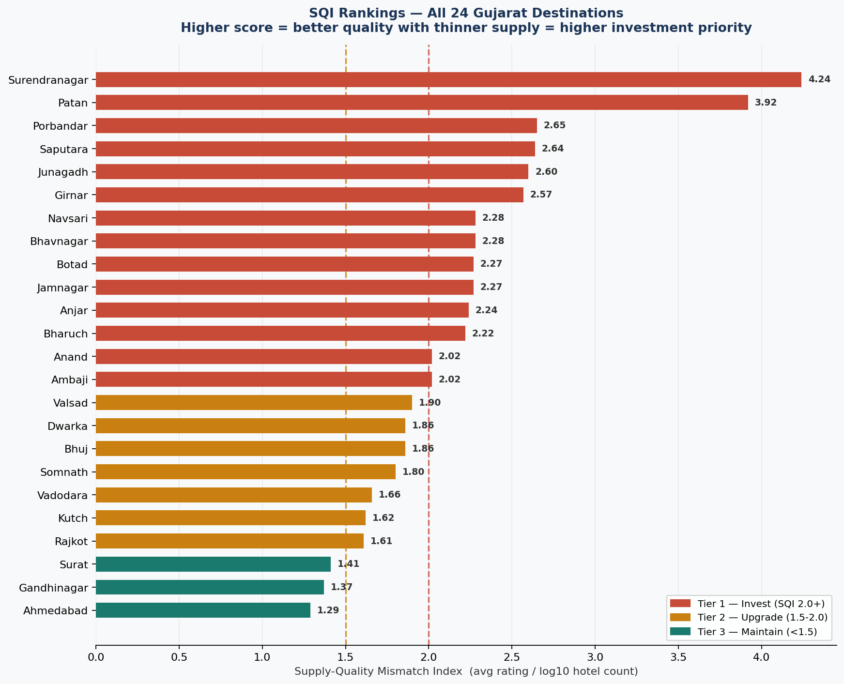
DATA INSIGHT — SUPPLY-QUALITY MISMATCH INDEX
The Index That Reveals Where Every Rupee Yields Most
Surendranagar — 4.24
Only 7 hotels, rated 3.59. Highest quality-to-supply gap in all of Gujarat.
Patan — 3.92
UNESCO heritage city. Highest rated destination in Gujarat. Only 10 hotels. Zero luxury.
Ahmedabad — 1.29
480 hotels already. Lowest SQI. Adding more investment here yields the lowest return.
5 / 14

Slide 6
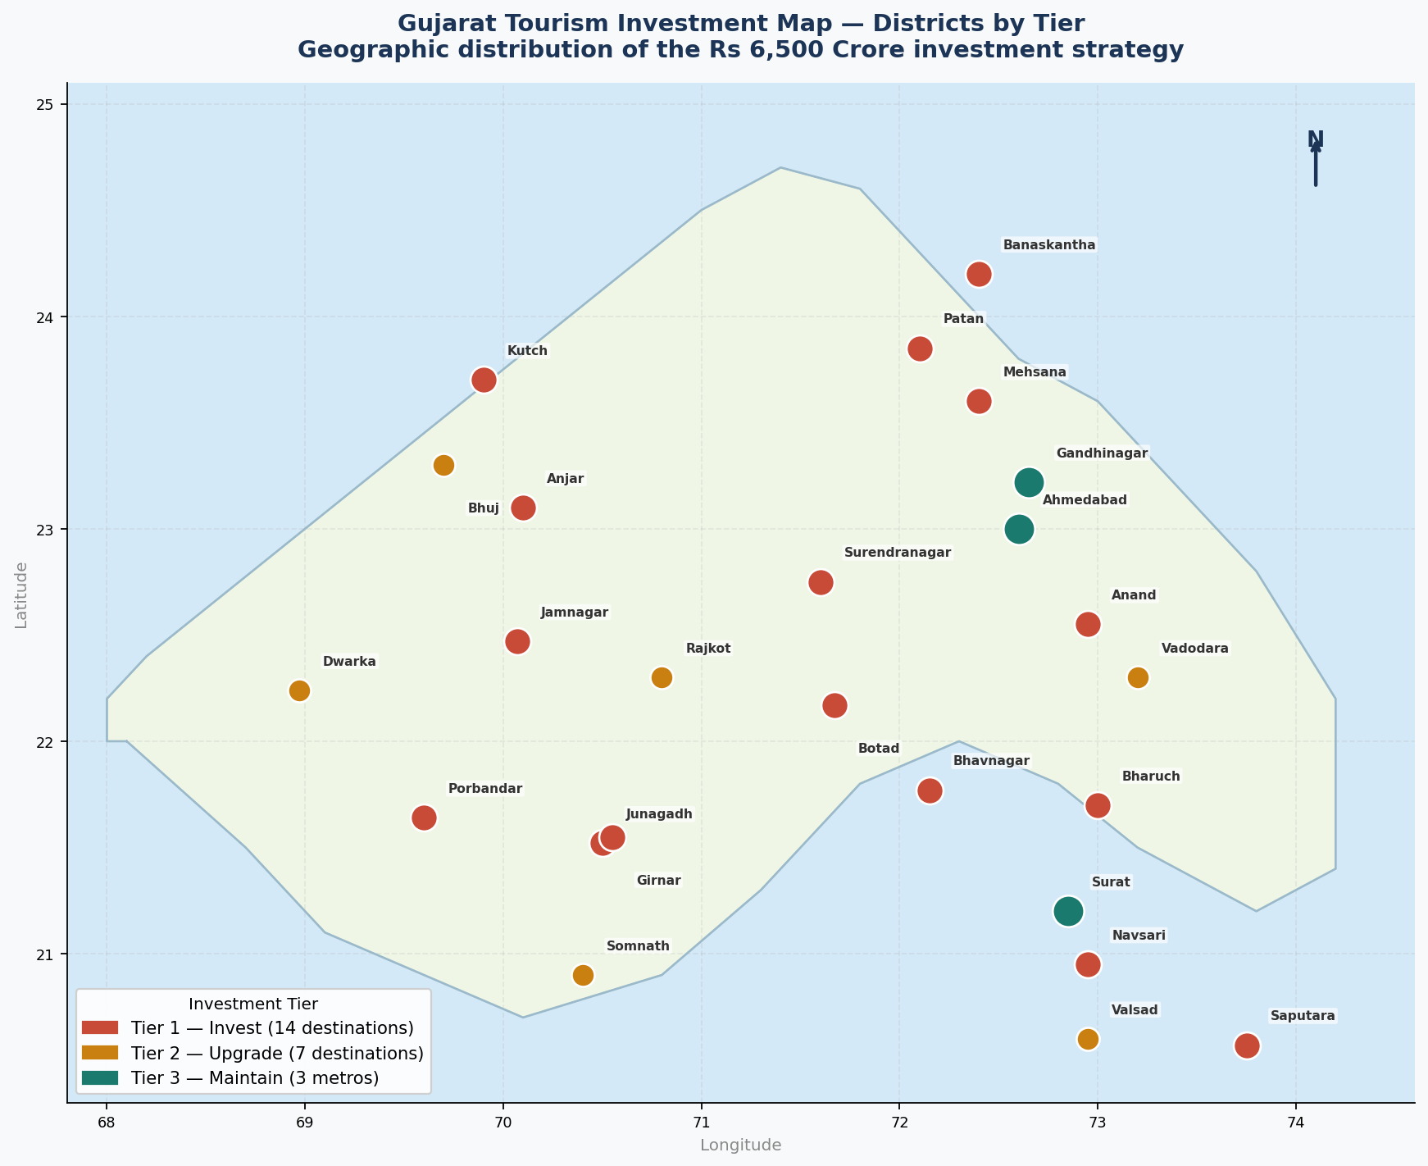
GEOGRAPHIC ANALYSIS — INVESTMENT TIER MAP
Where Are These Destinations? Spatial Distribution Across Gujarat
Tier 1 — Northwest cluster
Patan, Ambaji (Banaskantha), Surendranagar — all underserved despite proximity to Ahmedabad. Easy to reach, hard to stay.
Tier 1 — Coastal spread
Porbandar, Bhavnagar, Jamnagar, Navsari, Valsad — coastline stretching 1,600 km with almost no quality hotel supply.
Tier 3 — Central cluster
Ahmedabad, Surat, Gandhinagar form a triangle already saturated with hotels. Investment here reaches furthest by redirecting tourists outward.
Geographic insight
GEOGRAPHIC ANALYSIS — Spatial distribution of investment tiers across Gujarat districts
Tier 1 destinations form a ring around the metros — close enough to access, far enough to disperse tourist pressure.
6 / 14

Slide 7
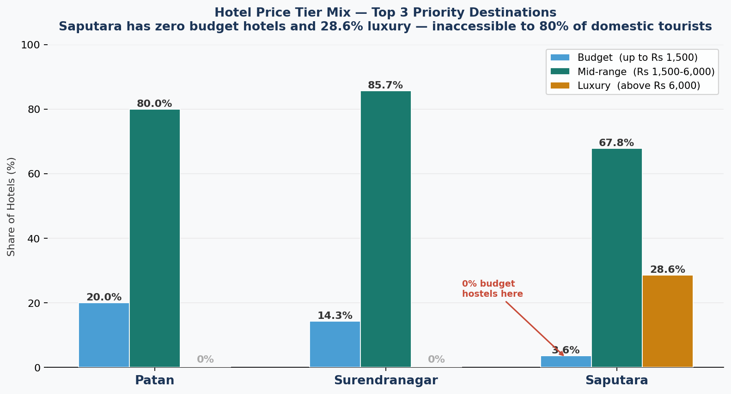
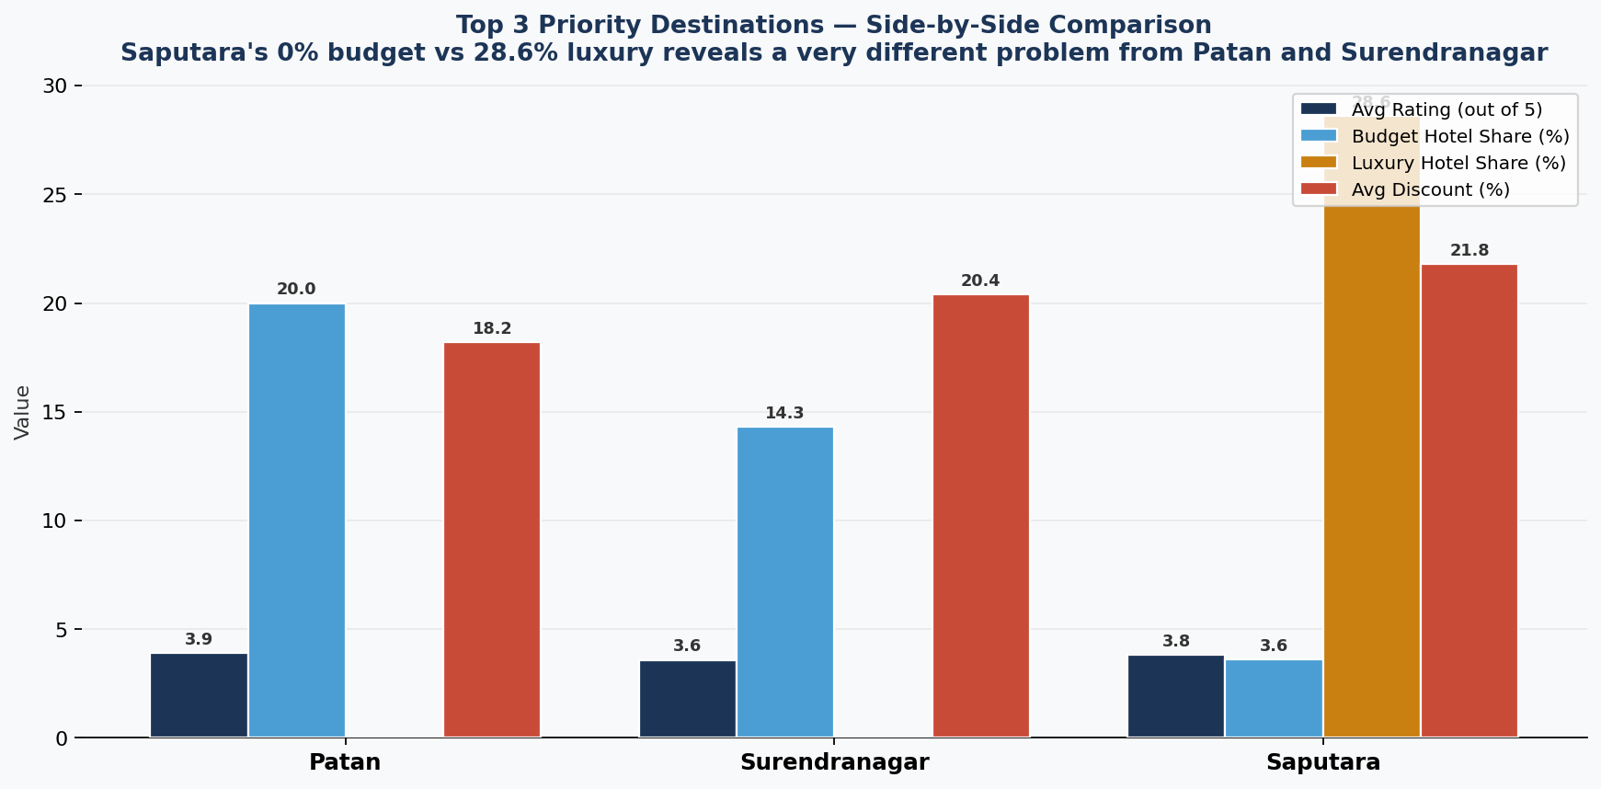
DEEP DIVE — TOP 3 INVESTMENT PRIORITY DESTINATIONS
Top 3 Destinations by SQI — What the Data Shows
Patan
Surendranagar
Saputara
UNESCO Heritage
Crafts Hub
Only Hill Station
Rating: 3.92
Hotels: 10
SQI: 3.92
Rating: 3.59
Hotels: 7
SQI: 4.24
Rating: 3.81
Hotels: 28
SQI: 2.63
Hotel price tier breakdown:
Key metrics comparison:
7 / 14

Slide 8
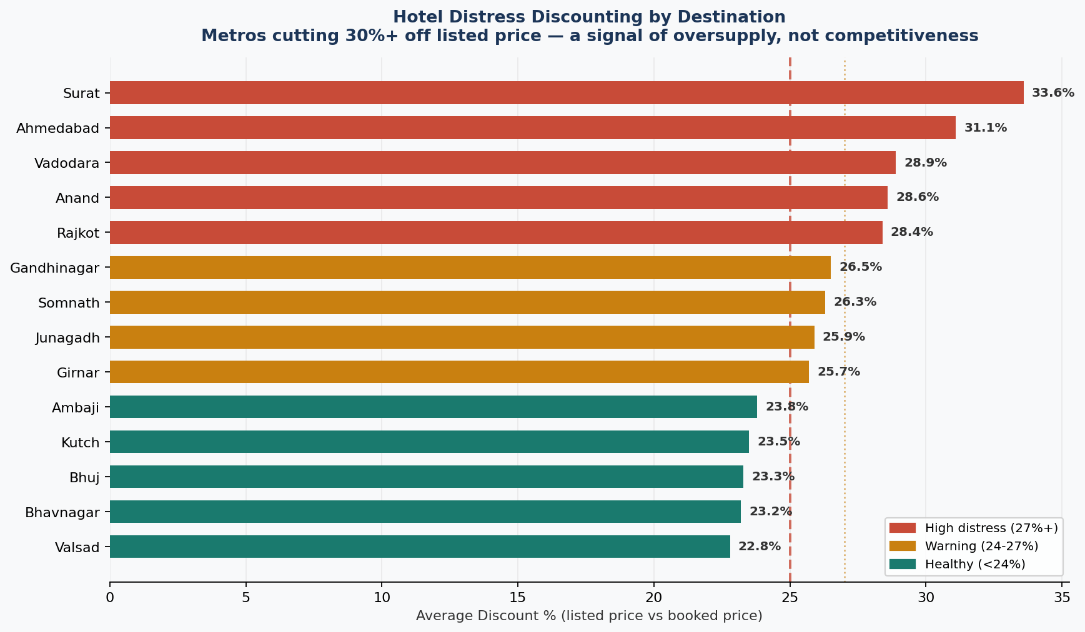
DATA INSIGHT — MARKET DISTRESS EVIDENCE
Hotels Are Slashing Prices to Survive
Surat and Ahmedabad at 30%+
Oversupply in metros. Too many hotels, not enough guests. Classic market saturation.
Somnath at 26.3%
97 hotels competing for the same pilgrim season. Boom-bust seasonality.
Patan and Surendranagar lowest
Under 21% discount. Demand is real. They just need more supply.
Implication
Redirecting investment from saturated metros to Tier 1 relieves distress market-wide.
8 / 14

Slide 9
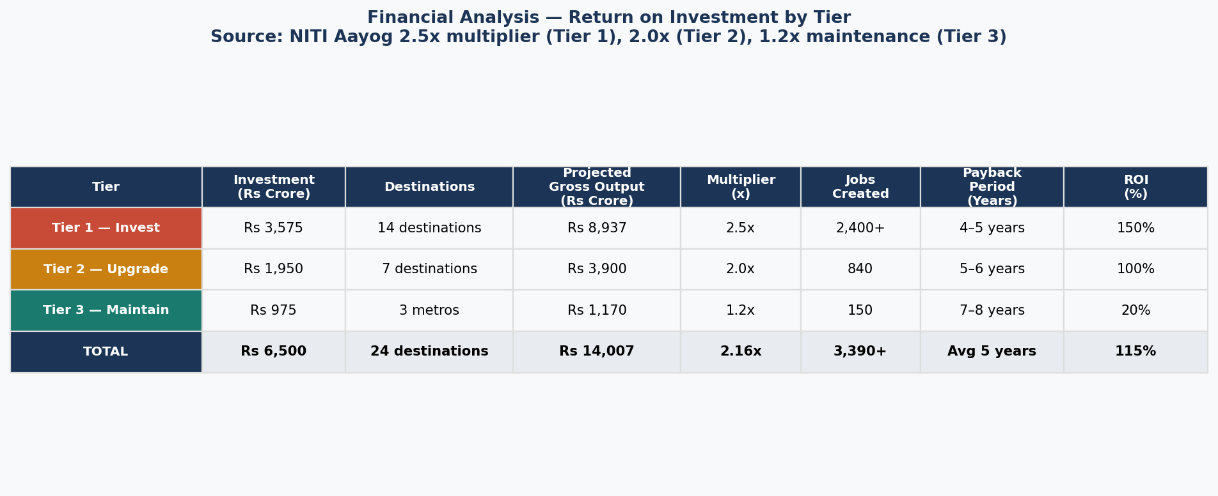
FINANCIAL ANALYSIS — RETURN ON INVESTMENT BY TIER
Every Rupee Accounted For — ROI Across All Three Tiers
Tier 1 — Best return
Tier 2 — Solid return
Tier 3 — Maintain only
Rs 3,575 Cr in, Rs 8,937 Cr out. 150% ROI. Payback in 4 to 5 years because each rupee serves 6x less existing infrastructure.
Rs 1,950 Cr in, Rs 3,900 Cr out. 100% ROI. Upgrade costs are higher per property but existing demand justifies investment.
Rs 975 Cr in, Rs 1,170 Cr out. 20% ROI. Metros are saturated. Investment here is sustaining, not growing.
FINANCIAL ANALYSIS — Budget allocation | ROI calculation | Multiplier analysis | Cost-benefit by tier
9 / 14

Slide 10
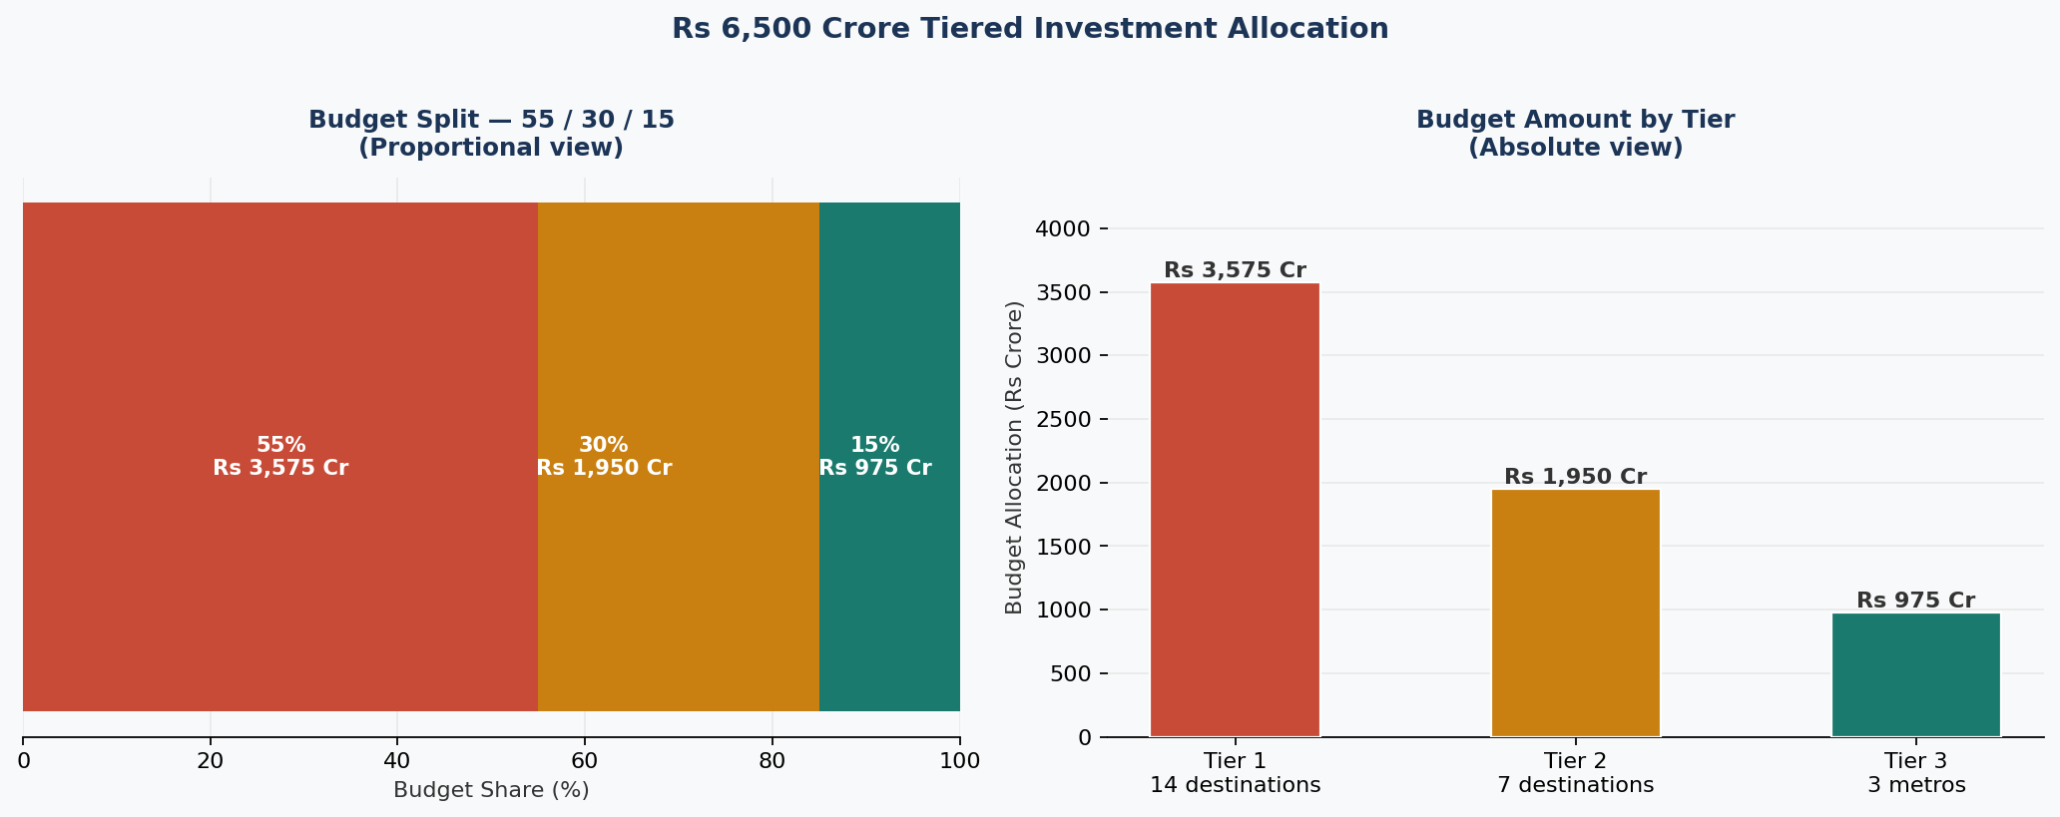
RECOMMENDATIONS — TIERED INVESTMENT ALLOCATION
Rs 6,500 Crore Allocated by Supply-Quality Index Tiers
Budget split derives directly from data: Tier 1 = 14 destinations x highest SQI gap | Tier 2 = 7 destinations x medium gap | Tier 3 = 3 metros x lowest gap
TIER 1
Invest — 14 destinations (SQI 2.0+)
55%
300 new hotels by 2027 | Heritage circuits: Patan, Surendranagar, Porbandar, Girnar +9 more | Pilgrimage infrastructure
Rs 3,575 Cr
TIER 2
Upgrade — 7 destinations (SQI 1.5–2.0)
30%
Bhuj, Dwarka, Kutch, Rajkot, Somnath, Vadodara, Valsad — quality upgrades | Rann Utsav extension
Rs 1,950 Cr
TIER 3
Maintain — 3 metros (SQI <1.5)
15%
Ahmedabad, Surat, Gandhinagar — sustain, digitise, redirect flow to Tier 1
Rs 975 Cr
10 / 14

Slide 11
FINANCIAL ANALYSIS — BUDGET DERIVATION
The 55/30/15 Split is Not Arbitrary — It Follows the Data
Why these percentages?
Tier 1 gets 55%
14 destinations, avg 36 hotels each vs 227 for metros. Every rupee serves 6x less infrastructure. Return is highest.
Tier 2 gets 30%
7 destinations with partial supply. Upgrade cost per property is higher than new-build on greenfield.
Tier 3 gets 15%
Metros hold 55.8% of supply already. Marginal return is the lowest of any investment in this framework.
FINANCIAL ANALYSIS — Marginal return analysis | Cost per destination | Infrastructure leverage ratio
11 / 14

Slide 12
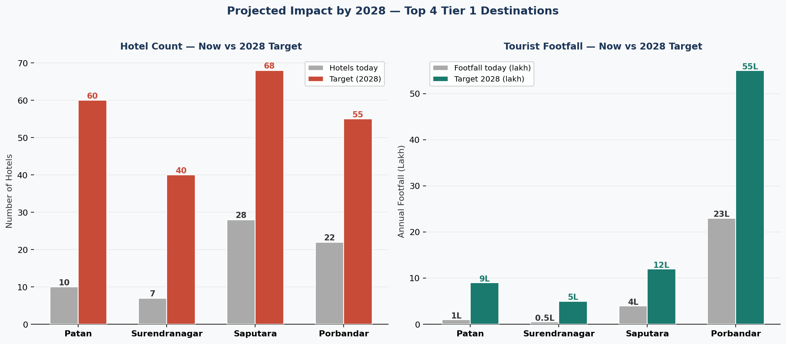
PROJECTED IMPACT — ALL FOUR EVALUATION PILLARS
Quantified Outcomes Across All Four Pillars
Economic
Development
Employment
Creation
Regional
Inclusion
Environmental
Sustainability
Rs 8,937 Cr
2,400+
14 districts
55% to 30%
gross output
(2.5x NITI Aayog multiplier)
direct hospitality jobs
300 hotels x 8 jobs
underserved destinations
activated for first time
metro share target
reducing over-tourism
Destination-level transformation by 2028:
13 / 14

Slide 13
THE BOTTOM LINE
Invest where tourism is
absent, not where it
already thrives.
55.8%
4.24
14
Rs 8,937 Cr
hotels in 3 metros
structural imbalance
highest SQI — Surendranagar
only 7 hotels
underserved destinations
proven quality signals
gross economic output
Tier 1 investment alone
The data does not suggest a balanced spread of investment. It demands a concentrated bet on 14 destinations where quality exists but supply does not. That is where Gujarat's Year of Tourism must plant its flag.
Data
Visualisation
Predictive
Analytics
Financial
Analysis
Statistical
Modelling
Geographic
Analysis

