Slide 1

Model Poisoning Attacks in Federated Learning : Literature Review
Presented By: Amrita Sinha Roy

Slide 2
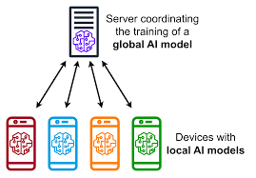
What is
Federated Learning
It is a decentralized machine learning approach
Multiple clients collaboratively trains a global model
Each client trains on local data and only sends the updated model parameters to the central server.
Application: In privacy sensitive domains like healthcare, finance, etc.
1

Slide 3
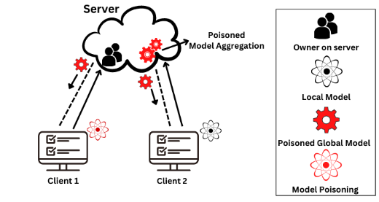
What is
Model Poisoning Attacks
An adversarial attack where malicious participants aim to corrupt the global model by altering their local updates.
Types of attacks :
Untargeted Poisoning: Corrupt the model's general performance.
Targeted Poisoning (Backdoor Attack): Mislead the model on specific inputs.
2

Slide 4
Objective
Explore the existing literature on the impact of model poisoning attacks in Federated Learning(FL)
Review the state-of-the-art defense mechanisms to prevent Model Poisoning Attacks(MPAs)
Highlight the unexplored and less researched areas which are of high importance.
Analyze the factors responsible for MPAs in FL.
Organize the literature in a logical and systematic way.
Suggest potential future research directions to enhance the robustness of FL systems against MPAs.
3

Slide 5

Focus of the Literature Review
Purpose: Review existing literature on model poisoning attacks in federated learning.
Analyze dimensions like attack methods, defenses, and research gaps.
Evaluate the impact of poisoning attacks under various data distributions
Methodology: Review of key papers from academic journals and conferences.
4

Slide 6
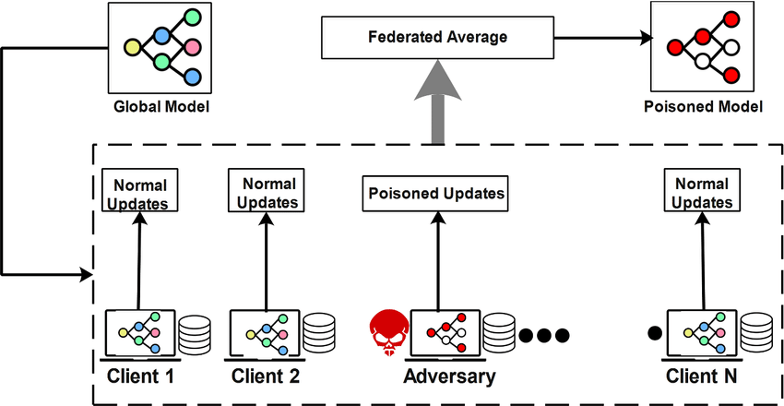
Dimensions of Analysis
Attack Techniques
Defense Mechanisms
Data distribution and System heterogeneity. Its impact on model poisoning attack
Computational cost of various defense mechanisms.
Collusion Among Malicious Clients
Real world implications in sensitive domains.
5

Slide 7
Search Strategies
Attack Type: "model poisoning" OR "poisoning attack"
Learning Paradigm: "federated learning" OR "distributed learning"
Security Focus: "security" OR "defense" OR "mitigation" OR "attacks"
Strategy 1:
Broad Query
Strategy 2:
Attack
Attack Type: "model poisoning"
Learning Paradigm: "federated learning" OR "distributed learning"
Focus: "attack"
Strategy 3:
FL Focus
Attack Type: "model poisoning"
Learning Paradigm: "federated" OR "distributed"
Strategy 4: Byzantine focus
Attack Type: "byzantine" AND "model poisoning"
Learning Paradigm: "federated" OR "distributed"
6

Slide 8
Resources
Inclusion/Exclusion Criteria:
Inclusion:
Papers published in peer-reviewed journals or conferences from the last 5 years
Studies with complete focus on Model Poisoning Attacks in FL
Research focusing one newer defence techniques and performance evaluations.
Researches conducted on industrial datasets and stimulated with real domain datasets in distributed settings
Exclusion:
Papers discussing broader privacy issues and defence mechanisms. Excluded the papers which provide a generic view of poisoning attacks.
Papers which focus on non-poisoning attacks like inference attacks unless linked with model poisoning attacks.
Total Papers Collected: 129
Papers Selected: 42
Papers Covered: 29
Databases Used:
IEEE Xplore
ACM Digital Library
ScienceDirect
7

Slide 9
Attack Mechanisms
Targeted Attacks: Attackers try to manipulate the model to produce specific output by misclassifying certain selective data points.
Scaling Attacks: Manipulates the model aggregation process by scaling up a malicious client’s gradient update before sending it to the server
Distributed Backdoor Attacks: Manipulate the trained model to predict a selective label by embedding a hidden trigger pattern
Untargeted Attacks: Goal is to prevent convergence of the global model by degrading the overall performance.
DeSMP: A differential privacy(DP) based MPA which adds noise to the local model updates. Central server cannot differentiate between malicious and benign DP noise added ones.
Sine: It utilizes vulnerability in cosine similarity which increases the attack success rate and decreases the performance of the central model.
Semi-targeted Attacks: Attacker specifies the source class they want to misclassify but not the output class.
Adaptive Directional Attack(ADA): Evaluates the global model’s gradient updates and by examining the backward gradients identifies the optimum target class
Fake Client Attacks: An attack where attacker introduces fake clients to degrade the performance of the global model.
Model Poisoning Attack using Fake Clients (MPAF):It injects fake client all together in the system. The fake clients try to pull the global model towards the base model with a low accuracy.
8

Slide 10
Detection of Attacks
Clustering algorithms are used to detect the outliers by grouping similar weights together and separating the ones behaving abnormally.
K-means and DBSCAN algorithms are usually used for clustering.
Gap statistics to find the optimal number of clusters.
DeMAC uses a matrix called GradScore to measure norm of a client’s gradient.
COMP algorithm is a group testing method to identify malicious clients. It has two phase i.e., encoding phase and decoding phase
9

Slide 11
Heterogeneity in Federated Learning
Data Heterogeneity
IID: Federated learning systems with independent and identically distributed data i.e, when each client datasets are having same distribution.
Non-IID: The client datasets vary significantly due to the usage pattern, complexity of the system. Clients have data of different distributions.
System Heterogeneity
Cross silo:
Systems which have reliable clients which have sensitive data like big organizations or institutions.
Difficult for the attacker to penetrate the system pertaining to the fact that they have their own secure protocols for communication
Cross Device:
Fully decentralized design
High complexity along with communication latencies makes it very complicated for MPAs to be detected and defended.
10

Slide 12
Defense Mechanisms
Aggregation Based Optimizations:
Aggregation methods like mean, trimmed mean, median and Krum.
Adaptive trimmed mean (FedATM) algorithm, where clients are sorted in accordance with the distances between local models.
FedDet splits the local models into layers for robust aggregation.
FLDetector checks the model updates consistently to detect the poisonous ones.
Trust Score Based Mechanisms:
FLTRust maintains a clean dataset at the root level which is used to bootstrap trust.
MODEL uses a two-fold incentive mechanism: constant reward and bidding reward.
FLARE assigns a trust score to clients based on penultimate layer representations(PLRs) discrepancies.
FLAIR uses reputation scores during the training phase.
Homomorphic Encryption Based Mechanisms:
SheildFL uses two trapdoor homomorphic encryption to resist encrypted model poisoning. It aggregates the user trained local gradients through a cryptographic protocol.
11

Slide 13
Literature Review Findings
Most of the researches have focused mostly on untargeted poisoning attacks.
There is not much research done on the introduction of Model Poisoning attacks invoking fake clients which could be very essential for the Federated Recommendation Systems.
Most of the papers have compared various defense mechanisms with respect to the Byzantine aggregation methods.
Datasets used does not take into consideration the practical real world application. Need to explore on this.
Data heterogeneity and System heterogeneity plays an important role in how the attack will be formed.
Cross-silo vs cross device FL plays significant role in model poisoning attack techniques to be used.
Earlier the focus was on improving the detection of malicious clients and eliminating them which lead to the loss of certain benign client in turn resulting in information loss. Recent times the focus has shifted to trust score assignment for detection of malicious clients.
12

Slide 14
Experimental Setup
1. Dataset: MNIST
2. Federated Learning Setup:
Clients: 5 clients. (0%,20% and 40% malicious)
No of rounds: 3
Framework: TensorFlow Federated
iv) Data Distribution:
IID: Uniform data split across clients.
Non-IID: Skewed class distributions
3. Aggregation Methods Used:
Mean
Trimmed Mean
Krum
Median
Bulyan
FedAvg
DP
4. Attack Strategies Used:
Label-flip
Noise
Model Poisoning
Data duplication
5. Evaluation Metrics:
Accuracy On test data, compared across aggregation methods per attack strategy and on both the data distributions.
6. Experiment Phases:
Phase 1: Federated training without attacks.
Phase 2: Simulate poisoning attack.
Phase 3: Compare performance in IID vs. non-IID settings.
13

Slide 15
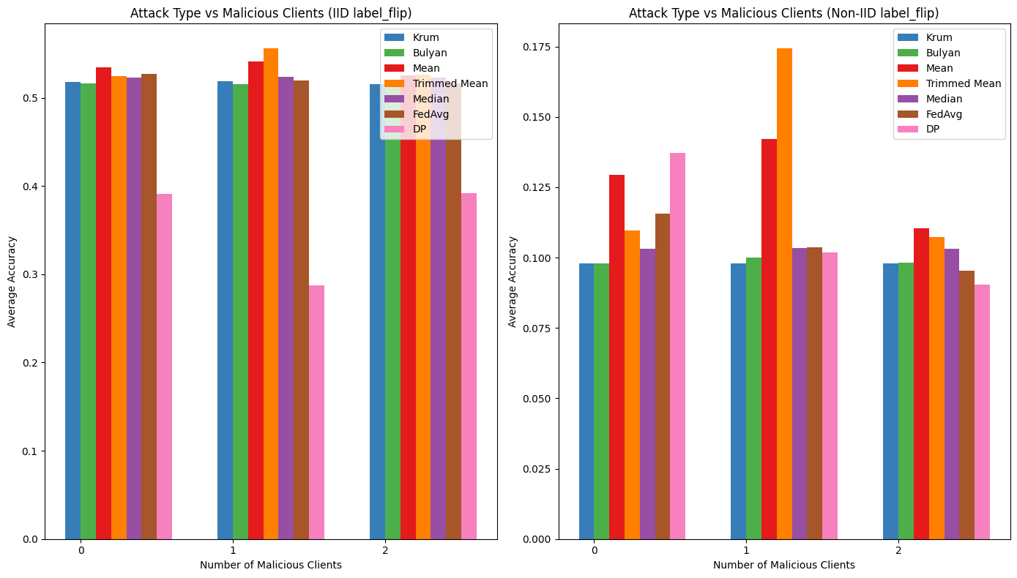
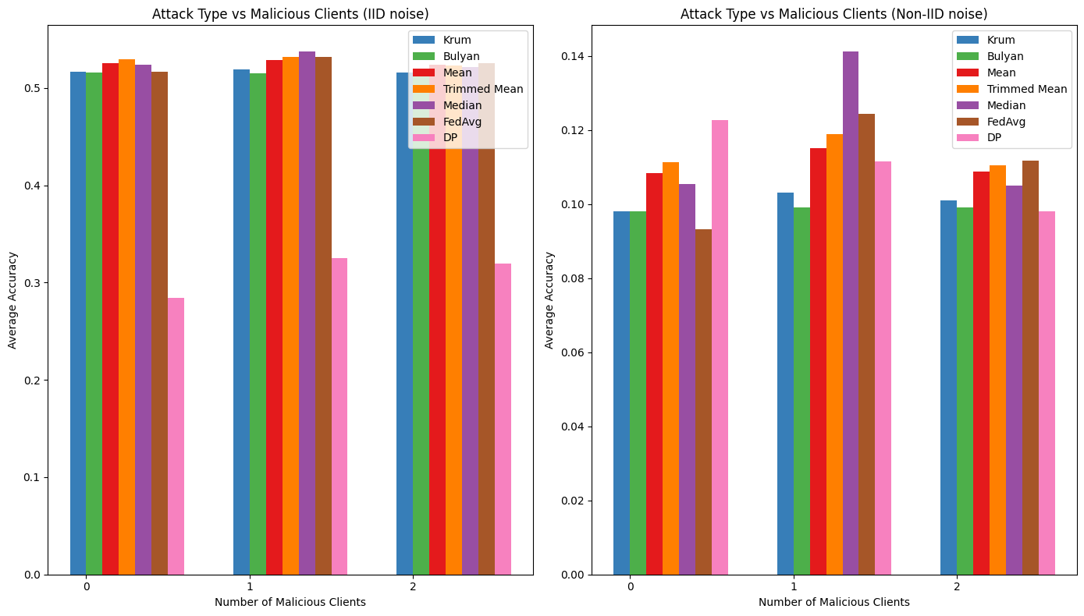
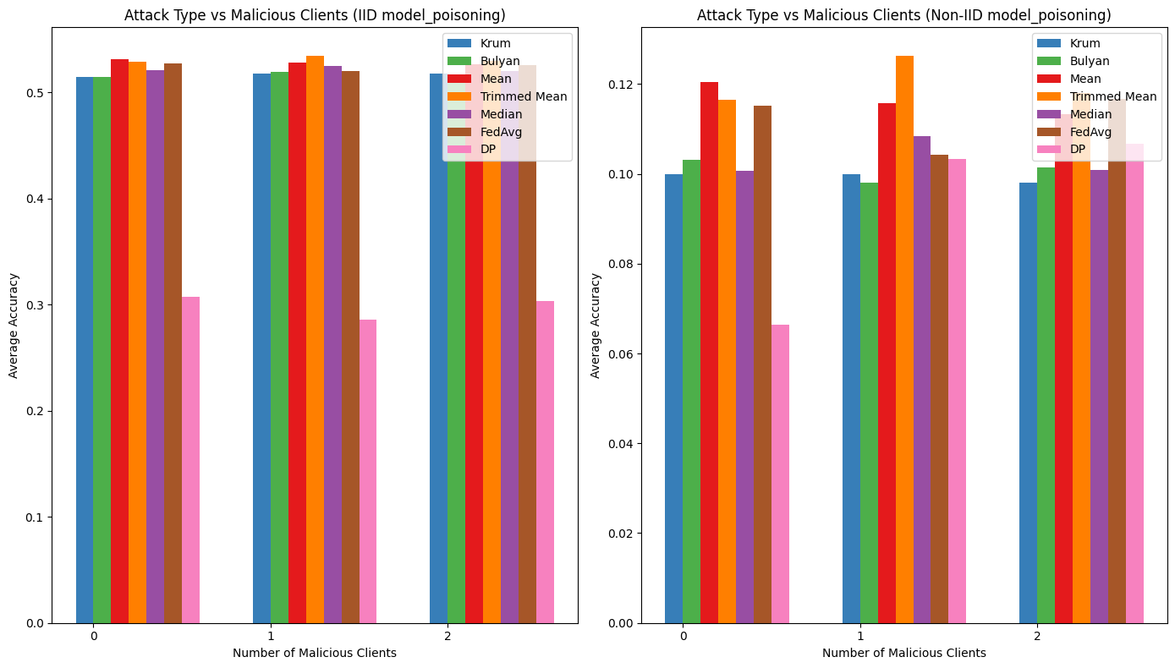
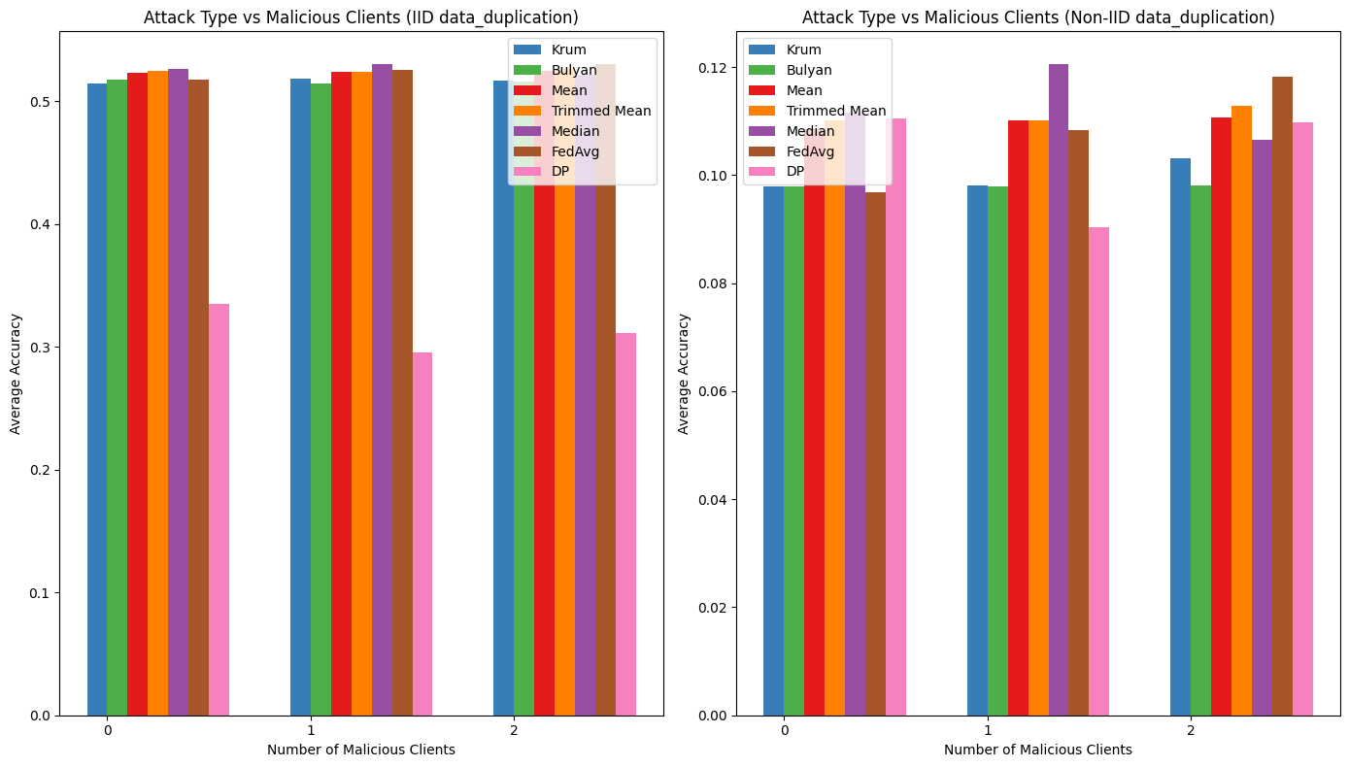
Experimental Results
The 4 accuracy vs number of malicious clients graph for each type of attacks.
Fig a: Label flip
Fig b: Noise
Fig c: Model poisoning
Fig d: Data duplication
Observations:
Aggregation methods performed well in IID settings compared to the Non-IID settings for almost at the types of aggregation methods.
Data heterogeneity plays a crucial role in the attack strategy determination as well as defense mechanism to be applied.
Fig a
Fig b
Fig c
Fig d
14

Slide 16
Gap Analysis
Trade-off between robustness and accuracy, lack of testing on real world application data.
Inadequate Study of Non-IID Data Distributions in real world settings.
Client drift and Model Poisoning attack trade offs.
Limited research of fake client injection in FL systems. Could affect systems like Federated Recommendation System.
Data heterogeneity is crucial in the analysis of model poisoning attacks and defense under FL settings.
Studies are mostly focused on untargeted model poisoning attacks. Targeted attacks seems to be less explored area.
Wireless ad hoc networks analysis shows they are resilient to model poisoning attacks while some shows they need efficient solutions for such a complex system.
15

Slide 17
Future Research Direction
Defenses against collusion of malicious clients is a crucial area yet to be explored.
Conduct study of Non-IID Data Distributions in real world settings with real-world datasets.
Fake client introduction in personalized systems like recommendation systems.
Client drift due to data heterogeneity is an area of future research.
To find the perfect balance between defending the model poisoning attacks vs reducing the performance of the model i.e., striking balance between utility and security.
16

Slide 18
References
1. J. Shi, W. Wan, S. Hu, J. Lu and L. Yu Zhang, "Challenges and Approaches for Mitigating Byzantine Attacks in Federated Learning," 2022 IEEE International Conference on Trust, Security and Privacy in Computing and Communications (TrustCom), Wuhan, China, 2022, pp. 139-146, doi: 10.1109/TrustCom56396.2022.00030.
2. Cao, Xiaoyu et al. “FLTrust: Byzantine-robust Federated Learning via Trust Bootstrapping.” ArXiv abs/2012.13995 (2020): n. pag.
3. Zaixi Zhang, Xiaoyu Cao, Jinyuan Jia, and Neil Zhenqiang Gong. 2022. FLDetector: Defending Federated Learning Against Model Poisoning Attacks via Detecting Malicious Clients. In Proceedings of the 28th ACM SIGKDD Conference on Knowledge Discovery and Data Mining (KDD '22). Association for Computing Machinery, New York, NY, USA, 2545–2555. https://doi.org/10.1145/3534678.3539231 4. D. Rong, S. Ye, R. Zhao, H. N. Yuen, J. Chen and Q. He, "FedRecAttack: Model Poisoning Attack to Federated Recommendation," 2022 IEEE 38th International Conference on Data Engineering (ICDE), Kuala Lumpur, Malaysia, 2022, pp. 2643-2655, doi: 10.1109/ICDE53745.2022.00243.
5. L. -Y. Chen, T. -C. Chiu, A. -C. Pang and L. -C. Cheng, "FedEqual: Defending Model Poisoning Attacks in Heterogeneous Federated Learning," 2021 IEEE Global Communications Conference (GLOBECOM), Madrid, Spain, 2021, pp. 1-6, doi: 10.1109/GLOBECOM46510.2021.9685082
17

Slide 19
Thank You

