Slide 1
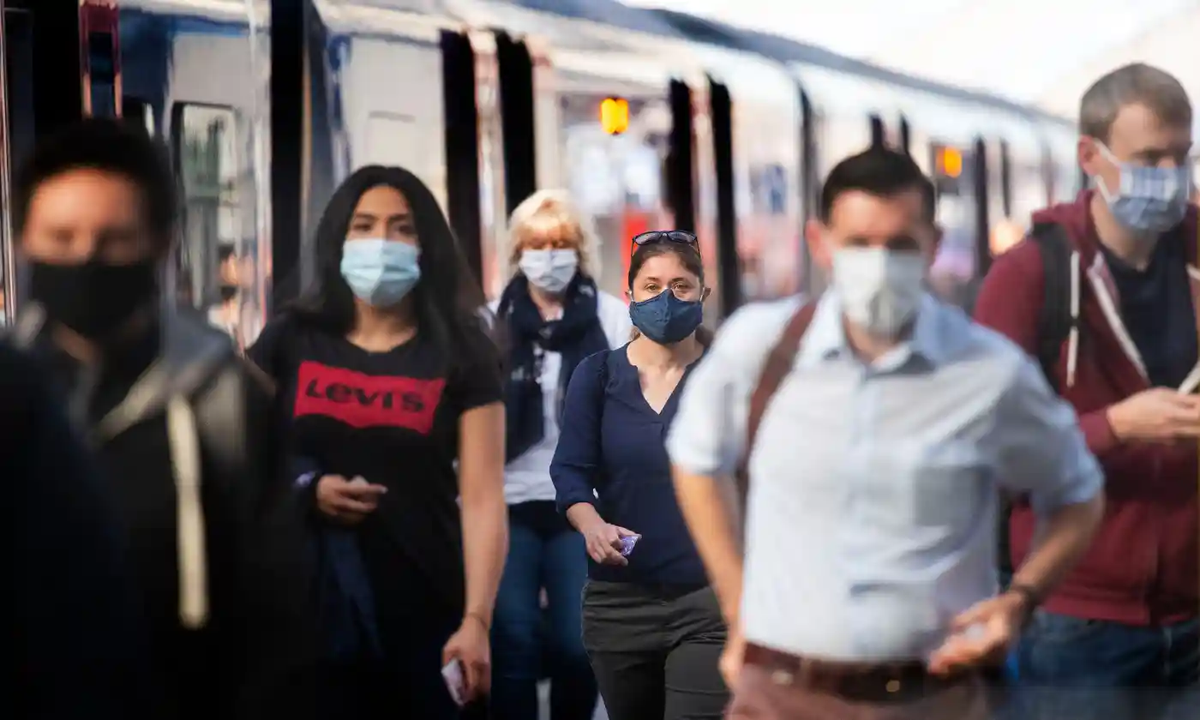
Affect of daily commute on COVID cases in Cook County

Slide 2
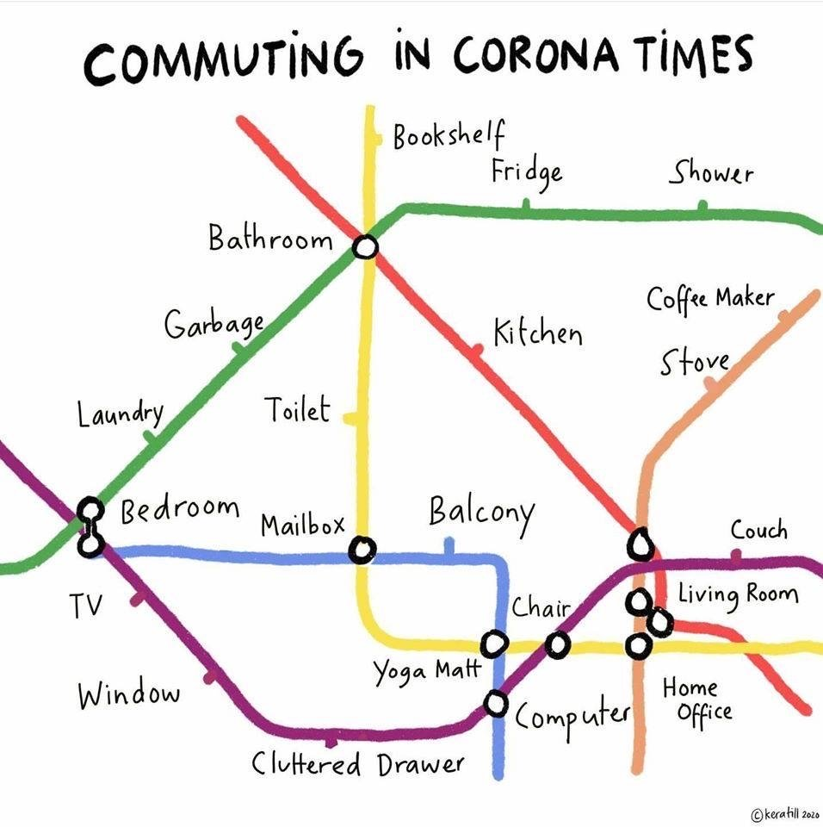
Motivation
Travel - first aspect of human life that COVID-19 upended
I dreaded not waking up to Bangalore traffic (10th most congested city in the world in terms of traffic)

Slide 3

Research Question: Was deferring travel plans useful to Cook County residents?

Slide 4
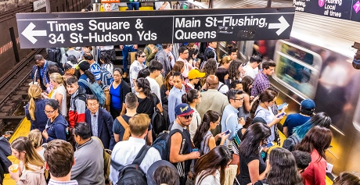

Slide 5
Data Sources
Trips by Distance (Bureau of Transportation statistics)
John Hopkins University COVID-19 data

Slide 6
Methods
Data TRENDS
Correlation
Regression

Slide 7
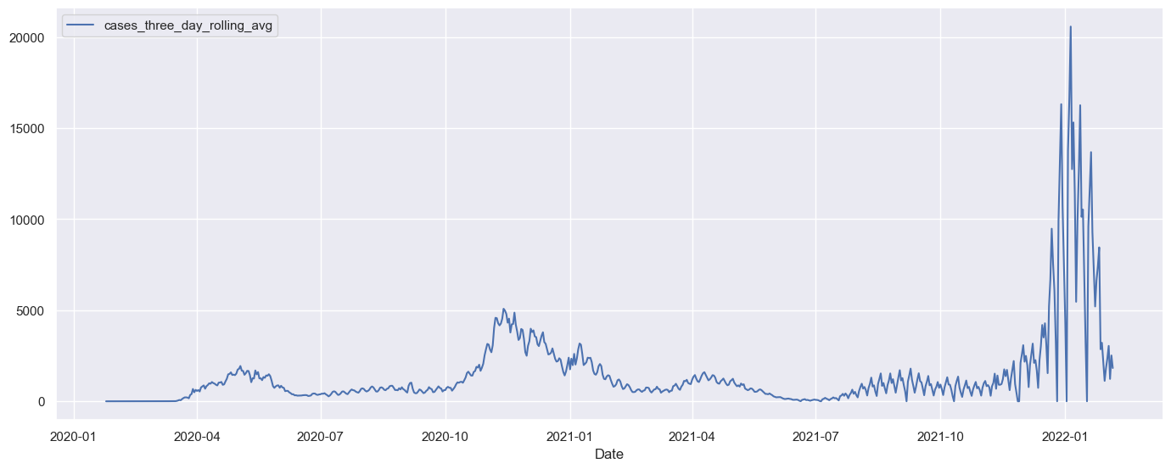
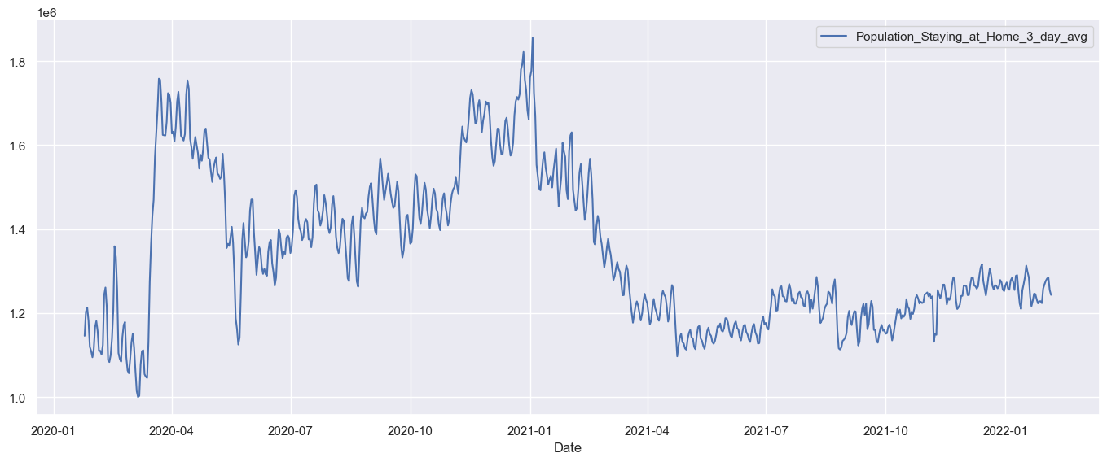
Results (Data Trends)
On a high level, cases came down when more people opted to stay at home

Slide 8
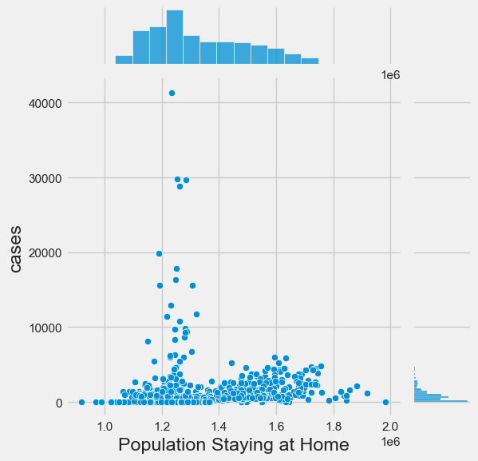
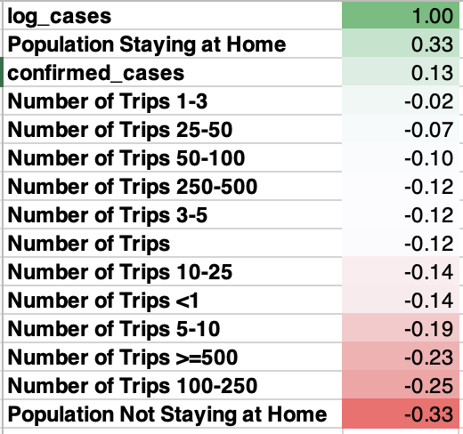
Results (Correlation)
Spearman correlation
Ordinal Data
Cases data isn’t normally distributed

Slide 9
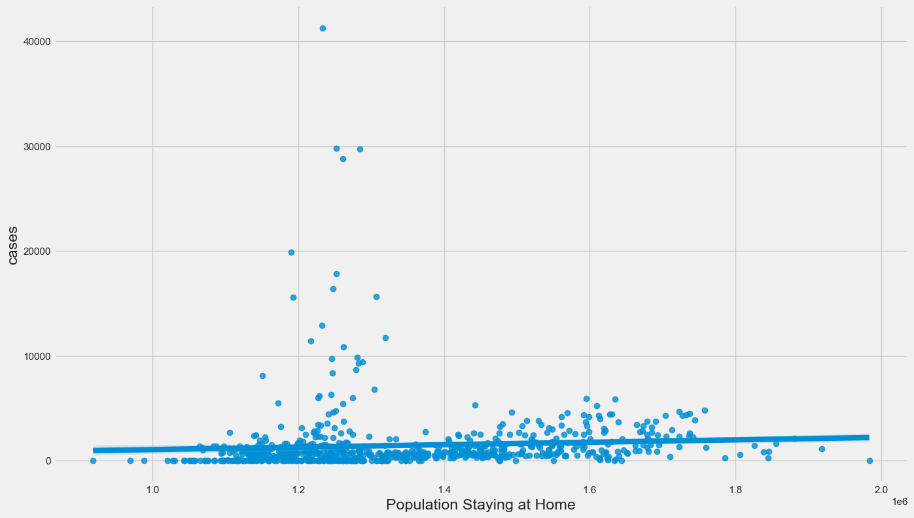
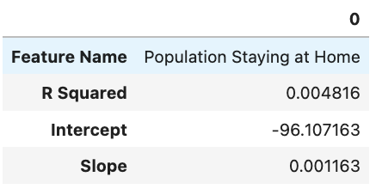
Results (Regression)
COVID cases decreased when people went out more 🤯
For every 1,00,000 increase in people who stayed home there were 116 new daily COVID cases

Slide 10

Go Travel!

