Slide 1


Slide 2

Overview
1
Dashboard
1
Analysis and Insights
1
Recommendations

Slide 3
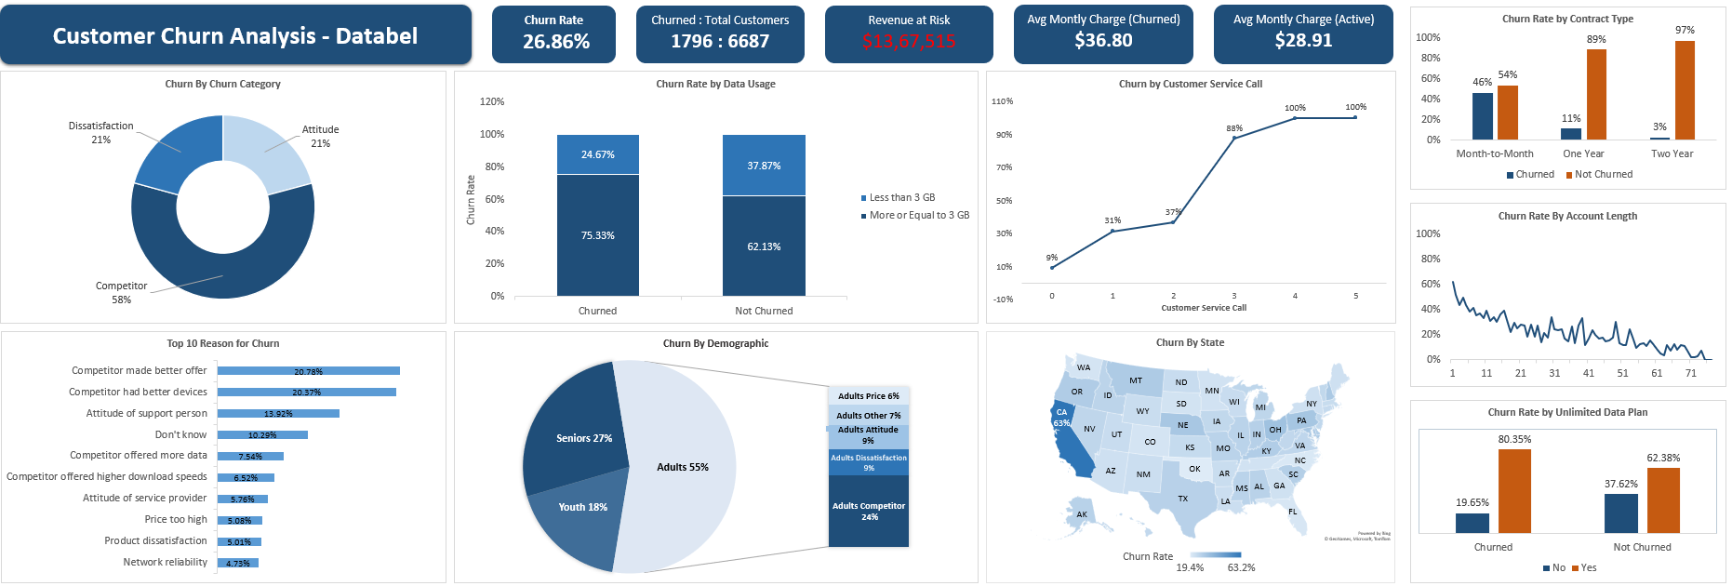
Dashboard

Slide 4
Objective
The goal of this project is to analyze customer churn for Databel and identify key factors driving attrition. The insights will help improve customer retention through targeted strategies.
Key objectives:
Analyze overall churn rates and high-risk segments.
Identify factors (subscription, usage, demographics) influencing churn.
Provide actionable recommendations to reduce churn and enhance retention.

Slide 5

What is the overall churn rate for the company?
The overall churn rate of 26.8% is quite high for a telecom company, where typical churn rates are usually between 10% and 20%
1,796 of our customers have churned, which continues to represent a significant portion of our total customer base

Slide 6
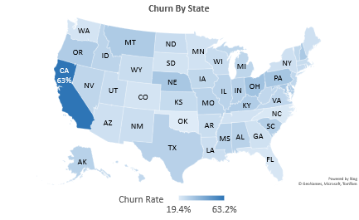

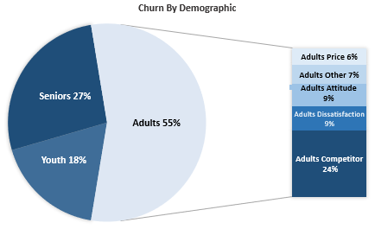
Are there specific customer groups with higher churn rates?
California (CA) had the highest churn rate at 63%
Adults had the highest churn rate at 55%, with 24% of accounts opting for competitors

Slide 7
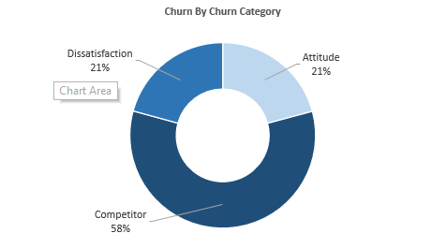
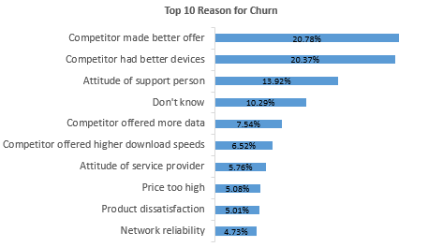
What are the most common reasons for customer churn?
The most common reasons for churn are switching to competitor (Due to better offers and better devices), it accounts for almost 40% of churn
~40%

Slide 8
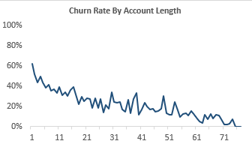
What are the most common reasons for customer churn?
Churn rates for users with an account length of less than 10 months are 25% higher than those for users with an account length greater than 10
43.6%
Churn 17.8%

Slide 9
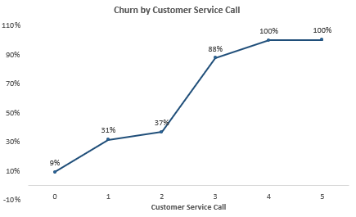

What are the most common reasons for customer churn?
The customer churn rate rises from 37% to 88% when the number of customer service calls increases from 2 to 3

Slide 10
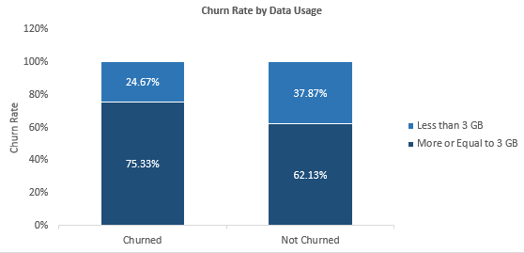
Do customers who consume less than 3 GB of data churn more often than those who consume more?
Customers who used more than 3 GB of data had a 13% higher churn rate
Plotted the distribution of churned vs. non-churned customers
to see if the usage patterns (>3GB vs. <3GB) were the same.

Slide 11
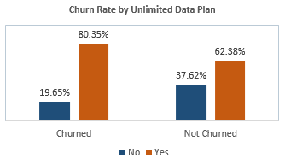
Is there a difference in churn rates between customers with unlimited subscriptions and those without?
Unlimited plan users showed an 18% higher churn rate
80.35% of Churned Users have Unlimited Plan
62.38 of Not Churned Users have Unlimited Plan

Slide 12
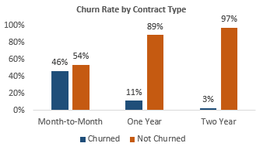
How does the type of contract (month-to-month vs. annual) affect churn?
Month-to-month users had the highest churn rate at 46%, compared to 11% for 1-year contracts and 3% for 2-year contracts

Slide 13
Recommendations to Reduce Churn
1. Competitive Analysis: Assess competitor products and devices to craft more attractive package options
2. Enhance Customer Service: Improve training and the work environment to boost representative productivity and morale
3. Review Pricing: Adjust pricing to enhance satisfaction for customers on the Unlimited Plan using less than 3 GB
4. Encourage Long-Term Contracts: Incentivize customers to switch to long-term plans by offering discounts or added benefits, as they are less likely to churn
5. Targeted Retention Strategies:
Target adults (55% churn) with personalized offers and support.
Focus on California (63% churn) with localized promotions.

