Slide 1




Ad Hoc Business Requests
By - Amritesh Rai
Tools Used:

Slide 2
Problem Statement
GoodCabs, an Indian cab service operating in 10 tier-2 cities, aims to help local drivers earn a sustainable living while providing high-quality service to customers. The company is performing well and seeks to improve further by analyzing key metrics.
GoodCabs requires quick insights into key performance metrics to support ad-hoc decision-making and drive improvements in their service and operations.

Slide 3
Cities of Operation
Chandigarh
Visakhapatnam
Surat
Indore
Vadodara
Jaipur
Mysore
Coimbatore
Kochi
Lucknow

Slide 4
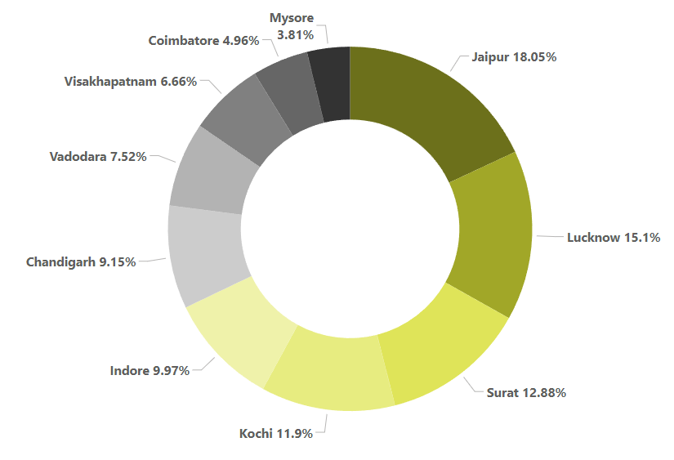
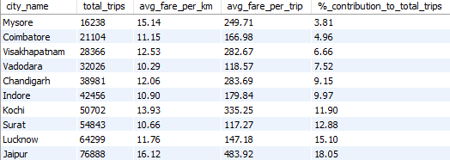

Business Request - 1: City-Level Fare and Trip Summary Report
Generate a report showing total trips, average fare per km, average fare per trip, and each city's percentage contribution to total trips, to evaluate trip volume, pricing efficiency, and city contributions.
Jaipur (18.05%) and Lucknow (15.10%) have the largest contributions to the total number of trips among all cities.
Mysore has a relatively high fare per km (₹15.14) and average fare per trip (₹249.71), indicating premium pricing, but its low trip volume suggests potential for growth by increasing demand while maintaining its fare structure.

Slide 5
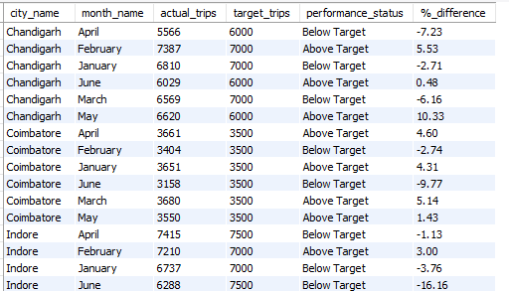
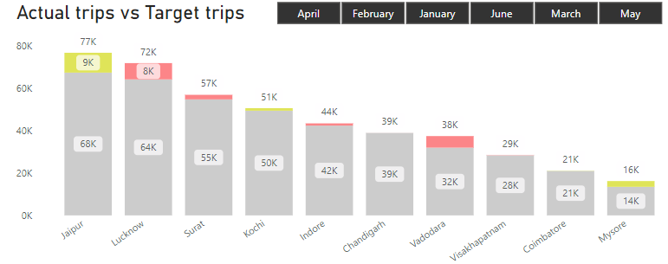
Business Request - 2: Monthly City-Level Trips Target Performance Report
Create a report comparing actual vs target trips at the city and month level, categorize performance, and calculate the percentage difference with a summary label
Mysore and Jaipur consistently exceeded targets, with Mysore reaching a high of 33.40% in February and Jaipur at 22.09% in February
Lucknow, Kochi, and Vadodara consistently underperformed, with Lucknow hitting a low of -16.48% in January, Kochi at -28.90% in June, and Vadodara at -27.92% in June.

Slide 6
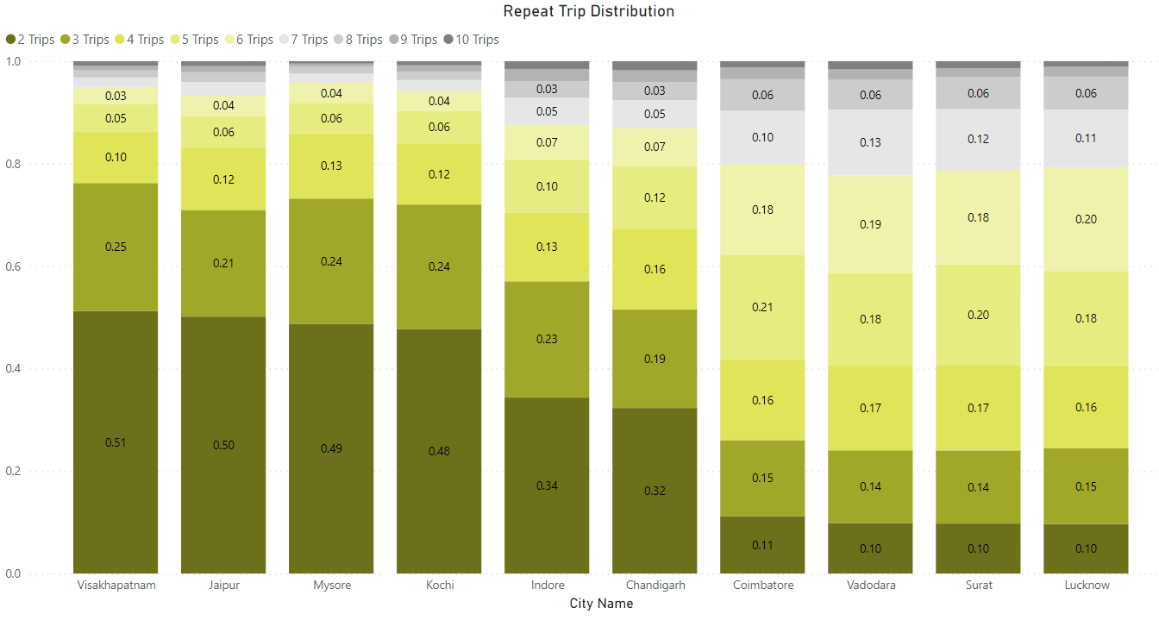
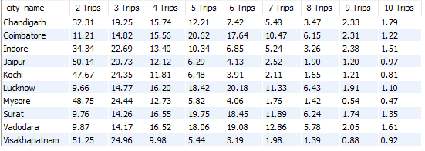
Business Request - 3: City-Level Repeat Passenger Trip Frequency Report
Generate a report showing the percentage distribution of repeat passengers in each city by the number of trips taken (2 to 10 trips). This will provide insights into customer loyalty and usage patterns across cities.
Cities like Visakhapatnam, Jaipur, Mysore, and Kochi show high percentages of customers taking only 2-3 repeat trips, indicating lower loyalty, suggesting the need for discounts or loyalty programs to boost customer retention.
Cities like Coimbatore, Vadodara, Surat, and Lucknow show strong loyalty with repeat trips up to 6, indicating satisfied customers; offering exclusive rewards or VIP programs can further strengthen retention.

Slide 7
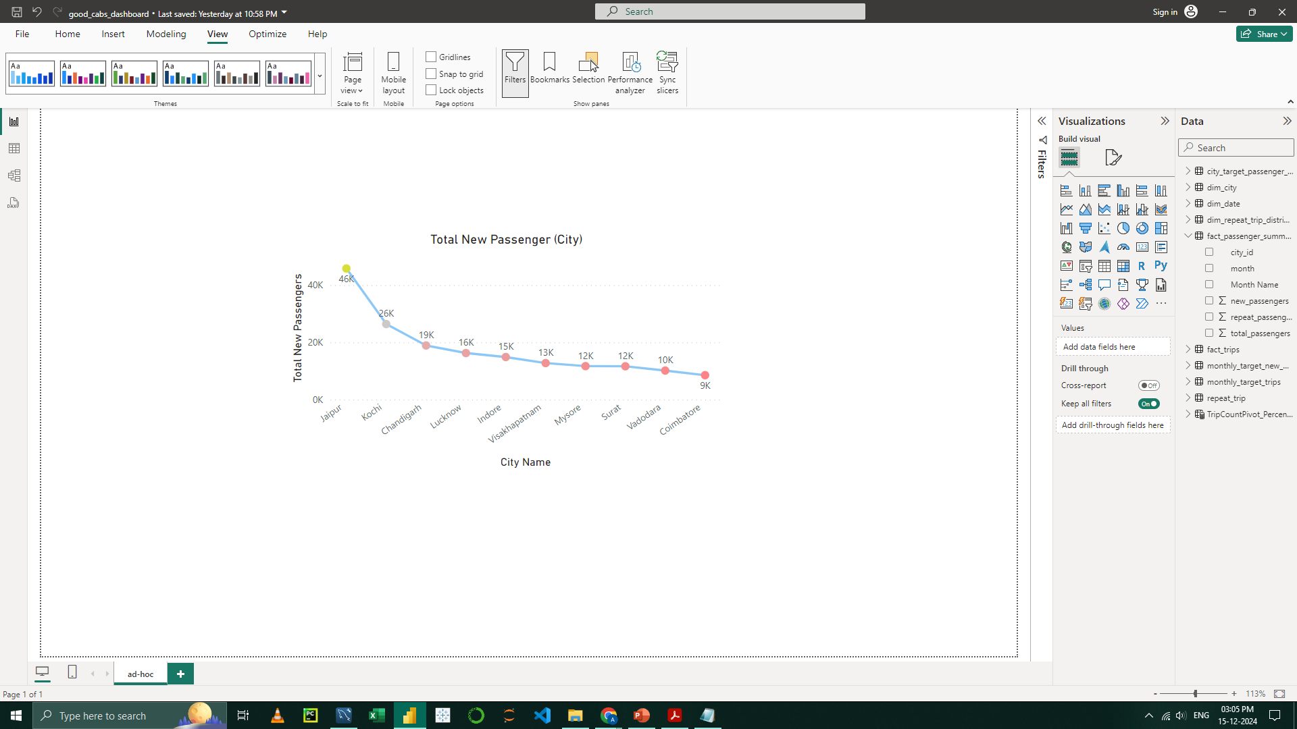
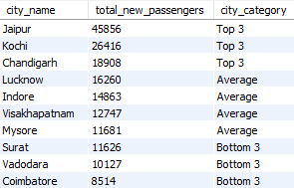
Business Request - 4: Identify Cities with Highest and Lowest Total New Passengers
Generate a report that ranks cities by total new passengers, highlighting the top 3 and bottom 3 cities.
Insights
Surat: Despite a high total passenger count, most are repeat customers, indicating a need to attract more new passengers
Jaipur and Kochi: These cities show strong growth in new passengers, highlighting successful customer acquisition strategies.

Slide 8
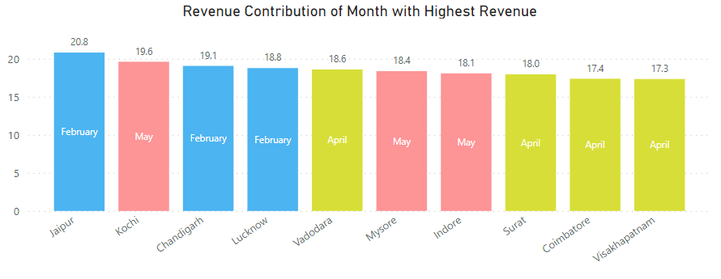
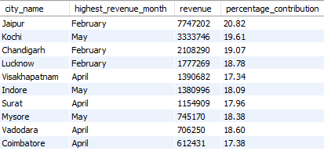
Business Request - 5: Identify Month with Highest Revenue for Each City
Generate a report identifying the month with the highest revenue for each city, showing the month, revenue amount, and its percentage contribution to total revenue.
February, April, and May are key revenue-driving months for most cities, likely influenced by seasonal trends and events during these periods.

Slide 9
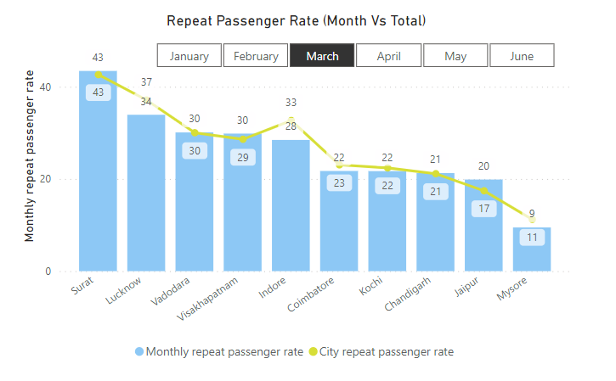
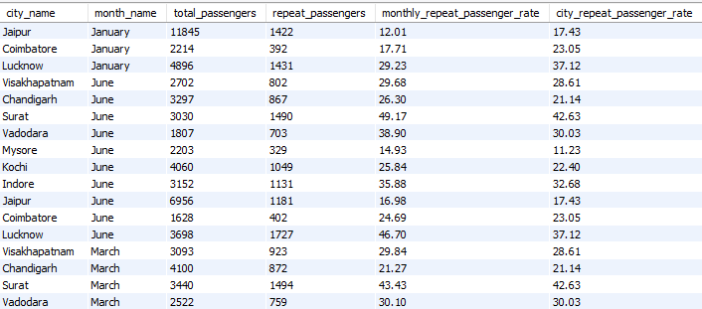
Business Request - 6: Repeat Passenger Rate Analysis
Calculate the monthly repeat passenger rate and city-wide repeat passenger rate for each city to analyze monthly trends and overall repeat passenger behavior
Cities like Surat and Lucknow show consistently high repeat passenger rates across months, indicating strong customer loyalty. In contrast, cities like Mysore and Jaipur exhibit lower repeat rates, suggesting potential opportunities for improving customer retention strategies.

Slide 10
Summary Insights
Top Contributors:
Jaipur (18.05%) and Lucknow (15.10%) lead in total trips, indicating strong city performance.
2. Growth Potential in Mysore:
High fare structure, but low trip volume presents an opportunity for growth.
Underperformance (Actual Vs Target):
Lucknow, Kochi, and Vadodara showed consistent underperformance, needing improvement strategies.
Repeat Trip Patterns:
Cities like Chandigarh, Jaipur, and Mysore show lower customer loyalty, suggesting a need for loyalty programs.
Revenue Months:
February, April, and May are key revenue months, influenced by seasonal trends.

