Slide 1
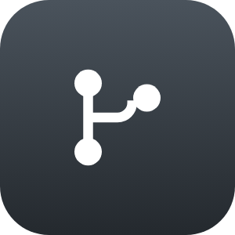
























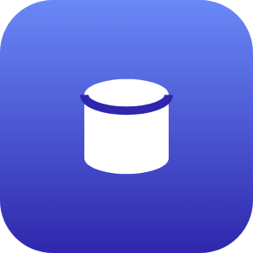









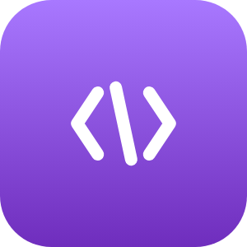

CI/CD PIPELINE
GitHub
GitHub Actions
Amazon ECR
BUILD & PUSH CONTAINER IMAGES → DEPLOY TO LAMBDA
CONTAINER IMAGE DEPLOY → VPC LAMBDA SERVICES
FRONTEND · EDGE
AWS VPC
SECURITY & ACCESS CONTROL
PROCESS STAGES
GEN AI · BEDROCK (NOVA)
PRIVATE SUBNET · STORAGE
User Browser
IAM Roles
Cognito Pools
client
Access control
AuthN / AuthZ
DATA SOURCE
SQS Queue 1
Step Functions 1
Amazon Cognito
Nova Validate
auth token
PRODUCT CONFIG
Amazon Bedrock
SECURES VPC & EDGE
CRUD / Logic Lambda
Amazon Nova
AWS WAF
VPC Sec Groups
AUTH REQUESTS → VPC
Actuarial Scripts
EC2 (Local LLM)
API protection
Isolation
ASSUMPTION
BEDROCK ASSISTS
validation
ENC
Assumption Lambda
Update Products
READS / WRITES
CloudFront
RDS (MySQL)
ENC
CDN
CALCULATION ENGINE
ETL & Data Conv.
structured
SQS Queue 2
Step Fn 2
S3 (Files)
ENC
SQL Query Gen.
assumptions
Model A
Model B
Model N
DB Handling
COMPARISON TOOL
S3 (Frontend)
S3 (Legacy)
Secrets Mgr
AWS KMS
React app
Compare Lambda
Credentials
Key mgmt
S3 (SPARTA)
ENCRYPTION
Amazon SES
TLS in-transit · AES-256 at-rest · KMS keys
SUPPORTING SERVICES
MONITORS & OPS
Global / managed · via VPC endpoints
API Gateway
routing
CloudWatch
IAM Roles
Secrets Mgr
VPC boundary
Front edge → VPC
Gen AI (Bedrock) link
Deploy (ECR → Lambda)
Reads / writes data
Security / access control
Encryption (KMS / TLS)
Monitoring (CloudWatch)
Data ingestion flow
Email (Amazon SES)

Slide 2

SPARTA — Workflow Overview
How a request flows through the platform, layer by layer
Frontend · Edge
User Browser
Cognito
Users open the React app served from S3 via CloudFront. Cognito authenticates the user and issues a token; API Gateway routes authenticated requests into the VPC.
STEP 1 · ENTRY
CloudFront
S3
API Gateway
Process Stages
SQS
Step Functions
Lambda
Data is queued & validated, products and assumptions are configured, the Calculation Engine runs models in parallel, and the Comparison Tool checks output vs. legacy — emailing results via SES.
STEP 2 · CORE PIPELINE
SES
Generative AI
Nova
Scripts
Update
Amazon Bedrock (Nova) assists every stage — generating actuarial scripts, rewriting product configs, running ETL jobs, generating SQL queries, and handling database operations.
STEP 3 · BEDROCK (NOVA)
ETL
SQL
DB
Private Subnet
EC2
RDS
S3
An isolated, encrypted data tier: EC2 for in-VPC validation, RDS (MySQL) for structured data, and S3 for assumption & raw files. All data is encrypted at rest.
STEP 4 · STORAGE
Security & Access Control
IAM
Cognito
WAF
Secures the VPC and edge: IAM roles, Cognito, AWS WAF, VPC security groups, Secrets Manager, and KMS — with TLS in-transit and AES-256 at rest.
CROSS-CUTTING
Sec Groups
Secrets
KMS
Supporting Services
CloudWatch
IAM
Secrets
Global / managed services via VPC endpoints: CloudWatch for monitoring & logging, IAM execution roles, and Secrets Manager for runtime secrets.
OPERATIONS

