Slide 1
Chest X-Ray Pneumonia Classification
A Comparative Study of Logistic Regression, CNNs, ViTs, and Hybrid Architecture
H. Şeyda Gündüz — Data, Metrics & Logistic Regression
Amrithavarshini Satheesh — CNN Baseline
DivyaTej Reddy Kavalagari — Vision Transformer Baseline
Sohith Vishnu Sai Yachamaneni— Proposed Hybrid ViT Model
Notes:
Today we’ll present our project on chest X-ray pneumonia classification using both traditional machine learning and modern deep learning architectures.
We compare four approaches:
1. Logistic Regression
2. CNNs
3. Vision Transformers
4. A custom hybrid CNN + ViT architecture

Slide 2
Why This Problem Matters
Pneumonia is a major respiratory disease
Chest X-rays are commonly used for diagnosis
AI can support radiologists by improving consistency and speed

Slide 3
Formal Problem Setting
Input: Chest X-ray image xᵢ ∈ ℝ^(H×W×C)
Output label yᵢ ∈ {0,1,2}
0 = Normal (i.e. no Pneumonia)
1 = Bacterial Pneumonia
2 = Viral Pneumonia
Supervised three-class image classification problem

Slide 4
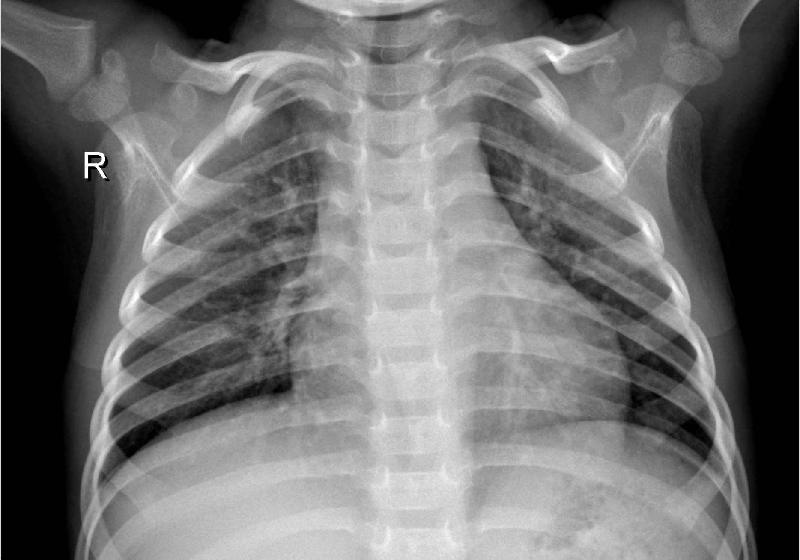
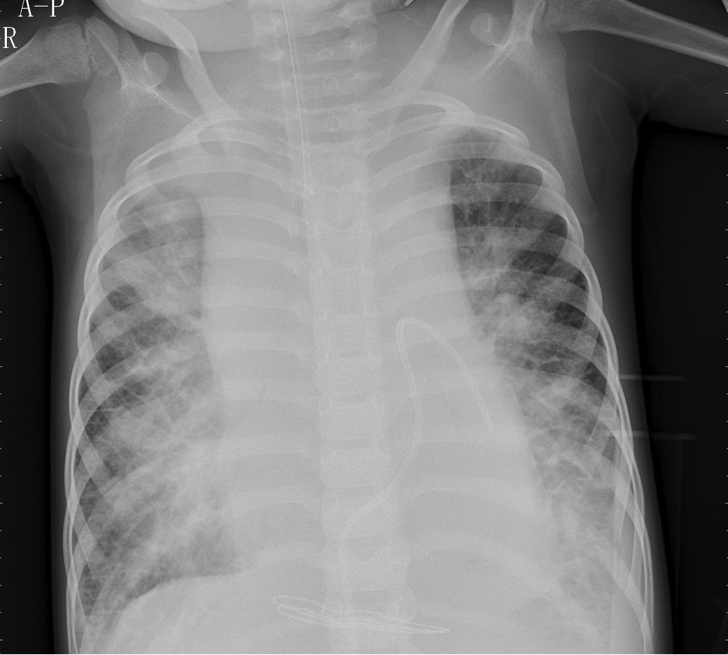
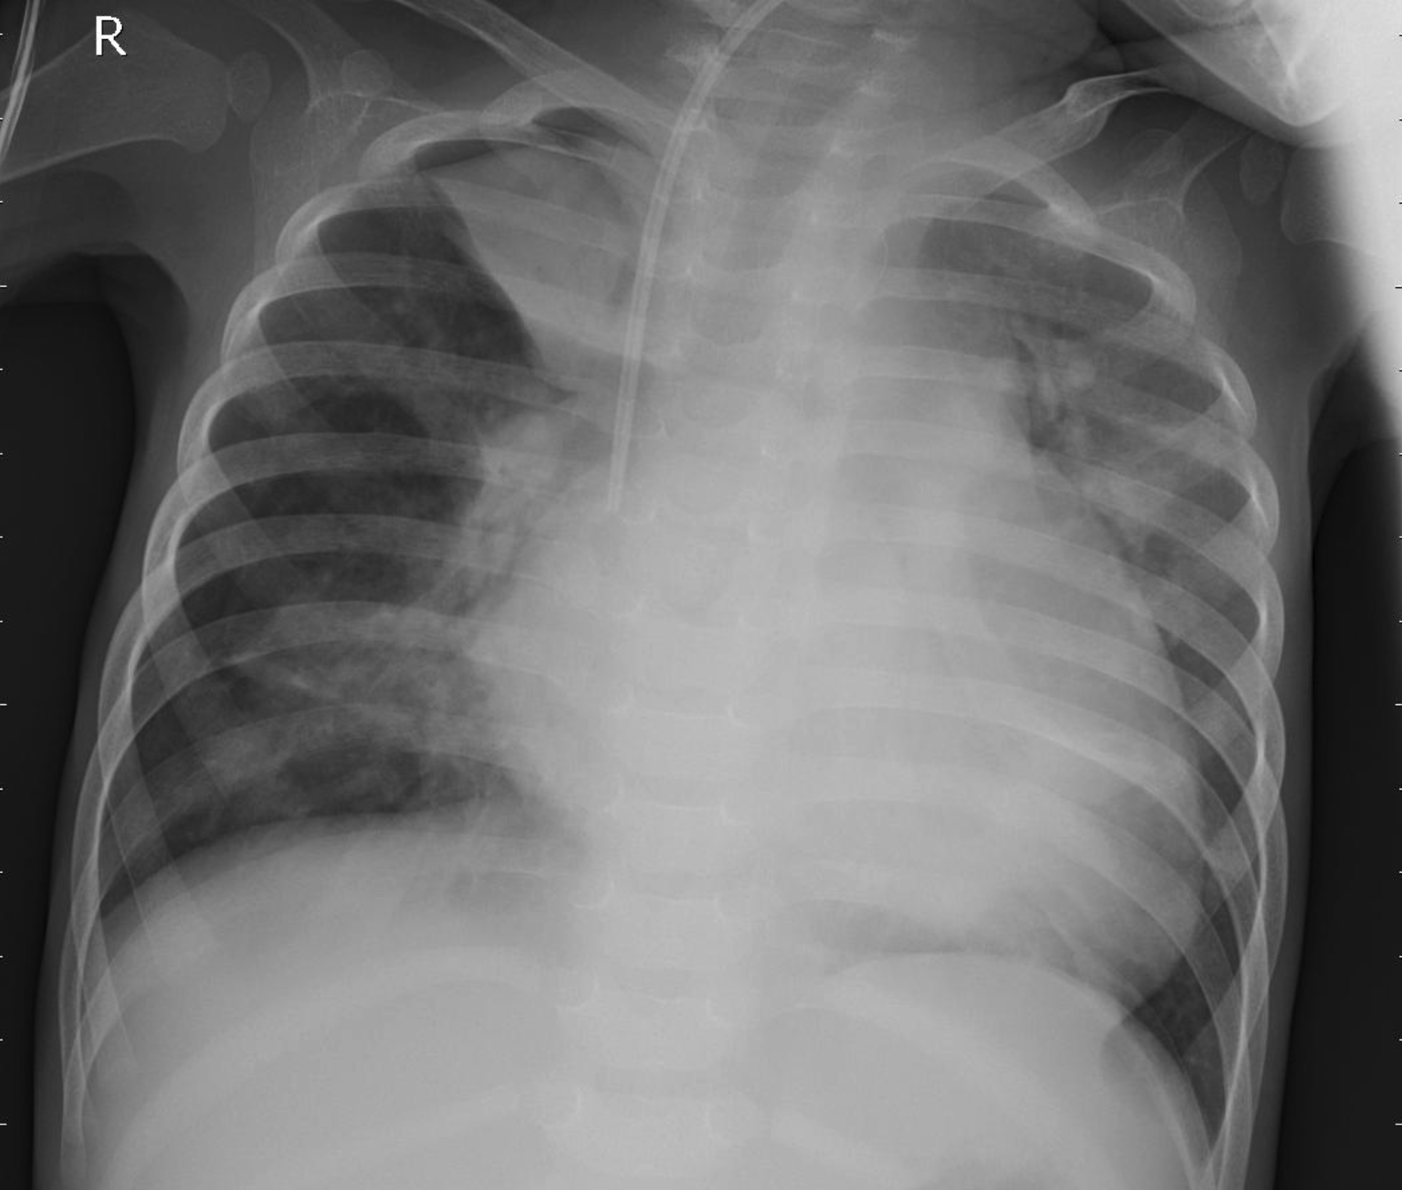
Dataset Introduction
Chest X-Ray Pneumonia Dataset*
Classes:
Normal: Clear lung fields
Bacterial: Typically focal lung opacity
Viral: Diffuse and widespread involvement
Normal
Viral
Bacterial
https://www.kaggle.com/datasets/paultimothymooney/chest-xray-pneumonia

Slide 5
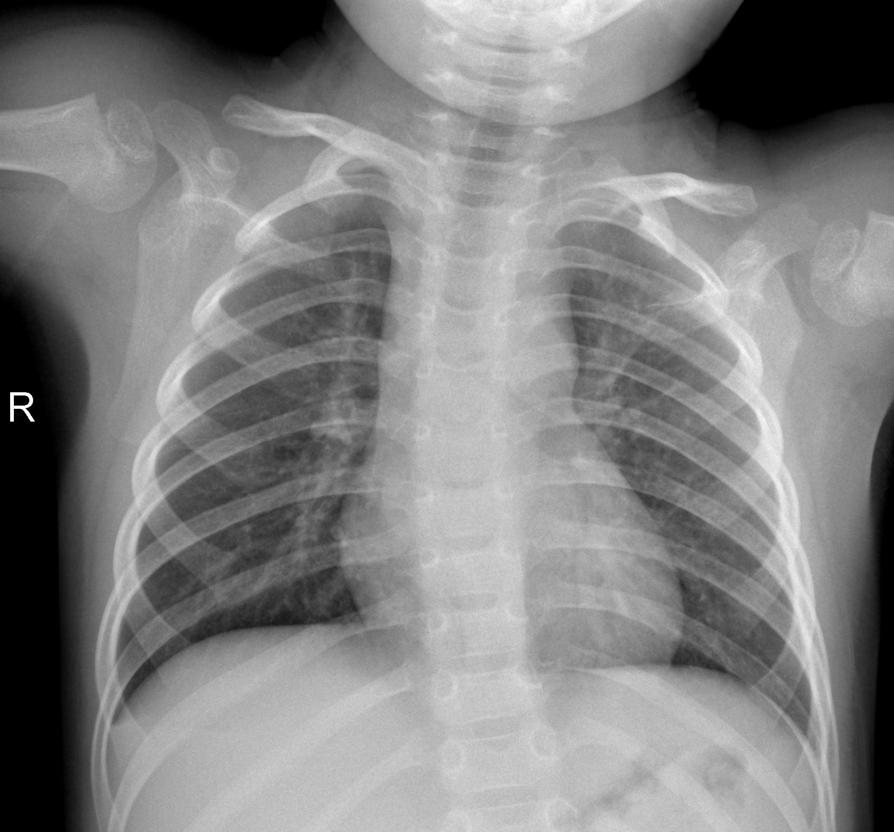
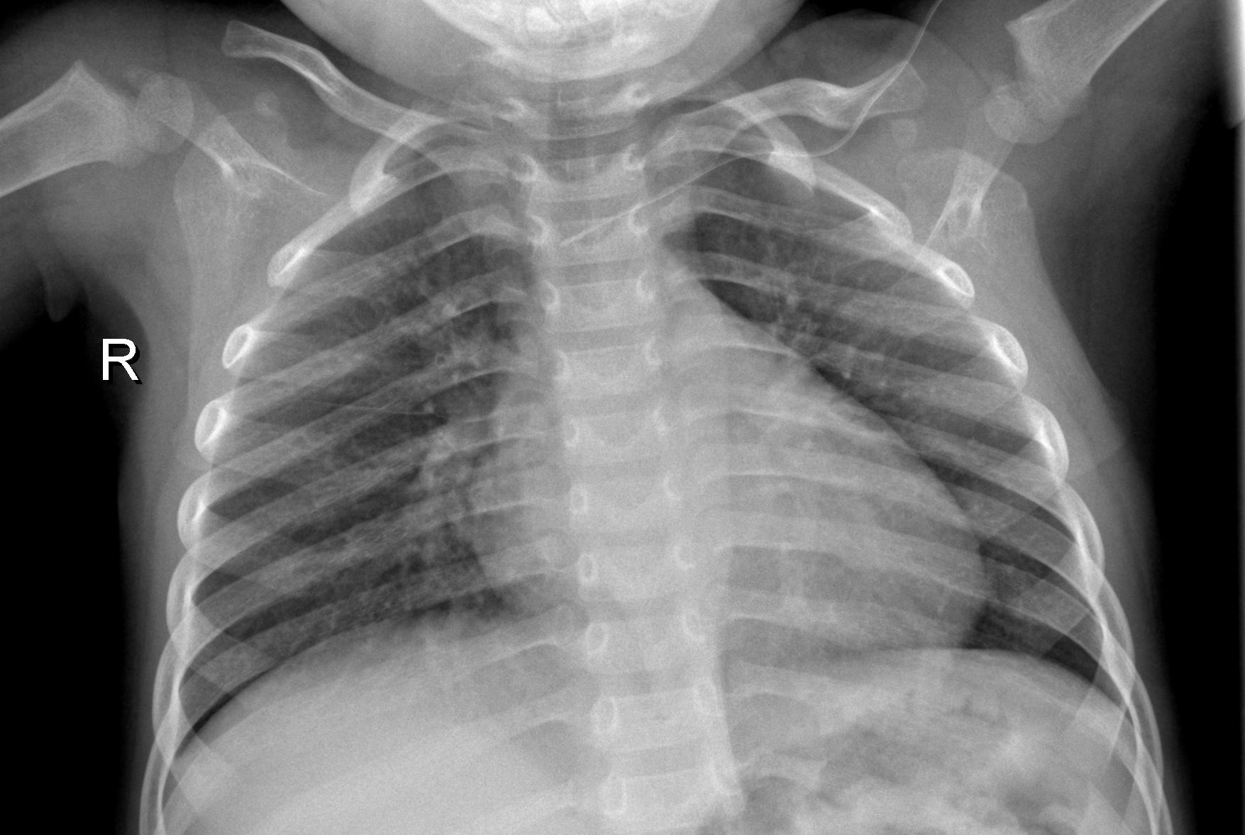
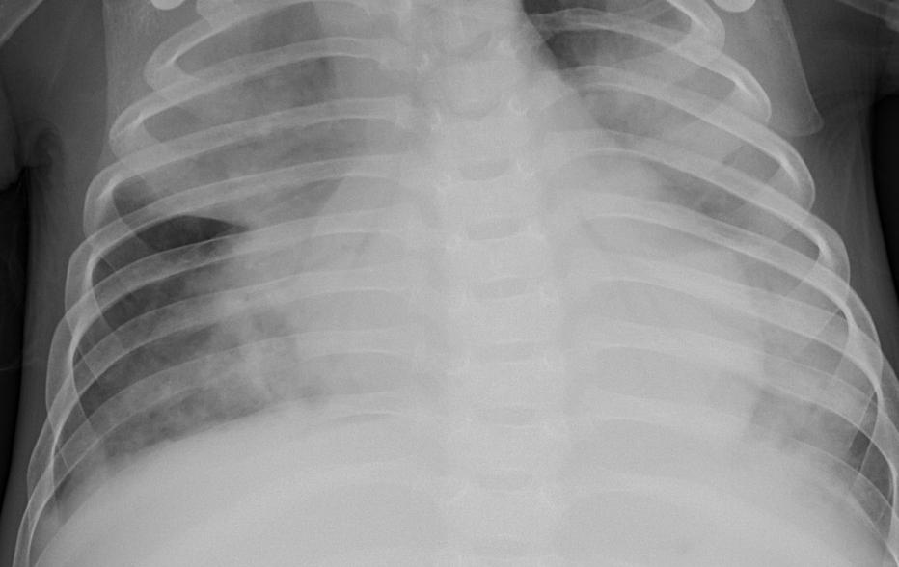
Dataset
Approximately 5,800 chest X-ray images
Images contain:
Different patient positioning
Varying image quality
Machine-specific artifacts
Different coverage regions
https://www.kaggle.com/datasets/paultimothymooney/chest-xray-pneumonia

Slide 6
Dataset Distribution
Significant class imbalance exists
Validation set is extremely small
Bacterial pneumonia is the dominant class
Split | Total | Bacterial | Viral | Normal
train | 5216 | 2530 | 1345 | 1341
val | 16 | 8 | - | 8
test | 624 | 242 | 148 | 234

Slide 7
Dataset Analysis
All images are converted to a consistent 3-channel format during preprocessing
Data is pre-cleaned up. However pixel intensity statistics are analyzed for outliers using:
Min / max intensity
Mean brightness
Contrast
Observed intensity differences are likely caused by scanner or acquisition variability

Slide 8
Preprocessing & Augmentation
All images are downscaled to 224x224
Augmentation during training
Random rotation up to ±10°
Translation up to 3 pixels
Gaussian noise with standard deviation 0.02
Brightness adjustment up to ±0.10
Augmentation probability: 0.5

Slide 9
Evaluation Metrics
Macro Recall is chosen as:
Robust to class imbalance
Gives equal importance to all classes
Measures sensitivity across classes

Slide 10
Baseline 1 — Logistic Regression
Logistic Regression as an ML baseline:
Flatten each image into a one-dimensional feature vector
Z-score standardization across training set
PCA for dimensionality reduction
Class-balanced weights to address dataset imbalance

Slide 11
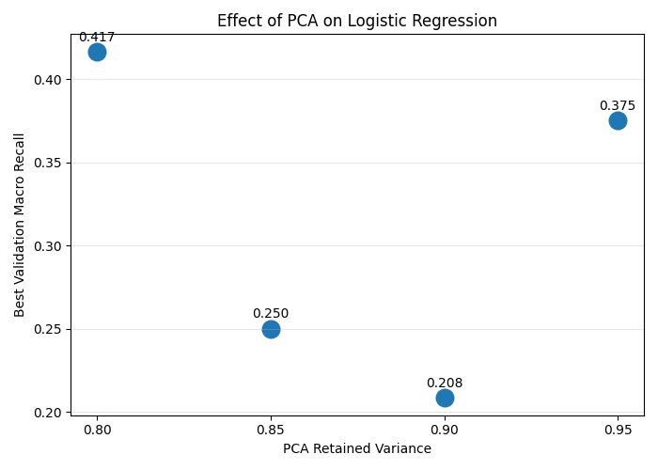
Baseline 1 — Logistic Regression
Best PCA: 0.80
Best validation Macro Recall: 0.417
Regularization strength had minimal impact on performance

Slide 12
Baseline 2 — CNN Model
DenseNet-121 architecture
Through convolutions, the model is able to process local image regions
In medical imaging, pneumonia appears as localised texture patterns and opacities, and so CNN would be a good choice
Notes:
cnn.py
- 3 classes
- pre-trained imagenet weights
- feature extractor layers are not frozen, based on hyperparameter tuning results
- classifier layer is adapted to our task
cnn_dataset.py
- get_cnn_transforms: allows images to be resized for densenet requirements, then converts images into a pytorch tensor , and values are normalised to make training stabilisation and pretrained densenet expectations
- augmentation configuration is used only on training data
- image loaded, converted to rgb numpy array, augmentation, then converted to PIL which is expected, and resized to 224 x 224 for cnn, convert to tensory, normalise, label string is converted to integer
cnn_utils.py
- train_one_epoch: sets model to training mode, which enables dropout and batch normalisation updates. pytorch gradients are cleared before a new backpropagation so that it’s more memory efficient. optimiser to update weights, and loss is accumulated
- evaluate function: set model to evaluation to disable dropout and batchnorm updates, turns of gradient tracking to make it faster, and gets model predictions.
- load images
- compute class weights: to count number of samples per class, and smaller classes get larger weights so that minority-class mistakes are penalised more heavily
train_cnn.py
- dataset split into training, validation, and testing, and the labels are encoded
- train dataset to have augmentation with deterministic randomness
- val + test dataset to have no augmentation
- train loader to split data into batches, shuffle (so that training order is random - important for generalisation), and parallelise (num_workers, to improve speed)
- val + test loader splits data into batches and parallelise but no shuffling
- model is initialised, pretrained weights are used, backbone is not frozen
- using cross entropy loss for multi-class classification to penalise minority-class mistakes
- using adamw optimiser for adaptive learning rates and proper weight decay regularisation
- weight decay + learning rate from hyperparameter tuning
- using the same classification evaluator
- check model performance on validation dataset with each epoch, and use that to select the best model
- model then runs predictions on unseen test data and computes final test performance
cnn_hyperparameter_tuning.py
- grid search on learning rate + weight decay + batch size + whether to freeze backbone or not
- batch size: smaller batch = noisier gradients, but less memory, and could have better generalisation. bigger batch = smoother gradient, but would use more memory
- freeze_backbone to test whether there should be transfer learning or full fine-tuning
evaluating the results
- hyperparameter tuning results in a low validation recall of 0.5
- test performance — macro-recall of 82.28% which shows that model performance is balanced across the classes

Slide 13
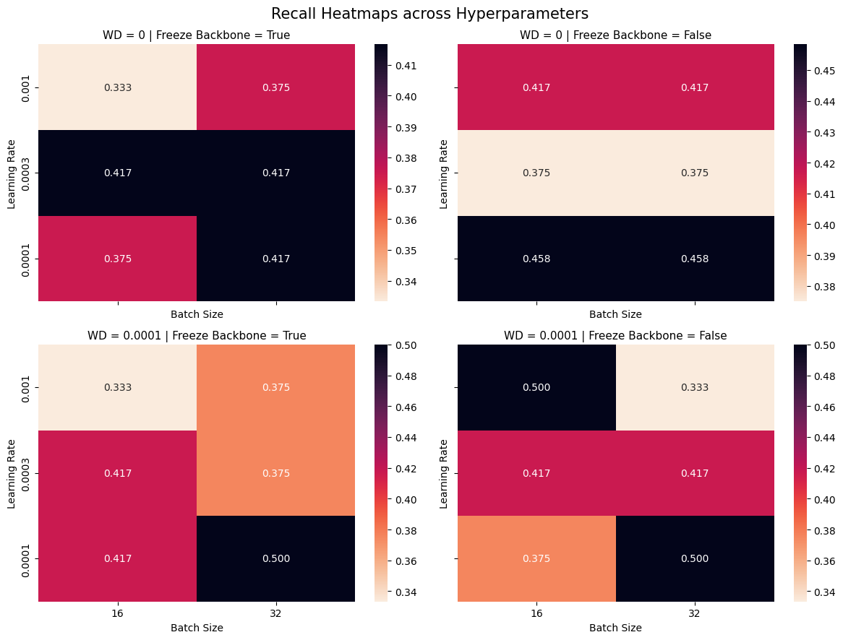
Baseline 2 — CNN Model
Through hyperparameter tuning, we set
Learning rate = 0.001
Weight Decay = 0.0001
Batch Size = 16
Backbone is not frozen, so the entire network is fine-tuned
Notes:
cnn.py
- 3 classes
- pre-trained imagenet weights
- feature extractor layers are not frozen, based on hyperparameter tuning results
- classifier layer is adapted to our task
cnn_dataset.py
- get_cnn_transforms: allows images to be resized for densenet requirements, then converts images into a pytorch tensor , and values are normalised to make training stabilisation and pretrained densenet expectations
- augmentation configuration is used only on training data
- image loaded, converted to rgb numpy array, augmentation, then converted to PIL which is expected, and resized to 224 x 224 for cnn, convert to tensory, normalise, label string is converted to integer
cnn_utils.py
- train_one_epoch: sets model to training mode, which enables dropout and batch normalisation updates. pytorch gradients are cleared before a new backpropagation so that it’s more memory efficient. optimiser to update weights, and loss is accumulated
- evaluate function: set model to evaluation to disable dropout and batchnorm updates, turns of gradient tracking to make it faster, and gets model predictions.
- load images
- compute class weights: to count number of samples per class, and smaller classes get larger weights so that minority-class mistakes are penalised more heavily
train_cnn.py
- dataset split into training, validation, and testing, and the labels are encoded
- train dataset to have augmentation with deterministic randomness
- val + test dataset to have no augmentation
- train loader to split data into batches, shuffle (so that training order is random - important for generalisation), and parallelise (num_workers, to improve speed)
- val + test loader splits data into batches and parallelise but no shuffling
- model is initialised, pretrained weights are used, backbone is not frozen
- using cross entropy loss for multi-class classification to penalise minority-class mistakes
- using adamw optimiser for adaptive learning rates and proper weight decay regularisation
- weight decay + learning rate from hyperparameter tuning
- using the same classification evaluator
- check model performance on validation dataset with each epoch, and use that to select the best model
- model then runs predictions on unseen test data and computes final test performance
cnn_hyperparameter_tuning.py
- grid search on learning rate + weight decay + batch size + whether to freeze backbone or not
- batch size: smaller batch = noisier gradients, but less memory, and could have better generalisation. bigger batch = smoother gradient, but would use more memory
- freeze_backbone to test whether there should be transfer learning or full fine-tuning
evaluating the results
- hyperparameter tuning results in a low validation recall of 0.5
- test performance — macro-recall of 82.28% which shows that model performance is balanced across the classes

Slide 14
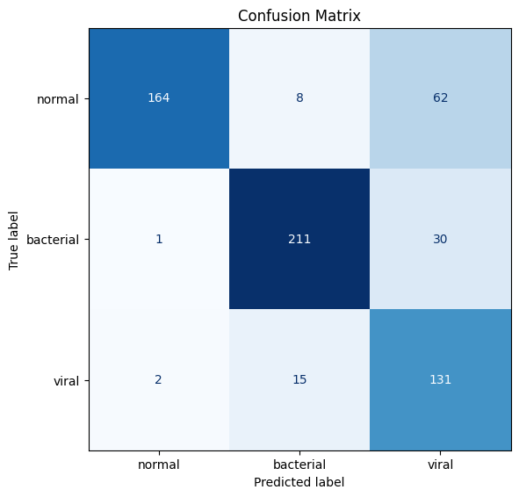
Baseline 2 — CNN Model
Model is trained on augmented data
We use Cross Entropy Loss as a loss function so that minority-class mistakes are penalised more
Notes:
cnn.py
- 3 classes
- pre-trained imagenet weights
- feature extractor layers are not frozen, based on hyperparameter tuning results
- classifier layer is adapted to our task
cnn_dataset.py
- get_cnn_transforms: allows images to be resized for densenet requirements, then converts images into a pytorch tensor , and values are normalised to make training stabilisation and pretrained densenet expectations
- augmentation configuration is used only on training data
- image loaded, converted to rgb numpy array, augmentation, then converted to PIL which is expected, and resized to 224 x 224 for cnn, convert to tensory, normalise, label string is converted to integer
cnn_utils.py
- train_one_epoch: sets model to training mode, which enables dropout and batch normalisation updates. pytorch gradients are cleared before a new backpropagation so that it’s more memory efficient. optimiser to update weights, and loss is accumulated
- evaluate function: set model to evaluation to disable dropout and batchnorm updates, turns of gradient tracking to make it faster, and gets model predictions.
- load images
- compute class weights: to count number of samples per class, and smaller classes get larger weights so that minority-class mistakes are penalised more heavily
train_cnn.py
- dataset split into training, validation, and testing, and the labels are encoded
- train dataset to have augmentation with deterministic randomness
- val + test dataset to have no augmentation
- train loader to split data into batches, shuffle (so that training order is random - important for generalisation), and parallelise (num_workers, to improve speed)
- val + test loader splits data into batches and parallelise but no shuffling
- model is initialised, pretrained weights are used, backbone is not frozen
- using cross entropy loss for multi-class classification to penalise minority-class mistakes
- using adamw optimiser for adaptive learning rates and proper weight decay regularisation
- weight decay + learning rate from hyperparameter tuning
- using the same classification evaluator
- check model performance on validation dataset with each epoch, and use that to select the best model
- model then runs predictions on unseen test data and computes final test performance
cnn_hyperparameter_tuning.py
- grid search on learning rate + weight decay + batch size + whether to freeze backbone or not
- batch size: smaller batch = noisier gradients, but less memory, and could have better generalisation. bigger batch = smoother gradient, but would use more memory
- freeze_backbone to test whether there should be transfer learning or full fine-tuning
evaluating the results
- hyperparameter tuning results in a low validation recall of 0.5
- test performance — macro-recall of 82.28% which shows that model performance is balanced across the classes

Slide 15
Baseline 3 — Vision Transformer (ViT)
ViT processes images as sequences of patches
Pipeline:
• Patch extraction
• Patch embeddings
• Transformer encoder
• Classification using CLS token
Strength: Global context modeling
Notes:
Explain how Vision Transformers differ from CNNs.
Instead of convolutions, ViTs use self-attention to model relationships between all image patches.
This helps capture global chest structure and long-range dependencies.

Slide 16
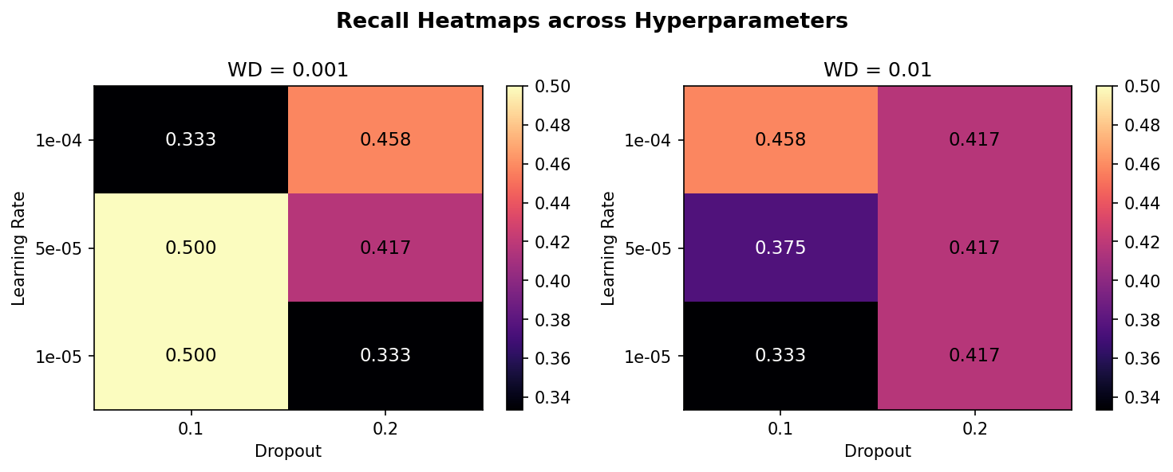
ViT Hyperparameter Tuning
Through hyperparameter tuning, we set
Learning rate = 1e-4
Weight Decay = 0.01
Dropout = 0.1
Backbone is not frozen - so the entire network is fine-tuned

Slide 17
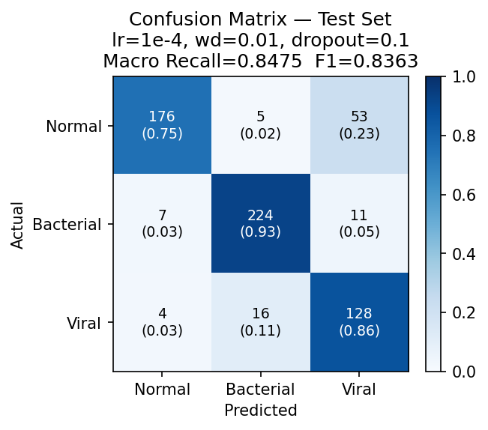
ViT Results
Model is trained on augmented data
Weighted Cross-Entropy Loss with label smoothing to handle class imbalance

Slide 18
Challenges with Standard ViTs
Problems on small datasets:
Weak spatial inductive bias
Data hungry
Overfitting risk
Observation:
CNNs = better local features
ViTs = better global structure
Notes:
Explain why a standard ViT alone is insufficient here.
Our dataset only contains about 5,800 images, which is relatively small for transformer-based architectures.
This motivated our hybrid architecture idea.

Slide 19
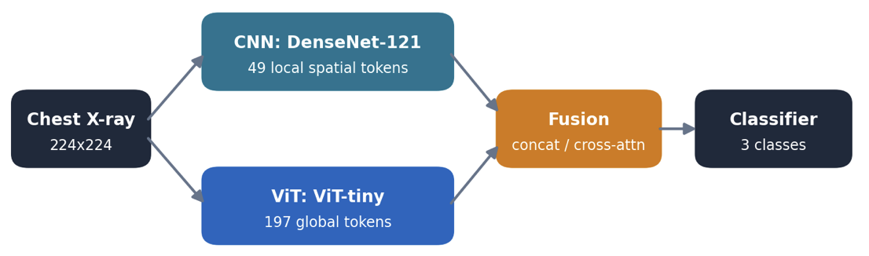
Proposed Hybrid Architecture
Two parallel branches, each kept at full token resolution
CNN — DenseNet-121: keeps 49 local spatial tokens (texture, focal opacities).
ViT — ViT-tiny: 197 global patch tokens for overall lung structure.
Fusion → classifier: the two token sets are combined, then classified into Normal / Bacterial / Viral.
Both branches keep their spatial tokens (not collapsed to a single vector), so fusion can relate local detail to global context.
Notes:
Explain the central contribution of the project.
The CNN captures local pneumonia textures while the ViT captures broader structural relationships.
By combining both, we aim to improve robustness and generalization.

Slide 20
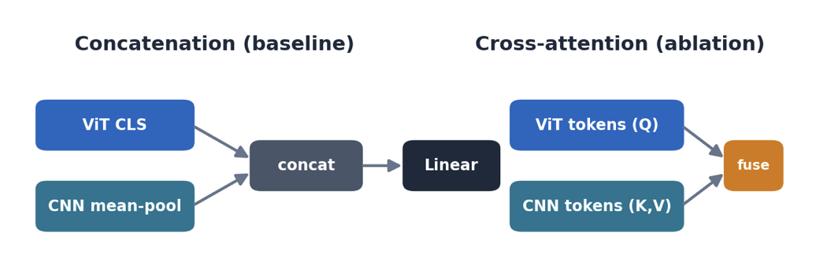
Fusion Mechanism & Regularization
Concatenation (baseline): ViT CLS token + mean-pooled CNN tokens → a linear classifier.
Cross-attention (ablation): ViT patch tokens query the CNN spatial tokens via multi-head attention, so global features pull in the most relevant local detail.
Regularization: embedding-level noise / dropout + class weighting to counter imbalance and overfitting.
Notes:
Explain the fusion mechanism.
We concatenate CNN and ViT feature vectors before classification.
We also apply dropout specifically to the ViT branch to reduce overfitting and force the model to rely on both branches.

Slide 21
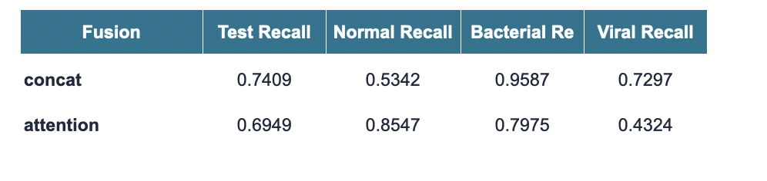
Fusion Mechanism
Concatenation
ViT CLS token + mean-pooled cnn map gives one vector and linear classifier.
Fixed combination, the vit and cnn branch doesn’t interact before classifier
Cross-Attention
ViT tokens query the CNN spatial tokens (multi-head), then pool
Learned interaction, but a fresh attention block to train, which is more Hyperparameter sensitive harder to optimize
In this experiment setup concatenation has performed better as cross attention’s extra block was harder to train and collapsed on viral, the hardest and most fusion depend class - so concatenation is our hybrid setup here in the final results.
Notes:
Explain the fusion mechanism.
We concatenate CNN and ViT feature vectors before classification.
We also apply dropout specifically to the ViT branch to reduce overfitting and force the model to rely on both branches.

Slide 22
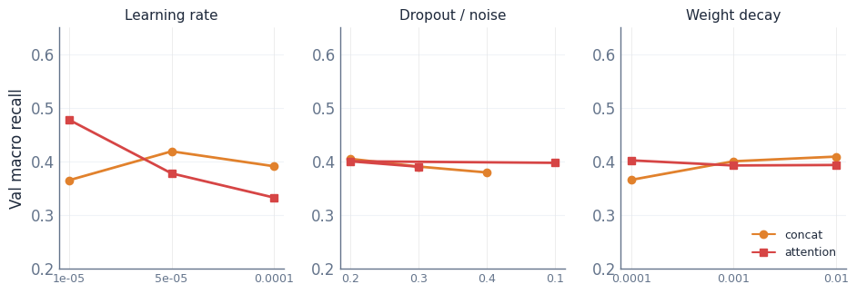
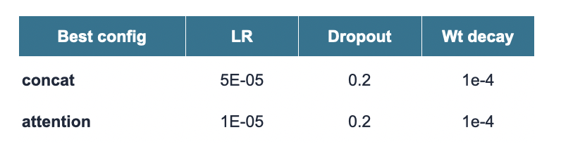
Hyperparameter Tuning
Learning rate dominates — dropout and weight decay barely move validation recall.
Two-phase search, run separately for each fusion type
27 configs (learning rate × dropout × weight decay) screened for 8 epochs → best configs retrained for 20 epochs.
Selected on a stratified fold held out from train — the official 16-image val (with 0 viral cases) is too small to select on.

Slide 23
Results
 | LR | CNN | ViT | Hybrid (Concat)
Macro Recall | 0.69 | 0.82 | 0.84 | 0.74
Notes:
Summarize expected behavior of each model.
The hybrid architecture should outperform the others because it combines complementary strengths.
Focus again on improving recall and reducing false negatives.

Slide 24
Comparison
Logistic Regression: Simple but limited
CNN: Strong local feature extraction
ViT: Strong global context
Hybrid Model: Combines local and global representations
Model | Macro Recall | Normal Recall | Bacterial Recall | Viral Recall
Logistic Regression | 0.69 | 0.43 | 0.89 | 0.75
CNN(DenseNet 121) | 0.82 | 0.70 | 0.88 | 0.88
ViT | 0.84 | 0.75 | 0.93 | 0.86
Hybrid (Concat) | 0.74 | 0.53 | 0.95 | 0.72
Notes:
Summarize expected behavior of each model.
The hybrid architecture should outperform the others because it combines complementary strengths.
Focus again on improving recall and reducing false negatives.

Slide 25
Conclusion
The standard ViT baseline model performed better than our proposed hybrid architecture
A significant limitation is the dataset imbalance,
The validation set contains only 16 images, with no viral pneumonia cases, which limits its ability to provide a reliable estimate of model performance during hyperparameter tuning and model selection
The hybrid -complex- architecture is not able to generalise well, especially given the small and imbalanced dataset
Future work could explore with better split of dataset to improve diagnostic accuracy
Notes:
The standard ViT baseline outperformed our proposed CNN–ViT hybrid architecture, suggesting that combining local and global features through simple feature fusion did not provide additional benefits on this dataset.
Dataset imbalance was a significant limitation, with highly uneven class distributions across the train, validation, and test splits.
The validation set contained only 16 images and no viral pneumonia cases, limiting its ability to provide a reliable estimate of model performance during hyperparameter tuning and model selection.
Future work could explore more balanced evaluation protocols, larger datasets, and advanced attention-based fusion mechanisms to better leverage complementary CNN and ViT representations.
The hybrid underperformed the ViT because it diluted each branch's strength rather than combining them, the simpler fusion was the more robust of the two, and the biggest practical limitation was a validation set too small and skewed to select on — which is also the first thing we'd fix.

