Slide 1
Evidence-based Decision-making for School Leaders
Fiona Hollands, Ph.D.
Yilin Pan, Ph.D.
Maya Escueta, M.A.
Center for Benefit-Cost Studies of Education
Teachers College, Columbia University
January 13, 2018

Slide 2
New School Design
Problem of interest: a choice problem among multiple options/solutions
Purchase an intervention or program
Design professional development for teachers
Conduct major adoption of a curriculum
Evidence-based decision-making
Goal: guide and inform your decision-making
Evidence: research findings from rigorous program evaluations
Current evaluation methods we use
Introduce cost-utility framework

Slide 3
Current Evidence-based Evaluation Methods
Effectiveness studies: Detect whether a program produces better outcomes than business-as-usual.
Center for Benefit-Cost Studies of Education (CBCSE) adds
Cost analysis: Identify all resources required to implement a program/intervention, whether or not a budget item.
Cost-effectiveness analysis: Looks at both costs and effects (e.g., costs of improving learning outcomes).
Cost-benefit analysis: Assess whether the program benefits (translated into $ amounts) outweigh the investment.
Notes:
Add cost dimension to evaluations of educational programs/policies/interventions to inform decision-making
Improve efficiency of educational resource use through cost-feasibility, cost-effectiveness, cost-benefit analyses.

Slide 4
Hypothetical Costs and Effects of Online Math Programs for 6th graders
Program | STAR gain for 6th graders | Difference in STAR gain compared with face-to-face instruction: “Effectiveness” | Differential cost per participant
Face-to-face instruction (business-as-usual) | 40 | 0 | 0
March for Math | 52 | +12 | $2,013
iCount | 46 | +6 | -$412
Math 4 All | 36 | -4 | $609
Summing Up | 38 | -2 | -$1,217

Slide 5
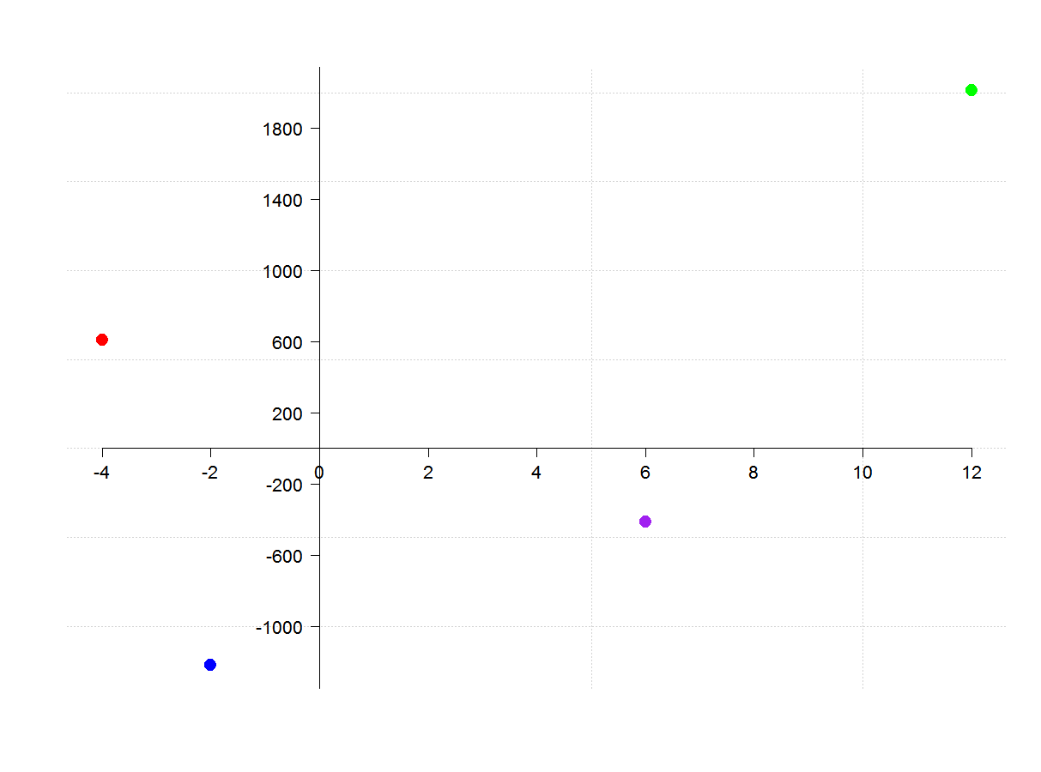
Costs, Effects and Cost-effectiveness
Differential cost per participant ($)
March for Math
Math 4 All
Face-to-face instruction
Difference in STAR gain
iCount
Summing Up

Slide 6
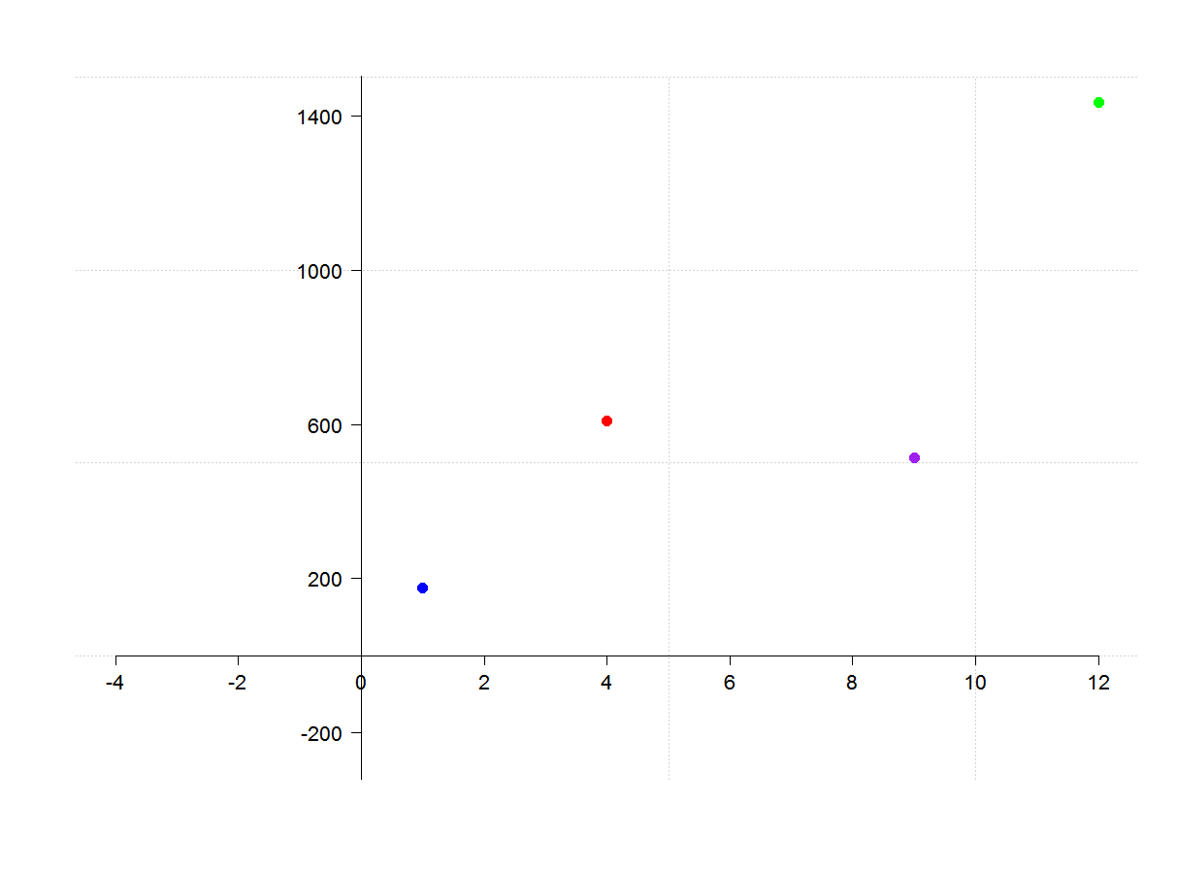
Costs, Effects and Cost-effectiveness
Differential cost per participant ($)
$120 per point increase
$152 per point increase
$56 per point increase
$175 per point increase
Difference in STAR gain
Face-to-face instruction

Slide 7
Cost-Benefit Analysis
Belfield, Nores, Barnett, and Schweinhart (2006): Perry PreSchool
Program costs per participant $15,000 (in 2000 dollars).
Benefits to participants: over $49,000 per person
Net benefits to the general public: over $180,000 per participant
Notes:
Results of this analysis have often been used to argue for wider implementation of preschool programs, particularly for at-risk children.

Slide 8

CostOut www.cbcsecosttoolkit.org

Slide 9
Costs of Literacy Ladders by Ingredient Categories
Average cost per participant: $13,612

Slide 10
Evaluation Constraints for Schools
Hard to generalize from one school context/student population to another
Few resources available for evaluation
Hard to establish baseline or comparison condition if all students are participating in a program

Slide 11
Limitations of Current Evaluation Methods
Take too long to inform decisions
Rarely the primary influence on a decision
The more rigorous the methodology, the more costly, infeasible and less generalizable it may be (e.g., RCTs)
Hard to accommodate multiple outcomes, e.g., reading and math scores

Slide 12
Introducing Cost-Utility Analysis (CUA) (1)
Similar to CEA and CBA, it is a type of return on investment (ROI) analysis that balances what is gained (both subjective and objective benefits) from a program or strategy against the resource demands (the costs)
Utility is the overall “usefulness” or “satisfaction” gained by stakeholders from a program or strategy
We use Multi-Criteria Decision-Making (MCDM) to determine utility or overall usefulness of each program/strategy being considered
Utility can consist of a variety of factors or multiple “evaluation criteria,” e.g.,
Gains in student learning
Teacher buy-in
Fit with education agency’s vision, mission, or strategic goals
Feasibility of implementation

Slide 13
Introducing Cost-Utility Analysis (2)
We will use Ingredients method (Levin & McEwan, 2001) to estimate costs of implementing them.
Costs/utility = “cost-utility ratio”
Cost per unit of satisfaction gained from each program
Can be used to rank the programs by overall usefulness

Slide 14
Advantages of cost-utility analysis
Unlike other ROI methods, CUA can take into account different types of outcome, both objective (e.g., gains in test scores) and subjective (e.g., satisfying parent preferences)
CUA can compare the overall benefits of programs/strategies that have the same or different goals (e.g., a reading program with a math program)
Utility (or “program success”) is defined by the education agency and by participants (e.g., district administrators, principals, students, parents)
Provides a systematic, collaborative, and transparent decision-making process

Slide 15
What kinds of decisions can CUA be applied to?
Which of several home schooling strategies should we use?
Is an existing program worth continuing to fund in our district?
Which elementary literacy programs are most appropriate for our students whose reading skills are below the 750 lexile level?
Should we scale up a promising program to a few grades at all our schools or to all grades at a few schools?
Which digital devices/tools should we provide for our students?
Should we have centralized or distributed data systems across our schools?

Slide 16
Step 1: Identify a decision to be made and potential solutions/options
Example
Decision to be made
What reading program should we use to help elementary school students improve reading comprehension?
Identify options/solutions:
Who will identify these options?
Are there any screening criteria to ensure a viable but manageable list?
Reading Program A
Reading Program B
Notes:
Note that the solution options may be found among programs/strategies already in use in some district schools.
FUSD’s decision problem:
Decision problem
Selecting 1-2 reading initiatives to pilot with African American (AA) students in K-2 during the Spring 2018 semester or summer school
Screening criteria proposed by Wendy
Program serves K-2 students
Data is available to indicate that program has been successful in improving reading for African American students.

Slide 17
Step 2: Agree stakeholders participating in decision
Note that you may or may not want stakeholders to help select the solution options

Slide 18
Step 2: Agree stakeholders participating in decision
Example
Division directors
Superintendent
Principals
Teachers
Parents
Students
Note that you may or may not want stakeholders to help select the solution options

Slide 19
Step 3: Engage stakeholders in developing a list of evaluation criteria for deciding among programs

Slide 20
Step 3: Engage stakeholders in developing a list of evaluation criteria for deciding among programs
Example
Evidence of effectiveness in improving reading comprehension
Feasibility of professional development requirements
Compatibility with existing curriculum
Buy-in from teachers who will implement program
Parent preferences

Slide 21
Step 4: Stakeholders attach importance weights to evaluation criteria
Example
Criterion | Importance score (out of 100)
Evidence of effectiveness in improving reading comprehension
Feasibility of professional development requirements
Compatibility with existing curriculum
Buy-in from teachers who will implement program
Parent preferences

Slide 22
Step 4: Stakeholders attach importance weights to evaluation criteria
Example
Criterion | Importance score | Adjusted Importance weight (sum = 1)
Evidence of effectiveness in improving reading comprehension | 90/100 | 0.26
Feasibility of professional development requirements | 70/100 | 0.20
Compatibility with existing curriculum | 50/100 | 0.15
Buy-in from teachers who will implement program | 75/100 | 0.22
Parent preferences | 60/100 | 0.17

Slide 23
Step 5: Evaluate each program to assess how well it meets your evaluation criteria
Example
Evidence of effectiveness in improving reading comprehension:
If any options are already used in your schools, check whether there are any data to show they have helped students; ask teachers/coaches for professional judgements
Search for existing research studies on each program
Conduct pilot study in a few schools with pre- and post- testing, and ideally a comparison group
Parent preferences
Provide parents info. about each option and survey their preferences, or conduct focus groups

Slide 24
Step 6: Estimate costs of implementing each program
Example
Determine all the resources or ingredients needed to implement each program
Personnel (include training and support needs)
Facilities and ongoing maintenance
Materials and equipment
Assess which of these resources are already available and which ones will represent new costs (or savings)
Start-up vs. running costs
“total cost of ownership”

Slide 25
Step 7: Use results of evaluation to calculate the overall utility of each program and compare with costs
Example
Program | Cost per student | Utility (min=0, max=10) | Cost-utility ratio
Program A | $2,300 | 6.9 | $333
Program B | $865 | 5.3 | $163
Program A costs much more than Program B ($2,300/student vs. $865/student)
Program A has a higher utility value (6.9 vs. 5.3)
The program with the lowest cost-utility ratio provides the greatest utility per dollar invested
Program A costs $333 per unit of utility
Program B costs $163 per unit of utility

Slide 26
Step 7: The results of a CUA can be used to rank the programs based on the CU ratio and to help inform a discussion
Example
Program | Cost per student | Utility (min=0, max=10) | Cost-utility ratio
Program B | $865 | 5.3 | $163
Program C | $1,200 | 6 | $200
Program D | $2,030 | 7.5 | $271
Program A | $2,300 | 6.9 | $333

Slide 27
Applying cost-Utility analysis (CUA) to the reading program selection decision: Criteria, weights, measures and utility values
Evaluation criteria | Adjusted weights | Measures |  | Program A |  | Program B
 |  | Evaluation Methods | Scale | Value on Measure | Utility value (min = 0, max = 10) | Value on Measure | Utility value (min = 0, max = 10)
Evidence of effectiveness in improving reading comprehension | 0.26 | Search for existing impact studies of each program, measured as the reduction in the % of students who perform below grade level in reading. | A reasonable range could be 0 – 50 percentage points | 25 | 5 | 15 | 3
Feasibility of professional development requirements | 0.20 | Ask vendors to provide information on how many hours of teacher training are required for each program. | 0-40 hours | 20 | 5 | 15 | 3.75
Compatibility with existing curriculum | 0.15 | Ask the reading specialist to rate the compatibility of each program with existing curriculum on a scale of 0-10. | 0-10 | 9 | 9 | 6 | 6
Buy-in from teachers who will implement program | 0.22 | Set up demonstrations of program materials and survey teacher representatives about enthusiasm for implementing each program using a scale of 0-10. | 0-10 | 8.5 | 8.5 | 5.8 | 5.8
Parent preferences | 0.17 | Distribute program materials and ask parent representatives to rate each program on a scale of 0-10. | 0-10 | 7.8 | 7.8 | 9.4 | 9.4
Total | 1 |  |  |  | 6.9 |  | 5.3

Slide 28
Introduction to Project: “A Cost-utility Framework to Facilitate Evidence-based Decision-making in Schools”
Purpose
To create a decision-making framework and online tool to facilitate the use of multiple forms of evidence by school, district, and state level decision-makers when making key programmatic and strategic decisions.
Products
A decision-making framework that facilitates evidence-based decision-making;
An online tool to facilitate use of the framework in practice.

Slide 29
The Teachers College Research Team (funded for this project by William T. Grant Foundation)
Principal Investigator | Fiona Hollands, Ph.D. fmh7@tc.columbia.edu Associate Director/Senior Researcher, CBCSE
Co-PI | Henry Levin, Ph.D. William Heard Kilpatrick Professor of Economics and Education; Director, CBCSE
Project Director | Yilin Pan, Ph.D. yp2266@tc.columbia.edu Post-doctoral Researcher, CBCSE
Measurement Expert | James Corter, Ph.D. Professor of Statistics and Education
Research Assistants | Maya Escueta, M.P.P. me17@tc.columbia.edu Atsuko Muroga, M.A. am3994@tc.columbia.edu
Program coordinator | Aasiya Kazi, M.A.

Slide 30
The framework and online tool will be developed in collaboration with 7 educational institutions
Teachers College, Columbia University
State Department of Education
Charter School
NJ
School district,
CA
School District, TX
School District, NC
District School
NY
Charter School,
IN

Slide 31
SPA participants’ experiences applying cost-utility framework to school decisions
Facilitator: Maya Escueta
Panelists
Jason Koch
NYC Lab School for Collaborative Studies, NY, NY
Kate Starke
North Star Academy Washington Park High School, Newark, NJ
Daniel Velasco
21st Century Charter School, Gary, IN

Slide 32
Exercises
Agree decision-problem and 2-3 options
Report out
As a group, come to consensus on
stakeholders
decision criteria
importance weight for each criterion
ways to measure how each of your options fulfils each criterion
Fill out Qualtrics Survey

Slide 33

Questions and comments?
Fiona Hollandsfmh7@tc.columbia.edu
Yilin Pan: yp2266@tc.columbia.edu
Maya Escueta: mme17@tc.columbia.edu

