Slide 1
BITS Pilani Presentation
JEEVARAAM K-2020H1400216H
RISHI SUDHIR PHAYE-2020H1400230H
SIDDHARTH SUKRTUH-2020H1400236H
M.E Embedded System

Slide 2
POTENTIAL FISHING AREA RECOGNITION AND GUIDANCE SYSTEM

Slide 3
Contents
CAUSE FOR THIS PROJECT
INTRODUCTION
WHAT IS POTENTIAL FISHING AREA
SHORE SYSTEM
MOBILE SYSTEM
FLOW CHARTS
UML
DESCRIPTION
CONCLUSION

Slide 4
Cause For This Project
For Low and Medium scale fishermen, the fishing sites are selected based on historical knowledge and knowledge that is passed on through generations.
This might not return a better results in the current competitive fishing routines
To help the fishermen in such scenario, a guidance system that can guide them to potential fishing zones can increase the overall fishing output thus helping fishermen in terms of revenue and also increases the overall fishing output as a nation.

Slide 5
Introduction
In Today’s Scenario, the location of potential availability of fish remains as a system without hands.
The location is present as data in the website or server and on the Coasts as a display on LCD Screen.
This project aims to acquire this data for the use of even small-scale fishermen and guide them to reach the potential fishing spots near their location.
This system makes it possible for the fishermen to reach these potential spots with ease.
This system will be in continuous contact with the fishermen and will be with them all the time.

Slide 6
What Is Potential Fishing Area ?
The potential fishing area is a surrounding in which the availability of the fishes is abundant.
These areas are recognized by thermal imaging from by the satellites and been recorded.
The Potential Fishing Zones are divided into 14 coastal regions throughout the country.
This data is provided by the Indian Government via INCOIS (Indian National Centre for Ocean Information Service).
This data is regularly refreshed on every Monday, Wednesday and Friday.

Slide 7
Shore System
The data from INCOIS is acquired as latitude and longitude information and stored in a SD-Card.
This data stored SD-Card is used in the Shore System of the setup.
Moreover the data has to be changed periodically for every 48 hours.
While the user registers himself for the first time in the Shore System, his contact number is also received and stored.
Whenever the INCOIS data is refreshed and the Shore System completes updating the same, an intimation will be sent to the registered contact numbers so that the Potential Fishing Zones are not out-dated.
The International Border Co-ordinates are stored in such a way that these data cannot be tampered with.

Slide 8
Mobile System
The Mobile System consists of GPS Receiver, Central Controller, LCD Display and SD Card Reader.
The Central Controller consists of Arduino unit and Four Input buttons. The Mobile System first checks for the stored Location Data in the SD Card.
If data is found, the location will be displayed to the user from which the user can select his preferred destination region.
Then, the system starts to receive the present location data from the attached GPS Module.

Slide 9
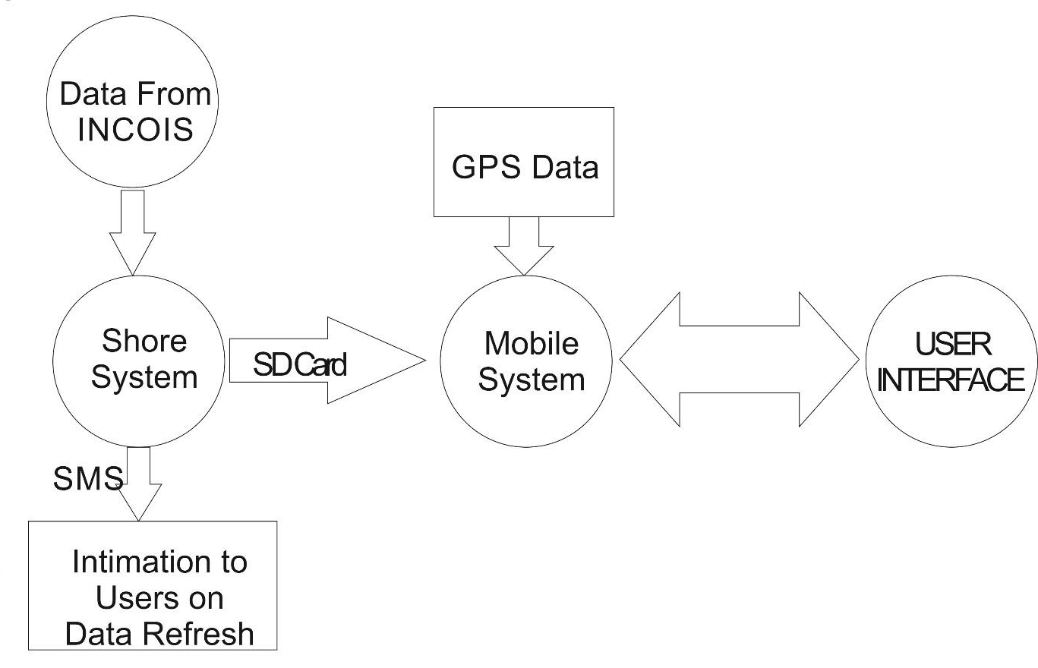
Flow Chart: Complete Overview
A COMPLETE OVERVIEW

Slide 10
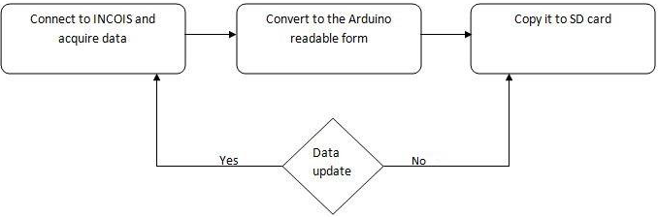
Flow Chart: Shore System – Flow of Process

Slide 11
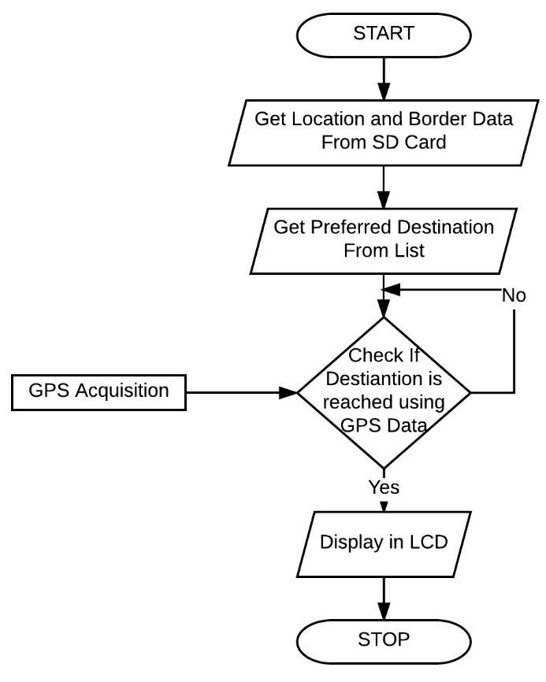
Flow chart: Mobile system – Flow of Process

Slide 12
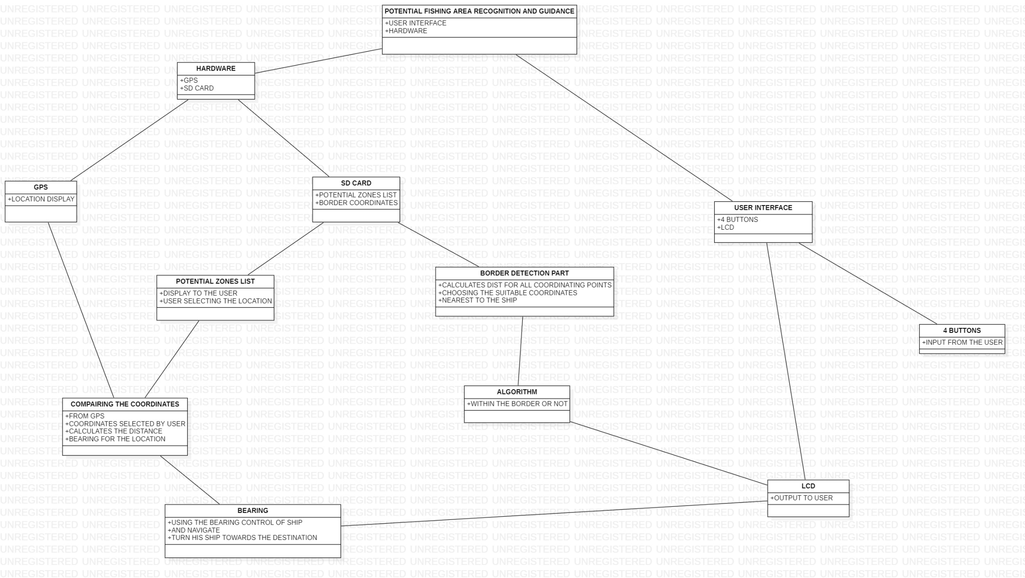
UML

Slide 13
Description
The Controller compares the present location with the user defined location and indicates its absolute bearing and distance to location.
If the location is reached, a signal indicating the same is displayed.
Caution is taken to see that international water boundaries are not crossed by referencing the co-ordinates present on the SD card and the Internationally agreed boundaries.
The Mobile System also logs the present GPS Data to the attached SD Card every five minutes

Slide 14
Conclusion
This Project not only aims to make the Potential Fishing Zone more realistically available to fishermen but also to make the data available to lower-class fishermen too.
The cost would be very minimal when compared to conventional one which makes this system a more-efficient one.
The Tertiary merits of this system include that the ratio between energy used and income from fishing could increase as this system guides the fishermen directly to a more reliable area than the fishermen using their long-acquired instinctual knowledge.

Slide 15
THANK YOU

