Slide 1
Project Based Learning –V (AIP102)
Team Details: Amrit Kaur(2310993773)
Prachi(2310993902)
Akansha(2310993769)
Topic:- DOCATHOME :AIDoctorChatbot
Faculty Coordinator: Dr.Harshvardhan
:
Chitkara University Institute of Engineering and Technology,
Chitkara University, Punjab

Slide 2
Table of Contents
Introduction
Problem Statement
Methodology
Objectives
Progress
Dataset
Conclusion
References/Links used

Slide 3
Introduction
The AI Medical Imaging Assistant is an intelligent Streamlit-based healthcare chatbot that assists doctors and radiologists in analyzing medical cases and reports. It uses Agentic AI principles and Hugging Face NLP models to simulate professional doctor-patient interactions. The system allows report uploads (PDF, DOCX, TXT) and interactive case discussions through chat. It provides context-aware, offline or online AI responses, making it reliable in all environments. Built with a modular design, it ensures scalability, flexibility, and easy integration into medical workflows.

Slide 4
Problem Statement
Access to timely and reliable medical guidance is still limited, especially in remote or underserved regions. Existing rule-based bots and symptom checkers often fail to understand context or complex medical terminology. Additionally, managing and retrieving large volumes of medical data efficiently remains challenging.There is a need for an AI-powered assistant capable of providing real-time, accurate, and personalized health support, while ensuring security, scalability, and ease of deployment through modern AI technologies

Slide 5
Methodology
Data Acquisition & Preprocessing
  Medical datasets and sample reports collected for training and testing.
  Text data cleaned, tokenized, and converted into embeddings for efficient retrieval.
AI Model Integration
  Used Hugging Face Transformers for text understanding and generation.
  Integrated Gemini / Hugging Face models for report-based Q&A and chat responses.
Backend Development
  Python-based backend manages report analysis, chat sessions, and data storage.
  JSON and local file storage ensure quick retrieval and persistence.
Frontend Interface
  Built using Streamlit for an interactive and user-friendly experience.
  Features include Report Upload, AI Chat, and Case Discussion modules.
Testing & Evaluation
  Validated chatbot responses for medical relevance and clarity.
  Ensured offline fallback and error handling for robust performance.

Slide 6
Methodology
Data Handling: Collected diverse medical case reports and text data for training and testing.
Model Integration: Used Hugging Face transformers (DistilGPT2 / Phi-2 / BioGPT) for generating medical responses.
Backend Development: Implemented chat logic, report parsing, and room-based discussion using Python and JSON storage.
Frontend Interface: Built an interactive UI using Streamlit with image upload, chat, and report Q&A features.
Testing & Optimization: Ensured accurate, context-aware responses, offline fallback mode, and smooth execution.

Slide 7
Objectives
Develop an Intelligent AI Chatbot
Create an AI-powered medical assistant that can simulate real doctor-patient conversations, providing basic medical guidance and symptom analysis.
Utilize NLP for Medical Understanding
Implement Natural Language Processing (NLP) techniques to accurately interpret user queries, extract symptoms, and provide context-aware responses.
Design an Interactive User Interface
Build an intuitive and user-friendly interface that enables patients to easily communicate with the chatbot using natural language input.
Assist in Preliminary Diagnosis
Help users identify potential health conditions, assess symptom severity, and suggest whether professional consultation is necessary.
Enhance Accessibility and Affordability
Deliver a cost-effective healthcare solution accessible even in remote or underserved regions, reducing the dependency on immediate hospital visits.

Slide 8
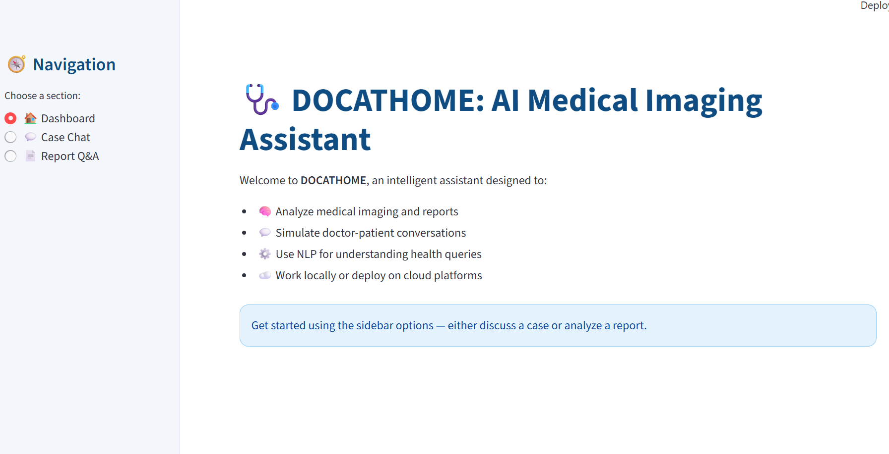
Progress

Slide 9
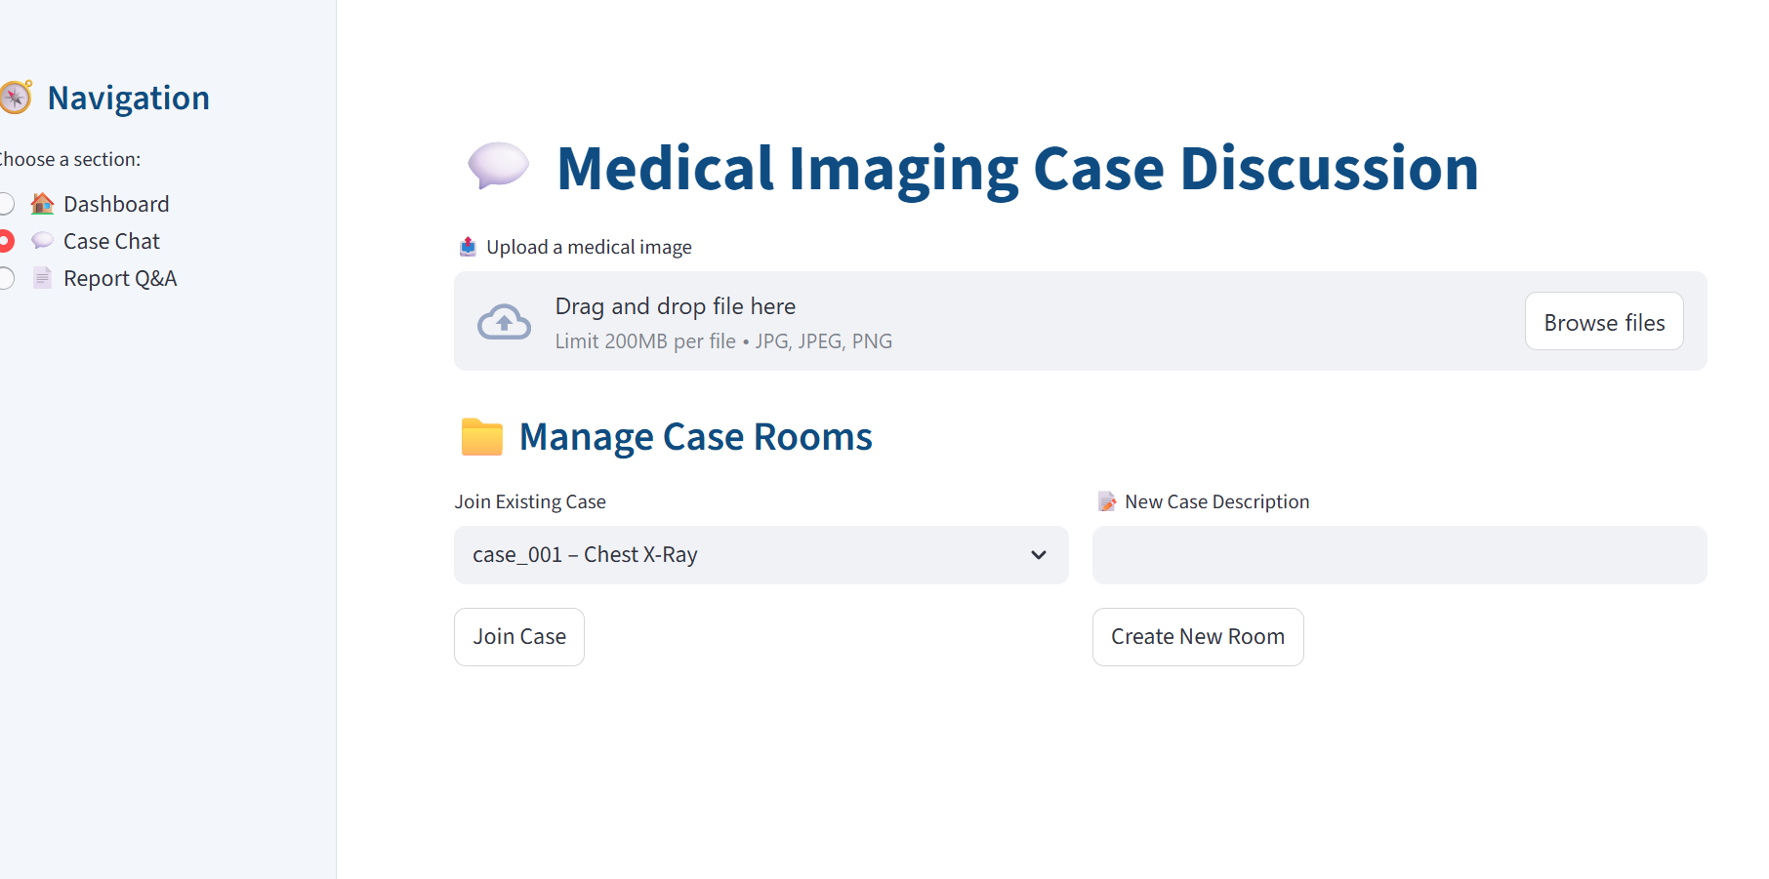
Progress

Slide 10
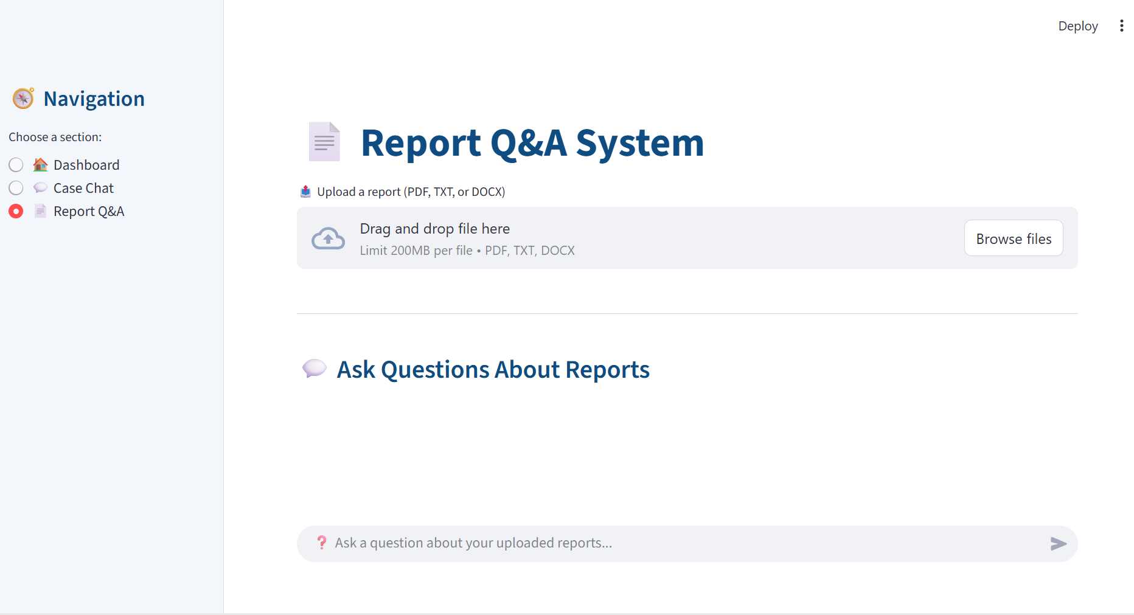
Progress

Slide 11
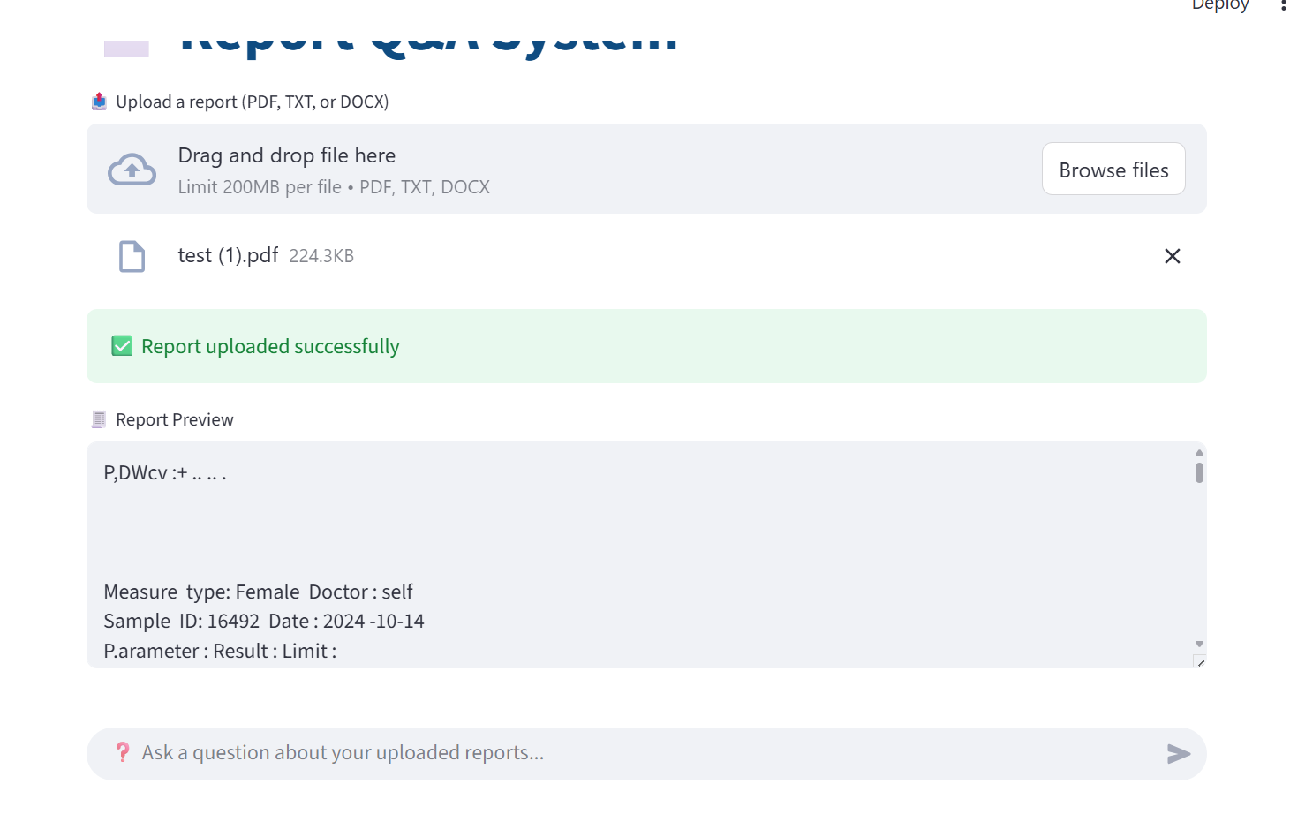

Slide 12
Conclusion
The DOCATHOME: AI Doctor Chatbot project showcases how artificial intelligence can enhance healthcare accessibility by providing an intelligent, conversational platform for preliminary medical assistance. Using natural language processing and machine learning, the chatbot can understand user symptoms, offer basic health advice, and suggest whether professional consultation is needed. It serves as a convenient, time-efficient, and affordable solution, especially for remote areas where healthcare access is limited. Although it cannot replace real doctors, DOCATHOME acts as a supportive tool for early symptom assessment, health awareness, and preventive care, paving the way for smarter and more accessible digital healthcare solutions.

Slide 13
References/Links used
OpenAI API Documentation https://platform.openai.com/docs/
Pinecone Vector Database https://www.pinecone.io/docs/overview/
Langchain Documentation (Optional, if used) https://docs.langchain.com/
Docker & Flask Deployment Guide https://docs.docker.com/get-started/overview/ https://flask.palletsprojects.com/en/3.0.x/

Slide 14


