Slide 1


◘ ECOMMERCE SALES ANALYSIS
Submitted towards the partial fulfillment of the criteria for award
Of
Post Graduation Analytics
Batch 32
AMRIT KUMAR

Slide 2
ABSTRACT
This dataset comprises a rich collection of e-commerce sales data,
encompassing various aspects of customer information, product
details, and order statistics. The dataset represents a comprehensive
snapshot of e-commerce operations, offering valuable insights for
businesses seeking to optimize their online sales strategies

Slide 3
Acknowledgements
I am using this opportunity to express my gratitude to everyone who supported us throughout the course of this project. I thankful for their aspiring guidance,invaluably constructive criticism and friendly advice during the project work. I am sincerely grateful to them for sharing their truthful and illuminating views on a number of issues related to the project.
Further, I am fortunate to have Vikas Atray as our mentor. He has readily shared his immense knowledge in data analytics and guide us in a manner that the outcome resulted in enhancing our data skills. I wish to thank, all the faculties, as this project utilized knowledge gained from every course that formed the PGA program.
We certify that the work done by us for conceptualizing and completing this project is original and authentic.
Date: October 04th 2023
Amrit Kumar
Place: New Delhi

Slide 4
Certificate of Completion
I hereby certify that the project titled “E-commerce Sales Analysis”
was undertaken and completed under my supervision by Amrit Kumar from
the Batch of PGA 32.
Mentor:- Vikas Atray
Date:- October 04th 2023
Place:- New Delhi

Slide 5
WHAT ARE WE GOING TO PRESENT?
Introduction of Tableau
Connecting to Data
Visual Analytics
Dashboard and Stories
Calculation
Mapping, Tableau Online & Competitors

Slide 6
1
Introduction of Tableau
Let’s Start with the first Concept!

Slide 7
WHAT IS TABLEAU?
We have to answer Two important questions:
WHAT IS DATA VISUALIZATION? WHY IS DATA VISUALIZATION IMPORTANT?

Slide 8
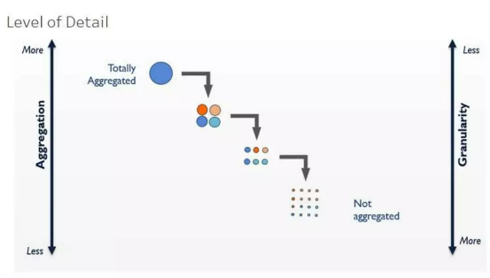
WHAT IS DATA VISUALIZATION?
Data visualization is the process of describing Information through
visual rendering.
LOD EXPRESSION
Level of Detail expressions introduce the capability to
Specify the exact level of aggregation within a calculation Itself.

Slide 9
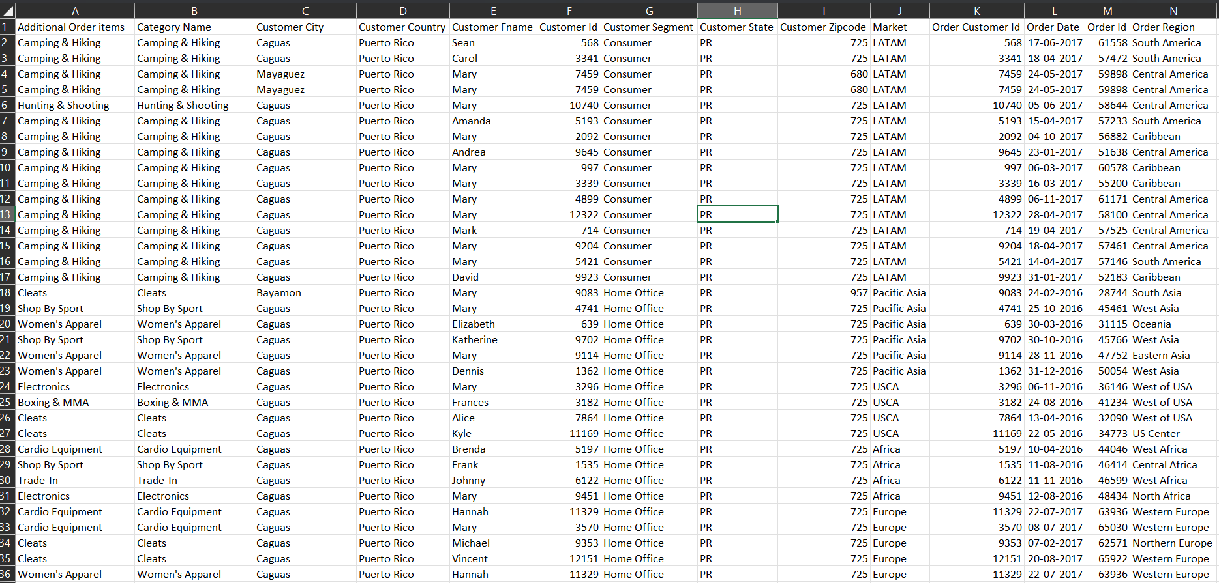
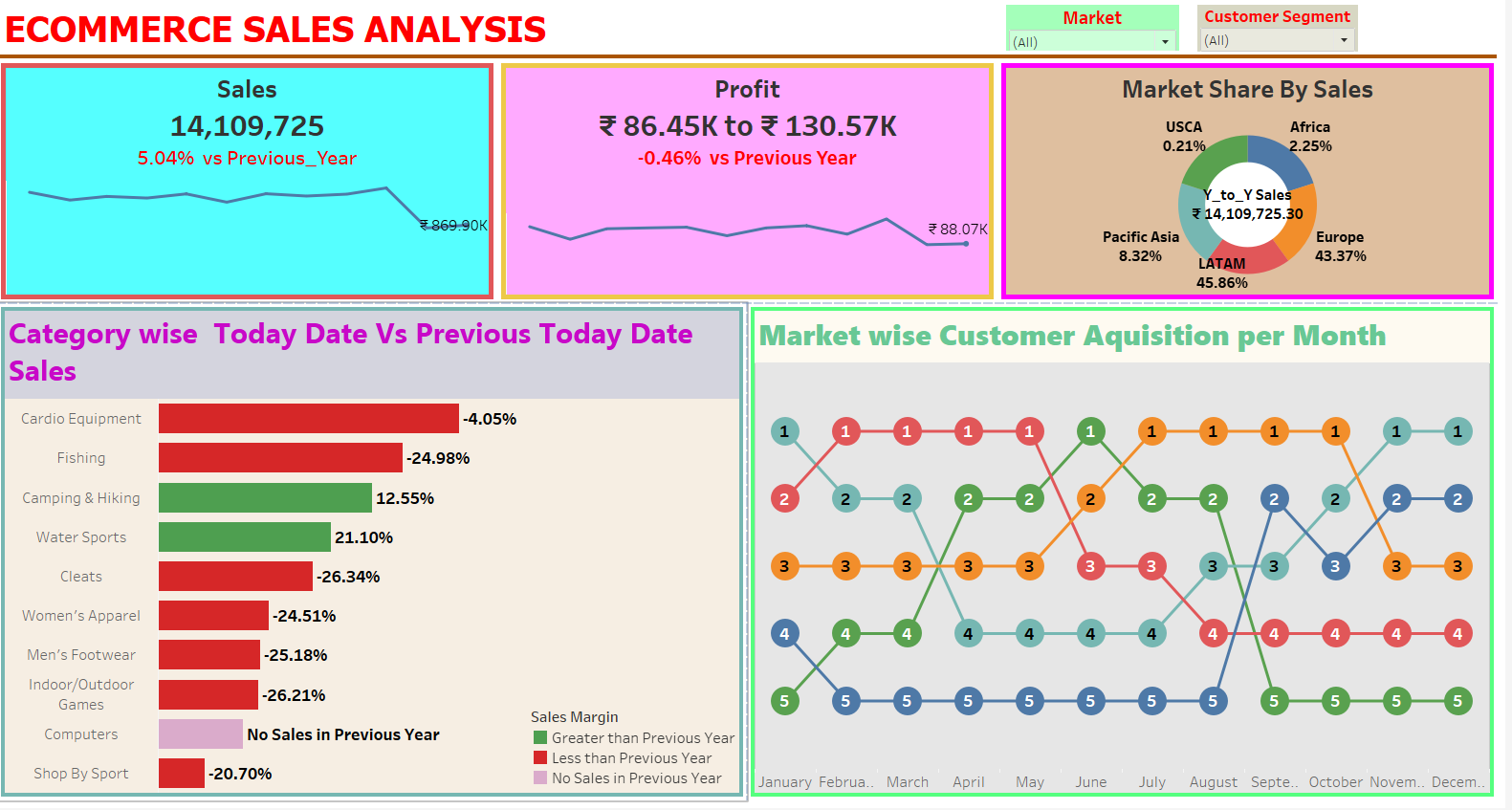
WHAT IS DATA VISUALIZATION?

Slide 10
WHAT IS DATA VISUALIZATION IMPORTANT?
Technological advances have made data visualization more prevalent and powerful than ever before.
Business’s purpose.

Slide 11
WHAT IS TABLEAU?
Tableau is groundbreaking data visualization software created by
Tableau Software.
Tableau connects easily to nearly any data source.
Tableau allows for instantaneous insight by transforming data
into interactive visualization called dashboards.

Slide 12
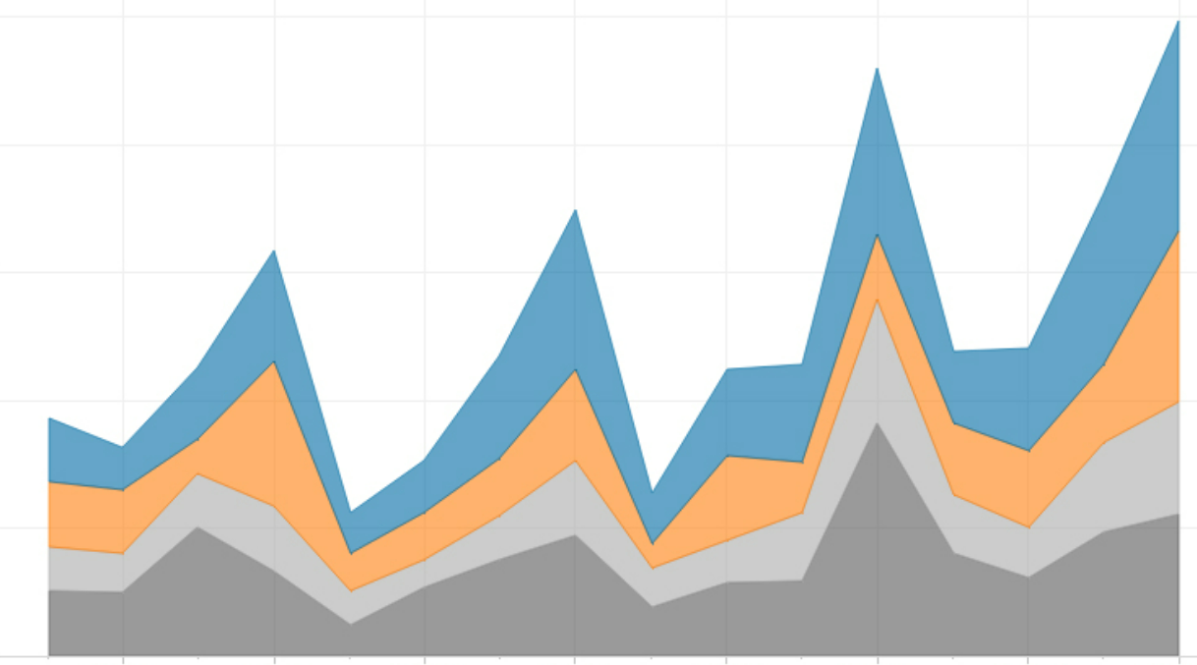


Slide 13




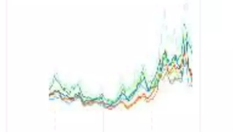

TABLEAU FEATURES
SPEED TO MARKET TABLEAU IS EASY TO USE TABLEAU DOES BIG DATA
TABLEAU DOES ANY DATA STUNNING & INTERACTIVE PLOTS TABLEAU IS AN INDUSTRY LEADER

Slide 14
2
Connecting to Data
Let’s connect Tableau to the Data!

Slide 15
CONNECTING TO DATA
EXCEL DATABASE CLOUD

Slide 16
ADDING ANOTHER DATA SOURCE
A workbook can have multiple data source. We can
Connect to a locally saved extract or to a data source
Which is published to Tableau Online or Tableau Server.
LIVE Vs EXTRACT

Slide 17




DATA PREPARATION WITH TEXT & EXCEL FILES
DATA INTERPRETER PIVOT
METADATA GRID SPLIT

Slide 18
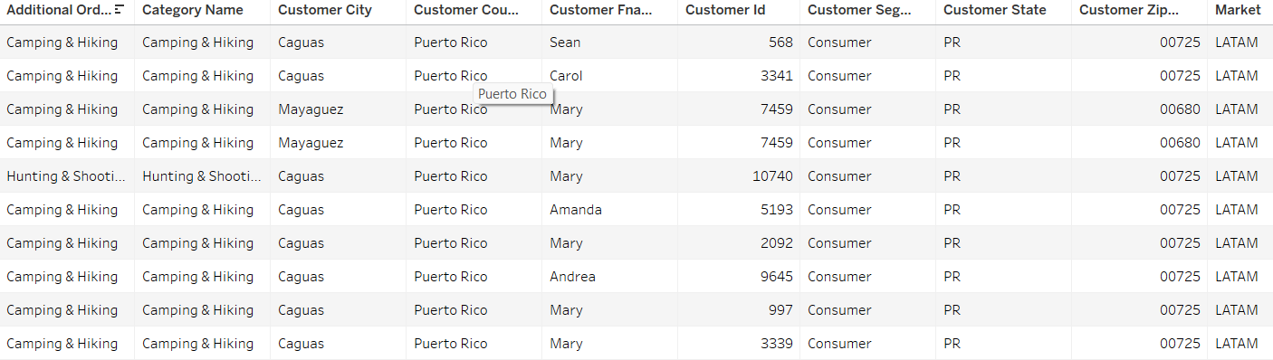
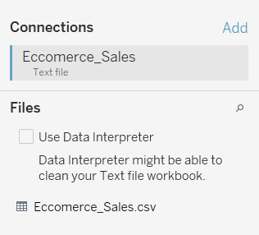
USING DATA INTERPRETER

Slide 19
SAVING & PUBLISHING DATA SOURCES
Saving a data source makes it
Easily
Available in your copy of
Tableau Desktop……
….Or it can be published to Tableau Online or
Tableau Server.
Saving data source as a .tds this is not the data itself!

Slide 20
A NOTE ON FILE TYPES
Workbook(.twb): Workbooks hold worksheets, dashboards and stories.
Bookmark(.tbm): Bookmarks contains a single sheet.
Packaged workbook(.twbx): Archive containing a workbook along with all data sources and files.
Data Extract(.tde): Local copy of a subset or entire data source to share and improve the performance.
Data source(.tds): Shortcut to oftenly used data sources, containing information and modifications.
Packaged data source(.tdsx): Archive containing a data source file along with any related files.

Slide 21
3
Visual Analytics
Let’s give some meaning to that data!

Slide 22
WHAT IS VISUAL ANALTICS?
Is a field in information visualization that focuses on
analytical reasoning facilitated and supported
by interactive visual interfaces.
Powerful to select & aggregate the data to consider.
Hierarchies
Groups
Sets
Filters

Slide 23
4
WorkSheets
Let’s make it visual!

Slide 24
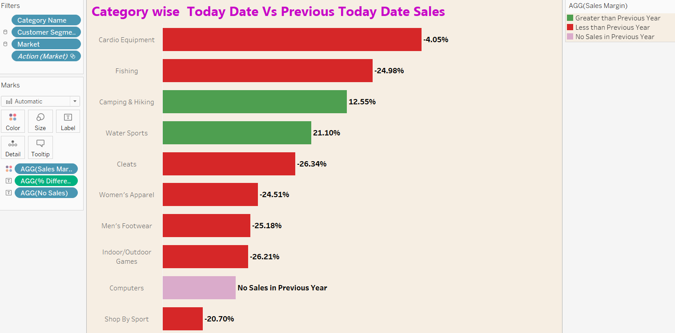
HOW DOES IT LOOK LIKE?

Slide 25
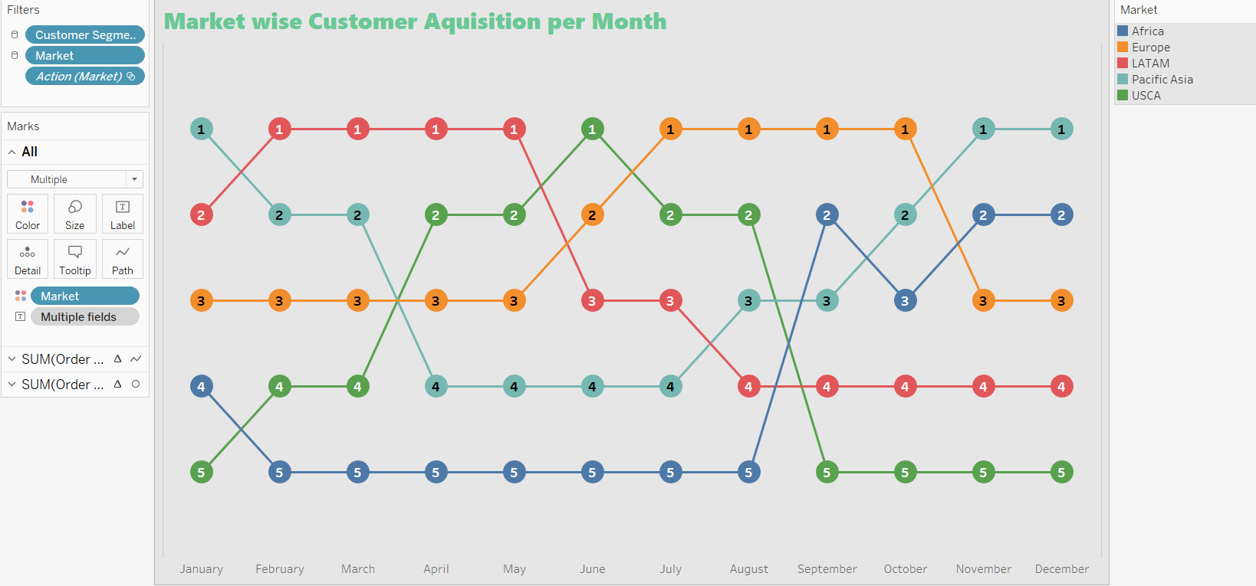
HOW DOES IT LOOK LIKE?

Slide 26
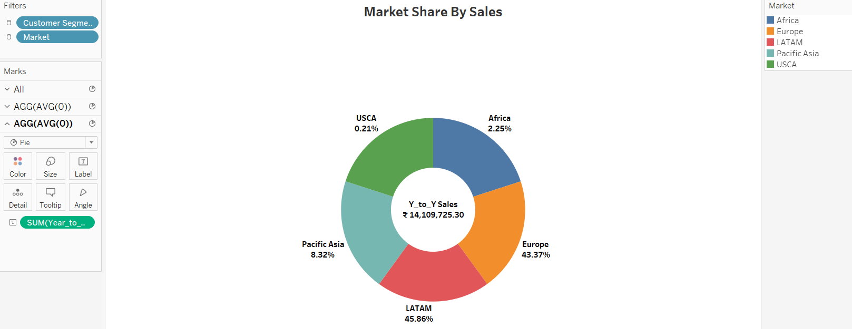
HOW DOES IT LOOK LIKE?

Slide 27
5
Dashboard & Story
Let’s make it visual!

Slide 28
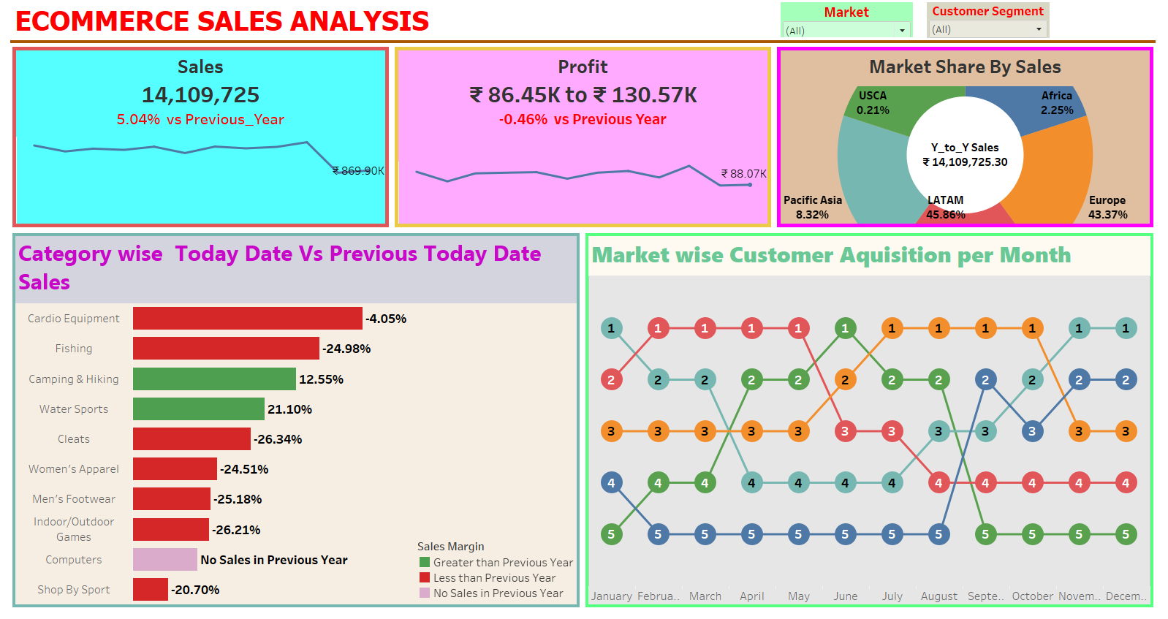
DASHBOARD

Slide 29
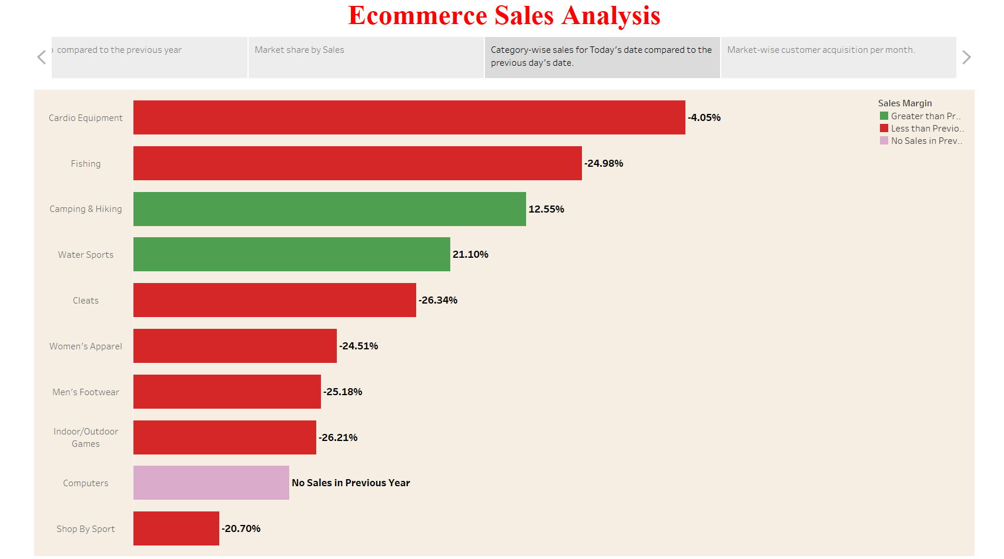
STORY

Slide 30
6
Conclusion & Recommendations

Slide 31
Conclusion
Shows ecommerce sales analytics for different categories and markets. The
overall conclusion is that the market is growing, with sales increasing by 5.04%
year-on-year. However, there is some variation in growth across categories and
markets.
The camping and Hiking category saw the highest increase of 12.55%. This is
probably due to the increasing popularity of outdoor activities and the
increasing demand for camping and Hiking gear. The water sports category
also saw a strong growth of 21.10%. This is likely due to the combination of
warmer weather and the increasing popularity of water sports such as
kayaking, surfing and paddleboarding.

Slide 32
On the other hand, some categories saw a decline in sales. The women’s
apparel category saw a decline of 24.51%, and the men's footwear
category saw a decline of 25.18%. This may be due to a number of factors,
such as changes in fashion trends, increased competition from other
retailers, or economic factors.
In terms of markets, the Pacific Asia market saw the highest growth of
8.32%. This is likely due to the growing middle class and increased adoption
of e-commerce in countries like China and India. The European market also
saw a strong growth of 43.37%. This is likely due to the continued recovery
of the European economy and the growing popularity of e-commerce in
countries such as Germany and the United Kingdom.
Overall, ecommerce sales analysis shows that the market is growing and
there are opportunities for businesses in different categories and markets.
However, businesses need to be aware of the different growth rates in
different categories and markets, and they need to adapt their strategies
accordingly.

Slide 33
Recommendations
Businesses in the camping & hiking and water sports categories should focus on
expanding their product offerings and marketing their products to consumers
interested in these activities.
Businesses in the women's apparel and men's footwear categories need to
identify the reasons for declining sales and take steps to address them. This may
include changing their product offering, pricing strategies or marketing
campaigns.
Businesses in the markets of Pacific Asia and Europe should focus on expanding
their reach and increasing brand awareness in these markets. This may include
investing in marketing and advertising campaigns, partnering with local retailers,
or opening physical stores in these markets.

Slide 34
THANK YOU !

