Slide 1

Paytm Epurchase Data Analysis Assessment
Using By MySQL Workbench & Microsoft Excel
Presentation By:
AMRIT KUMAR

Slide 2
Introduction
Paytm is a leading Indian digital payments and financial services platform. It offers a wide range of services, including mobile recharges, bill payments, online shopping, travel bookings, movie tickets, and financial services like bank transfers and investments.
A comprehensive data analysis of Paytm transactions can provide valuable insights into consumer behavior, spending patterns, and market trends. This information can be used by various stakeholders for different purposes.

Slide 3
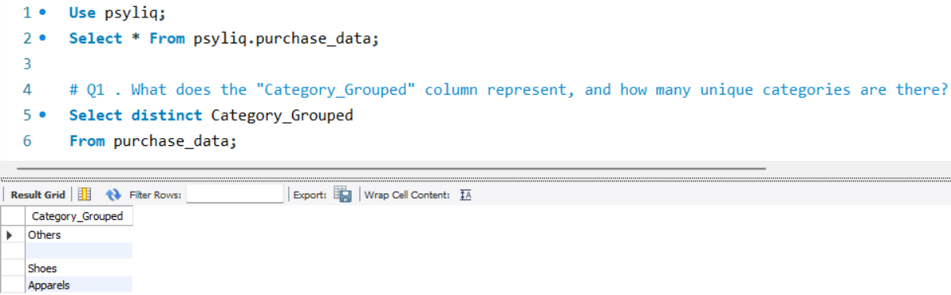
1. What does the "Category_Grouped" column represent, and how many unique categories are there?

Slide 4
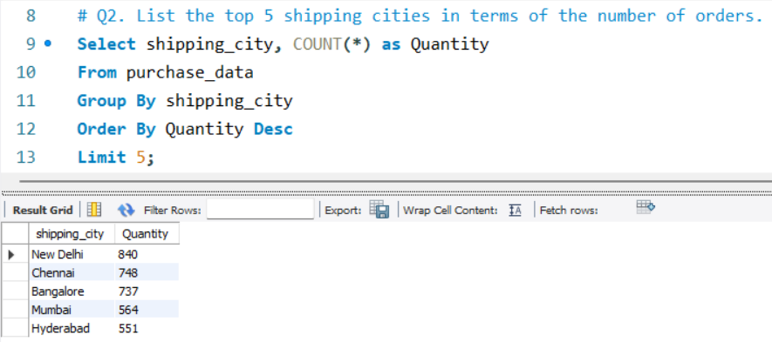
2. List the top 5 shipping cities in terms of the number of orders.

Slide 5
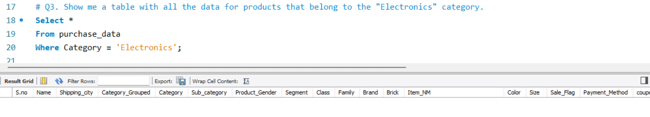
3. Show me a table with all the data for products that belong to the "Electronics“ category.

Slide 6
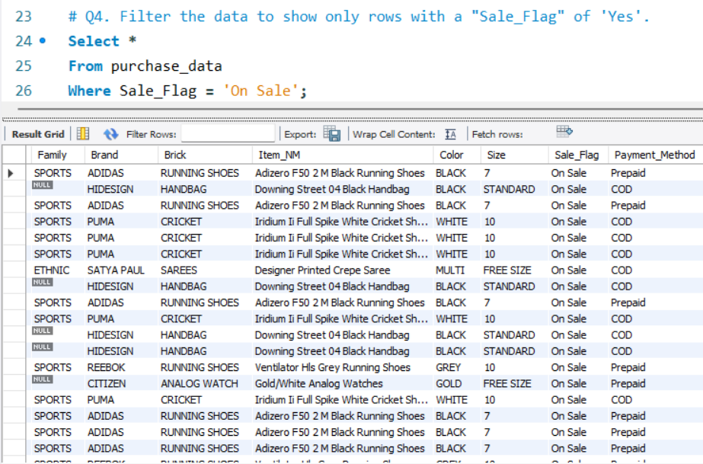
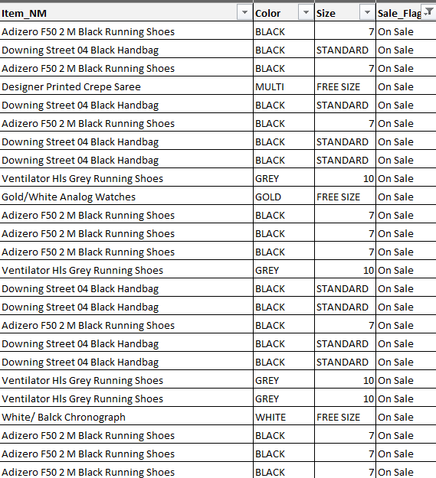
4. Filter the data to show only rows with a "Sale_Flag" of 'Yes'.
Using By Microsoft Excel
Using By MySQL

Slide 7
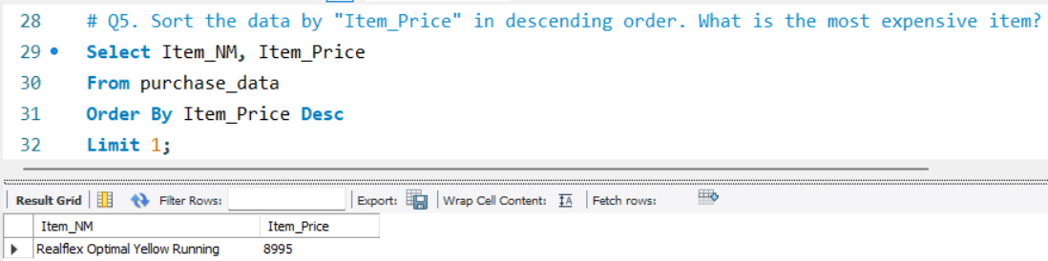
5. Sort the data by "Item_Price" in descending order. What is the most expensive item?

Slide 8
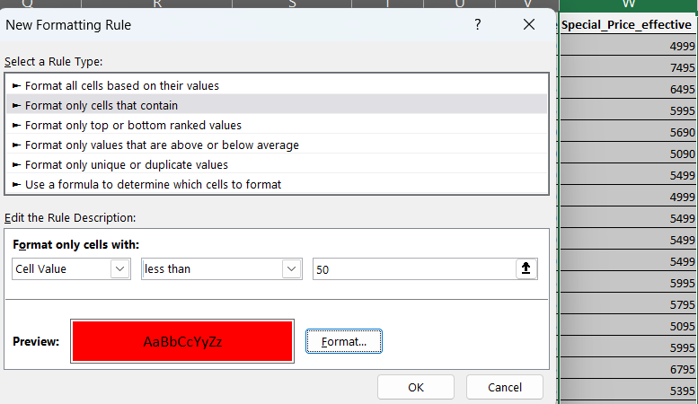
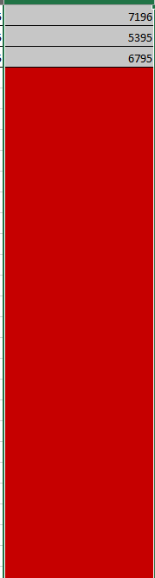
6. Apply conditional formatting to highlight all products with a
"Special_Price_effective" value below $50 in red.
There are no products with a Special Effective price below 50$.

Slide 9
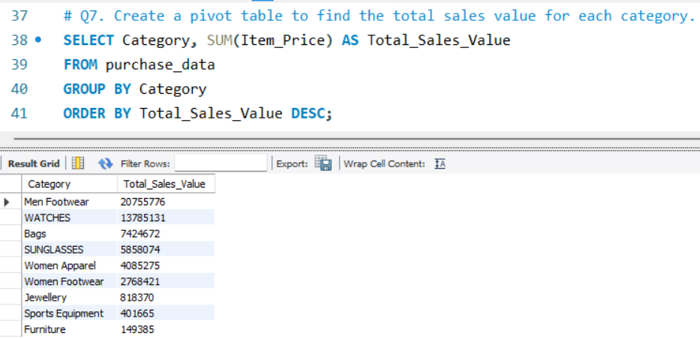
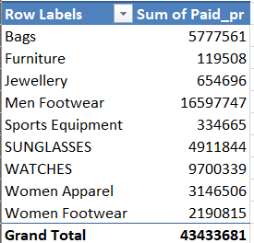
7. Create a pivot table to find the total sales value for each category.
Using By MySQL
Using By Microsoft Excel

Slide 10
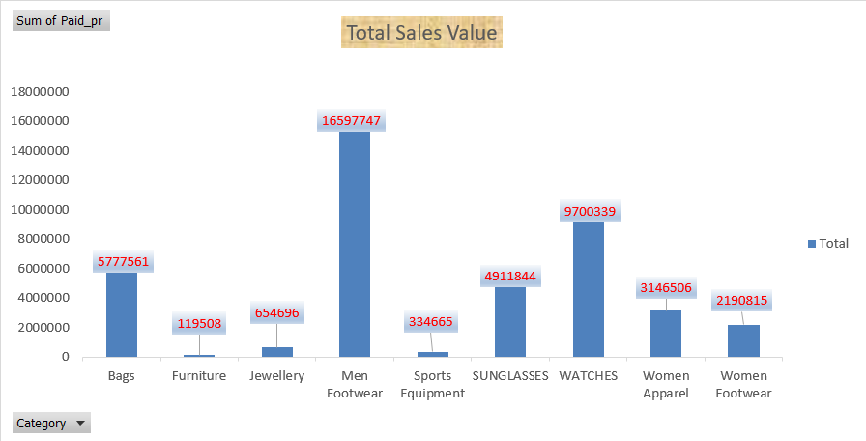
8. Create a bar chart to visualize the total sales for each category.

Slide 11
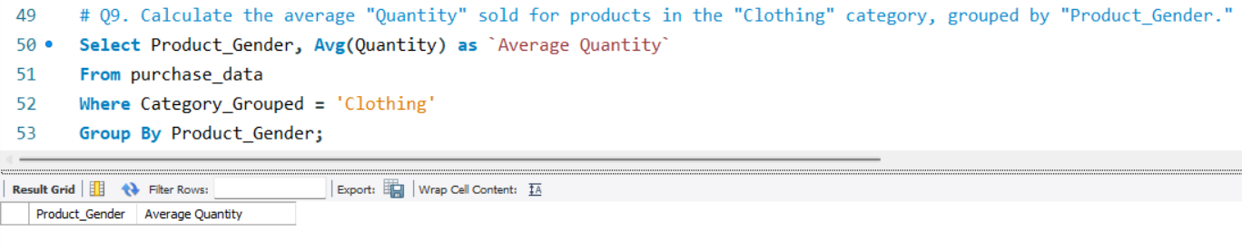
9. Calculate the average "Quantity" sold for products in the "Clothing" category, grouped by "Product_Gender."

Slide 12
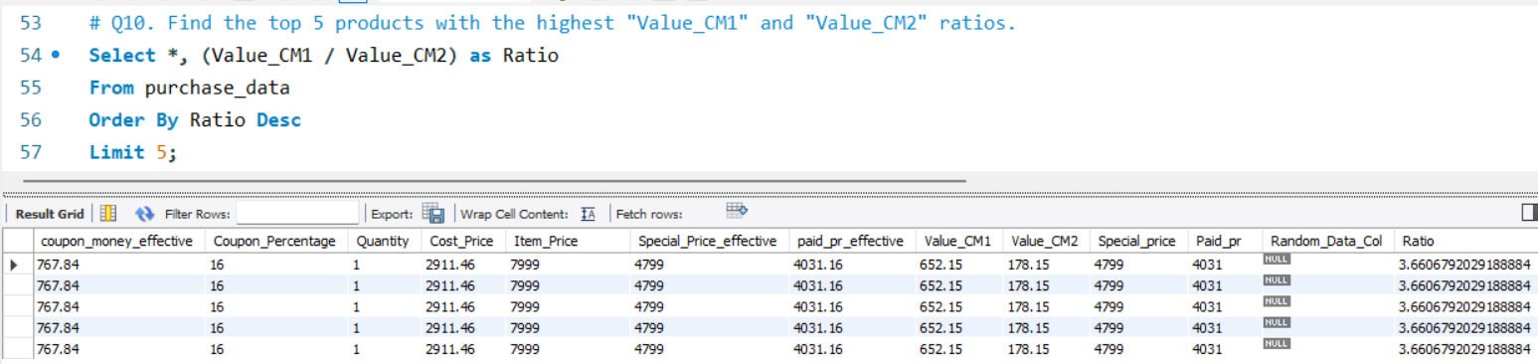
10. Find the top 5 products with the highest "Value_CM1" and "Value_CM2" ratios. Create a chart to visualize this data.

Slide 13
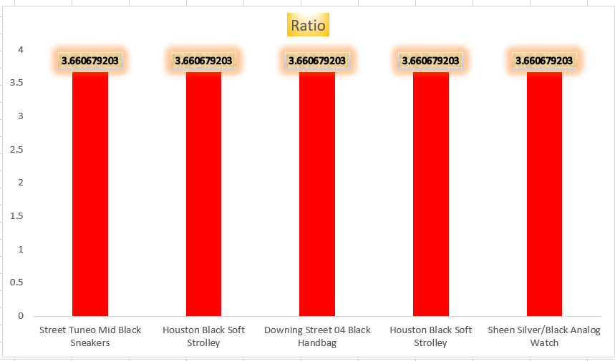

Slide 14
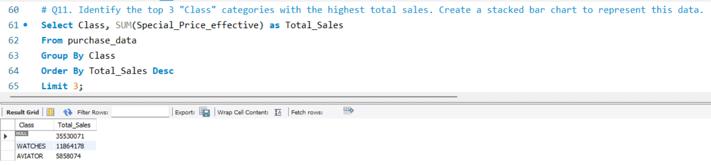
11. Identify the top 3 "Class" categories with the highest total sales. Create a stacked bar chart to represent this data.
Using By MySQL

Slide 15
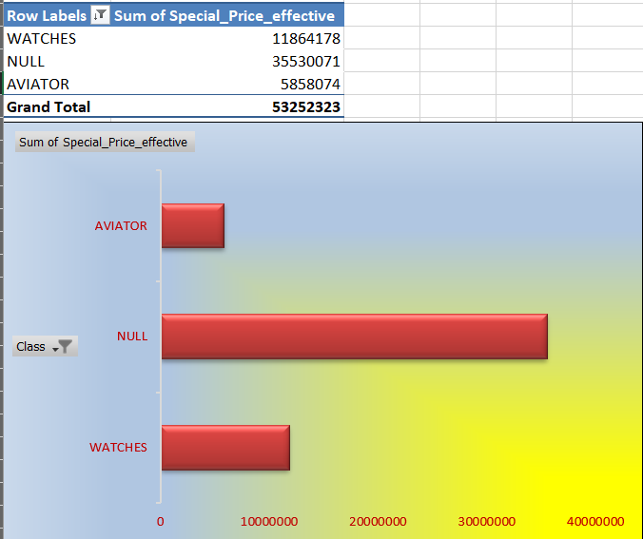
Using By Microsoft Excel

Slide 16
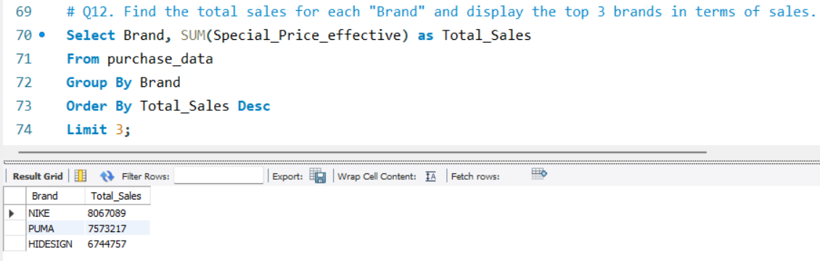
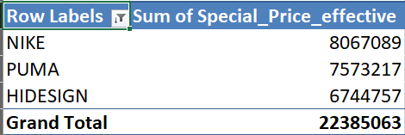
12. Find the total sales for each "Brand" and display the top 3 brands in terms of sales.
Using By MySQL
Using By Microsoft Excel

Slide 17
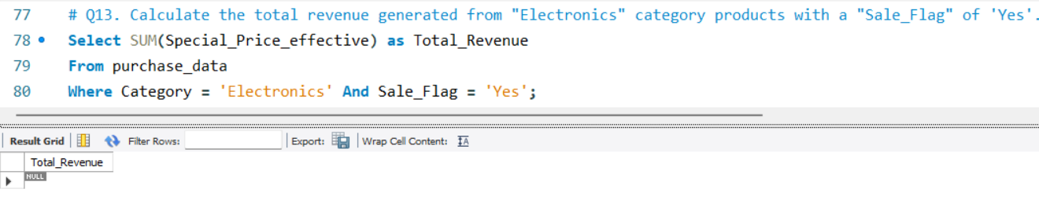
13. Calculate the total revenue generated from "Electronics" category products with a "Sale_Flag" of 'Yes'.

Slide 18
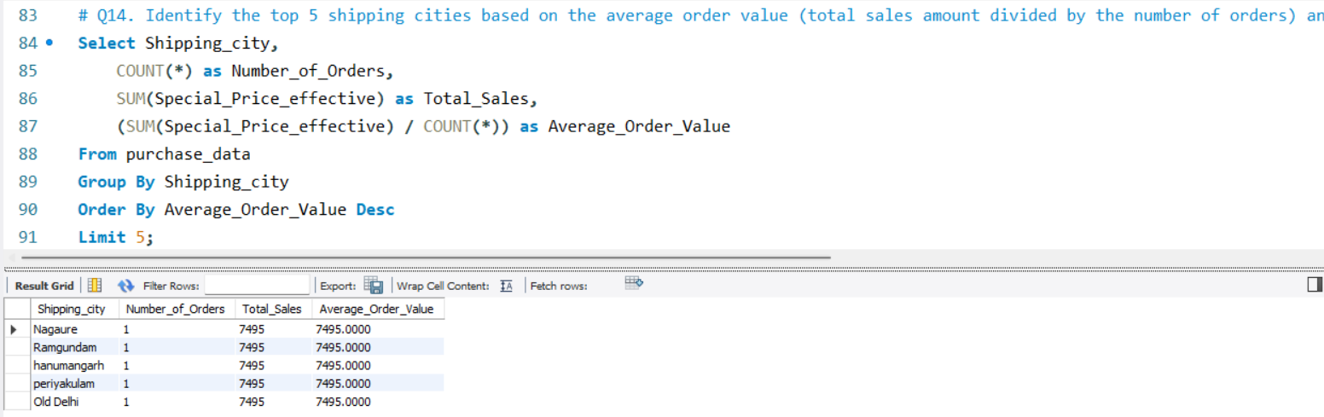
14. Identify the top 5 shipping cities based on the average order value (total sales amount divided by the number of orders) and display their average order values.

Slide 19
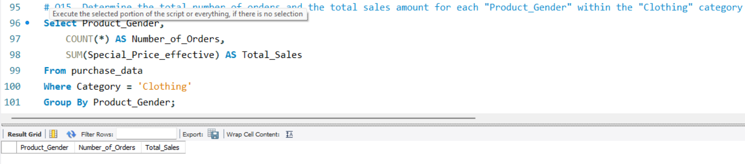
15. Determine the total number of orders and the total sales amount for each "Product_Gender" within the "Clothing" category.

Slide 20
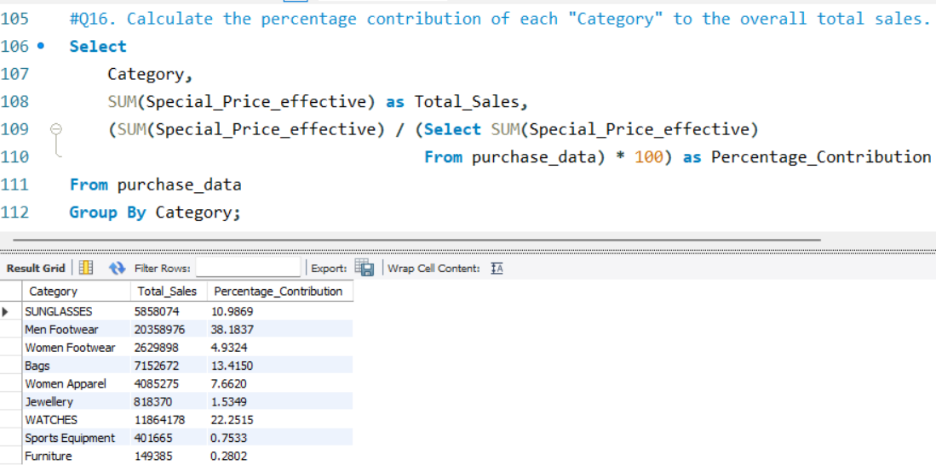
16. Calculate the percentage contribution of each "Category" to the overall total sales.

Slide 21
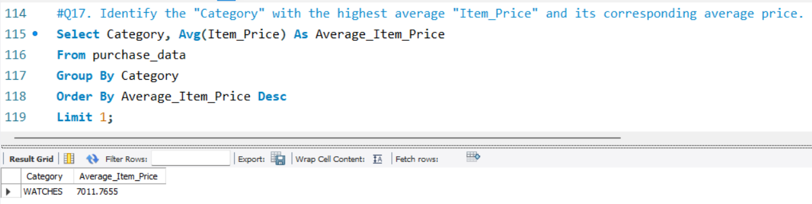
17. Identify the "Category" with the highest average "Item_Price" and its corresponding average price.

Slide 22
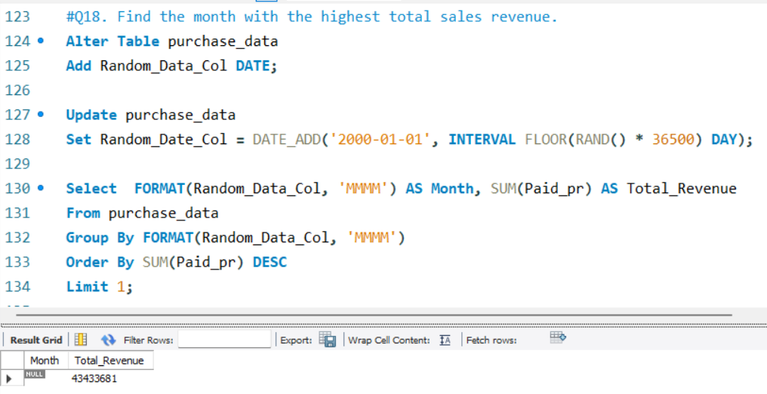
18. Find the month with the highest total sales revenue.

Slide 23
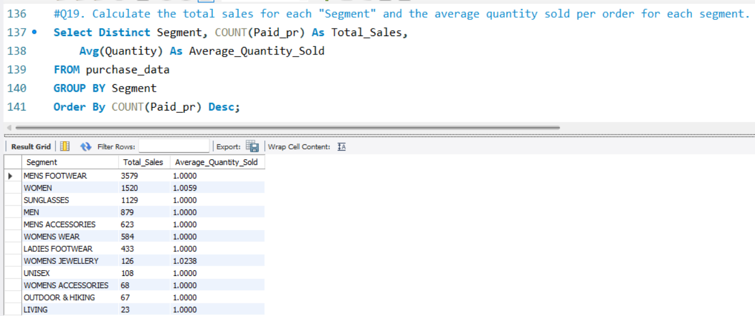
19. Calculate the total sales for each "Segment" and the average quantity sold per order for each segment.

Slide 24
THANK YOU !
FOR WATCHING THIS PRESENTATION

