Slide 1


Supermarket
Sales Analysis
By Using Microsoft Excel
Presentation By:
Amrit Kumar

Slide 2
INTRODUCTION:
Supermarket, a leading e-commerce platform, has been experiencing fluctuations in its sales performance over the past few months. To better understand the factors influencing these variations and identify potential areas of improvement, the company decided to conduct a comprehensive analysis of its sales data. The dataset includes transactional information, item codes, and product-related metrics.

Slide 3
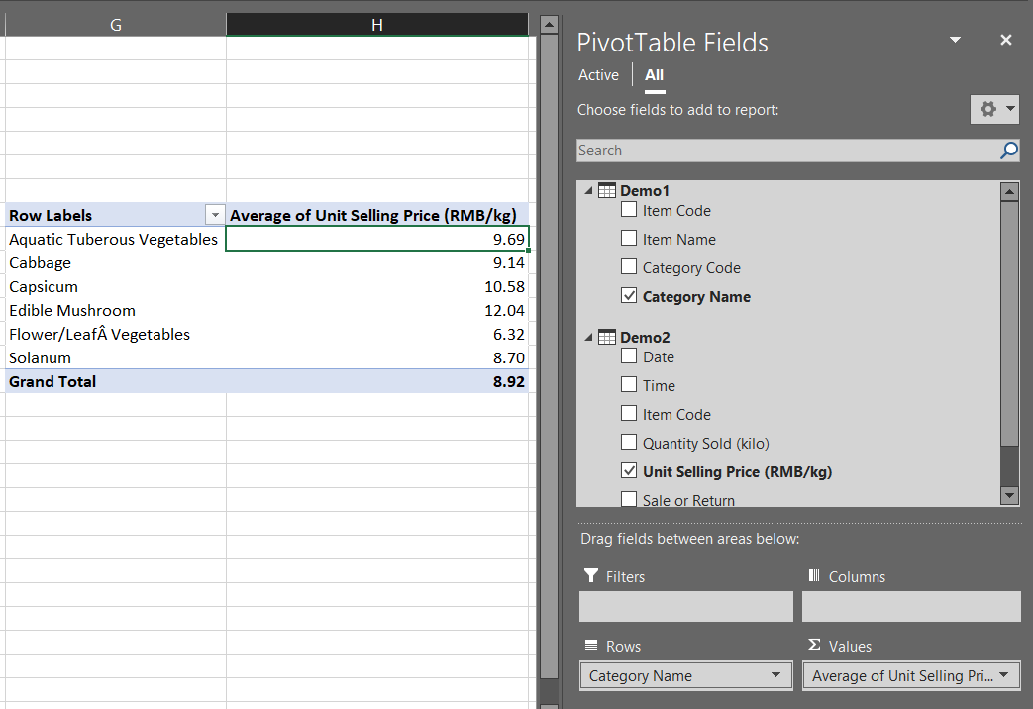
1. Calculate the average "Unit Selling Price (RMB/kg)" for each category and display the results in a separate table.

Slide 4
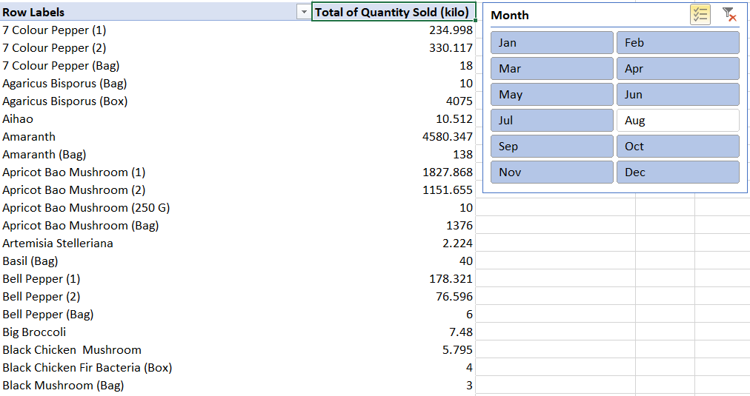
2. Create a pivot table that shows the total quantity sold for each item in each month. Add a slicer for easy filtering by month.

Slide 5
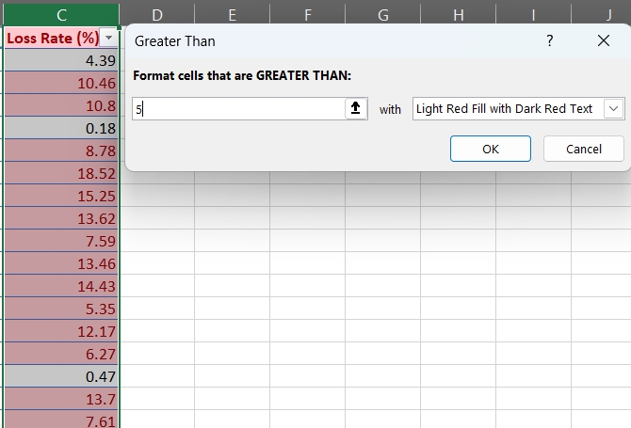
3. Use Excel's conditional formatting to highlight cells with a "Loss Rate (%)" greater than 5%

Slide 6
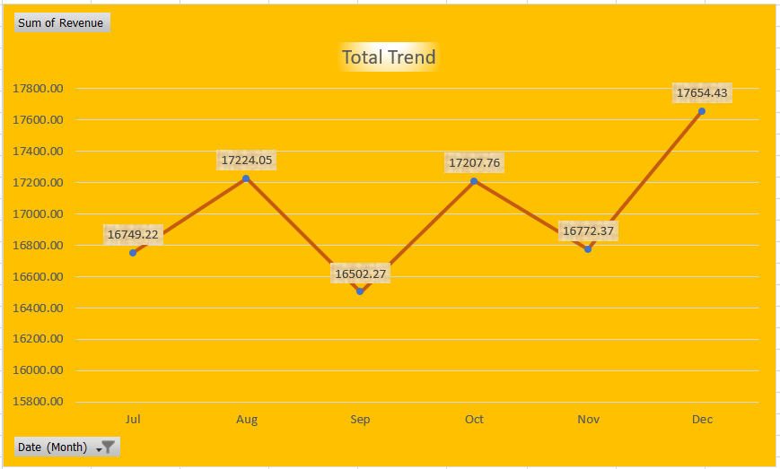
4. Calculate the total revenue for a specific item over the past six months. Create a line chart to visualize the revenue trend.

Slide 7
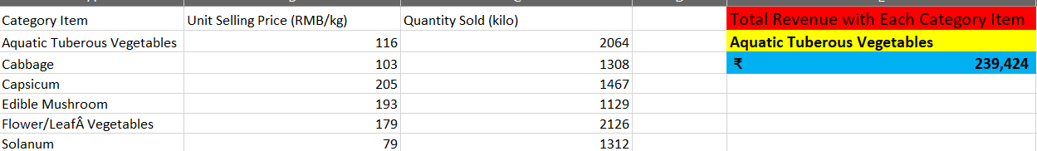
5. Use the SUMPRODUCT function to calculate the total revenue for a specific category.

Slide 8
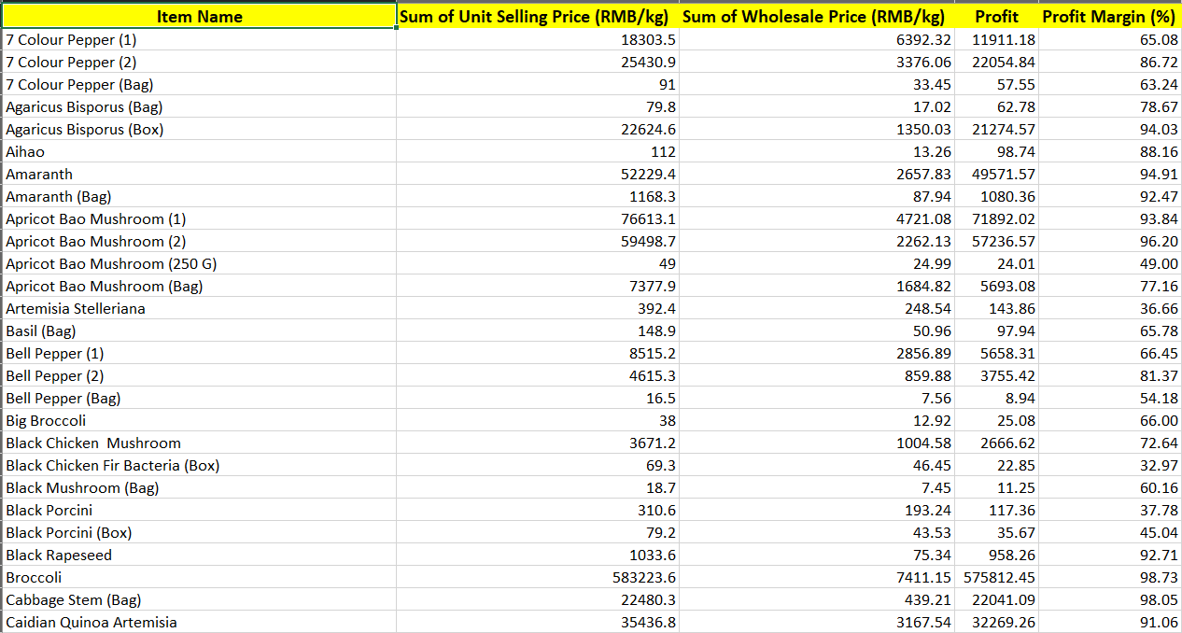
6. Calculate the profit margin for each item, considering the "Unit Selling Price" and "Wholesale Price (RMB/kg)." Display the results in a new column.

Slide 9
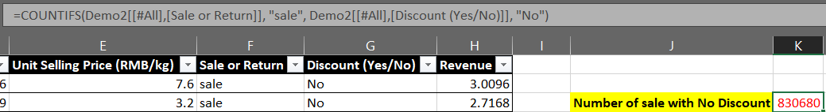
7. Use the COUNTIFS function to count the number of transactions where both "Sale or Return" is "Yes" and "Discount" is "No."

Slide 10
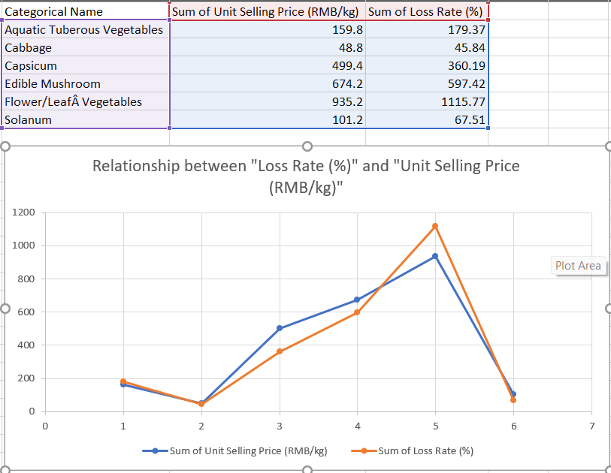
8. Create a scatter plot to explore the relationship between "Loss Rate (%)" and "Unit Selling Price (RMB/kg)" for all items.

Slide 11
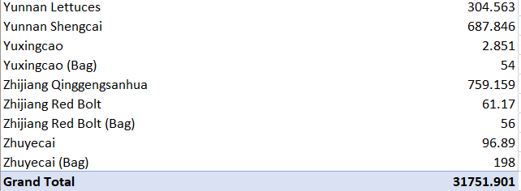
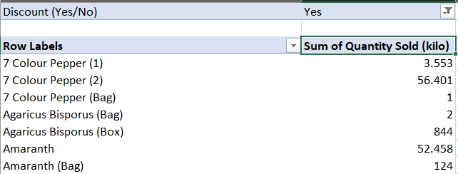
9. Calculate the total quantity sold for each item that had a discount applied. Compare it with items without discounts.

Slide 12
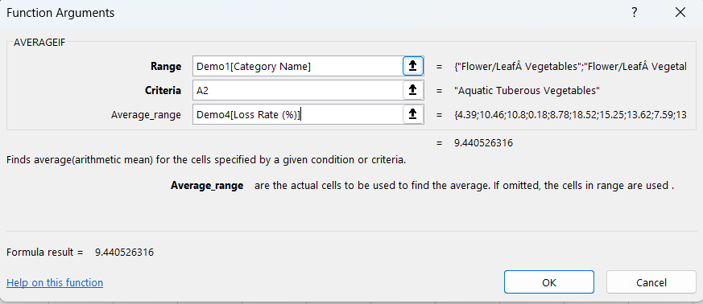
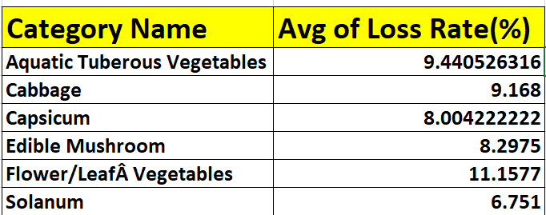
10. Use the AVERAGEIF function to find the average "Loss Rate (%)" for items in a specific category.

Slide 13
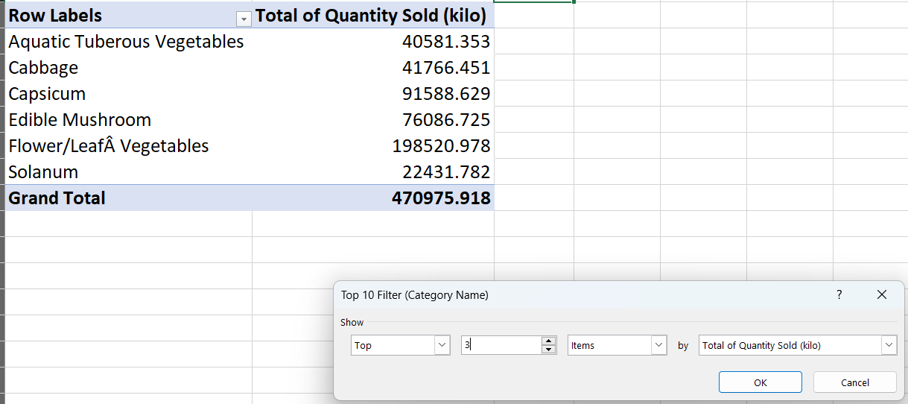
11. Create a bar chart to compare the total quantity sold for the top three categories.

Slide 14
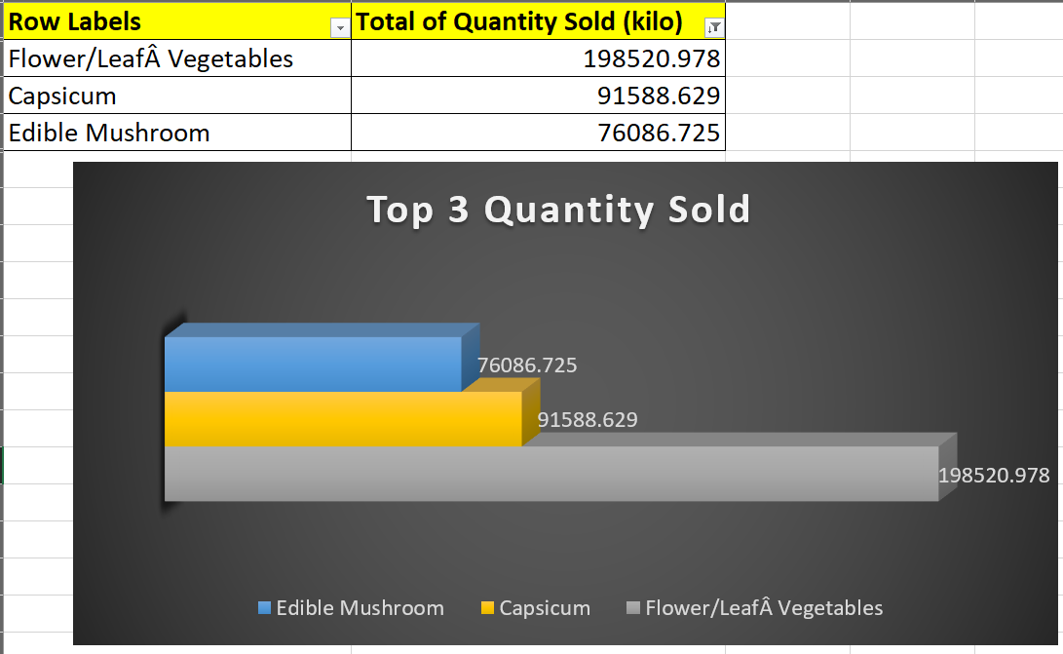

Slide 15
12. Calculate the total revenue for items sold in 2022. Use the SUMIFS function to filter by date.

Slide 16
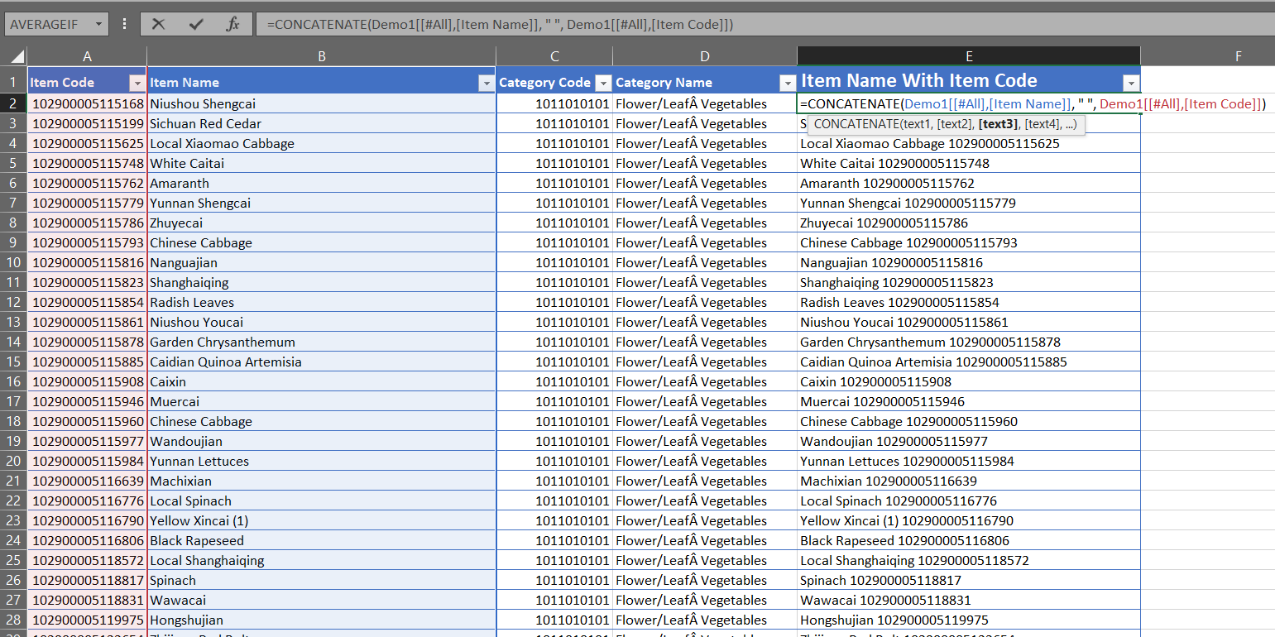
13. Use the CONCATENATE function to combine "Item Code" and "Item Name" into a single cell.

Slide 17
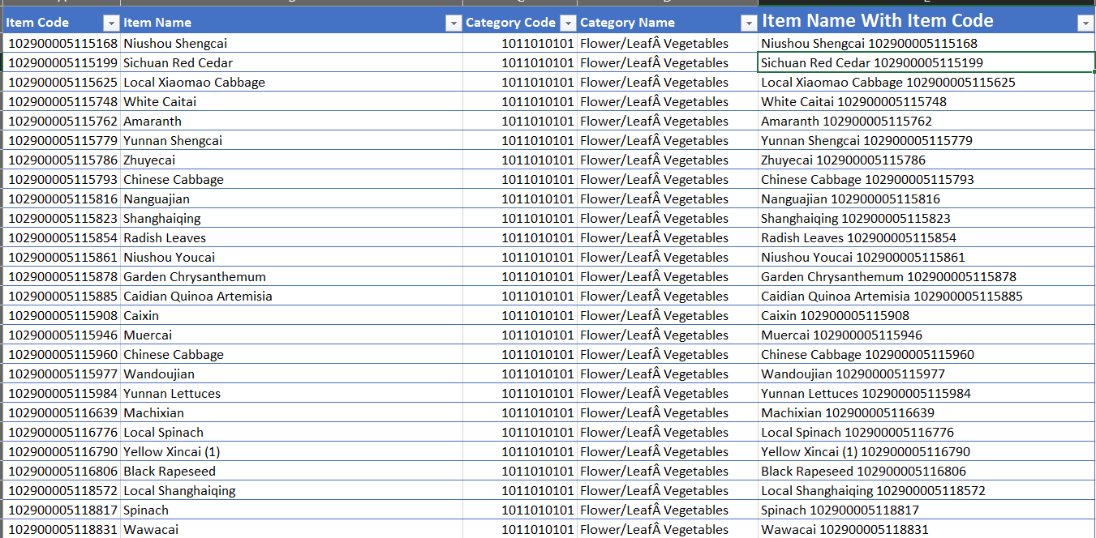

Slide 18
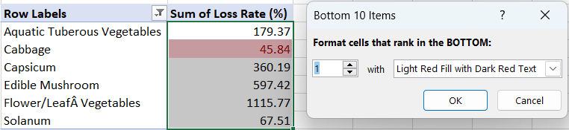
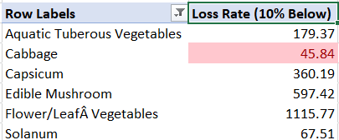
14. Calculate the percentage of items with a "Loss Rate (%)" below 10% for a specific category.

Slide 19
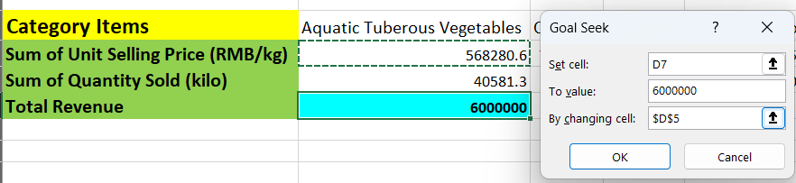
15. Utilize Excel's What-If Analysis tools to analyze how a change in "Unit Selling Price“ affects total revenue for a chosen item.

Slide 20
THANK YOU!

