Slide 1

C
S
E
6
5
5
Diversity in Hollywood
Network Science project
AMRITPAL SINGH (2018379)
VARINEE JAIN (2017369)
RISHABH SOLANI (2018257)

Slide 2
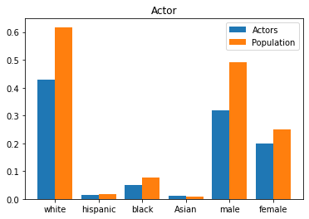
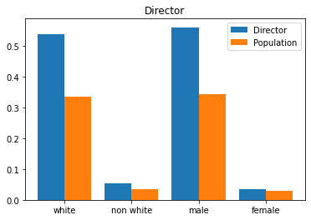
Introduction
The goal of this project is to understand the presence and absence of the diversity in Hollywood movies as related to directors, casts and revenue.
By examining these relationships we strive to :-
Understand the presence and absence of diversity in Hollywood films as related to directors, casts and revenue over time.
Uncover gender and race based assortativity patterns in the actor-actor and actor-director coworking networks.

Slide 3
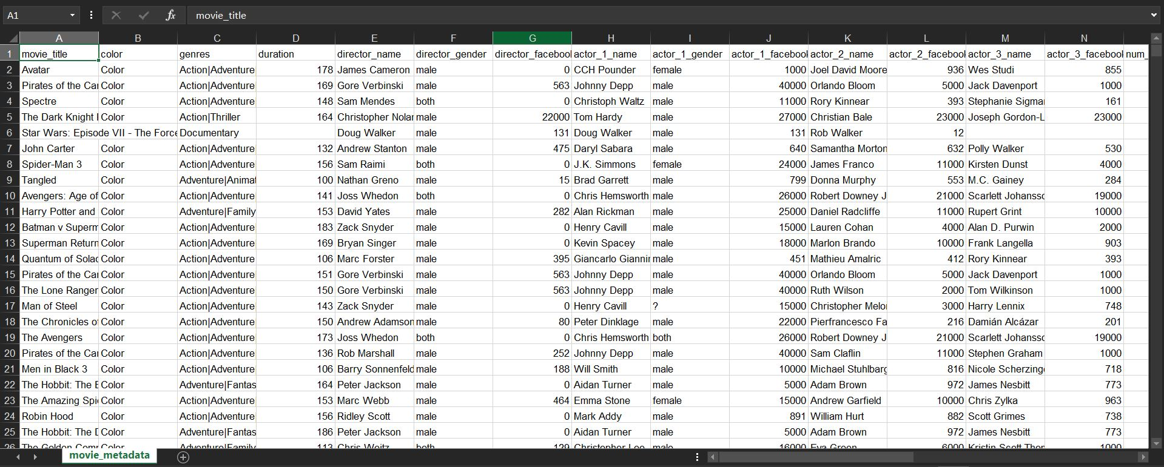
Dataset Used
Our initial dataset was from Kaggle, which contained information about 5044 movies including box office revenue, top actors, director, IMDB ratings, etc.
It did not however include information such as race and gender of the given actors and directors, for that we used the Notable Names Database (NNDB) website and scraped all the required data.
For getting the gender of directors and the actors we used Gender-guesser a python module available online that predicts gender based on first names.

Slide 4
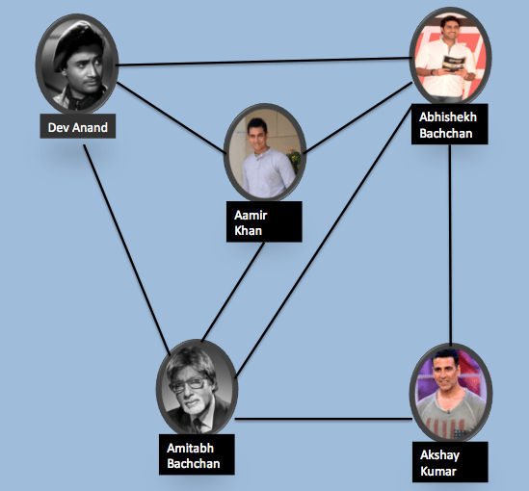
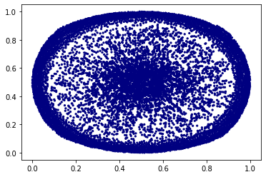
Visualisation

Slide 5
Methodology
Diversity Scores : We consider a movie to be diverse
Each movie is given a racial and a gender diversity score which is calculated as a fraction of its racial/gender diverse top billed actors vs overall cast size respectively.
Each director is also given a racial and a gender diversity score which is calculated as the average of his/her collective movies racial/gender diversity scores respectively.
Evaluation of Metric : It is consistent in that all scores are based on actor diversities - movie scores are calculated based on a movies cast of actors and director scores are subsequently calculated as an average of his or her collective movie scores.
Null Models : In order to interpret our diversity scores and other metrics we need a baseline of comparison, to obtain this we developed two different null models as Movie-Actor null model and Director-Movie null model.

Slide 6
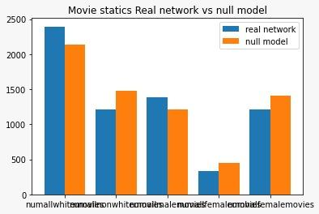
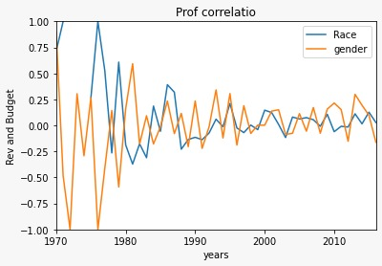
Null Models : In order to interpret our diversity scores and other metrics we need a baseline of comparison, to obtain this we developed two different null models as Movie-Actor null model and Director-Movie null model.
Correlation between movie diversity & box office performance: In order to evaluate the impact of on-screen diversity on box office performance we calculate the Pearson correlation coefficient for movie diversity score and movie revenue.

Slide 7
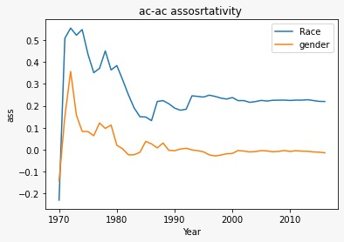
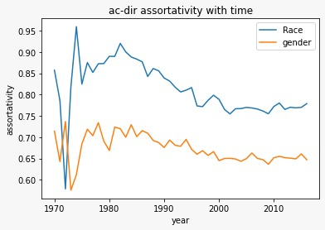
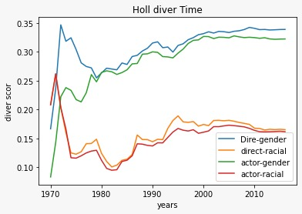
Results
Time series analyses

Slide 8
THANK YOU

