Slide 1
PredictWell: Disease prediction web application using ai Ml
Team Members:
Amrit Ranjan:- 21BCE1847

Slide 2
Software Technologies used
For Web Development We used Html, Css, Js, Bootstrap
In AI Model we used Python ,ML Algorithms For Development of Model
We will Further use React, Nodejs for backend, MongoDB for Database management,
We will use Flask For connecting the model with our Website

Slide 3
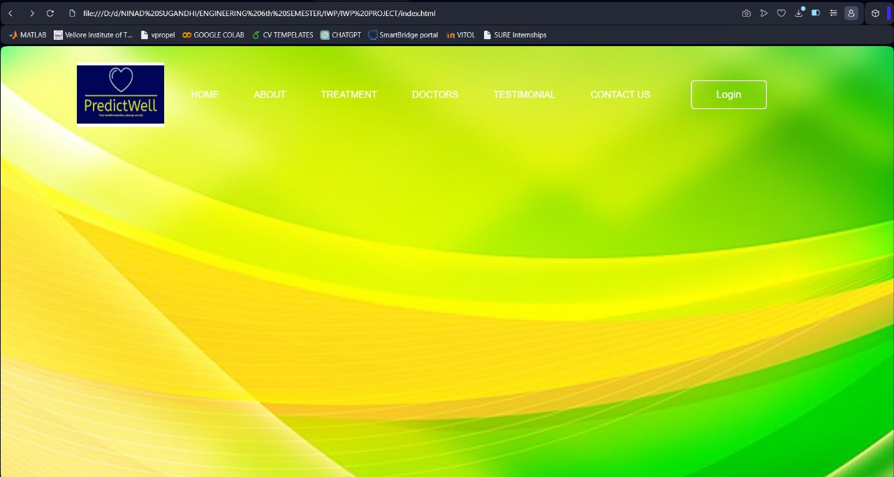
Design Of Website

Slide 4
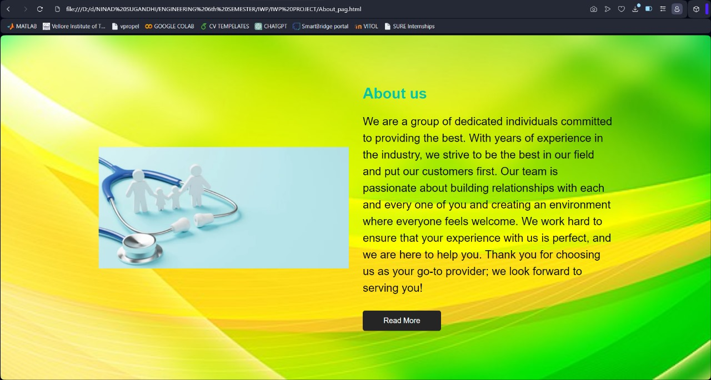
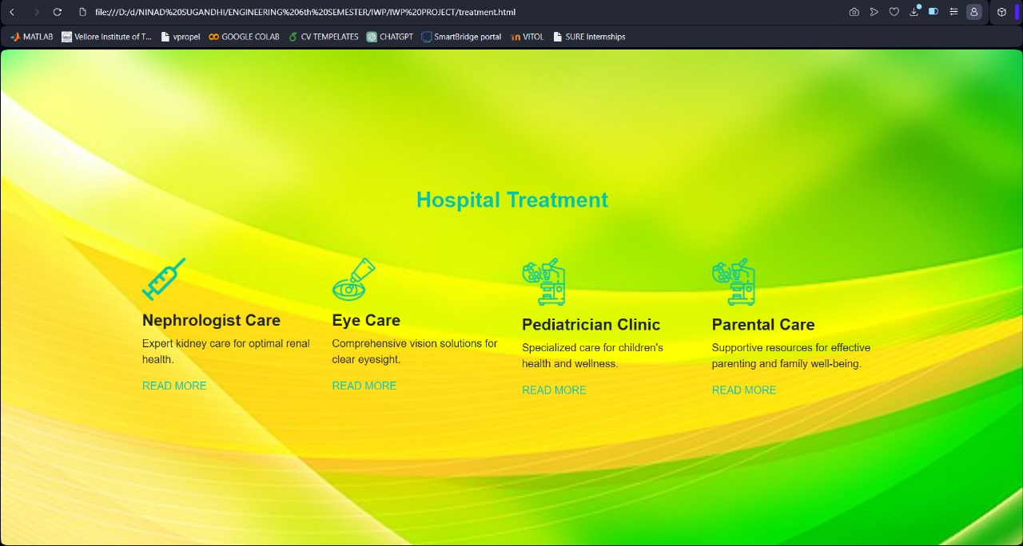

Slide 5
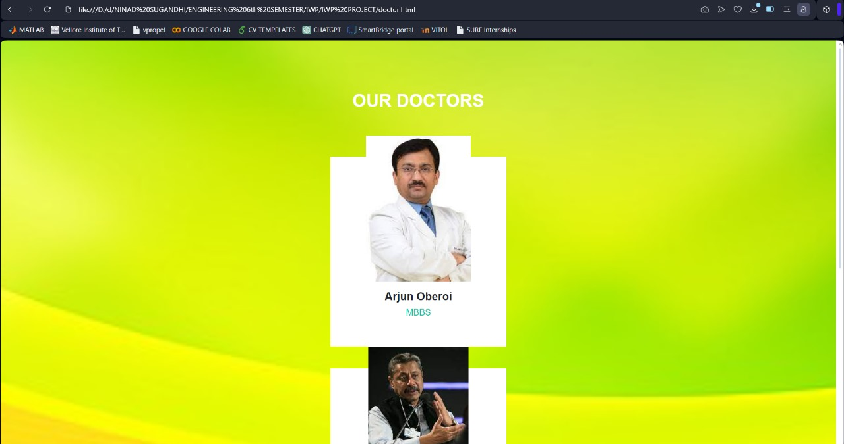
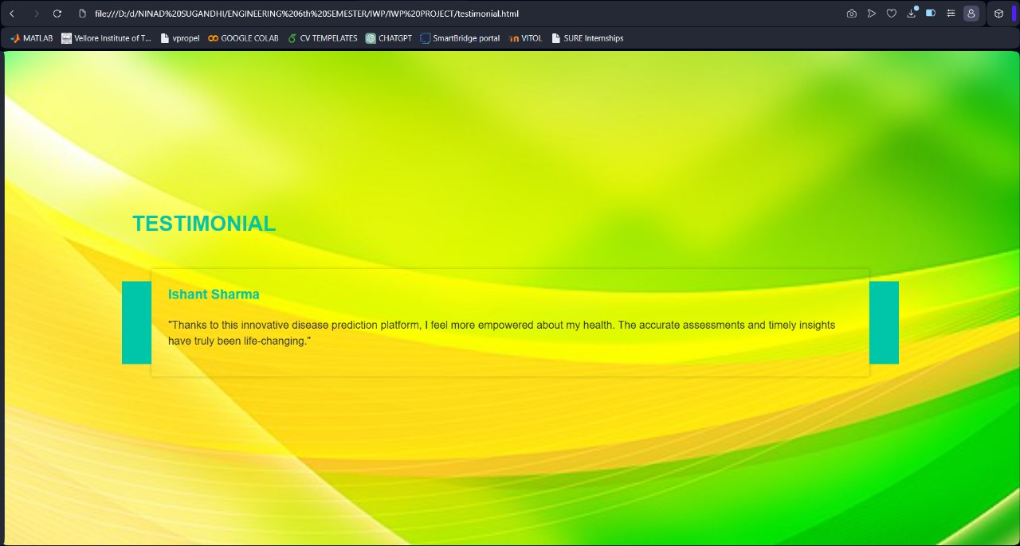

Slide 6
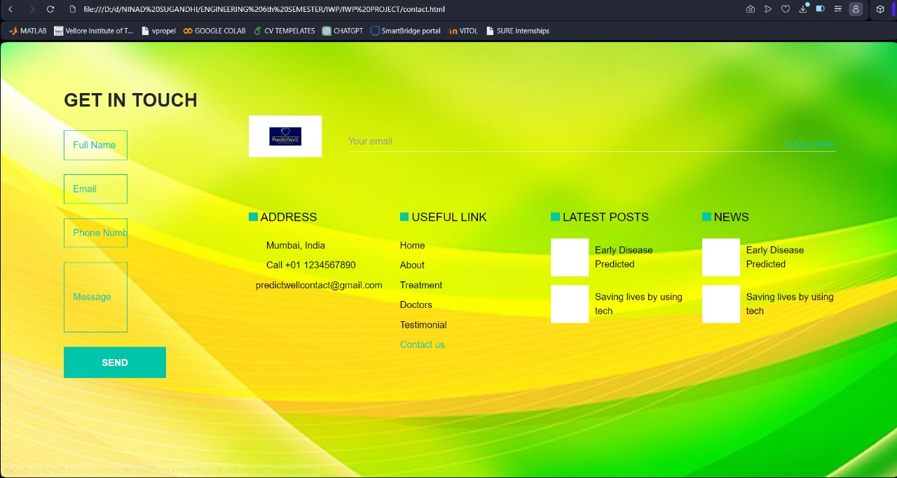
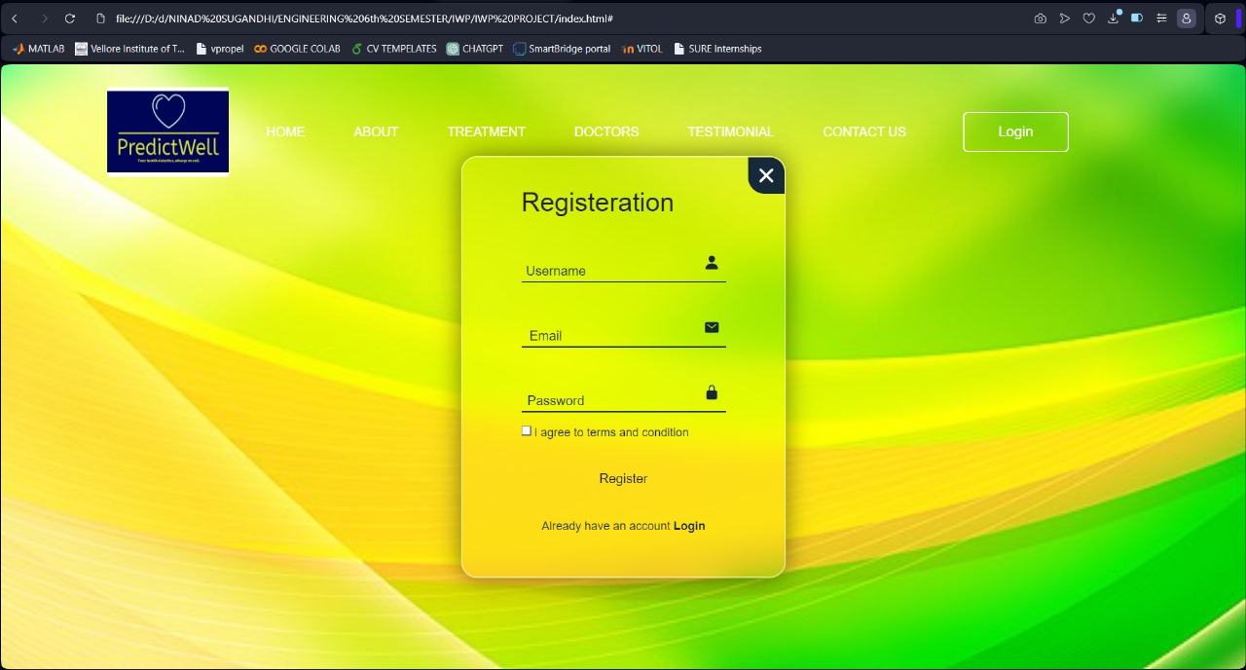

Slide 7
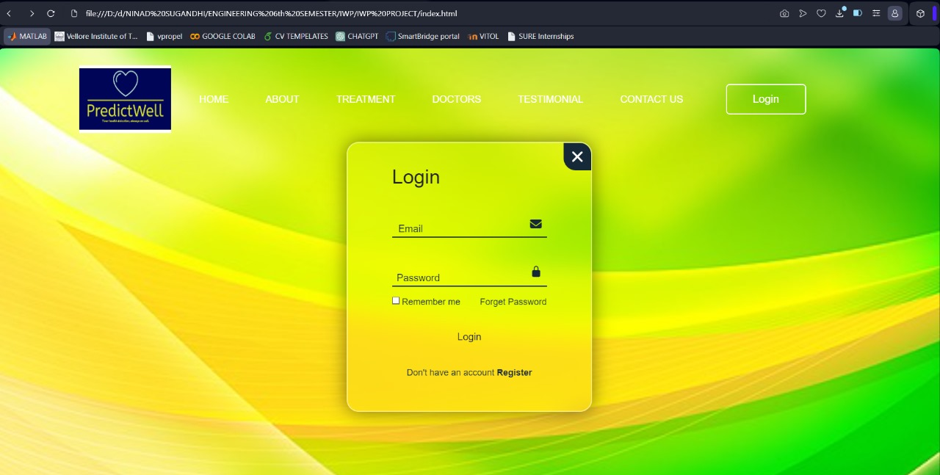

Slide 8
Contribution Of Each Member
Amrit Ranjan: Responsible for developing the login, register, and about us pages.
Responsible for developing the treatment, doctors, testimonial, and contact us pages.
Amrit Ranjan:
Login Page: Implement user authentication functionality, including input validation and secure login process.
Register Page: Develop user registration form with validation for creating new accounts securely.
About Us Page: Create a detailed page describing the team, project goals, and mission statement.
ML Model Implementation: Implemented ML Model on a dataset using Logistic Regression, Decision Tree, Random Forest, XgBoost, KNN Algorithms
Treatment Page: Develop a page showcasing information about disease prediction, treatment options, and health recommendations.
Doctors Page: Implement a directory of healthcare professionals involved in the project, including their specialties and contact information.
Testimonial Page: Create a page displaying user testimonials and feedback about the web app's effectiveness and benefits.
Contact Us Page: Develop a contact form and information section for users to reach out with inquiries, feedback, or support requests.

Slide 9
Future work
Expansion of Disease Coverage: Expanding the module’s capabilities to include prediction of a comprehensive set of other diseases and health conditions, including rare diseases and novel health concerns will be introduced.
Enhanced User Experience: Iteratively revising in order to improve the user interface and experience based on user feedback, which make the app more intuitive by making it more accessible and user-friendly.
Personalized Health Recommendations: Health support and disease prediction through the provision of personalized health recommendations based on predicted diseases risks, medical history, lifestyle and demographic trend.
Integration with Wearable Devices: Complementing our solutions with wearable devices, in the form of fitness trackers, smart watches, or health sensors on clothes, to add more real-time health data for more precise forecasting.
Telemedicine Integration: Adding features for online consultations for personal use and individuals who wish to discuss their risks in a more detailed manner together with health professionals.

