Slide 1
Data acquisition
Data pre-processing
Analysis
Reporting
Drawing comparisons
R&D development cycle for a general biology lab

Slide 2

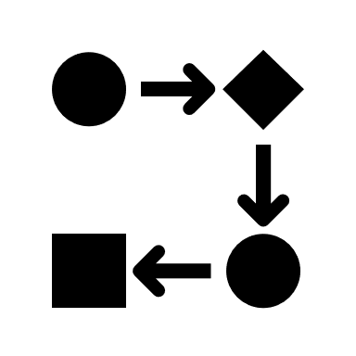
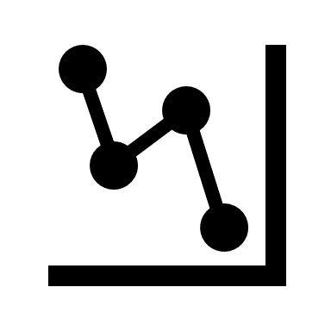
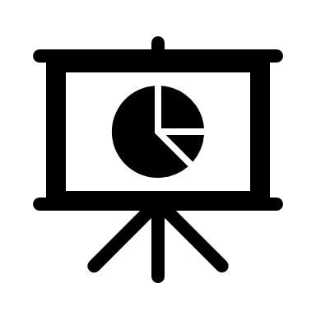

Traditional approach
Data pre-processing done using in-house methods
Analysis using proprietary software or outsourcing
Scientist collects data
Reporting either as a presentation or pdf document
Sample comparisons on spreadsheets
Modern approach
Automated comparisons from a database in the form of dashboards
Scientist collects data
Data pre-processing, analysis and reporting is handled with a web-framework front-end which is supported with a Python, C++, Java backend.

Slide 3
