Slide 1
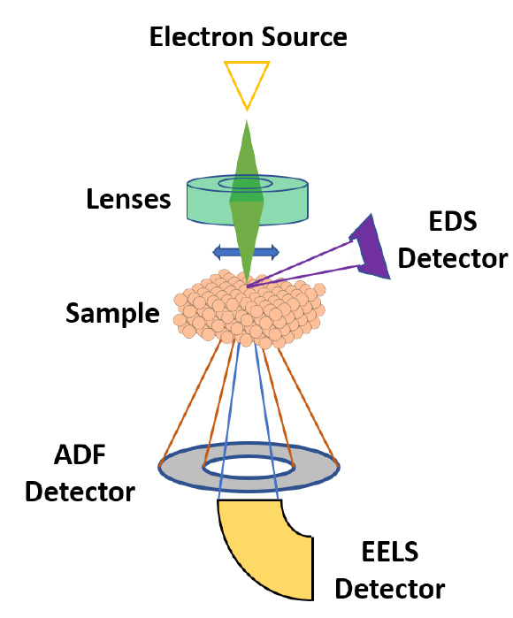
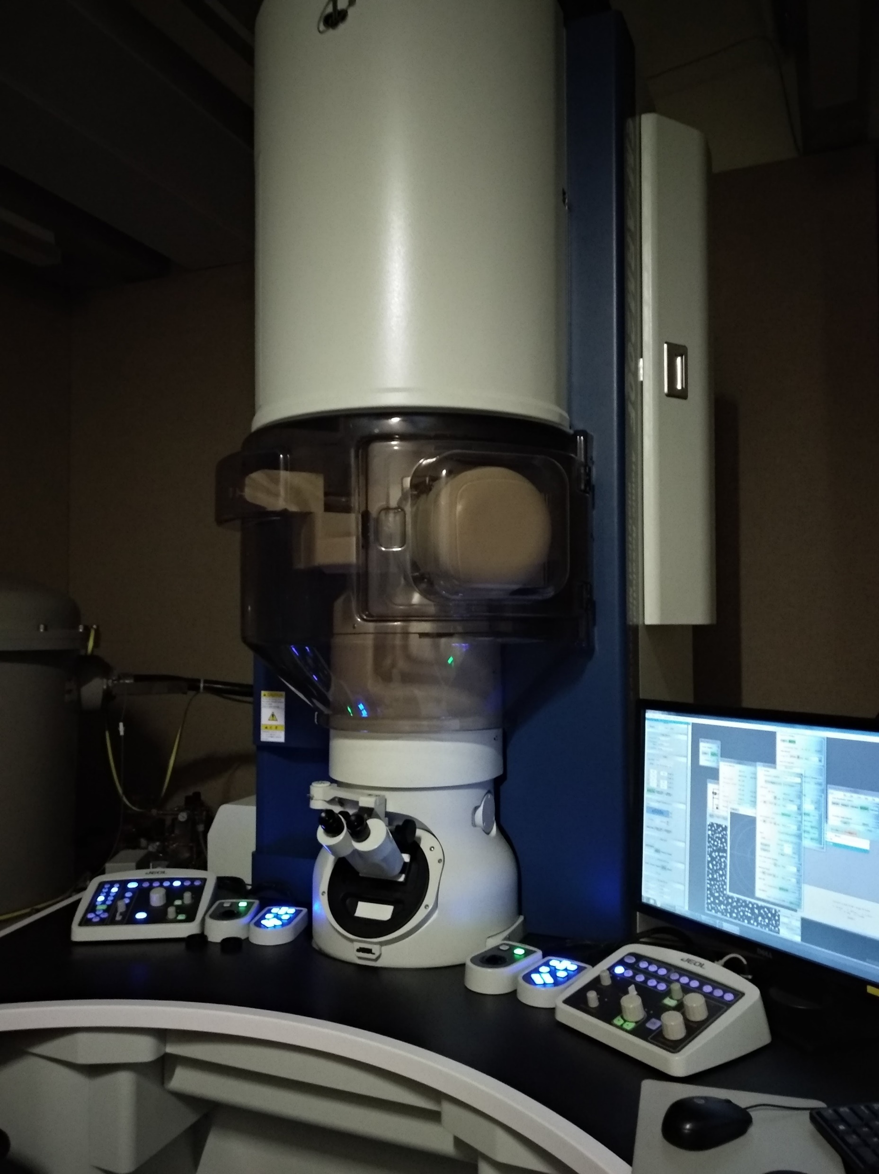

Slide 2




Interactive image painting
Image pre-processing
Machine learning classification
Segmentation

Slide 3
Interactive painting
Image pre-processing
Machine learning classification
Segmentation

